Slide 1
Applications

Slide 2
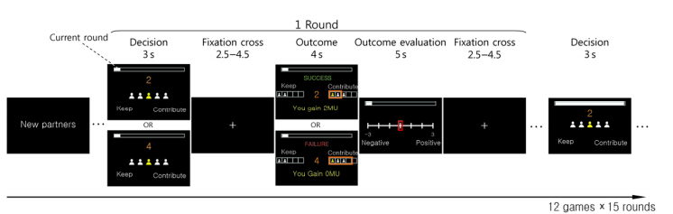
Laboratory data set
Modeling other minds: Bayesian inference explains human choices in group decision-making
K. Khalvati, and et,2019
Mimic the volunteer’s dilemma in a laboratory setting
Human behavior in a binary PGG
cooperate

Slide 3
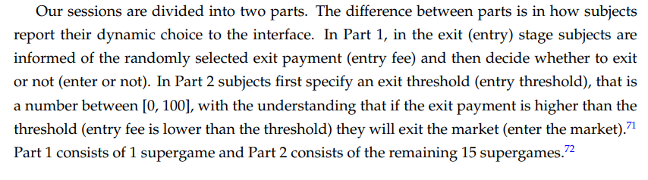
Laboratory data set
Estimating Dynamic Games of Oligopolistic Competition: An Experimental Investigation
T. Salz and E. Vespa, 2019
Oligopolistic competition
Infinite-horizon entry/exit game( Industrial management, pordutciton)

Slide 4
True data set
Identification and Estimation of Dynamic Games when Players’s Beliefs Are Not in Equilibrium
V. Aguirregabiria and A. Magesan, 2015
a dynamic game of store location between McDonalds and Burger King
Competitive game
Study store location of McDonalds (MD) and Burger King (BK) using data for the United Kingdom during the period 1991-1995 (Toivanen and Waterson (2005))

Slide 5
True data set
An empirical investigation of dynamic cooperative and noncooperative solutions for global warming
A. Xepapadeas and A. Yiannaka, 1997
CO2 accumulation with GDP
Linear utility function

Slide 6
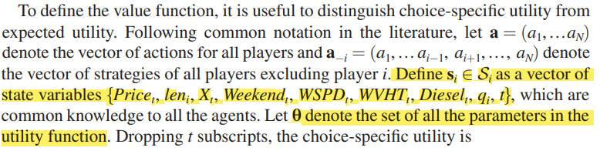
True data set
The Dynamic Efficiency Costs of Common-Pool Resource Exploitation
Ling Huang and Martin D. Smith, 2014
entering and exiting the shrimp industry
fishermen simultaneously decide whether to fish

