Slide 1
2 agents collaborate game with hidden states
(A toy model)

Slide 2
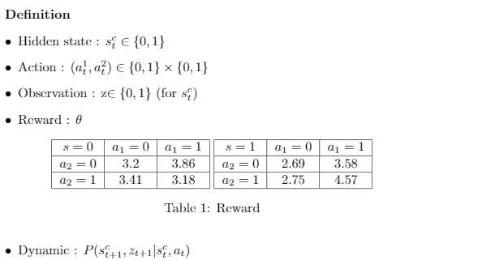

Slide 3
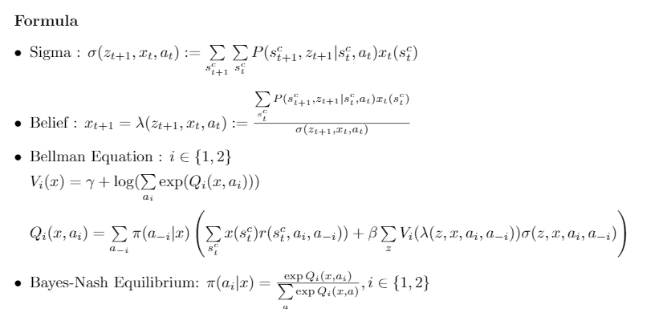

Slide 4
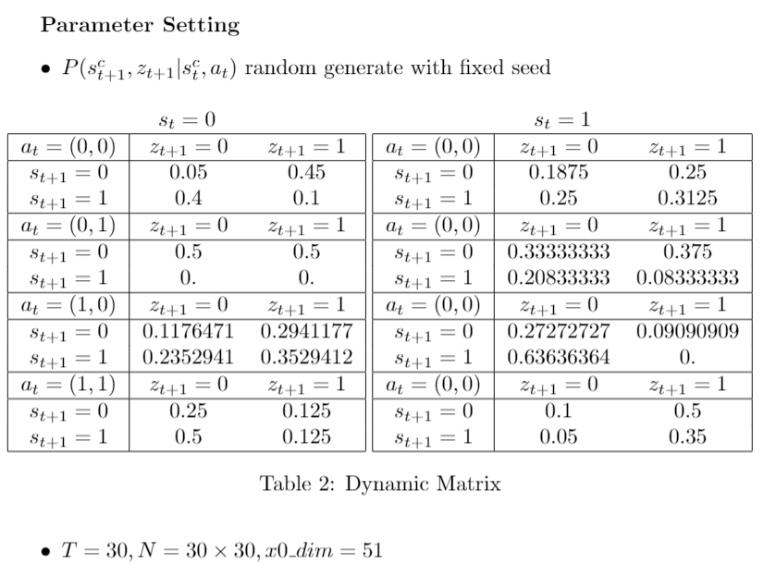

Slide 5
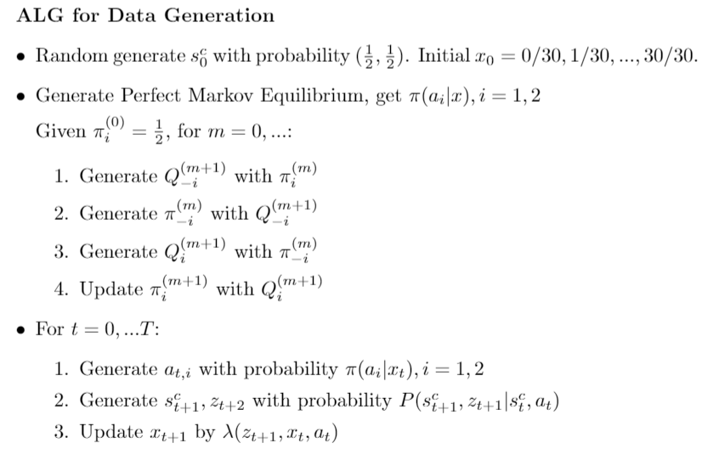

Slide 6


Slide 7
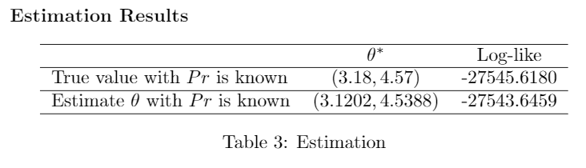

Slide 8
Fisherman model one agent with hidden states
(A guess)

Slide 9
