Slide 1
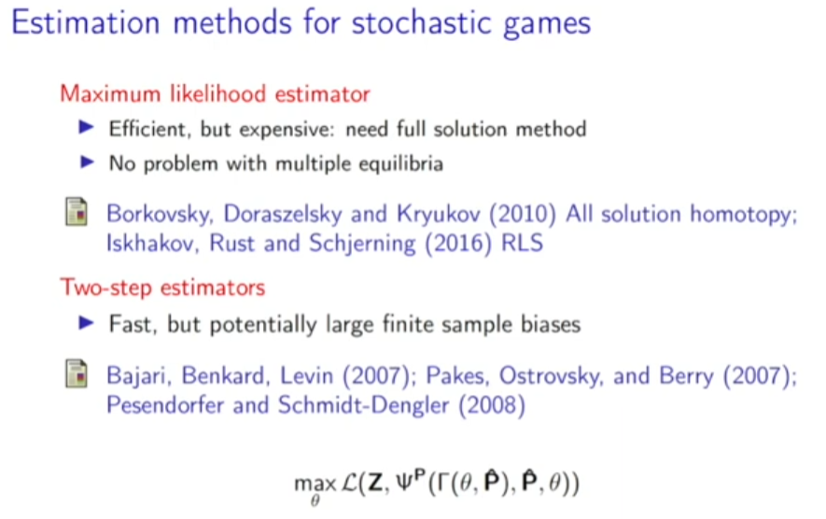

Slide 2
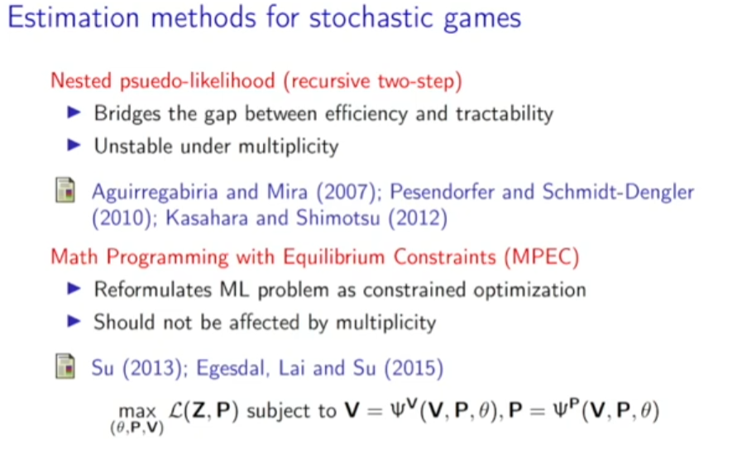

Slide 3
Problem of NPL
Convergence (even for static discrete-choice games, Su 2014)
Local stability condition (Kasahara and Shimotsu, 2012)
New method
NPL-Λ algorithms (Kasahara and Shimotsu ,2012)
MPEC (constraints on density of Jacobian matrix, Egesdal, Lai and Su, 2015)

Slide 4
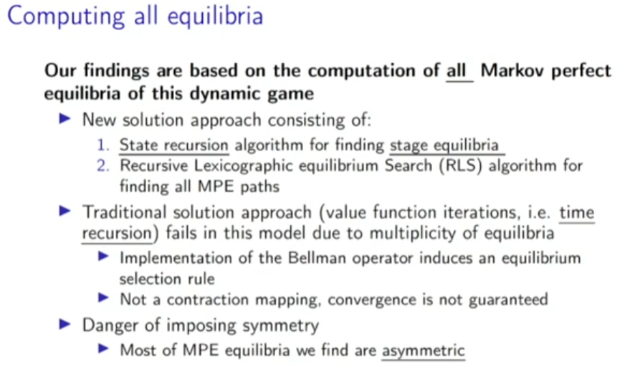
NRLS (nested recursive lexicographic search algorithm)

Slide 5
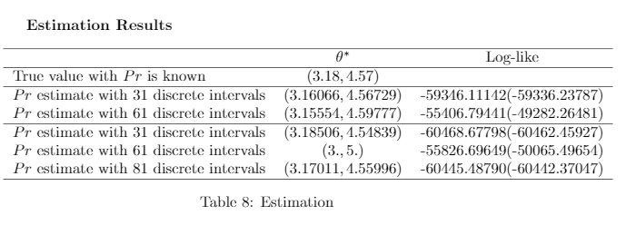
NPL Results

