Slide 1
Structural Estimation of a Partially Observable Discrete
Model Description
Definition of Markov Perfect Equilibrium(MPD)
Existence of MPE

Slide 2
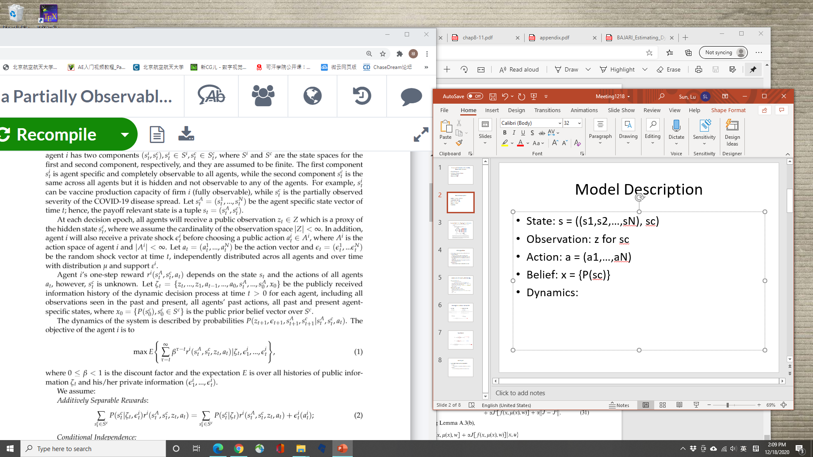
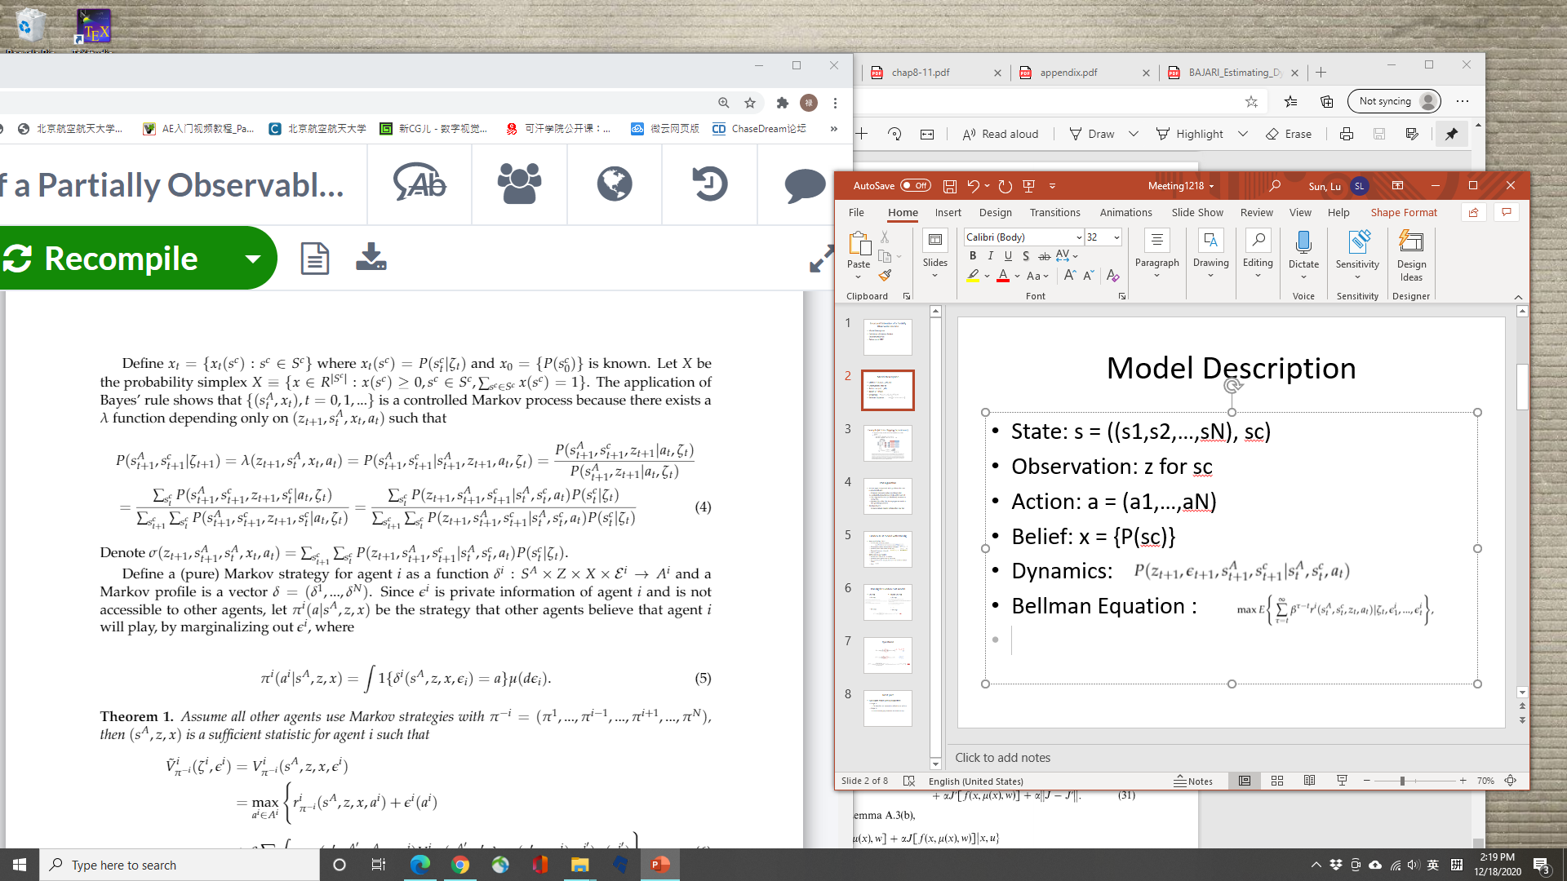
Model Description
State: s = ((s1,s2,…,sN), sc)
Observation: z for sc
Action: a = (a1,…,aN)
Belief: x = {P(sc)}
Dynamics:
Bellman Equation :

Slide 3
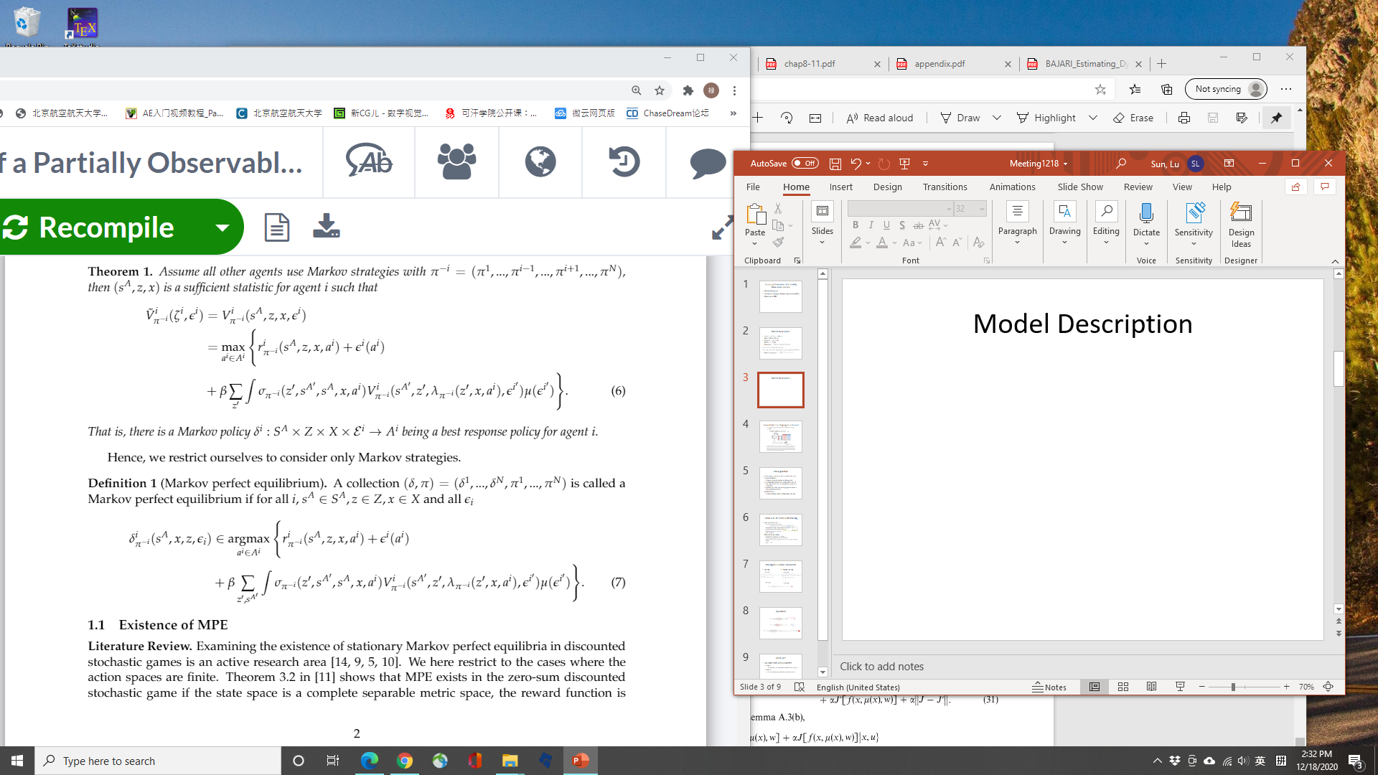
Model Description
Question: Should ‘z’ occur in value function?

Slide 4
Zero-Sum Stochastic Games with Partial Information, M. K. GHOSH, D. MCDONALD, S. SINHA, 2004
Definition totally different: s states; x actions
Controlled Markov processes, E.B. Dynkin, A.A Yushkevich, 1980
x observed states; y unobserved states; v belief of y
Final translates incomplete information model to complete information with x and v
If dynamics and actions doesn’t depend on x(observed states) then can be omitted.

Slide 5
Markov Perfect Equilibrium (MPE)

Slide 6
Next part
Proof the existence of MPE
2 agents, work together, symmetric case, common goal,

