Slide 1
09/28/2020 Monday
Finding the most optimum circuit (s)

Slide 2
Compare ranking based on Accuracy, Average distance, and flexibility (mean(KD and OE))

Slide 3
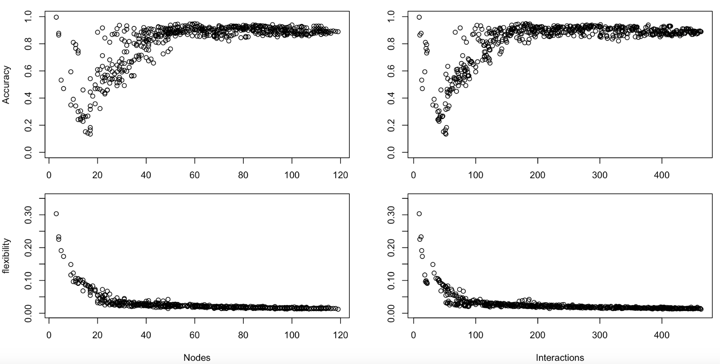

Slide 4
distribution ranks and combined ranks across network size (number of nodes)
Nodes
Nodes

Slide 5
circuits at the top
 | FeatureRatio | TopTFs | AbsCor | Nodes | Interactions | PosInt
0.07-32-0.75 | 0.07 | 32 | 0.75 | 52 | 165 | 87
0.07-32-0 | 0.07 | 32 | 0 | 58 | 176 | 97
0.08-28-0.55 | 0.08 | 28 | 0.55 | 53 | 168 | 92
0.06-32-0.25 | 0.06 | 32 | 0.25 | 60 | 181 | 101
0.06-56-0.85 | 0.06 | 56 | 0.85 | 45 | 200 | 110
0.05-60-0.85 | 0.05 | 60 | 0.85 | 53 | 230 | 127
0.08-28-0.7 | 0.08 | 28 | 0.7 | 50 | 158 | 85
0.07-44-0.85 | 0.07 | 44 | 0.85 | 39 | 145 | 78
0.06-32-0.4 | 0.06 | 32 | 0.4 | 59 | 180 | 100
Phase 46
10K models
 | FeatureRatio | TopTFs | AbsCor | Nodes | Interactions | PosInt
0.07-32-0.75 | 0.07 | 32 | 0.75 | 52 | 165 | 87
0.07-32-0 | 0.07 | 32 | 0 | 58 | 176 | 97
0.08-28-0.7 | 0.08 | 28 | 0.7 | 50 | 158 | 85
0.08-28-0.55 | 0.08 | 28 | 0.55 | 53 | 168 | 92
0.08-32-0.3 | 0.08 | 32 | 0.3 | 62 | 188 | 105
0.06-32-0.25 | 0.06 | 32 | 0.25 | 60 | 181 | 101
0.07-44-0.85 | 0.07 | 44 | 0.85 | 39 | 145 | 78
0.08-32-0.4 | 0.08 | 32 | 0.4 | 61 | 187 | 104
0.07-52-0.85 | 0.07 | 52 | 0.85 | 45 | 198 | 110
0.07-56-0 | 0.07 | 56 | 0 | 106 | 404 | 241
Phase 45
2K models

Slide 6
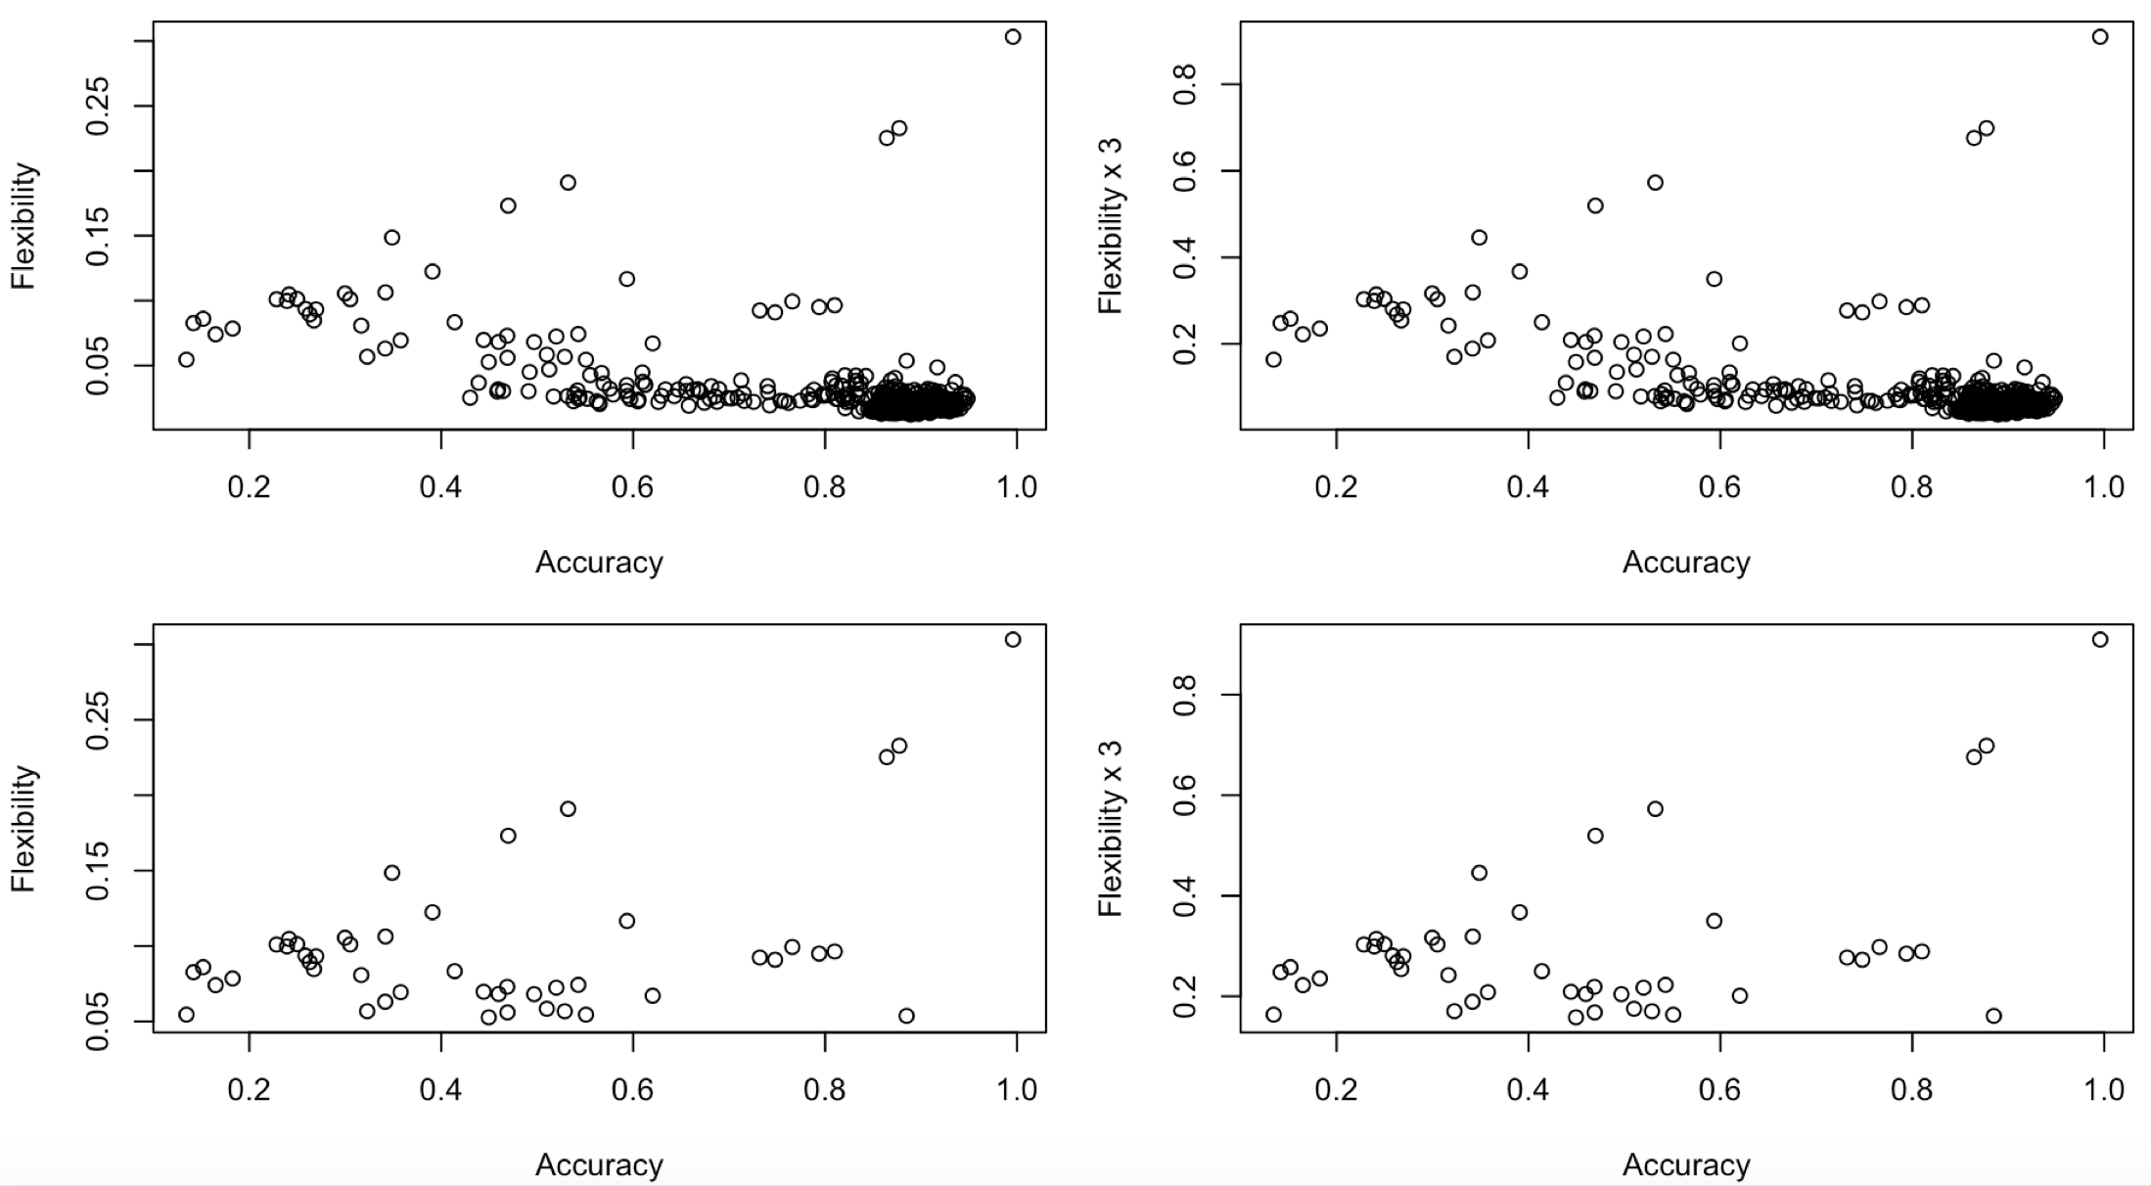

Slide 7
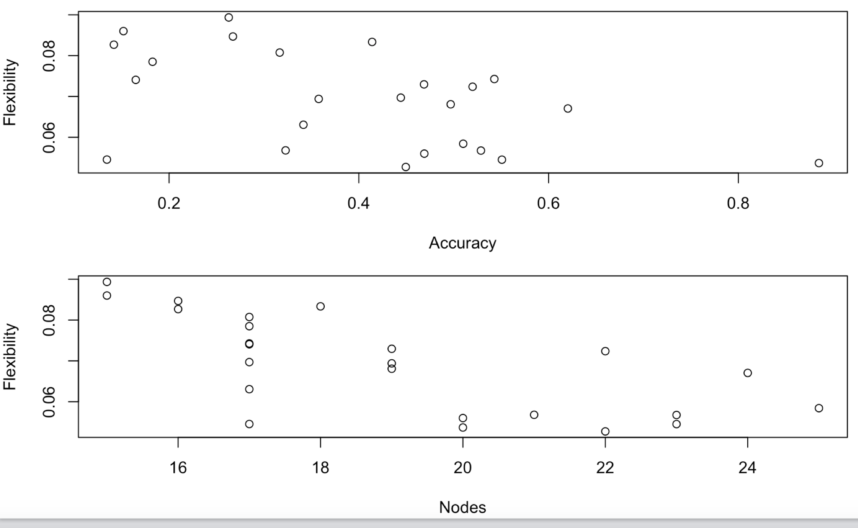
circuits with flexibility >=0.05 and number of nodes >=15

Slide 9
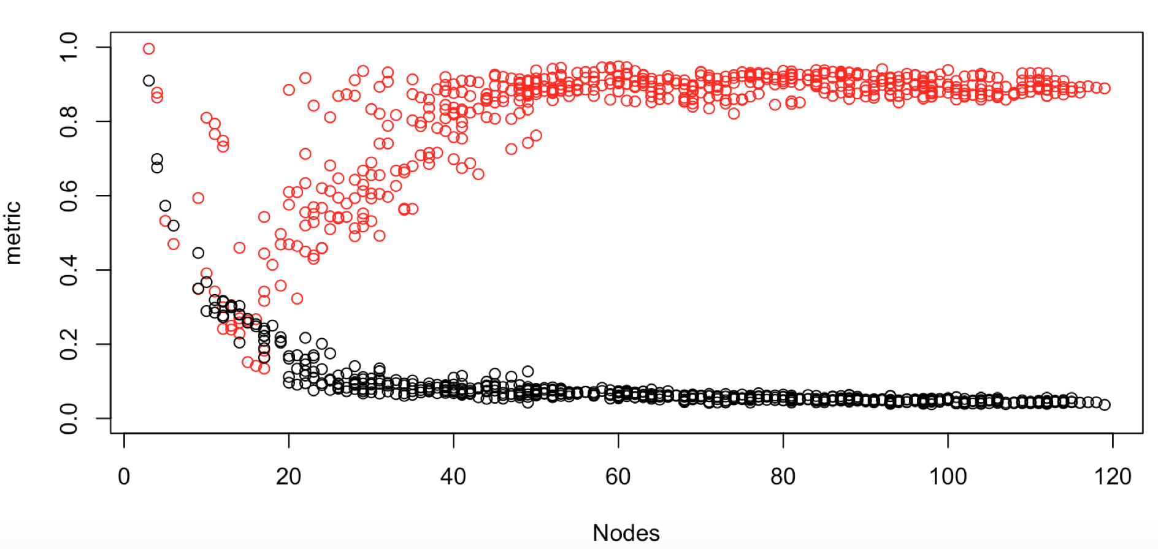
accuracy
flexibility
19~22

Slide 10
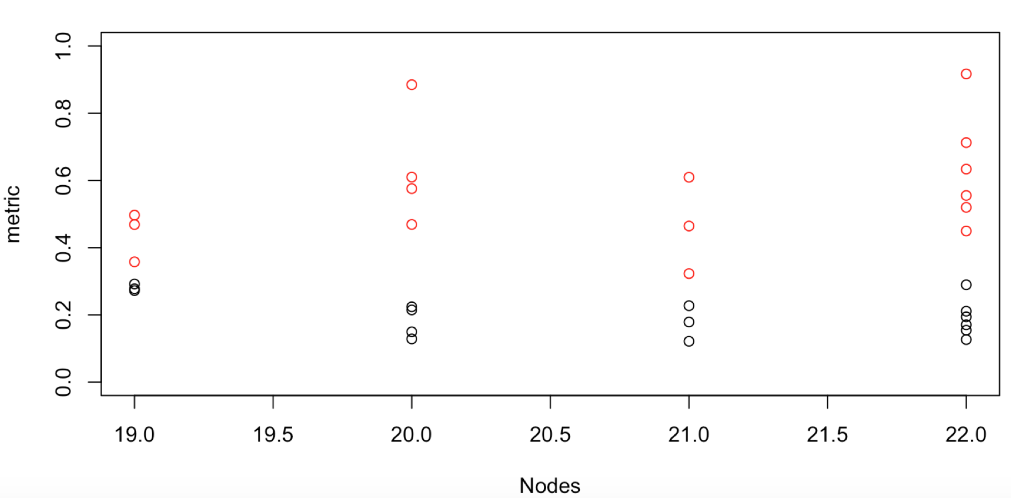
3
4
3
6
accuracy
flexibility

Slide 12
-negative log (flexibility)
-negative log (accuracy)

Slide 14
data normalized after scaling

Slide 15
data normalized after scaling

