Slide 1
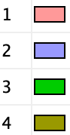
circuit.name | num_nodes | circuit.idx
circuit_1 | 52 | 0.07-32-0.75
circuit_2 | 58 | 0.07-32-0
circuit_3 | 29 | 0.09-32-0.85
circuit_4 | 22 | 0.16-28-0.85

