Slide 1
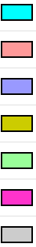
AMPK signaling pathway
Cell cycle/Cellular senescence
JAK-STAT signaling pathway
MAPK signaling pathway
p53 signaling pathway
PI3K-Akt signaling pathway
NA
Notes:
52 nodes

