Slide 2
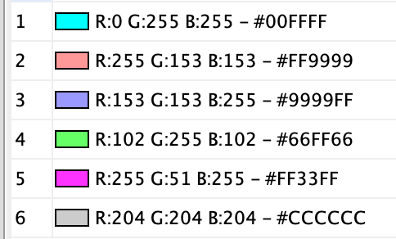
AMPK signaling pathway
Cell cycle/Cellular senescence
JAK-STAT signaling pathway
p53 signaling pathway
PI3K-Akt signaling pathway
NA

Slide 3
AMPK signaling pathway
Cell cycle/Cellular senescence
JAK-STAT signaling pathway
p53 signaling pathway
PI3K-Akt signaling pathway
NA

Slide 4
pathway | pathway_id
AMPK signaling pathway | 1
Cell cycle | 2
Cellular senescence | 2
JAK-STAT signaling pathway | 3
p53 signaling pathway | 4
PI3K-Akt signaling pathway | 5
NA | 6

