Slide 1
09/09/2020 Wednesday
Select top TFs from each method - selTopTFs.byMethod.R
Select top (4, 8, 12, 16, 20, 24, 28, 32) TFs from each method
Combine the top TFs from each method

Slide 2
Number of combined TFs
Netact
MARINa
CTRL
TRTMT
RI
COMBINED

Slide 4
RI method

Slide 5
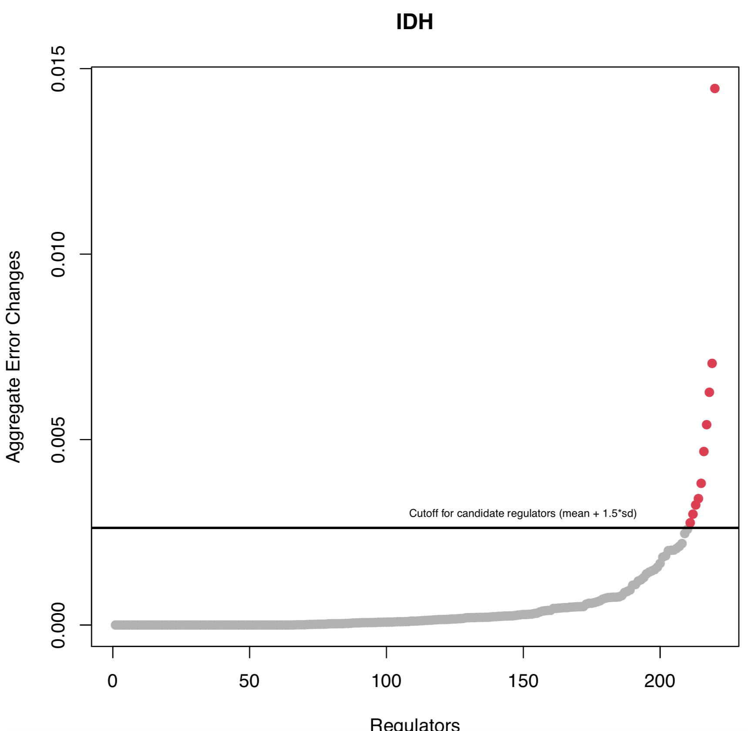
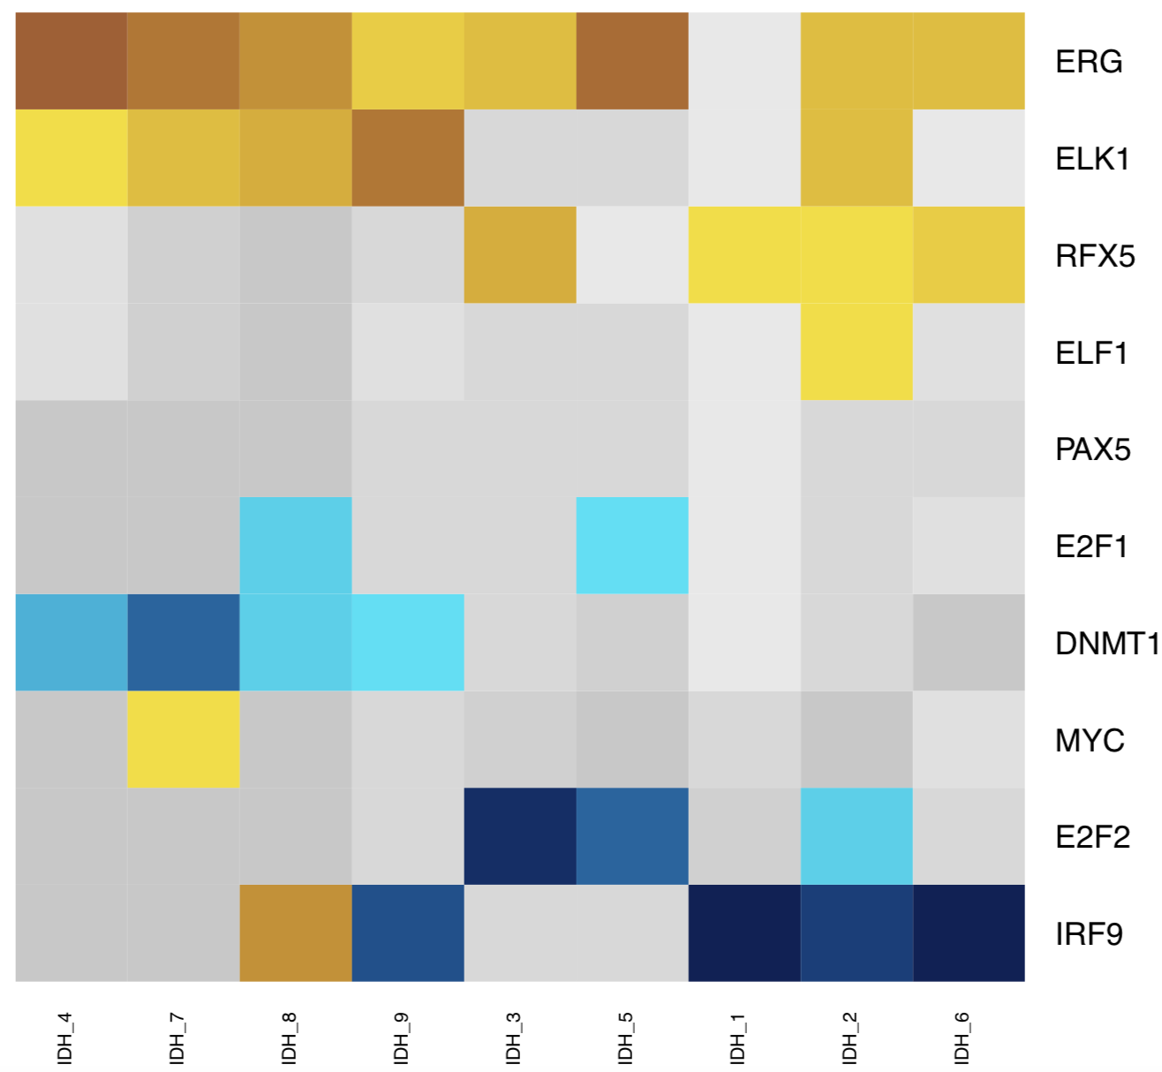
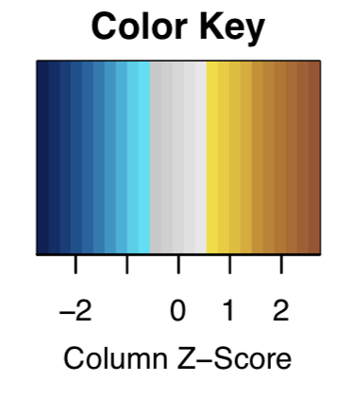
The heatmap showing sample-specific lasso model coefficients
Act
Exp
10 MRs:4 active, 6 regress

Slide 7
Act
Exp
tf | aggr.error
ELK3 | 0.008874882
TFDP1 | 0.004535639
TFAP2C | 0.004376888
FOXO4 | 0.002633999
E2F5 | 0.002423024
POLI | 0.002371509
NANOS1 | 0.001919212
ELK1 | 0.001498045
NFIC | 0.001441146
HSF4 | 0.001367616
POU5F1B | 0.001295376
EHF | 0.001220083
PAXIP1 | 0.001184841
MLXIPL | 0.001153367
ELF3 | 0.001044036
10 MRs:4 active, 6 regress

Slide 9
Method 2: linear regression
Motif files of TFs (220 TFs/316 TFs) from CIS-BP
I don’t have the license of TFANSFAC
JASPAR don’t have motif files of other 96 TFs
The number of binding sites of TFs in gene promoter
regions which located in chromosome accessible
regions using FIMO
Lasso linear regression to identify master regulators

Slide 10
MARINa

Slide 11
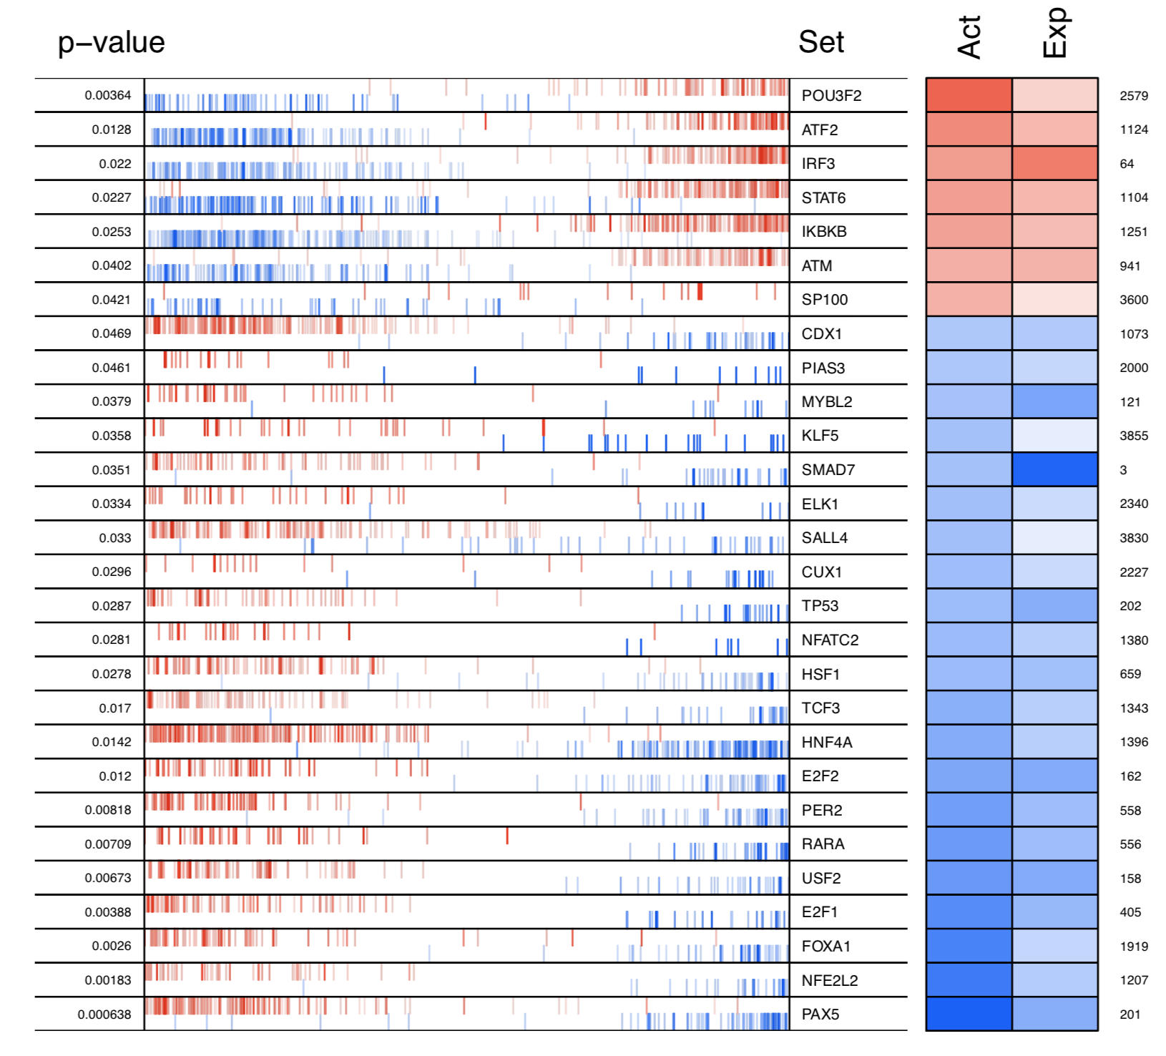
Down in IDH
Up in IDH
28 MRs: 7 active, 21 regress

Slide 12
Method 1:
FDR<0.05
None
316 TFs
Gene expression:
17,182 genes, 20 samples(11normal,9 IDHs)
ARACNe
IDH-specific regulatory network
278 TFs, 4,978 targets
12,289 interactions
MARINa
P value <0.05
28 Master Regulators

