Slide 1







STACK OVERFLOW DEVELOPER SURVEY 2019
MD LUTFUL KABIR
26 MAY 2023
Linkedin: https://www.linkedin.com/in/mdlutfulkabir/

Slide 2



OUTLINE
Executive Summary
Introduction
Methodology
Results
Visualization – Charts
Dashboard
Discussion
Findings & Implications
Conclusion
Appendix

Slide 3

EXECUTIVE SUMMARY
Data contextualization and analysis goal
Methodology description
Data gathering
Data analysis
Data visualization
Results shows the graphs and trend supported by various graphs
Discussion of overall findings and implications regarding the results previously exposed
Final conclusions of the findings in Dataset.

Slide 4

INTRODUCTION
Stack Overflow’s annual Developer Survey is the largest and most comprehensive survey of people who code around the world
Reuslt don’t represent everyone in the developer community evenly
Nearly 90,000 developers responded
Trends
Technology worked with
Future technology to work

Slide 5

METHODOLOGY
Collect survey data
Web scraping
APIs
Request library
Data wrangling
Exploratory Data Analysis (EDA)
Distribution
Outlier Handling
Correlation
Visualization
Distribution of data
Relationship
Comparison
Composition
Dashboards

Slide 6

RESULTS
What found?
What’s happening here…

Slide 7
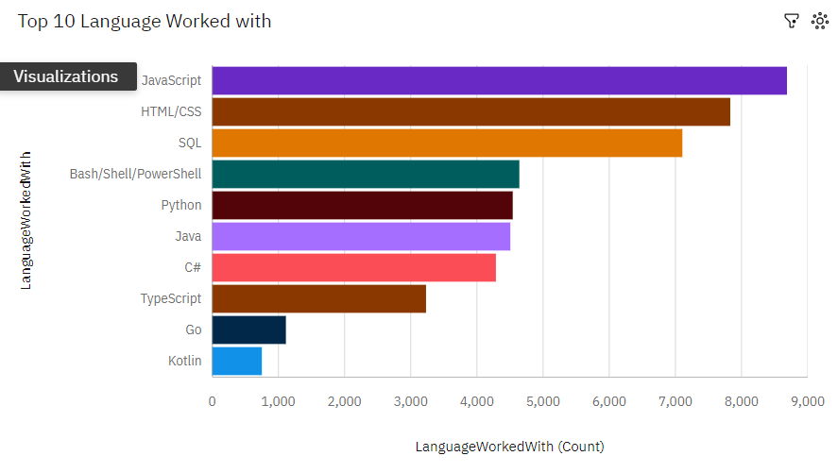
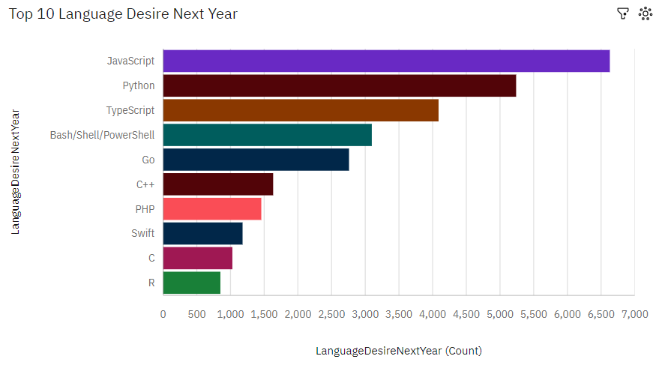
PROGRAMMING LANGUAGE TRENDS

Slide 8
PROGRAMMING LANGUAGE TRENDS - FINDINGS & IMPLICATIONS
Findings
Javascript leading
HTML,SQL might not use very much
Python might lead but Kotlin will jump it’s place significanlty
Implications
Possibility of learning New language among the developers and the future technology will worked on that language

Slide 9
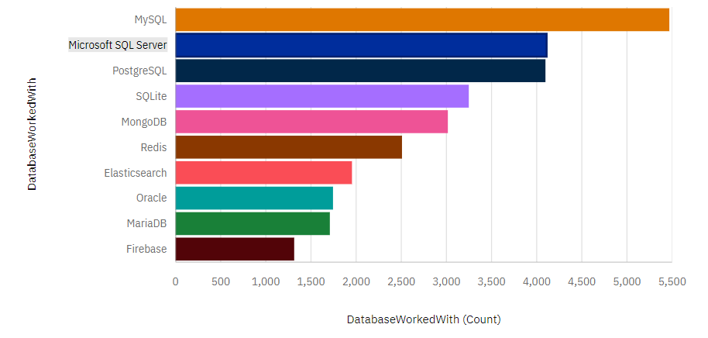
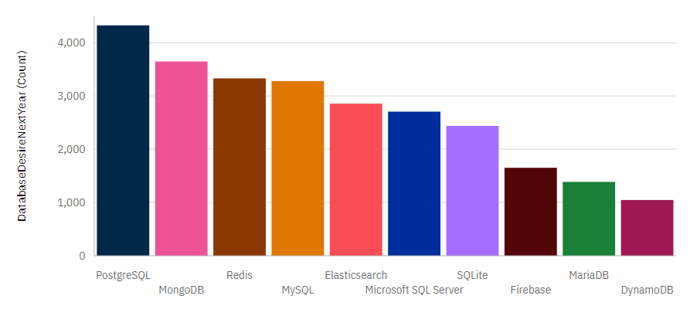
DATABASE TRENDS
Current Year
Next Year

Slide 10
DATABASE TRENDS - FINDINGS & IMPLICATIONS
Findings
MySQL as most used database.
Lack of interest in Microsoft SQL Server and SQLite.
Increasing interest in PostgreSQL and MongoDB.
Implications
Microsoft SQL Server and SQLite losing ground in the market.
PostgreSQL and MongoDB establishment in the market.

Slide 11

DASHBOARD
https://eu2.ca.analytics.ibm.com/bi/?perspective=dashboard&pathRef=.my_folders%2Fcapstoe%2Bproject%2BStack%2Boverflow%2Bdataset&action=view&mode=dashboard&subView=model0000018faf1cc329_00000000

Slide 12
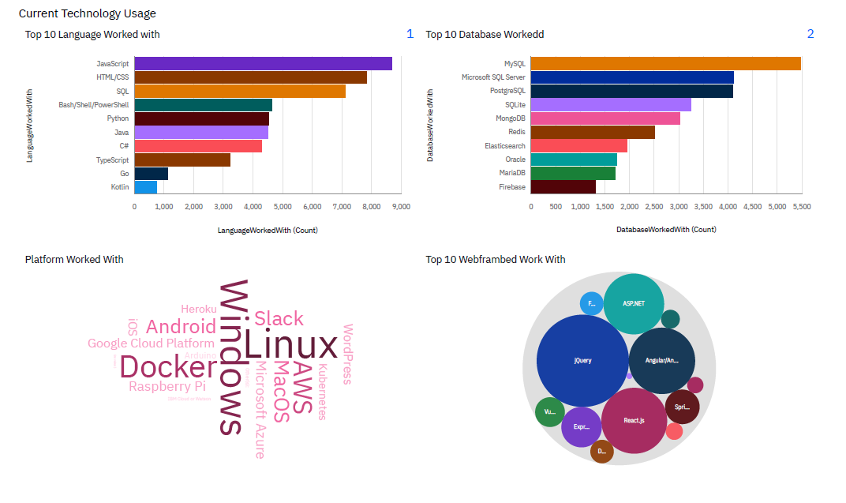
DASHBOARD TAB 1

Slide 13
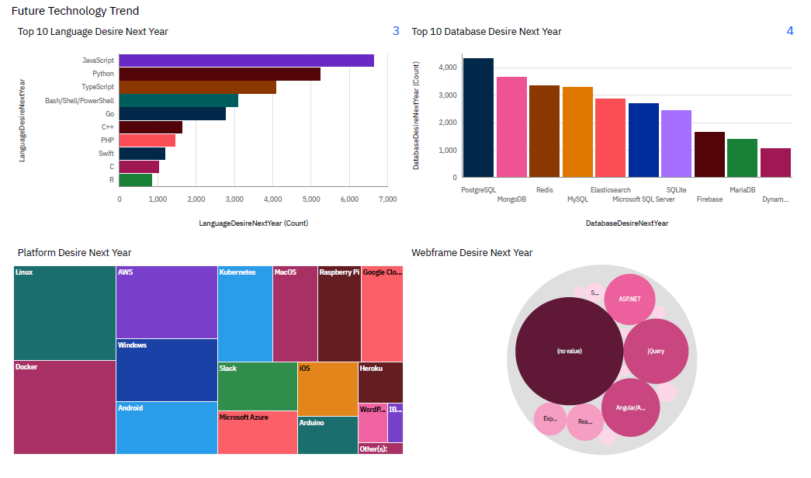
DASHBOARD TAB 2

Slide 14
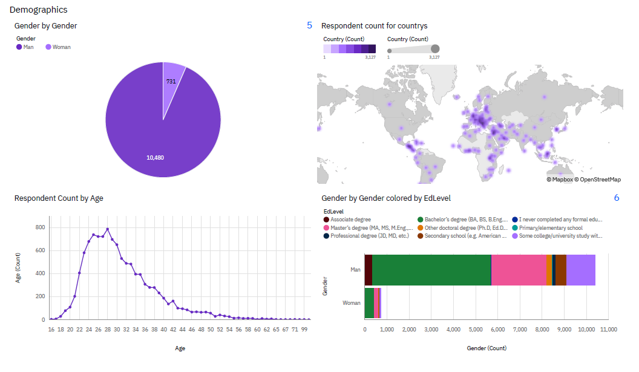
DASHBOARD TAB 3

Slide 15
DISCUSSION

Slide 16
OVERALL FINDINGS & IMPLICATIONS
Findings
JavaScript widely used and TypeScript getting popular.
Over 90% young male developers.
Developers mostly located in developed countries.
Implications
JavaScript and TypeScript web frames gaining followers.
Global polarization of developers location and gender.
Young developers without postgrad studies on its majority.

Slide 17

CONCLUSION
Developers are people with very marked characteristics.
A good idea of popularity trends of different tools, platforms and languages can be obtained.
There is a job to be done to spread accessibility of this labor market to countries in development.

Slide 18

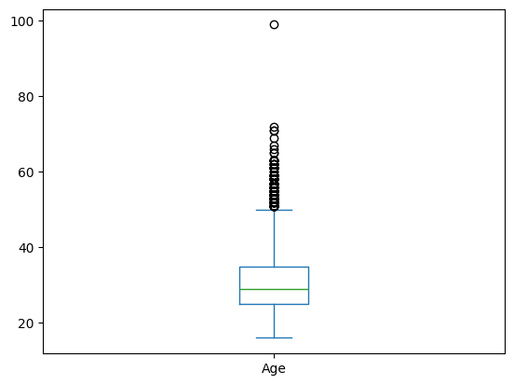
APPENDIX
Box plot of Age groups of Developer

Slide 19
POPULAR LANGUAGES

