Slide 1
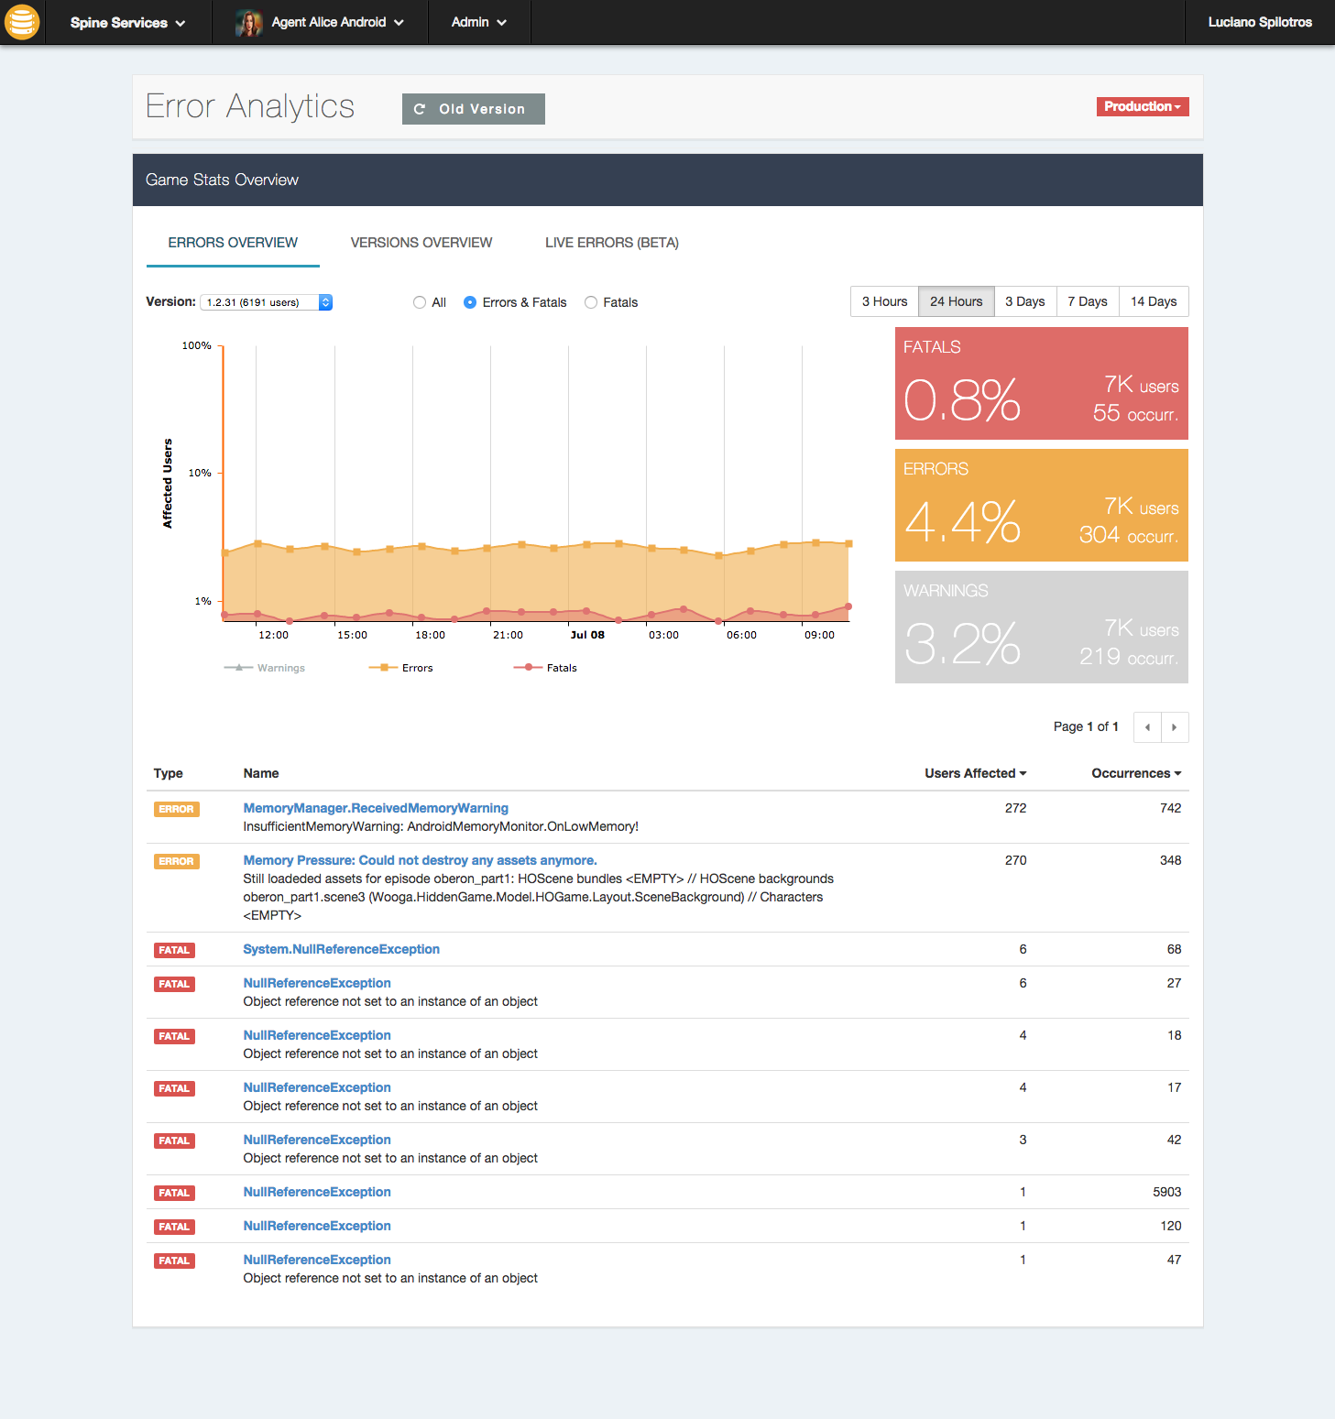
SBS Error Analytics Quick Walkthrough

Slide 2
Role #1:
The Project Manager
Case #1:
“I want to have a daily overview of the error rate”

Slide 3
Key stats per severity types at glance
Errors peaks over time
Critical error occurrences

Slide 4
Role #1:
The Project Manager
Case #2:
“I want to compare latest version with older”

Slide 5
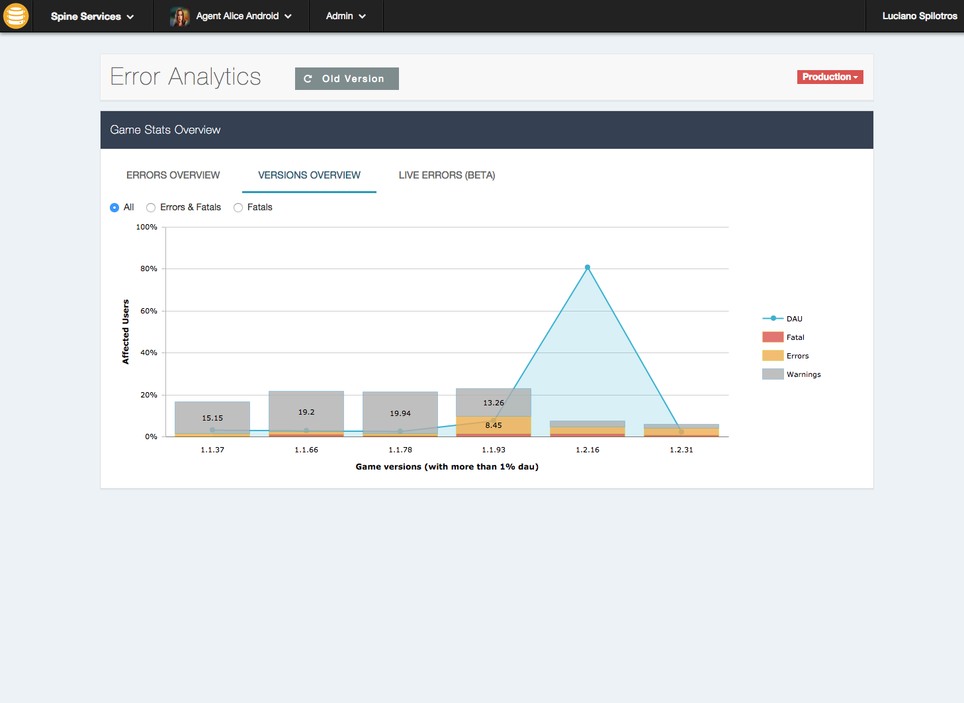
See DAU across different versions
Compare errors rate

Slide 6
Role #2:
The Developer
Case #1:
“I want to debug most popular error of the game so I could fix them easily”

Slide 7
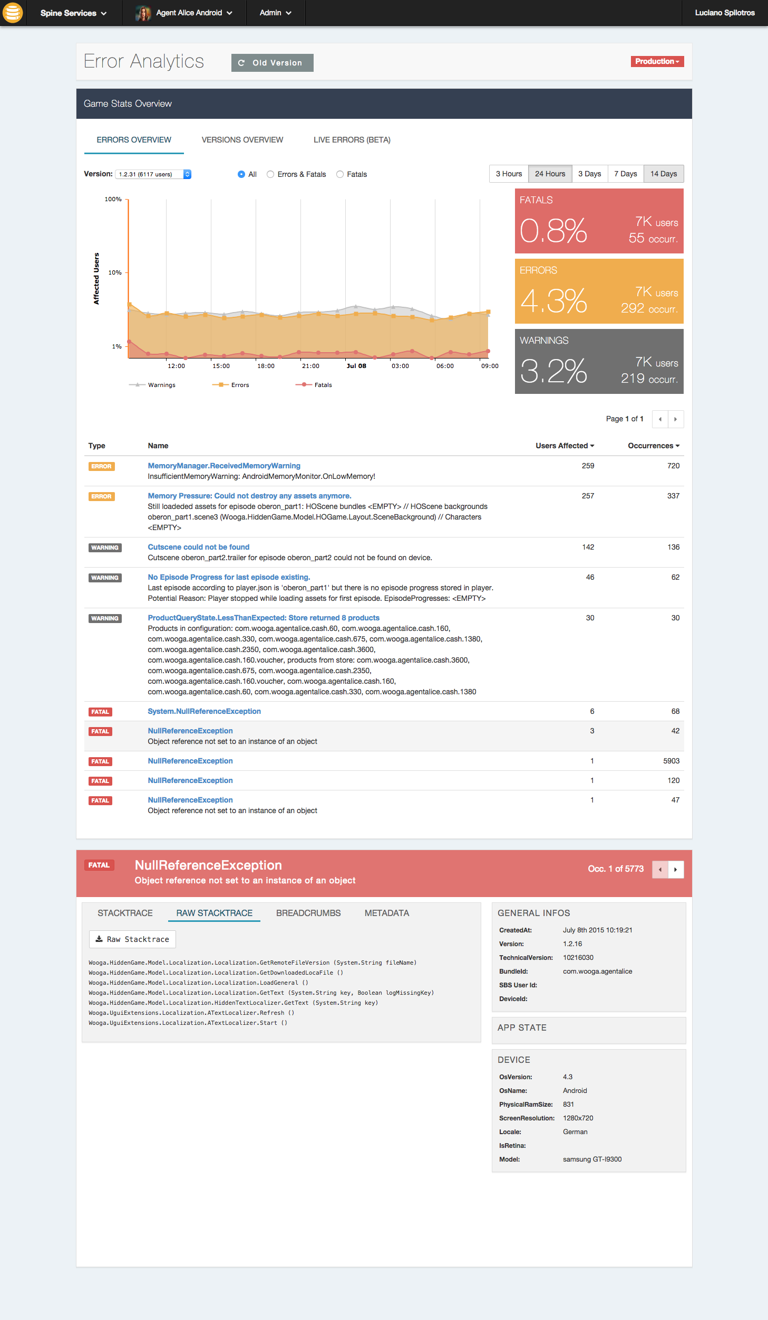
Occurrences navigation
Debugging
Occurrence-specific information

Slide 8
Role #2:
The Developer
Case #2:
“I want to see live occurrences, so I am aware of what is happening right now to my game”

Slide 9
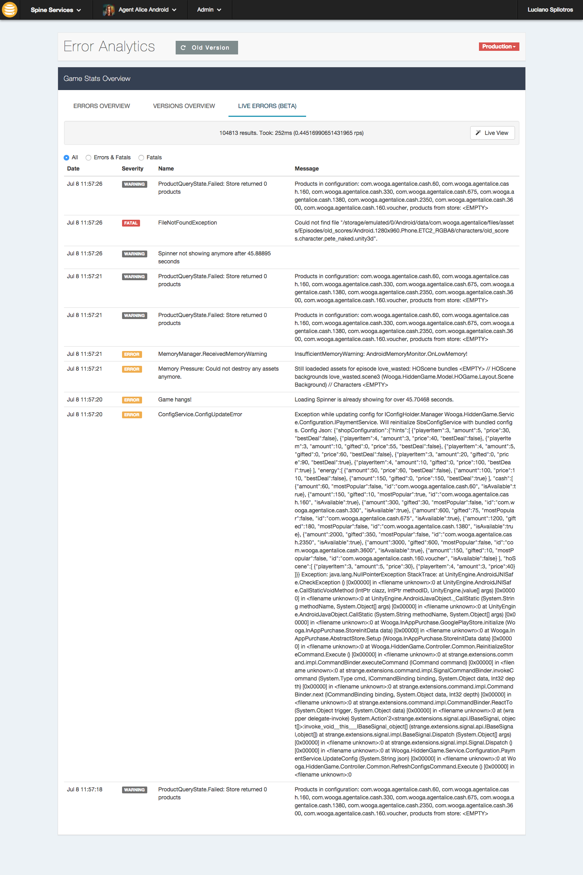
Display errors as they happen
Show all live occurrences with relevant information

Slide 10
Coming next
“I want to search occurrences for specific device, sbs-id, os, or any other property”

Slide 11
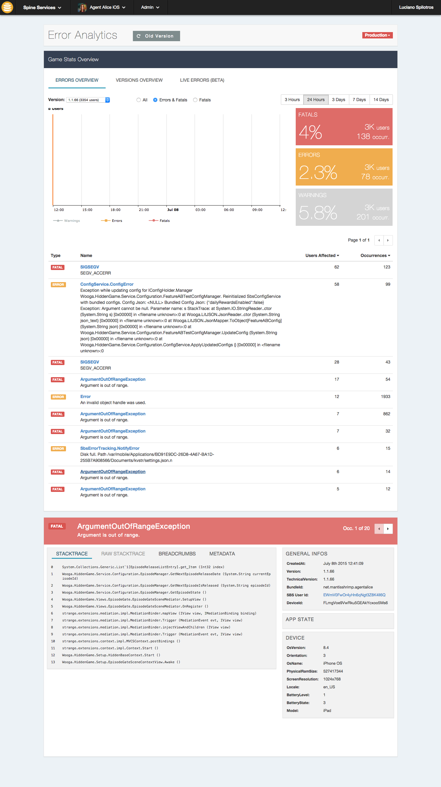
Using ElasticSearch will be possible to query for occurrences with any of these fields

