Slide 1
Inheritance
Md. Khan
Date: 01/13/18

Slide 2
Example with your resume,
class new_resume extends old_resume {}
Example:
class Resume2018 extends Resume2017 {}

Slide 3
Basic Syntax of a Class
Modifier Class_Key_Word Class_Name Class_Body

Slide 4
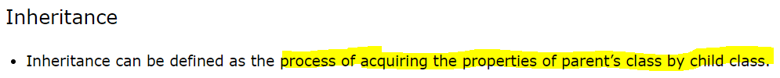
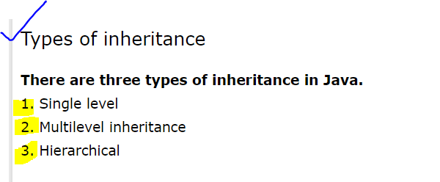
Inheritance

Slide 5
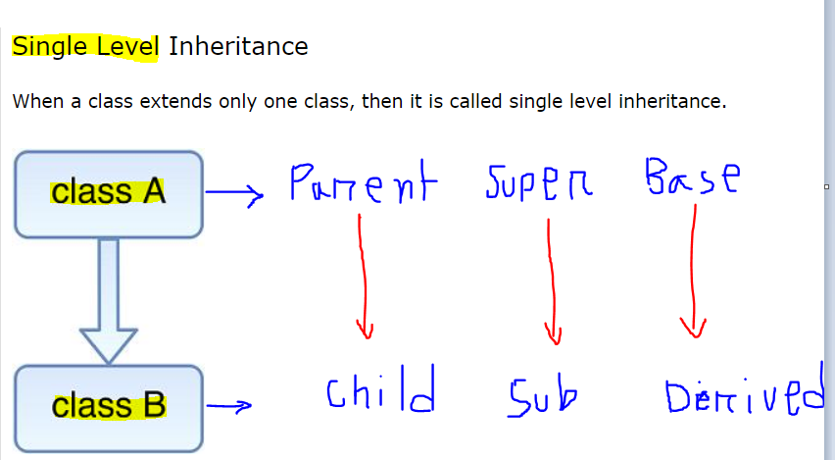
Single Level Inheritance

Slide 6
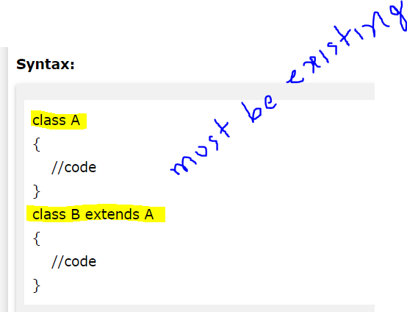
Syntax

Slide 7
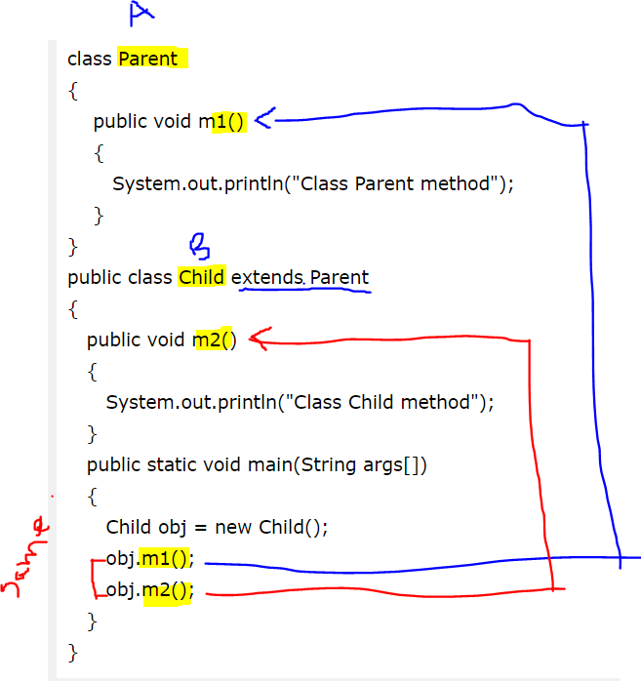
Example

Slide 8
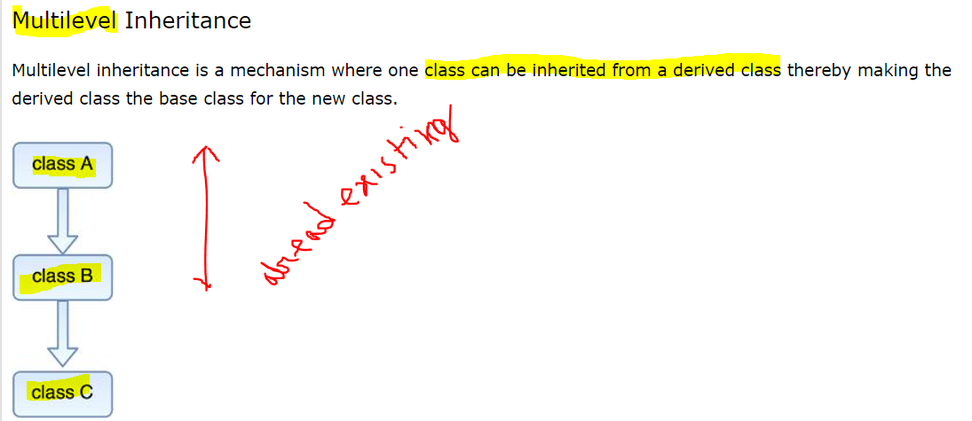
Multilevel Inheritance

Slide 9
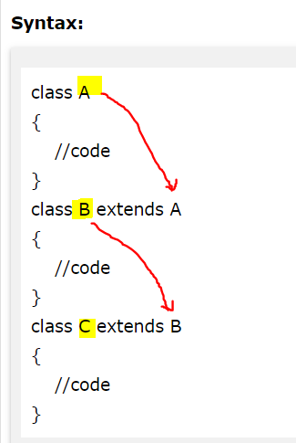
Syntax of Multilevel Inheritance

Slide 10
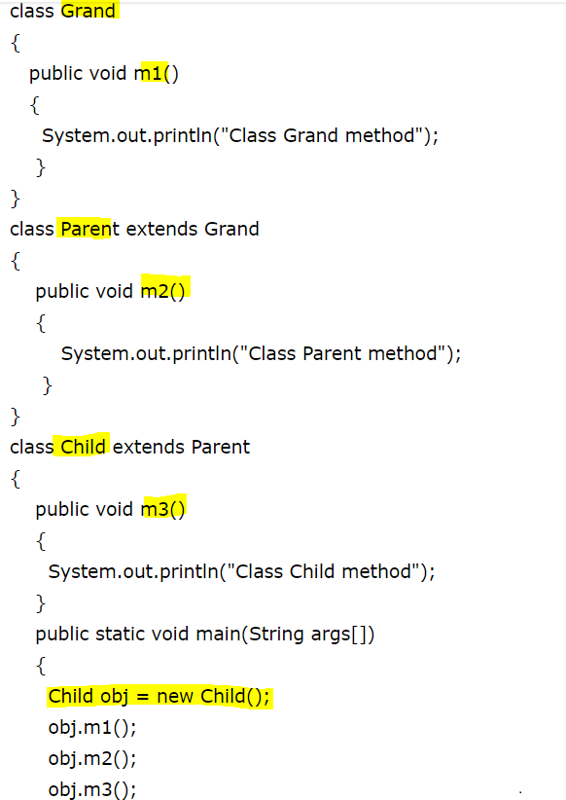

Example Multilevel Inheritance

Slide 11
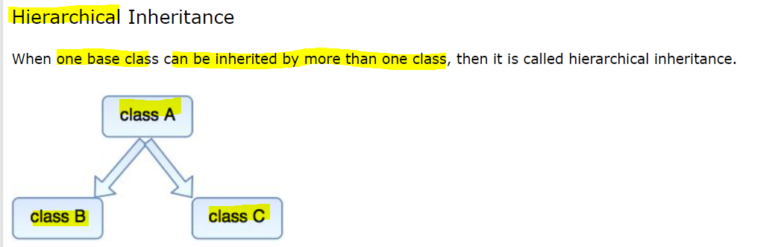
Hierarchical Inheritance

Slide 12
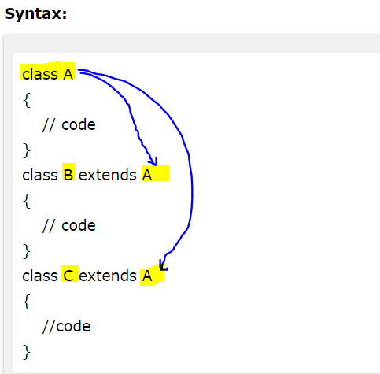
Syntax of Hierarchical Inheritance

Slide 13
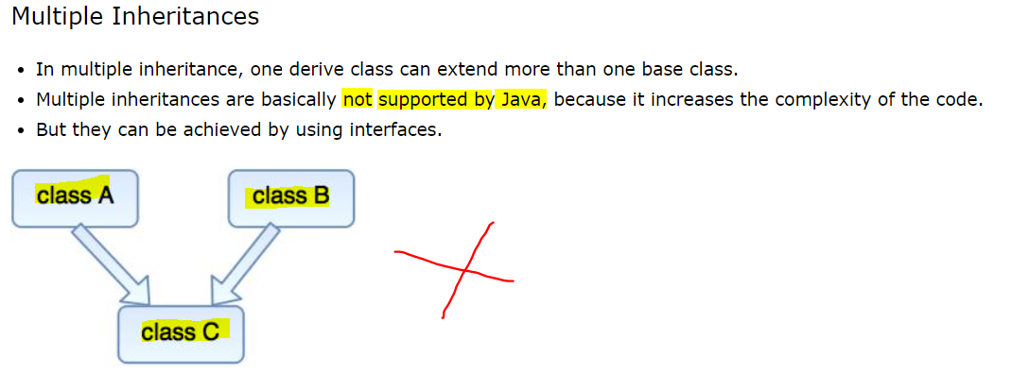
Java Does Not Support

Slide 14
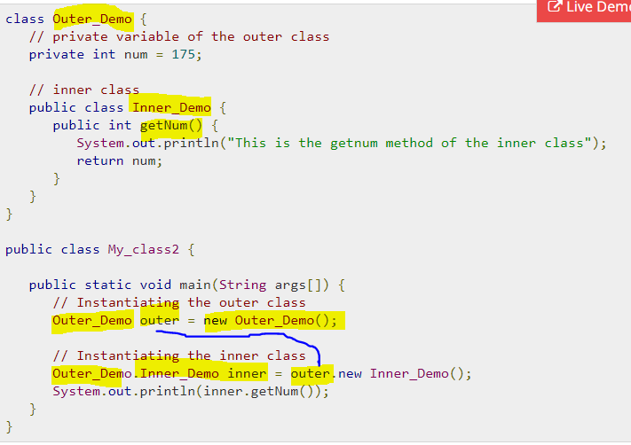
Nested Class

Slide 15
Use of Method
Using one method we want operate number of operation
Method name: Application_Map(eleType,elePath,testData,Action);

Slide 16
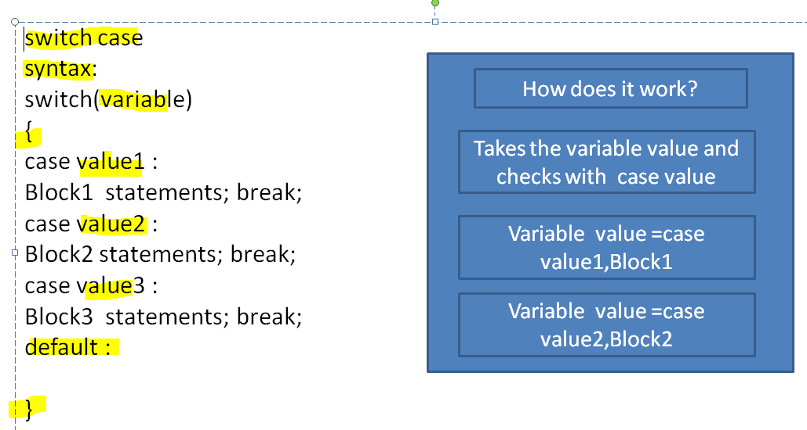

Slide 17
switch(eleType) {
case “editBox”:
driver. elePath.Action(testData)
Break;
case “button”:
driver. elePath.Action
Break;
}

