Slide 1
TEDDIT
Prepared by Team Troika
Alin Mohammad Sifayet 190041222
Md Abdullahil Kafi 190041224
Lutful Awal Rafi 190041210
1

Slide 2
TABLE OF CONTENTS
01
02
03
04
Project Overview
Implemented Features
Live Demonstration
User Interface
2

Slide 3
Project Overview
3

Slide 4

ABOUT TEDDIT
Tedit is a voice-based text editor where users will be able to use all the functionalities of a regular text editor like Notepad, SublimeText with the help of voice commands only.
4

Slide 5

Teddit will emerge as a breakthrough software for disabled people especially people with upper limb deformaties.
5

Slide 6
Implemented Features
6

Slide 7
FEATURES
Users can type using keyboard as well as voice
Maintain separate user profiles
Sign-up and Log-in feature
Advanced Database which will help track users their most frequently used words
Save Current File & Open existing files
Change the fontsize of their texts
7

Slide 8
Description of Features and UI Design
8

Slide 9
LOGIN & SIGNUP
Upon entering the software, the user will be introduced to the login window where they have to enter their username and password to access the software. If a person is not registered, he has to sign-up first.
9

Slide 10
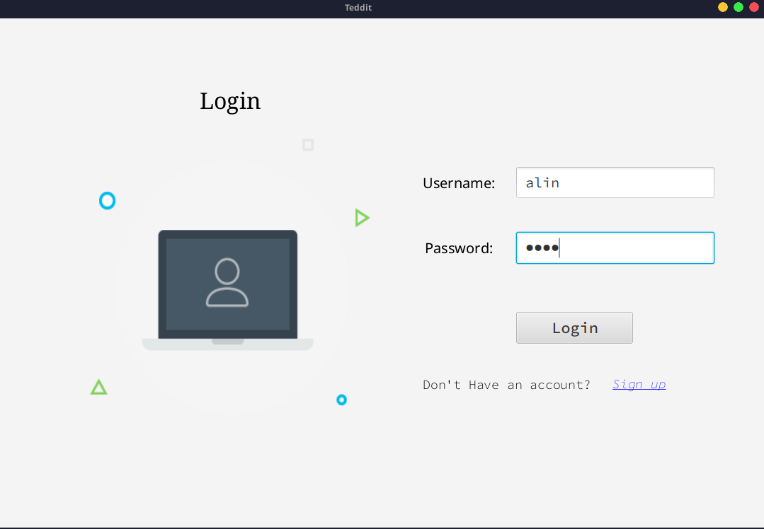
LOG-IN Page
10

Slide 11
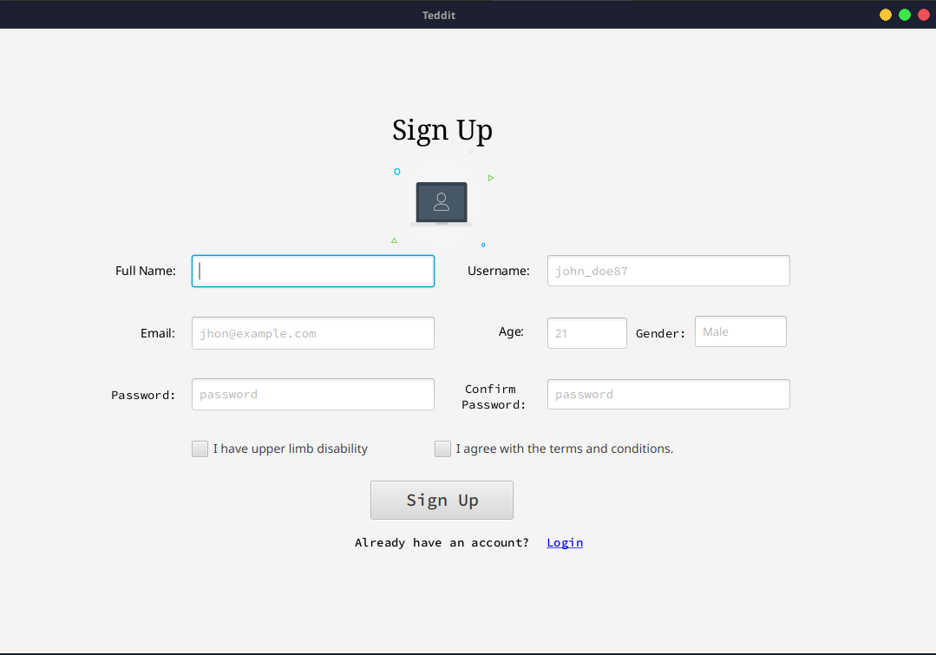
SIGN-UP Page
11

Slide 12
Homepage
After correctly entering the username and password, user will be directed to the homepage. The user can now type by either using their keyboard or by using their speech by clicking the button on the bottom right corner.
12

Slide 13
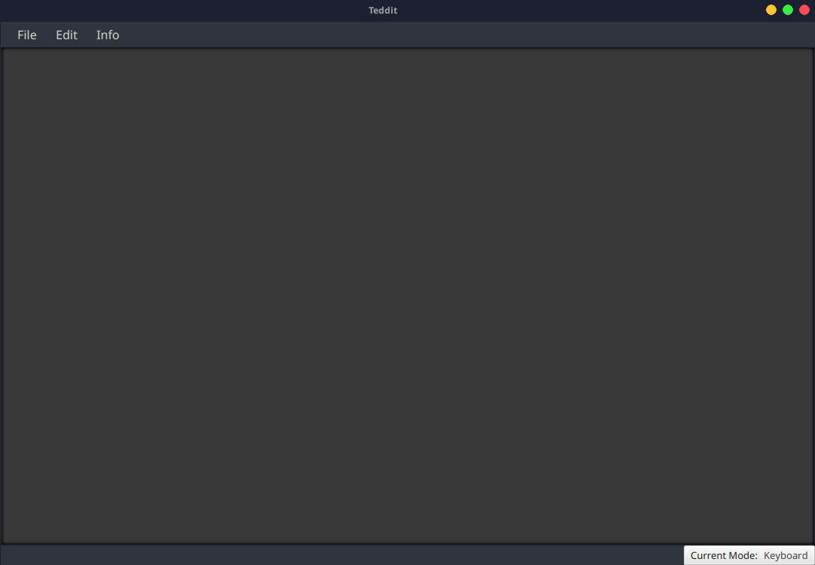
Home Page
13

Slide 14
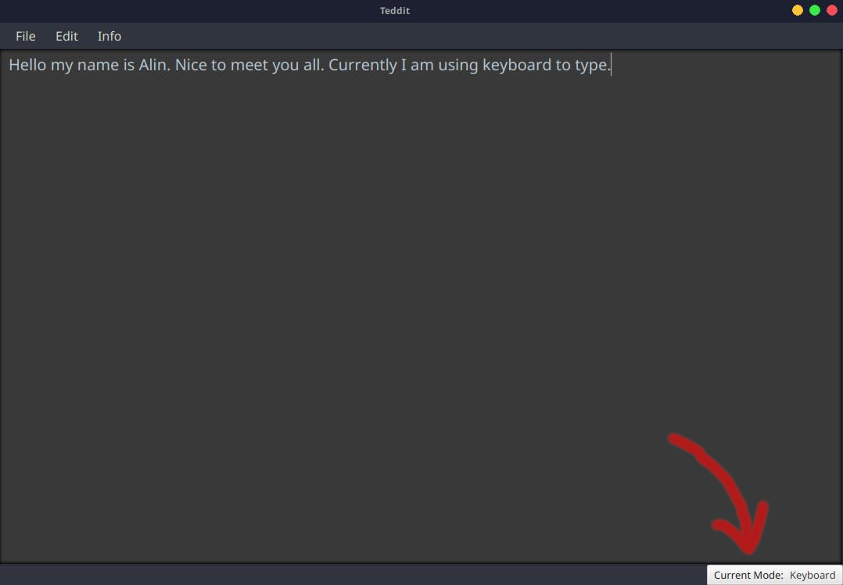
Type using keyboard
14

Slide 15
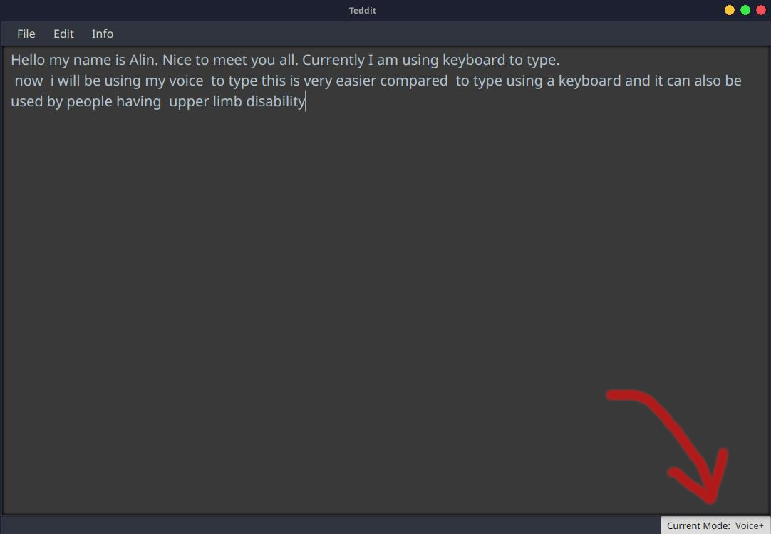
Type using speech
15

Slide 16
Use of Database
01
02
03
Store sensitive information such as username and password
Store other user information
Calculate and store frequently used words by the user
16

Slide 17
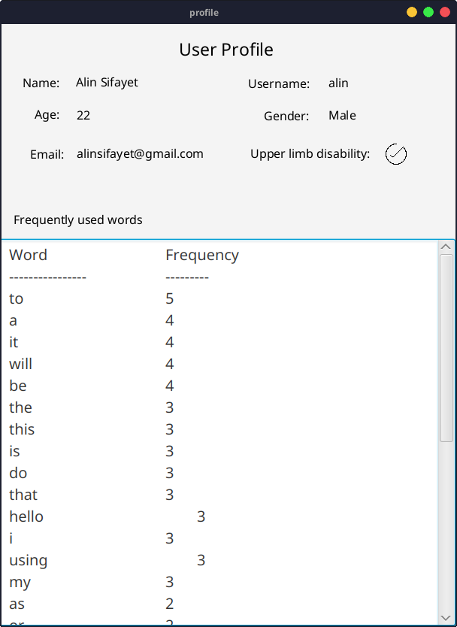
User Profile
17

Slide 18
Save Current File & Open existing files
The user has the option of saving the file and save all the progress.
They can also open existing files from the repository and edit them.
18

Slide 19
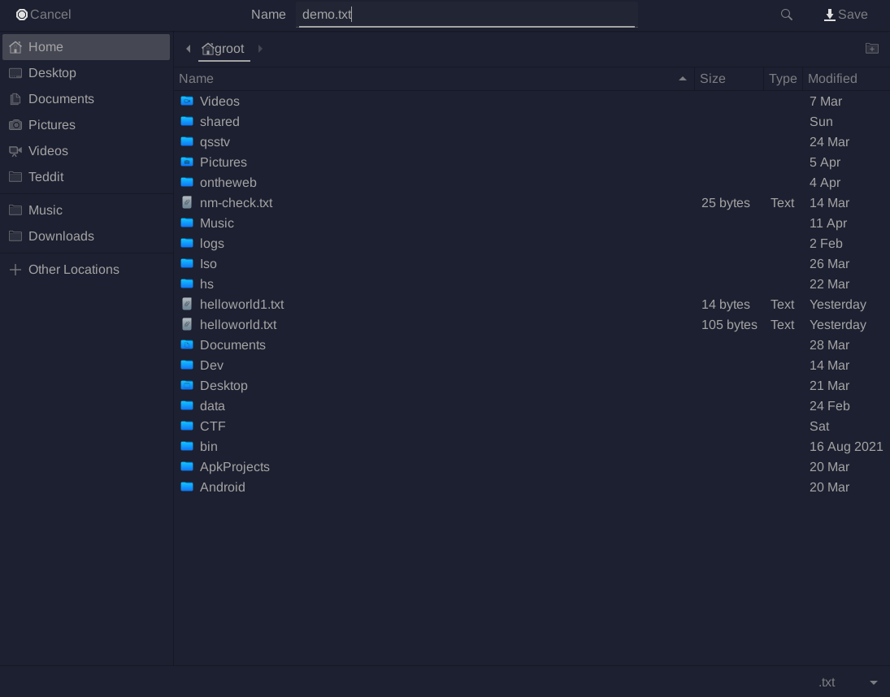
Save Current File & Open Existing File
19

Slide 20
Change Font Size
The users can also change the fontsize of their text. This can be done by pressing the “Edit Fontsize” option under the “Edit” Option
20

Slide 21
Live Demonstration
21

Slide 22
THANK YOU!
22

