Slide 1
Python In ChemE
End Term Evaluation
ARMEET LUTHRA

Slide 2
Assignment 1 : STOKES LAW
Problem statement :
In this assignment we were required to compare the analytical and numerically calculated terminal velocity of a sphere in a medium of given density and viscosity.
Physics and equations :
A freely falling spherical ball experiences three forces:
Gravitational force downwards,
Buoyancy upwards,
Drag force, which acts opposite to the direction of velocity of the particle

Slide 3
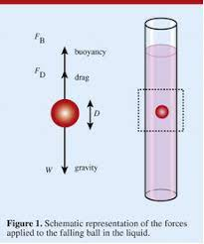
Assignment 1
The equation of motion can be written as: mdu/dt=mg-⍴Vg-6πrηu.
m=mass of sphere
u=velocity of sphere
g=gravitational acceleration
⍴=density of fluid
V=volume of sphere
r=radius of sphere
η=viscosity of the fluid

Slide 4
Assignment 1
Algorithm
1) Input the necessary parameters (density of liquid, sphere, viscosity of liquid, radius of sphere, tolerance and integration time step)(initial velocity of sphere is assumed to be 0)
2) The equation of motion is integrated using linear approximation to integral:
du/dt≃[u(t+Δt)-u(t)]/Δt
u(t+Δt)=gΔt(1-⍴V/m) +u (t)[ 1+6πrηΔt/m ]
3) This is implemented using a loop incrementing the Δt each time till the error between u(t+Δt) and u(t) is less than the given tolerance.
4) The final u will be the terminal velocity
5) Analytical terminal velocity Is calculated by putting acceleration=0 in the equation of motion.
6) For a sphere it comes out to be: vt=(⍴s-⍴l)*g*r² *2/(9*n)

Slide 5
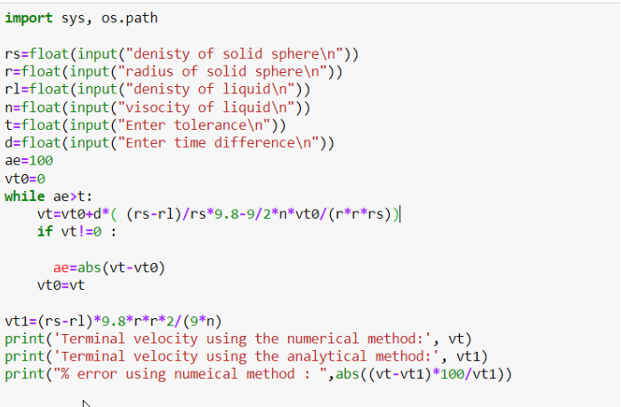
Python Code

Slide 6
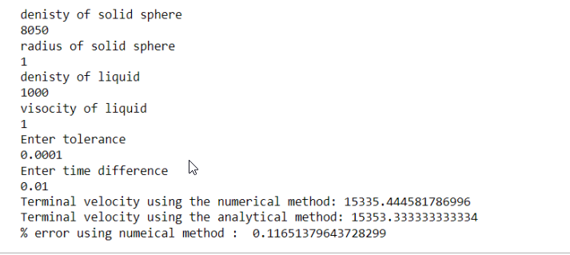
Output

Slide 7
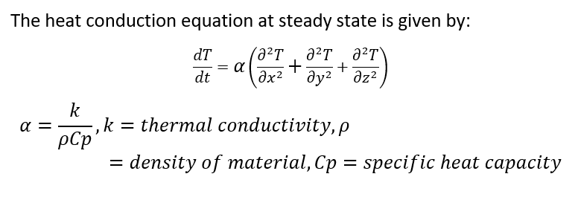
Assignment 2 : Heat Diffusion Equation
Problem Statement:
In this assignment we were required to find the TEMPERATURE PROFILE OVER TIME for a flat plate, subject to certain fixed boundary conditions and also animate the changes. This was done by solving the Heat diffusion equation.
Physics of problem
The heat conduction equation at steady state is given by:

Slide 8
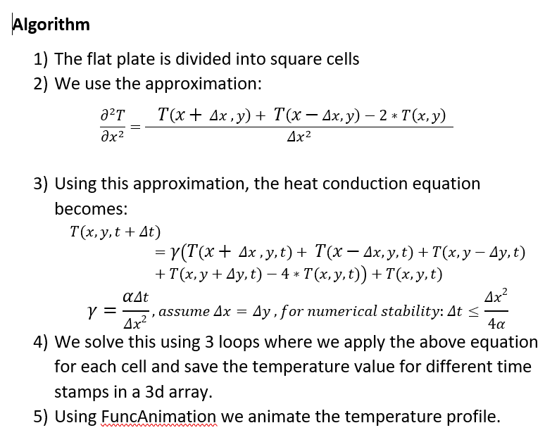
Assignment 2

Slide 9
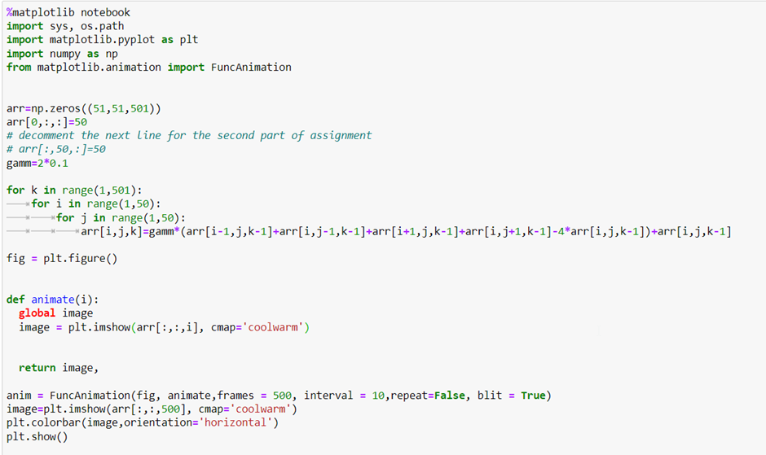
Python Code

Slide 10
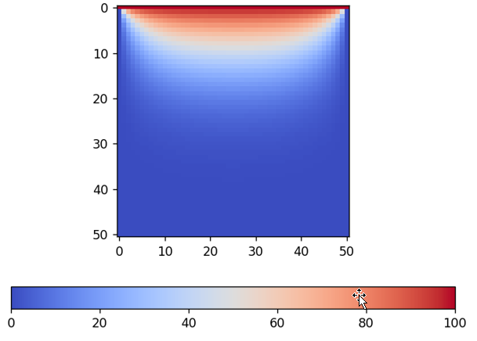
Output
Initial boundary condition: Top edge at 100º, rest plate at 0º. Final temperature profile for this case is :

Slide 11
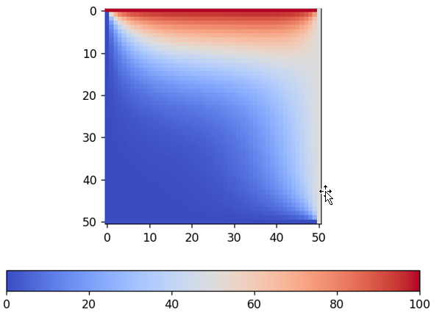
Output
2. Initial boundary condition: Top edge at 100º, Right edge at 50º, rest plate at 0º.Final temperature profile for this case is:

Slide 12
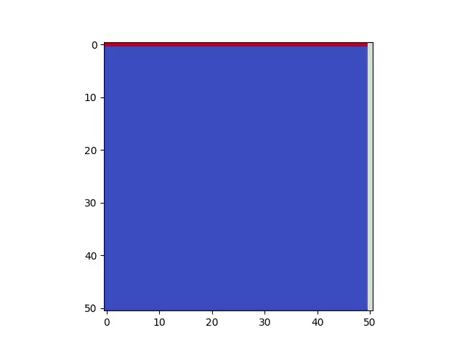
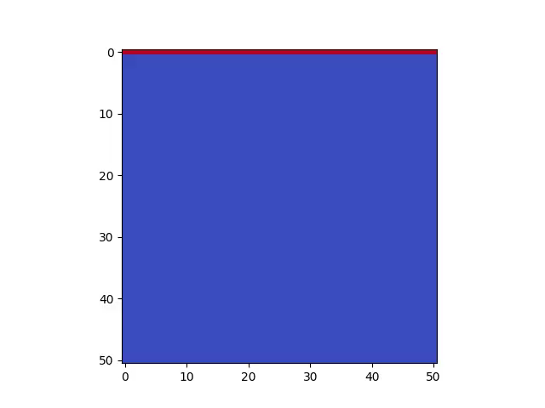
Animation

Slide 13
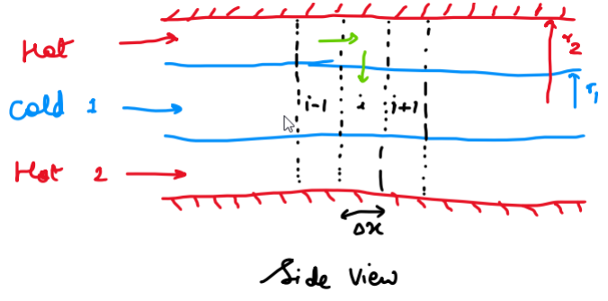
Assignment 4 : Double pipe heat exchanger
Problem statement :
In this assignment we were required to solve and obtain the transient response of Temperature with time for the given concentric cylinder double pipe heat exchanger for co-current flow.

Slide 14
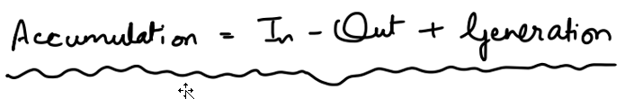
Assignment 4
Physics and equations :
Using energy balance:
The heat balance equation for concentric heat exchanging cylinders is:

Slide 15
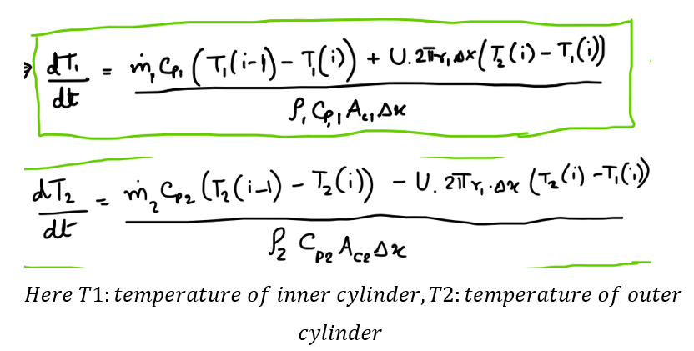
Assignment 4

Slide 16
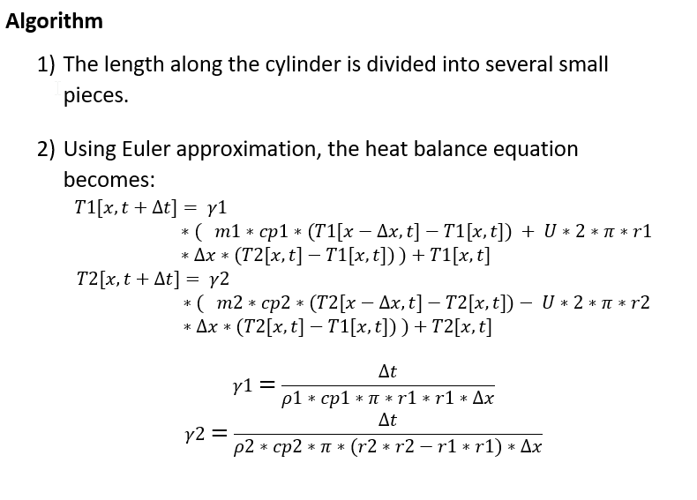
Assignment 4 : Algorithm

Slide 17
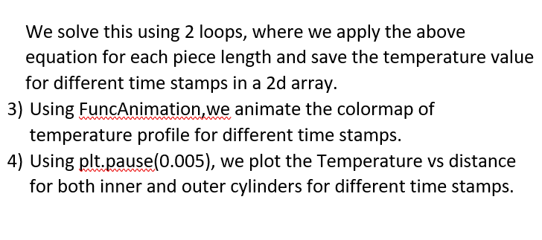
Assignment 4 : Algorithm

Slide 18
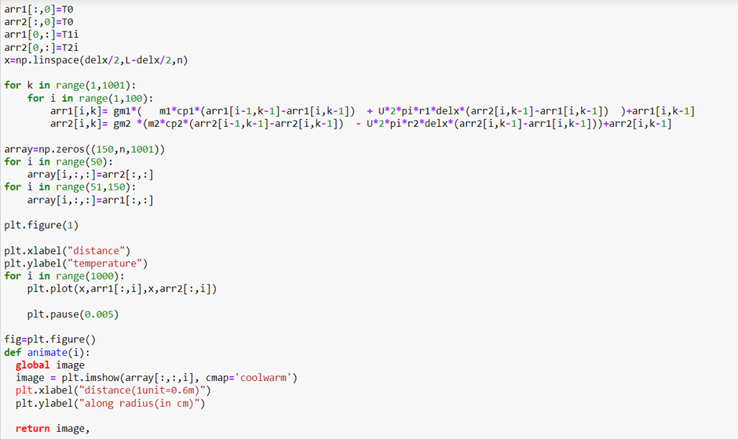
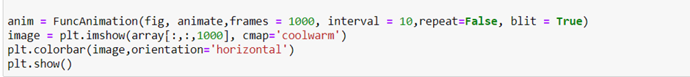
Python Code

Slide 19
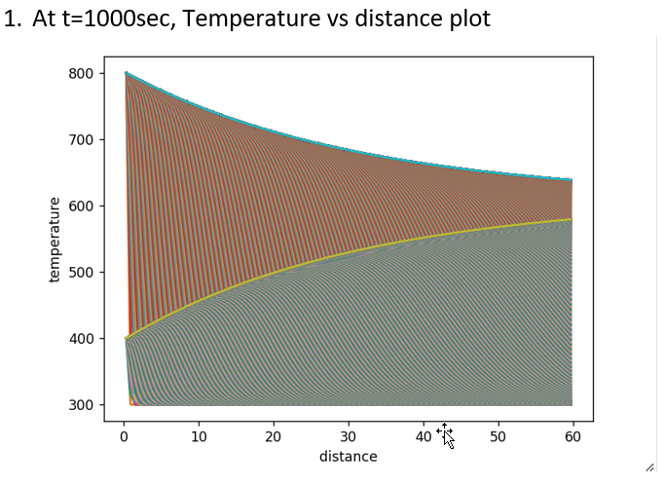
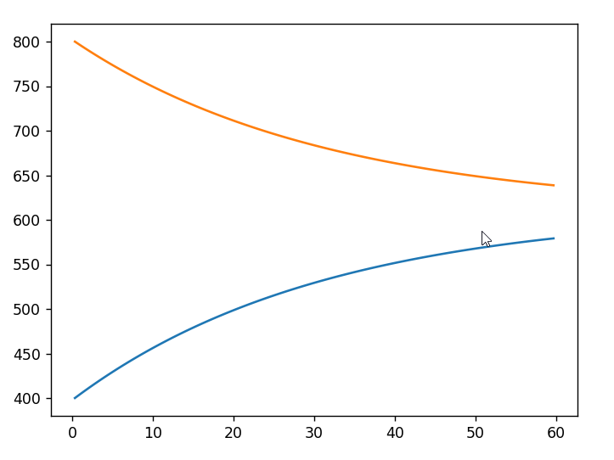
Output

Slide 20
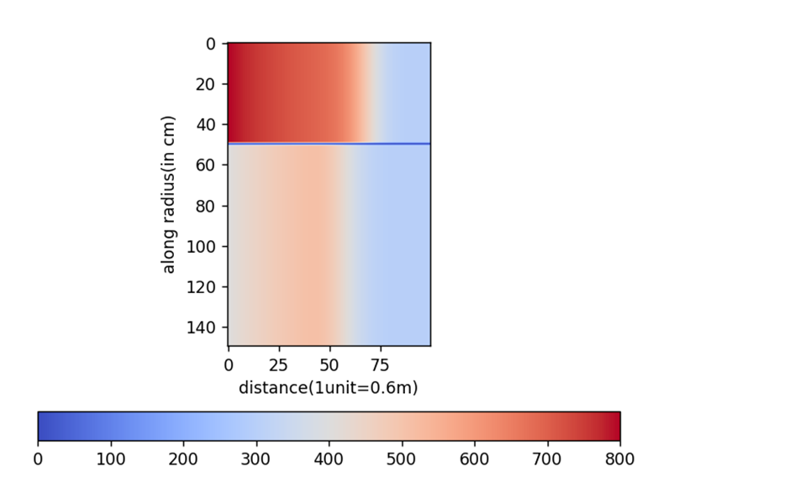
Output
2) Temperature profile color map at some instant

Slide 21
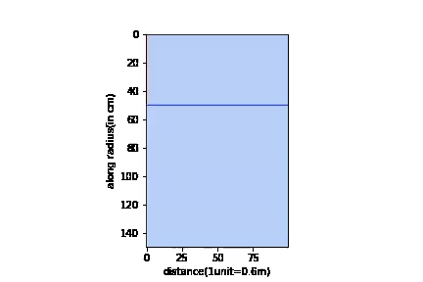
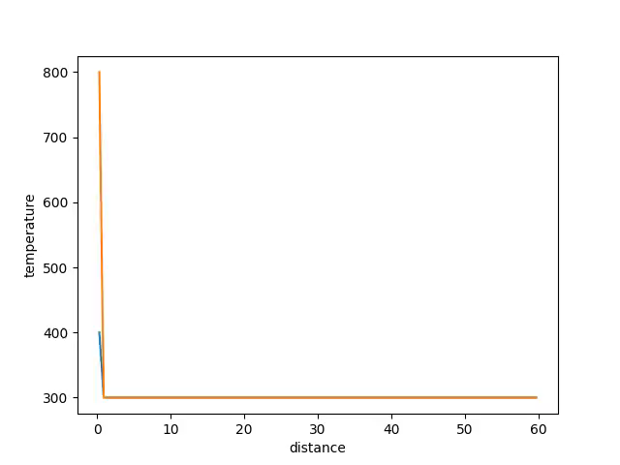
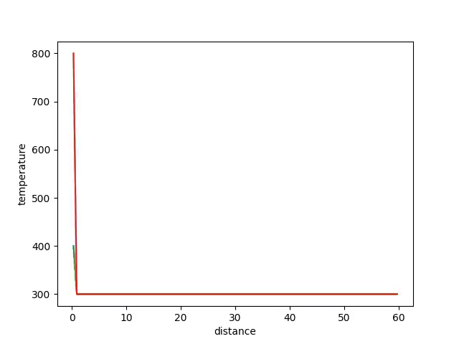
Animation

