Slide 1
Python Iterators and Generators

Slide 2
Overview
What are iterables?
What are iterators?
What are generators?
How to make this stuff from classes.
I assume you know about basic for loops and list comprehensions.

Slide 3
Iterables
my_list = [34, 6, 90, 78]
print(max(my_list))
# => 90
So max must take a list, right? Let’s see what the docs say...

Slide 4
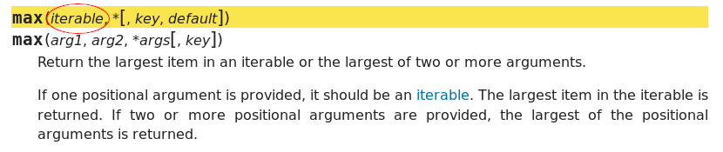
Iterables
Most library functions that can take a list actually take any kind of iterable.
What’s an iterable?

Slide 5
Iterables
An iterable is anything you can call iter() on.
iter() returns an iterator.
Any collection is iterable (if implemented properly).
In a for loop, the expression between the in and the colon must always be iterable.
Ok, but what’s an iterator?

Slide 6
Iterators
An iterator is anything you can call next() on.
When you call next() on an iterator, it returns the next item of whatever sequence it’s supposed to be iterating through.
An iterator can yield values from anything: A list, lines from a file, an infinite series of numbers, etc.
If the iterator is out of items, next() raises StopIteration.
You can also call iter() on an iterator. It returns the iterator itself. That means all iterators are iterable.

Slide 7
for loops
We now know enough to explain how for loops work.
for x in iterable:
print(x)

Slide 8
for loops
We now know enough to explain how for loops work.
for x in iterable:
print(x)
iterator = iter(iterable)

Slide 9
for loops
We now know enough to explain how for loops work.
for x in iterable:
print(x)
iterator = iter(iterable)
while True:

Slide 10
for loops
We now know enough to explain how for loops work.
for x in iterable:
print(x)
iterator = iter(iterable)
while True:
try:
x = next(iterator)
except StopIteration:
break

Slide 11
for loops
We now know enough to explain how for loops work.
for x in iterable:
print(x)
iterator = iter(iterable)
while True:
try:
x = next(iterator)
except StopIteration:
break
print(x)

Slide 12
Generator Expressions
[x**2 for x in range(10)]
# => [0, 1, 4, 9, 16, 25, 36, 49, 64, 81]

Slide 13
Generator Expressions
[x**2 for x in range(10)]
# => [0, 1, 4, 9, 16, 25, 36, 49, 64, 81]
(x**2 for x in range(10))
# => <generator object <genexpr> at 0x7f961c338b48>

Slide 14
Generator Expressions
[x**2 for x in range(10)]
# => [0, 1, 4, 9, 16, 25, 36, 49, 64, 81]
(x**2 for x in range(10))
# => <generator object <genexpr> at 0x7f961c338b48>
How come we can’t see what’s inside the generator?

Slide 15
Generator Expressions
A generator expression is one way of creating an iterator.
Doesn’t store any items.
Calculates each item on the fly.
Once you get the next item, that item is gone. No going backward.

Slide 16
Generator Expressions
If you need to access a generator (or any iterator, for that matter) multiple times:
Convert to list:
gen = (x**2 for x in range(10))
items = list(gen)
Return from a function:
def make_iterator():
return (x**2 for x in range(10))

Slide 17
Generator Functions
What if we want a more complicated iterator?
A generator function is any function with a yield statement.
When called, it does not execute your code.
Instead, it returns an iterator which starts executing the function whenever the next item is requested.
The function executes up until it hits a yield statement, which gives the item returned by next().
Subsequent next() calls resume from the previous yield that was executed.
Can use yield from to yield items from another iterator.

Slide 18
Generator Functions
def squares_then_normal(n):
for i in range(n):
yield i**2
yield from iter(range(n))
# Automatically throw StopIteration
print(list(squares_then_normal(5)))
# => [0, 1, 4, 9, 16, 0, 1, 2, 3, 4]

Slide 19
Classes
How do I make my own classes iterable?
Simply add an __iter__ method!
__iter__ takes a self parameter and must return an iterator.
Since generator functions effectively return iterators, feel free to use yield inside your __iter__ methods!

Slide 20
Classes
How do I make my own iterator classes?
Implement __next__ and __iter__ methods.
__next__ takes a self parameter and returns the next item in the sequence.
__next__ must raise StopIteration at the end (unless you want it to run forever).
Since iterators are also iterable, they must always have an __iter__ method that returns self.

