Slide 1
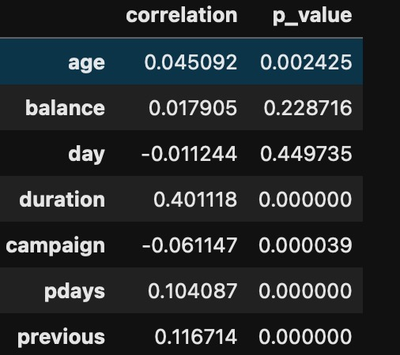
Direct Market Analysis: Biserial Correlation of Numerical Variables
Age shows a very weak positive correlation with a p_value less than 0.05 indicating that this feature is statistically significant. As the age increases, the more likely that a client will give a yes response
Balance on the other hand has a very weak positive correlation and is not statistically significant. This is not a good indicator for the target variable
day a weak negative correlation and is not statistically significant
duration good positive correlation and is statistically significant. This states that as the duration increases, the more likely that a client will give a yes response.
campaign (Number of contacts performed during this campaign) a weak negative correlation and is statistically significant. This states that as the number of contacts increases, the less likely that a client will give a yes response.
pdays (Number of days since the client was last contacted from a previous campaign) and previous(Number of contacts performed before this campaign) shows a weak positive correlation and is statistically significant. This states that clients that were previously contacted are more likely to give a yes response

Slide 2
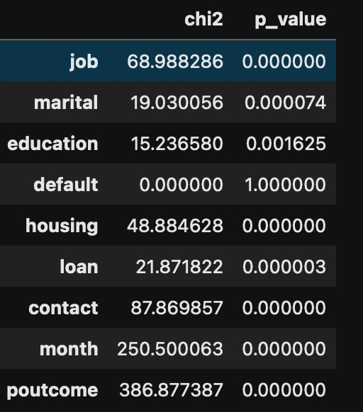
Segmentation: Categorical Variables Using Chi-Squared Test
job and marital Status and education are statistical significance here which indicates that the job type, marital status, and education affects the likelihood of yes response
default has no statistical significance here having credit in default does not affect the likelihood of a yes response.
housing and loan are statistical significance which indicates that have a housing loan and a personal loan affects the likelihood of a yes response.
contact is statistical significance which indicates that type of contact communication affects the likelihood of a yes response
month and poutcome are statistical significance and they show a strong association that affects the likelihood of a yes response

Slide 3
Machine Learning Algorithm: Random Forest Classifier
Response | Precision | Recall | F1-Score | Support
No | 83 | 81 | 82 | 105
Yes | 81 | 84 | 82 | 104

Slide 4
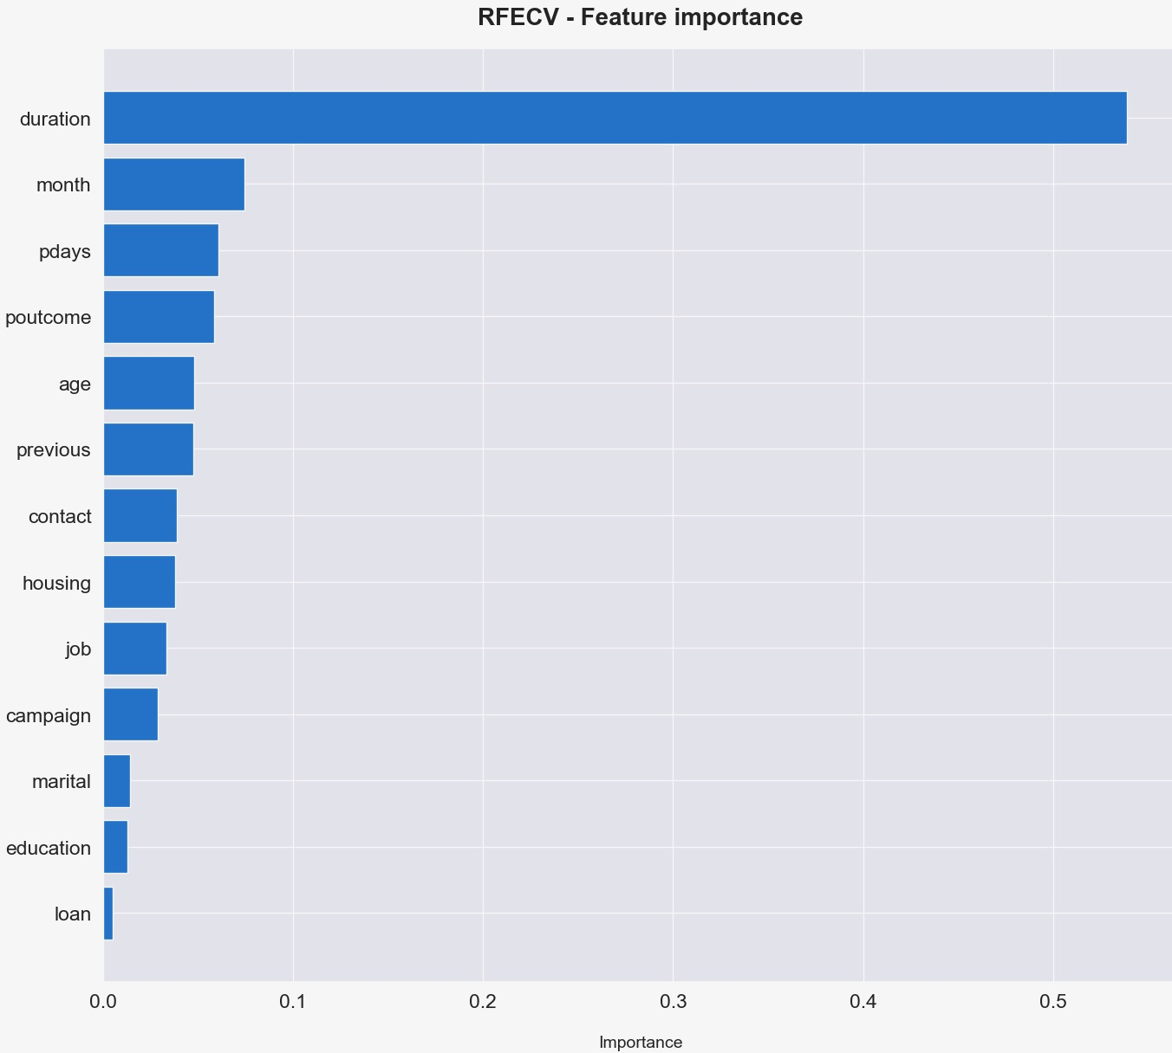
Random Forest Classifier: Feature Importance

Slide 5
Insights and Recommendation
Long Calls and Engagement: There is a strong correlation and statistical significance between the duration of calls and the likelihood of securing a subscription. Therefore, focusing on longer, more engaged conversations can increase subscription rates. Summary: Prioritise meaningful, lengthy calls to boost subscriptions.
Previous Campaign Contacts: Clients previously contacted show a weak positive correlation with subscription likelihood, supported by statistical significance. This indicates that individuals engaged in past campaigns are more likely to subscribe. Summary: Re-engage individuals from past campaigns for better subscription rates.
Best Channel - Cellular: Cellular communication emerges as the most effective channel for gaining subscriptions. Summary: Use cellular as the primary channel for higher subscription success.
Age Factor: Age demonstrates a very weak positive correlation with a statistically significant p-value below 0.05. Clients aged 25-59, particularly those in management, blue-collar, technician, and retired roles, are more likely to subscribe. Summary: Target clients aged 25-59 in specific job categories for higher subscription likelihood.
Seasonal Trends and Previous Campaign Outcomes: Certain months, like May and August, show higher subscription rates. The results of previous marketing campaigns are statistically significant and strongly influence subscription likelihood. Summary: Focus efforts during high-performing months and leverage past campaign outcomes.
Contact Frequency During Campaign: There is a weak negative correlation with statistical significance between the number of contacts during the campaign and subscription likelihood. Increasing contacts does not necessarily lead to more subscriptions, suggesting the need to optimise contact frequency. Summary: Optimise the number of contacts (from about 1 to 4) during the campaign to avoid diminishing returns.
Previous Contact Frequency: The number of contacts before the current campaign shows a weak positive correlation and statistical significance. Clients previously contacted are more likely to subscribe. Summary: Leverage previous contacts (of those contacted up to 2 times) to improve current campaign success.
Model Validation with Random Forest: The insights are further validated by a hyperparameter-optimised Random Forest classifier predictive model. This model uses these features to predict if a customer will subscribe, achieving a good precision of over 80% score on both the train and test datasets. Summary: The Random Forest model, optimised for hyperparameters, confirms the insights with a precision score of over 80% in predicting subscriptions on both training and testing data.
Recommendation for Model Application: I recommend using this hyperparameter-optimised Random Forest model on new data to enhance the team's performance. This will help in selecting individuals who are more likely to subscribe. Summary: Implement the Random Forest model on new data to improve team performance by targeting likely subscribers.
Link to full report on GitHub: https://github.com/luthergit/Direct_Marketing_Analysis/blob/54dc399330231c09a5bc590142714605d9d462e2/direct_marketing_analysis_with_commentary.ipynb

