Slide 1
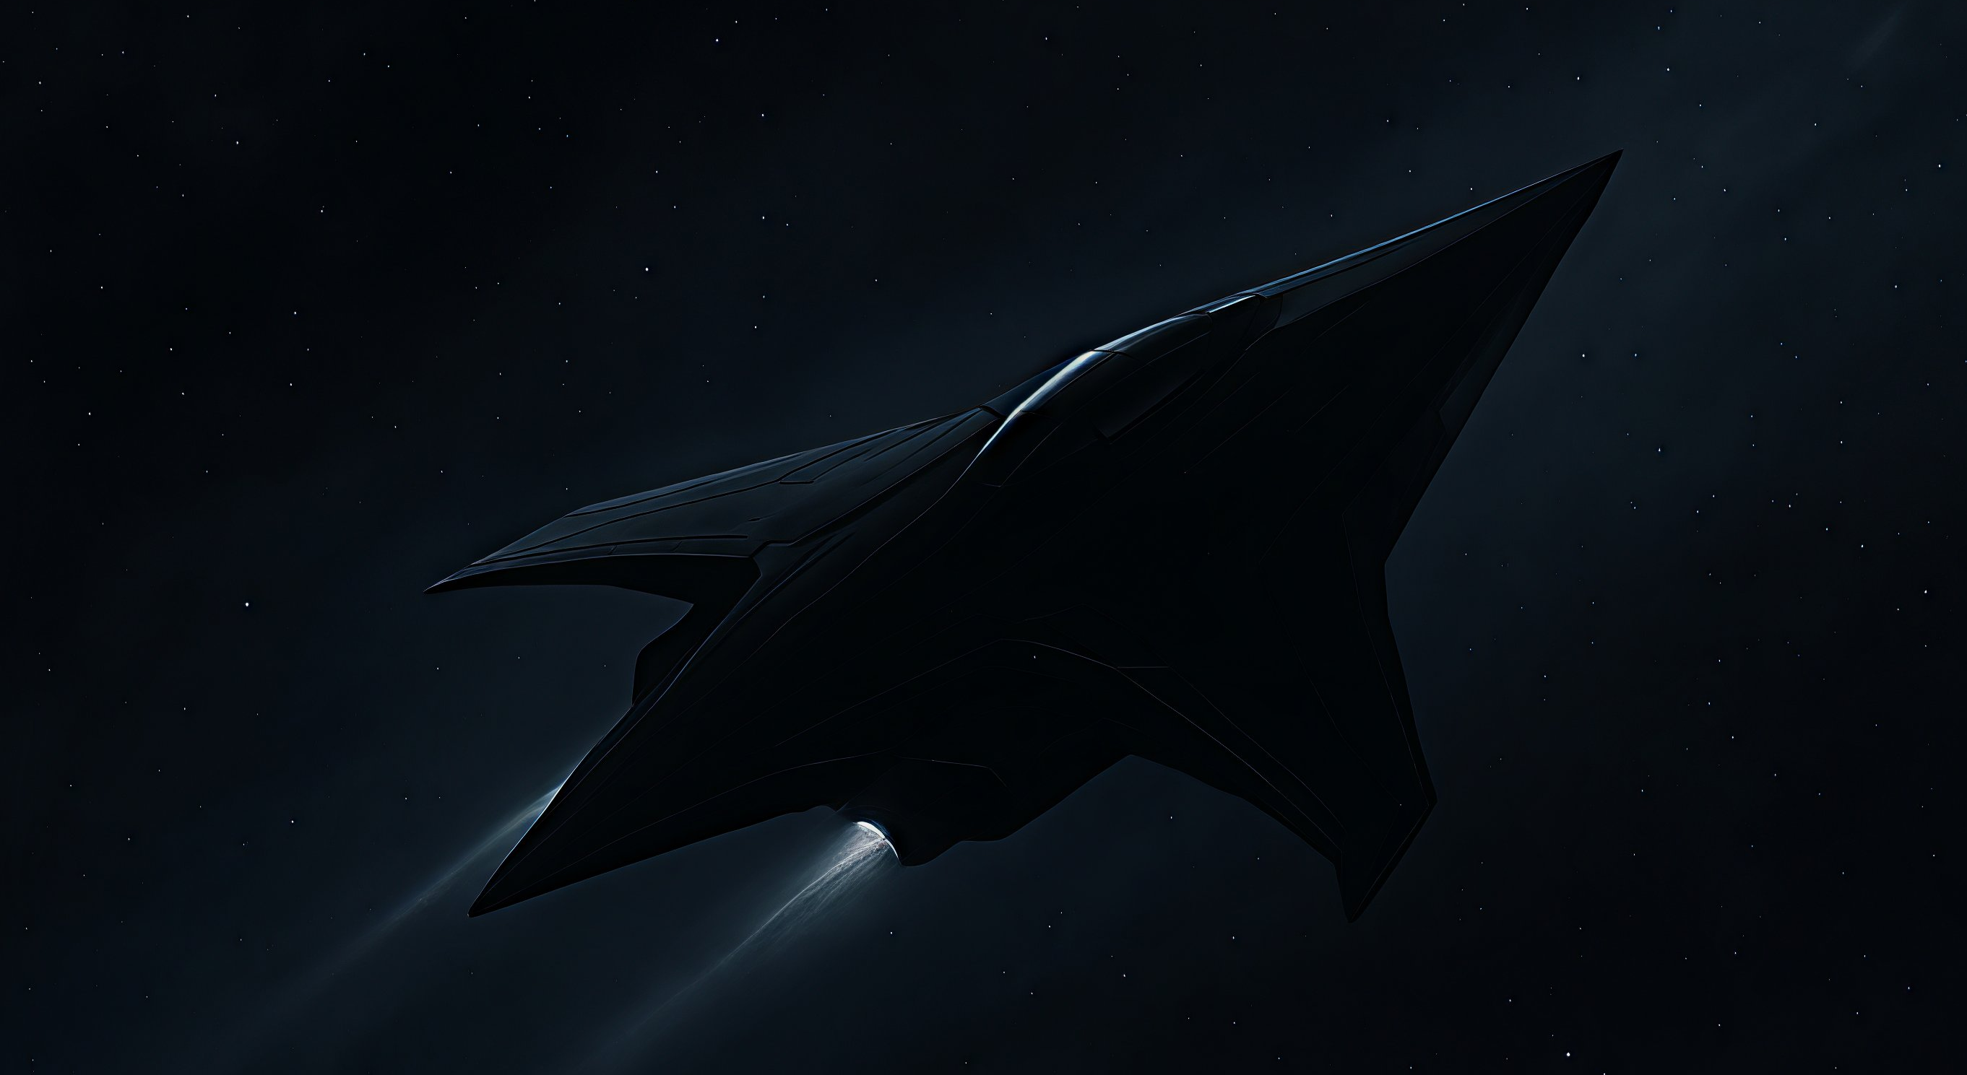
Home Stories Dictionary
Welcome to syllable division
Best reads
The Black Ship
Wyatt finbds himself in a war against mysterious black ships
Ekida 8.2.2026
Syllable Work
Help progress some stories trough helping with syllable breaks

Slide 2
Home Stories Dictionary
Stories

