Slide 1


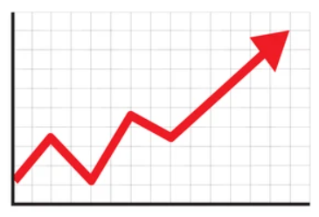

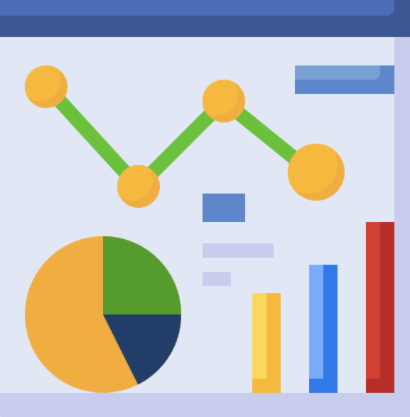

Data Sources
?
DW
Model - forecast
Dashboard
Extract Load
Transform
Analytics
Notes:
orchestrator di gcp?
table baru - data mart => dashboard
lod table
environment - script pipeline (end to end execution - utk monitoring)
testing (row, data lineage) => multi envi (docker)

Slide 2

Data Sources
?
DW
Model - forecast
Orchestrator
Dashboard
Extract Load
Transform
Analytics

Slide 3

Inside BigQuery
DataMart_DataScientist
raw_data
DataWarehouse
DataMart_DataAnalyst

