Slide 1

Business Performance
Olist
Luthfi Raditya Meza
March 2022

Slide 2
Agenda
Introduction
Business Performance
Summary & Recommendation

Slide 3

01
Introduction

Slide 4
What will you get?
2

Slide 5




Objectives
Company Current Condition
Increase Company Value
Deliver current condition of the company to know the business performance.
Can be increase company value from the new business insight.
Get New Business Insight
Plan for Future Strategy
Get a new business insight that can help to reach a new level of company achievement.
Give the company idea to make the future strategy to handle the obstacle for their business.
3

Slide 6

02
Business Performance

Slide 7
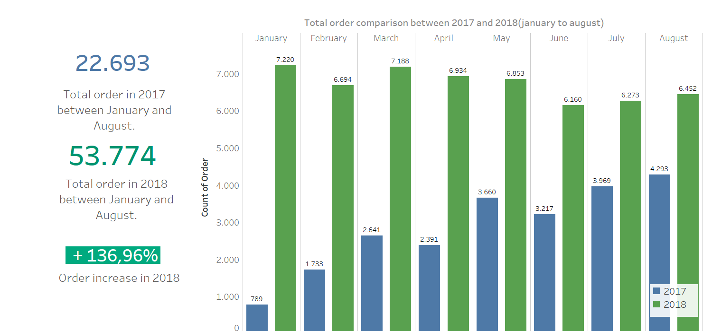
Business Performance in 2018
In 2018(January to August), order increased from 22.6K order in 2017 to 53.7K in 2018(by percent +136%) .
5
Data Source: Brazilian E-Commerce Public Dataset by Olist

Slide 8
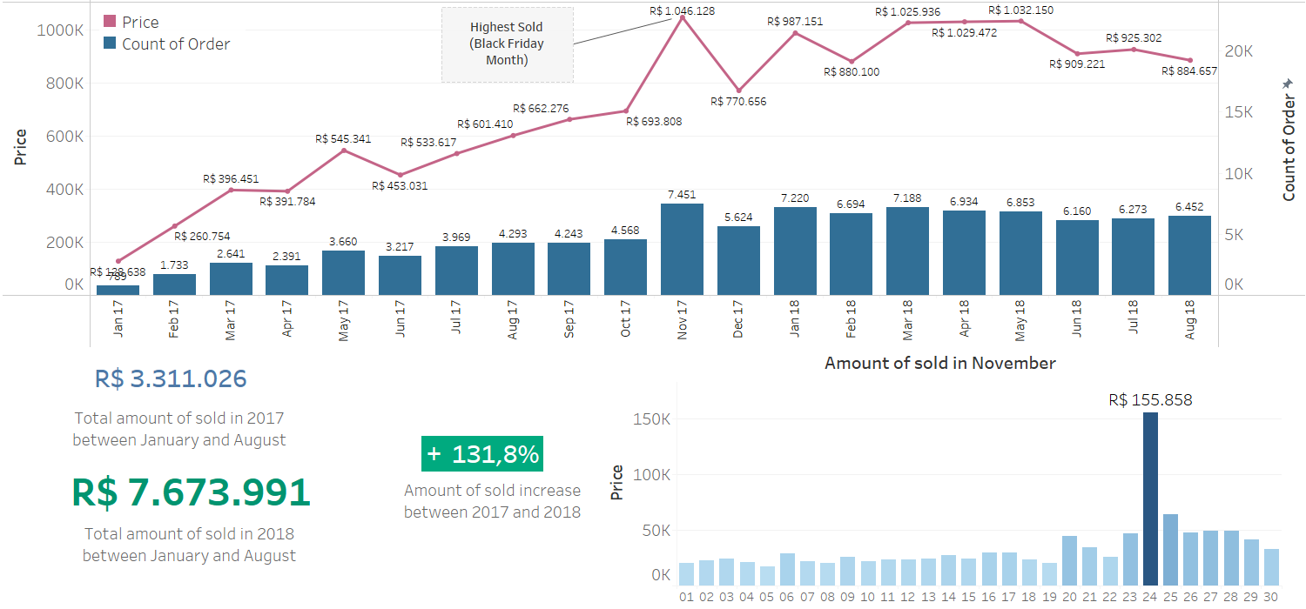

The amount of sold in 2018 is increase by +131% . The highest amount of sold and order occurred in November 2017, this is due to black friday.
6
Data Source: Brazilian E-Commerce Public Dataset by Olist

Slide 9
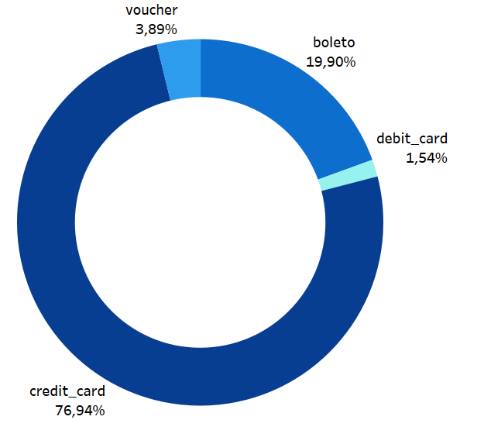
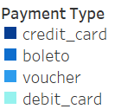
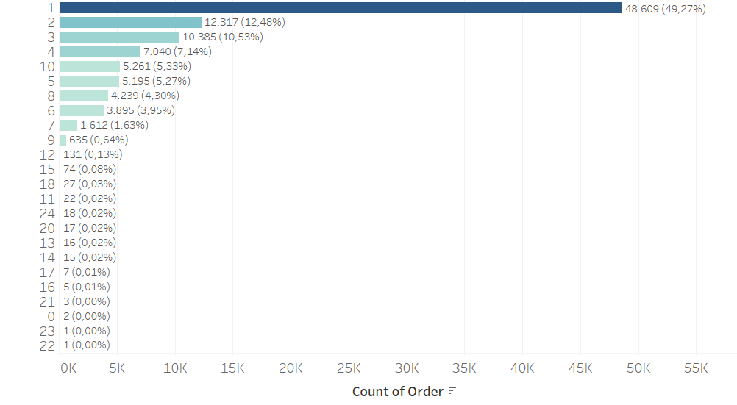
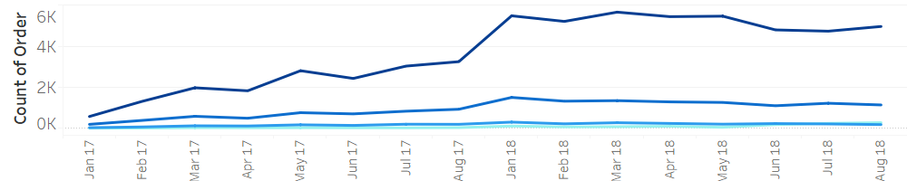
Most Widely Used Payment Type
The most widely used type of payment is Credit Card
payment instalment
7
Data Source: Brazilian E-Commerce Public Dataset by Olist

Slide 10
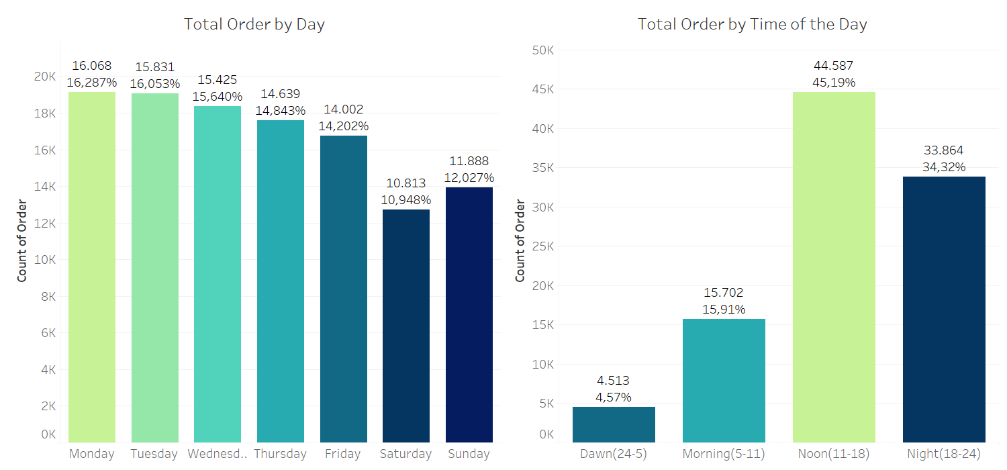
Order by Order Time
The day with the most total of order is Monday. Customers order more often during the noon(11-18).
8
Data Source: Brazilian E-Commerce Public Dataset by Olist

Slide 11
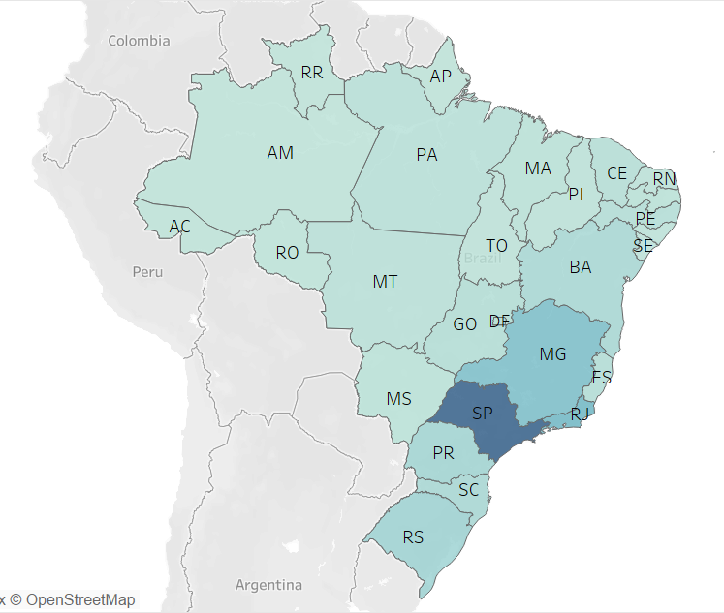
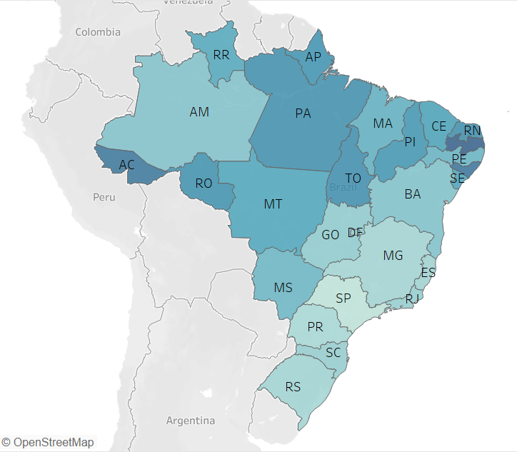
Total of Sold vs Mean of Sold by State Period: all time
Total of sold by state
Average of sold by state
10
Data Source: Brazilian E-Commerce Public Dataset by Olist

Slide 12
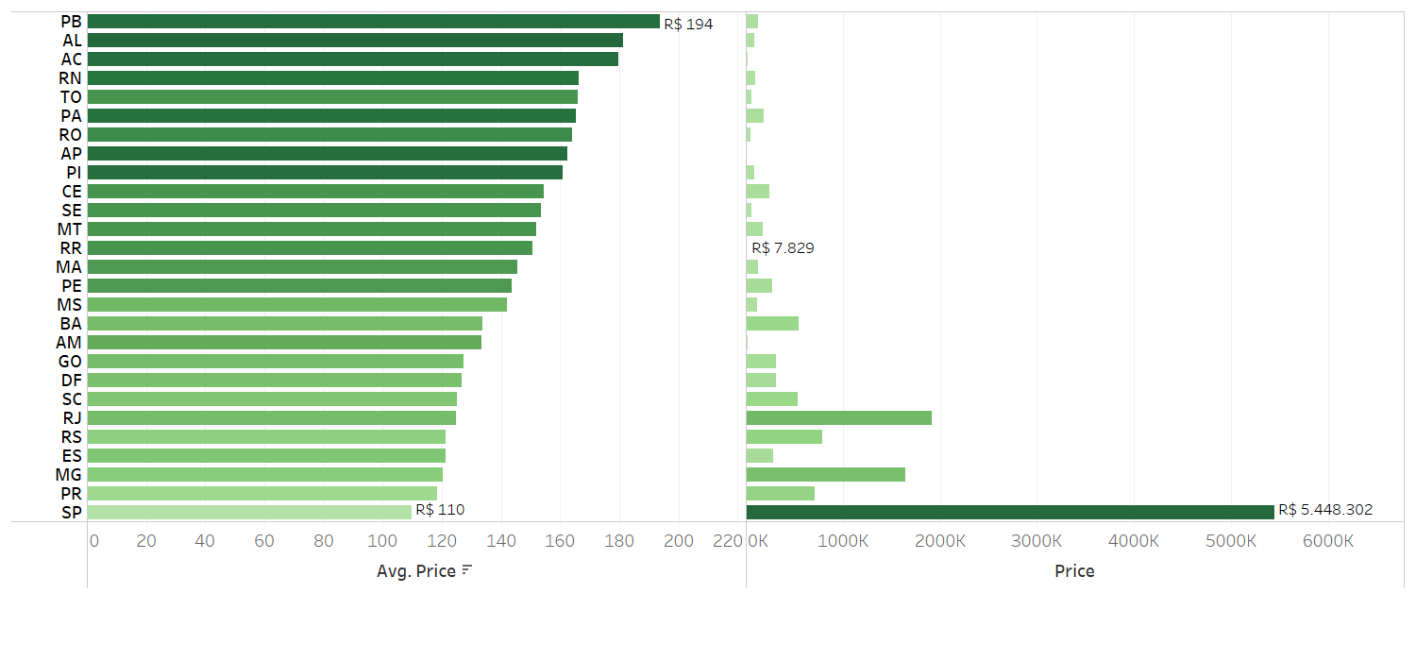
Total of Sold vs Mean of Sold by State
Some states have a high total amount of sold but have a low price (calculated using the mean). For example, SP(Sao Paulo), this state is the most valuable state(R$ 5.448.302 total sold), but the customer there pays the lowest for each order(R$ 110).
Mean of price each customer by customer state
Total of price by customer state
9
Data Source: Brazilian E-Commerce Public Dataset by Olist

Slide 13

03
Summary

Slide 14
This January 2022, Dairy division increased by +27% on Average Weekly and overall YTD Revenue compared to same month on the previous year
On the monthly Revenue index growth, Dairy division had above border line (1) for the last 3 months
Drop size increased by +11.5% with 340 pieces drop per visit and day of visit increased by +1.5% with rate of 2.1x visit per customer per month
Top % growing province was Kalimantan Utara with +457.5% and Bottom % growing province was Sumatera Barat with +3.8%
Top absolute province was Jawa Barat with +23.11B and Bottom absolute province was Sulawesi Barat with +0.08B
Summary
In 2018(january to august), total amount of order increased by +136%
The amount of sold increase by +131%. The highest amount of sold occurs in November, it is because of black friday in 24 November. Black friday causes total daily sales on black friday to increase 5x than the average for other days
Credit card is the most widely use type of payment, 76% of transactions that occur at olist(all period) use credit card.
Total orders tend to be a small on weekend(saturday and sunday). Customers order more often during the noon(11-18).
Some states have a high total amount of sold but have a low price, for example Sao Paolo.
13

Slide 15
THANK YOU!

Slide 16
Olist Colours
#0B29D0
#00D993
#006D46

Slide 17
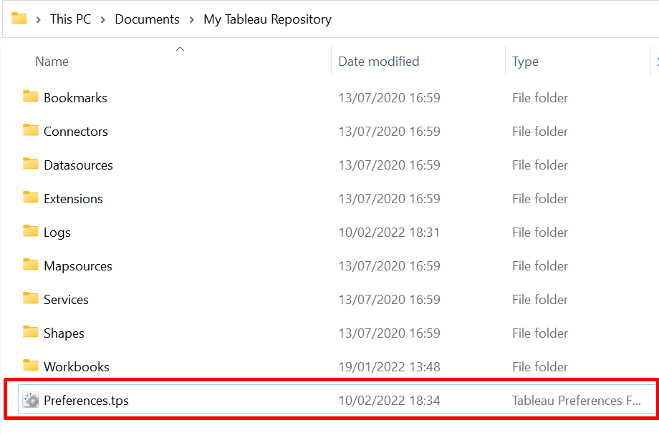
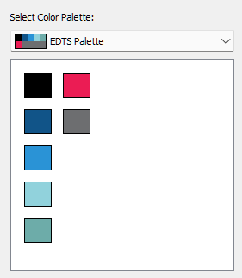

Tableau Preferences – EDTS Colours
Replace default Preferences.tps in “My Documents” > “My Tableau Repository” using following file for adding new color palette in Tableau
‹#›

