Slide 1

Final Project Presentation JC Data Science Batch 1
UK Data Accident 2005 -2015
by Luthfir Rahman Bagaskara

Slide 2

Problem
High Numbers of Accidents in UK, whether It was Slight or Fatal Accidents

Slide 3
Goal
Reduce the number of Accidents(Slight, Serious and Fatal) in UK

Slide 4
Data Pros and Cons
Pros
Cons
Easy to Processing the Data Because Almost features is Categorical Data
Imbalanced Accident and Severity Data

Slide 5
The Accidents causes By
Vehicle Type
Weather Conditions
Road Type
Months (Winter, Spring, Summer, Autumn)
Time
and Many More

Slide 6
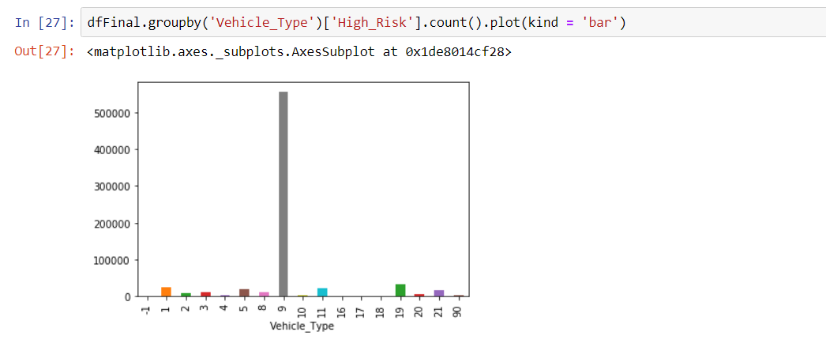
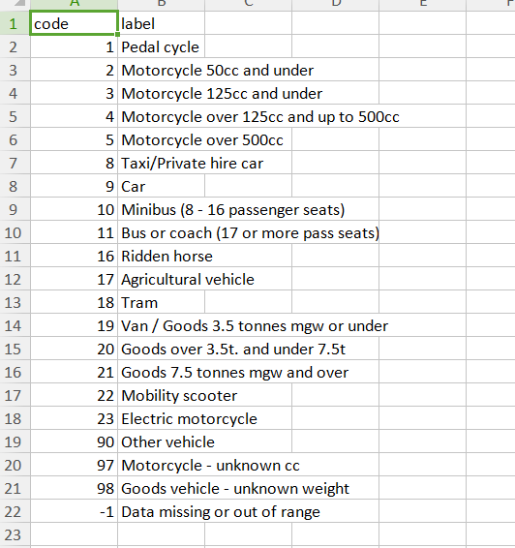
Vehicle Type
Bar Plot
Code

Slide 7
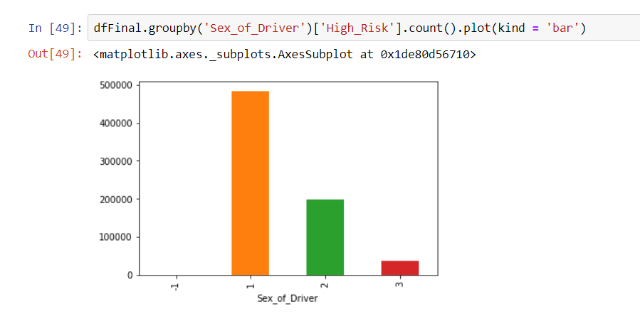
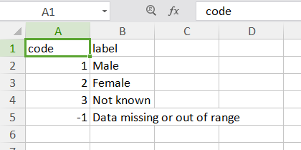
Sex of Driver
Bar plot
Code

Slide 8
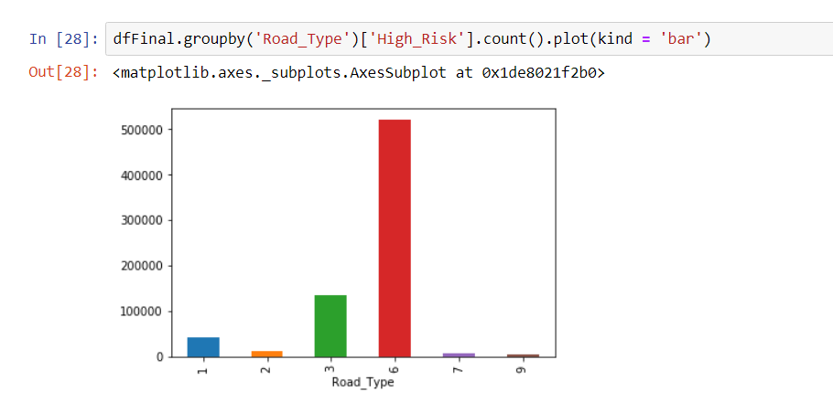
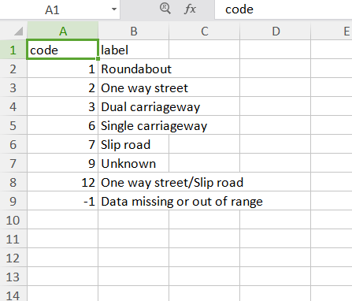
Road Type
Bar Plot
Code

Slide 9
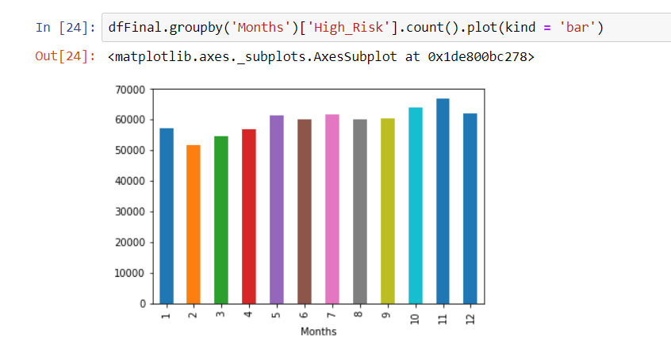
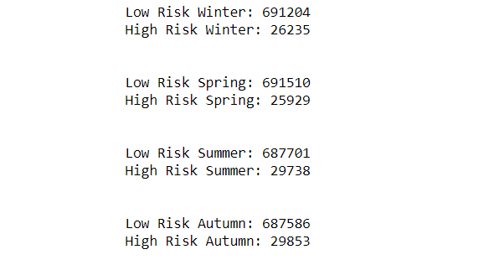
Months(Winter, Spring, Summer, Autumn)
By Months
By Seasons

Slide 10

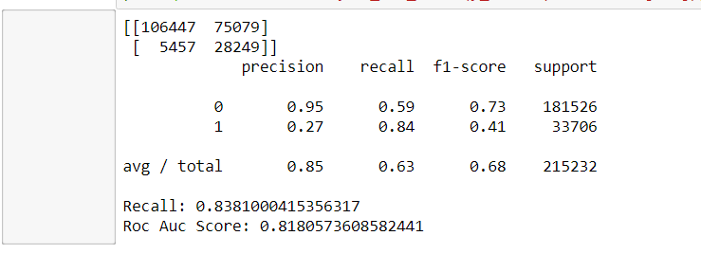
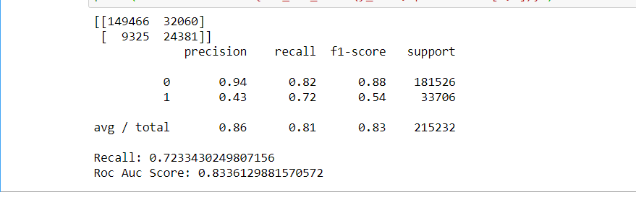
Random Forest and K-NN Method
Random Forest
K-NN

Slide 11
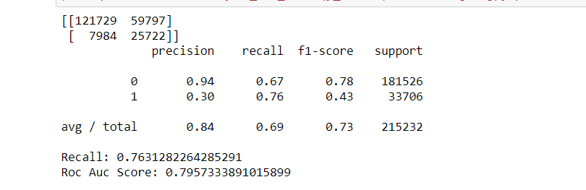
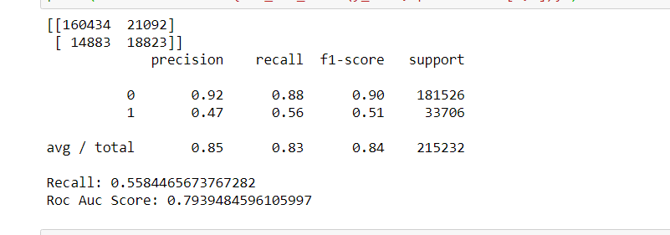
AdaBoost Method
With ROS
Without ROS

Slide 12
Conclusion
The highest rate number of Accidents is on Slight Accident, but we can reduce the Accidents(Slight, Serious, or Fatal) when we go out with Public Transportation. But if you really urgently to go out with your own Vehicle, you must focus on the way up to your destination and obey the traffic rules.

Slide 13
Background Image Source
https://www.xoriant.com/blog/product-engineering/decision-trees-machine-learning-algorithm.html
https://martechtoday.com/modern-marketers-guide-machine-learning-algorithms-197246
https://datascience.foundation/datatalk/machine-learning-and-data-security

Slide 14
Thank You :)

