Slide 1

Introduction to Angular JS
Framework By Google
Source: https://angular.io/
Author: Manisha Luthra

Slide 2
What we will cover?
Why JS?
What is AngularJS?
Why use MV* or MVW?
AngularJS - Architecture - Building blocks
AngularJS - Features
AngularJS - Quick Start
Comparison - “Big 4”

Slide 3
Why JS?
These day’s most actions on webpage go back and forth to webserver. Using JS in such case would provide:
More interactive and responsive UI
Save bandwidth
Save CPU consumption on the web server
http://blog.orbitone.com/post/Angularjs-the-Model-View-Whatever-javascript-framework1

Slide 4

What?
Misko Hevery and Adam Abrons
Maintained by Google and community
Intial release: 2009
Current stable release: June 15, 2016, v1.5.7
Latest release candidate: Angular 2

Slide 5
What?
MVW framework to help build client apps in HTML and JS (or Dart, TypeScript).
Consists of some cooperating libraries some core and some optional.
Write applications by composing HTML templates with Angularized-markup.
Write component classes to manage those templates.
Add application logic in services, and handing the top root component to Angular's bootstrapper.

Slide 6
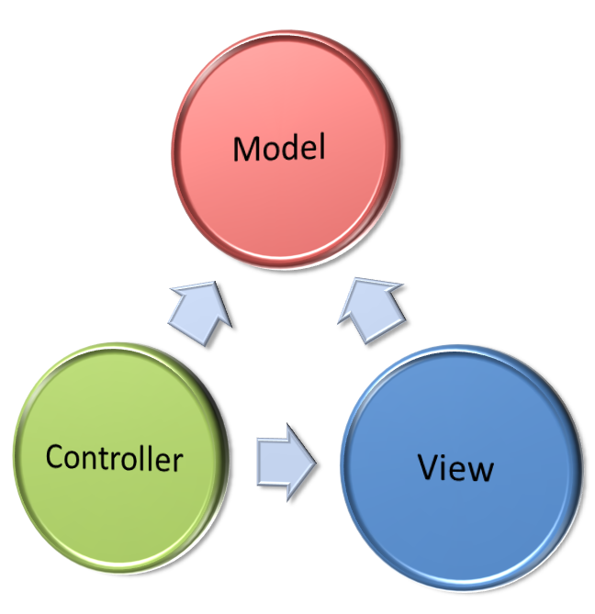
What is MVW? And Why use it?
Model-View-Whatever
Separate presentation logic from business logic
Here, JS provides the model and “logic”
HTML/HTML5 provides the presentation logic
http://blog.orbitone.com/post/Angularjs-the-Model-View-Whatever-javascript-framework1

Slide 7

What? - Eight building blocks
Module Component
{ }
Module Service
{ }
Metadata
4
Template
< >
Module value
{ }
Module
function
{ }
Directive
{ }
1
3
6
Injector
Metadata
Property
Binding
Event
Binding
Component
{ }
Service
{ }
5
5
7
2
8

Slide 8
AngularJS - Building Blocks
Eight main building blocks
Cohesive block of code for single purpose.
E.g., export class AppComponent { }
Some modules act as libraries to other modules
E.g. @angular/core, @angular/common, ..
import { Component } from ‘@angular/core’;
Module Component
{ }
Module Component
{ }
Contain patch to call a view
Application logic to support the view
Class interacts with view through properties and methods.
Library Module Component
{ }

Slide 9
AngularJS - Building Blocks
Eight main building blocks
Template is a form of HTML that tells Angular how to render the component.
It tells Angular how to process a class. Decorators are used to attach metadata to “class”.
Data Binding
A mechanism for coordinating parts of a template with parts of a component.
Directives
Templates are dynamic. They transform the DOM according to the directives.
e.g. ngModel (see in Demo)
Templates
< >
Metadata

Slide 10
AngularJS - Building Blocks
Eight main building blocks
Broad category encompassing value, function or feature that app needs. Available for injection.
E.g. logging service, app config, ..
Dependency Injection
Important application design pattern.
Angular provides its own dependency injection framework. Service exposes getter that returns data. @Injectable decorator is important above this Service class
Service
{ }

Slide 11
Features
Cross Platform
Progressive Web Apps
Modern web platform capabilities.
High Performance
Native
Build native mobile apps.
Desktop
Apps for Mac, Windows, Linux for web plus ability to access native OS APIs.
Speed & Performance
Code generation
Turn templates into highly optimized JS code
Universal
Near-instant rendering in just HTML and CSS
Code Splitting
Auto code splitting
Only load code required to render the view

Slide 12
Features
Productivity
Templates
Create quickly UI views
Angular CLI
CLI tools - build fast, deploy instant
IDEs
Full Development Story
Testing
Karma for unit tests
Protractor to make scenario run fast and stable
Animation
Create high performance animation with minimal effort
Accessibility

Slide 13
Quick start - 5 min
https://github.com/manishaluthra/quickstart ( forked ;) )
Verify that you are running at least node v5.x.x and npm 3.x.x (package mgr for JS) by running node -v and npm -v in a terminal/console window.
Use nvm to update node,
and update npm by:
npm install npm -g

Slide 14
Quick start - Steps
Prerequisite: Node.js
Package definition and configuration files
package.json
Npm package configuration
dependencies
devDependencies

Slide 15
Quick start - Dependencies - Npm package configuration
3 package categories
Features
e.g., @angular/core, @angular/common, @angular/compiler, @angular/http, ..
Polyfills
e.g., core-js, reflect-metadata, rxjs and zone.js
Other
e.g., angular2-in-memory-web-api, bootstrap

Slide 16
TypeScript
Developed by Microsoft (https://github.com/Microsoft/TypeScript)
First release: October, 2012
Stable release: January 2016, v1.8
JavaScript that scales
Superset of JavaScript that compiles to plain JavaScript
Supports class based object-oriented programming
https://www.typescriptlang.org/index.html

Slide 17
TypeScript - Features
Interface
e.g., interface Person {
firstName: string;
lastName: string;
}
function greet(person: Person) {
return “Hello, “ + person.firstName + “ ”+person.lastName;
}
var user = { firstName: “Manisha”, lastName: “Luthra”};
document.body.innerHTML = greeter(user);
https://www.typescriptlang.org/index.html

Slide 18
TypeScript - Features
Classes (continued…)
e.g., class Student {
fullName: string;
constructor(public firstName, public middleName, public lastName) {
this.fullName = firstName + “ “+ middleName+ “ “ + lastName;
}
}
function greet(person: Person) {
}
var user = new Student(“Manisha”, “K.”, “Luthra”);
document.body.innerHTML = greeter(user);
https://www.typescriptlang.org/index.html

Slide 19

Demo

Slide 20
Demo (1/2) - Template and Component
Start from Quick Start
$ npm start (starts TypeScript compiler, have it watch for changes, and start our server
update app.component.ts
import { Component } from '@angular/core';
@Component({
selector: 'my-app',
template: '<h1>{{title}}</h1><h2>{{hero}}</h2>'
})
export class AppComponent {
title = 'Angular 2 Tour';
hero = 'SAP Hana';
}

Slide 21
Demo (2/2) - Two way binding by directive
export class AppComponent {
title = 'Angular 2 Tour';
company: Company = {
id: 1;
name: 'SAP AG'
}
}
import { Component } from '@angular/core';
@Component({
selector: 'my-app',
template:` <h1>{{title}}</h1>
<h2>{{company.name}} details!</h2>
<div><label>id: </label>{{company.id}}</div>
<div>
<label>name: </label>
<input [(ngModel)]="company.name" placeholder="name">
</div>
`
})
https://angular.io/docs/ts/latest/guide/forms.html#!#ngModel

Slide 22
Other Competitive JS Frameworks
“Big 4” JS Frameworks
Knockout
Backbone
React-Ember
Angular JS

Slide 23










Big 4 - Comparison Matrix
Features | Backbone.js | Ember | Knockout | AngularJS
Open source
Quick start
No Dependencies
Data Binding
View
Testing
Community support
Third-party libraries
http://www.slideshare.net/deepusnath/javascript-frameworks-comparison-angular-knockout-ember-and-backbone

Slide 24
Helpful Links
Tutorial: https://docs.angularjs.org/tutorial
API Docs: https://docs.angularjs.org/api
Developer Guide: https://docs.angularjs.org/guide
Cheat sheet: https://angular.io/docs/ts/latest/guide/cheatsheet.html

