Slide 1
2
0
2
1
Database & Workshop Joint Project
Football Data Integrated System
GROUP 16:
陆天宇 1930026092
郑武庚 1930026173
张泽楷 1930026166
黄梓浩 1930026053
Notes:
更多模板请关注：https://haosc.taobao.com

Slide 2
目录/CONTENTS
01
02
03
04
Data collection & cleaning
Introduction
Database
Web App

Slide 3
01
Introduction

Slide 4

Introduction
Reptile
Navicat
implement
request
beautifulsoup
Table
Trigger
Django
Vue

Slide 5
02
Data collection & cleaning

Slide 6
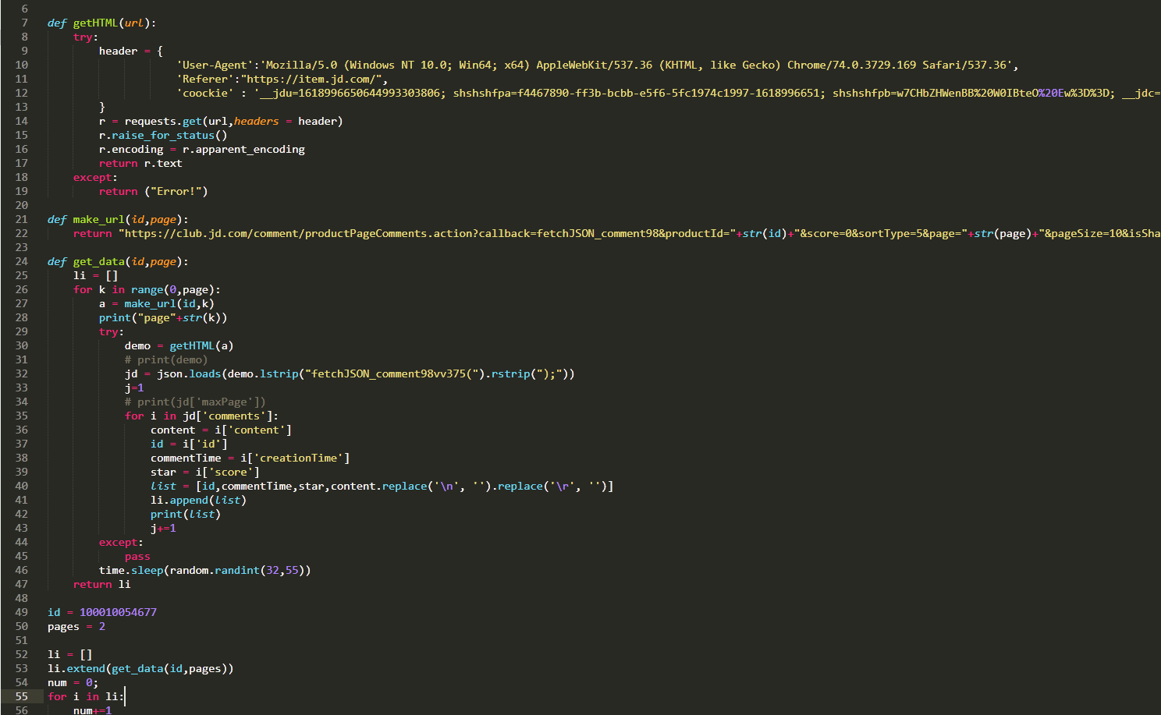
Data collection & cleaning
Initial direction was about Jingdong feedback

Slide 7
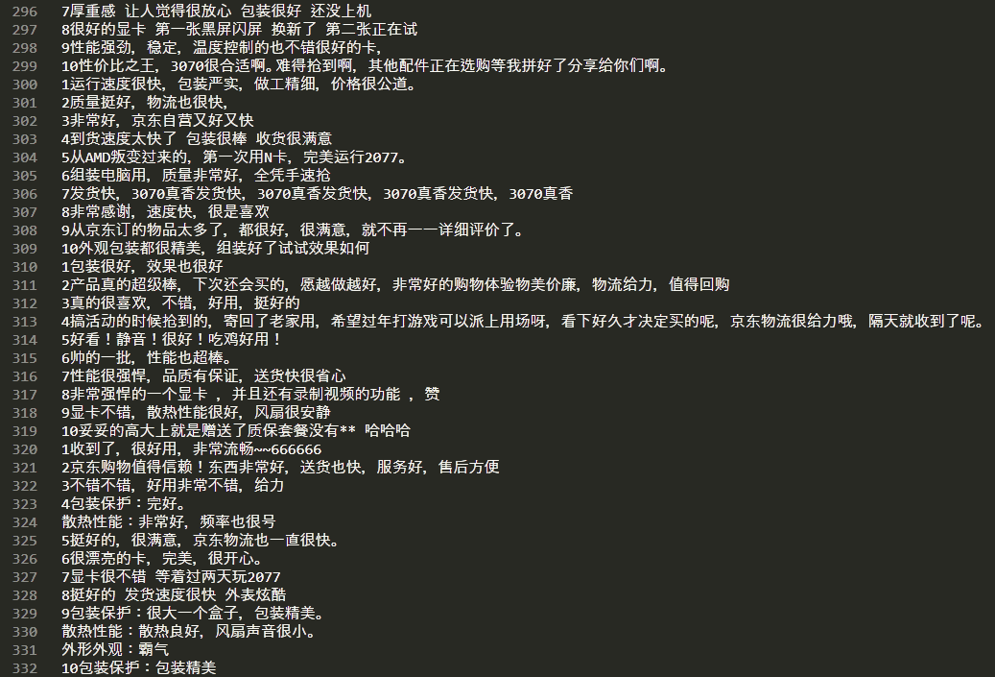
Data collection & cleaning
And then we
get some data

Slide 8
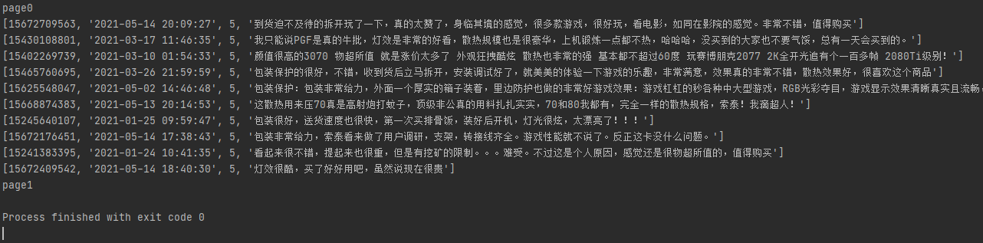
Data collection & cleaning
But was banned sooner

Slide 9
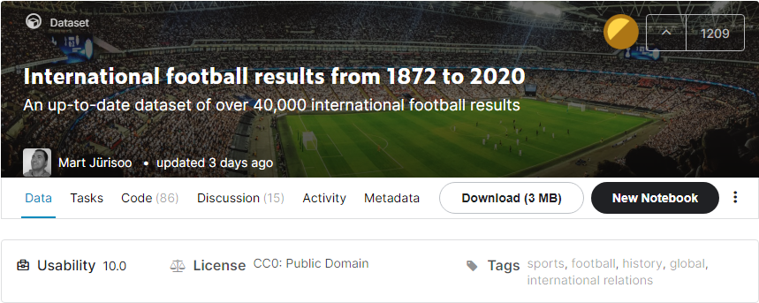
Data collection & cleaning
We first found a suitable dataset on the Kaggle website, which contains more than 42,000 pieces of data about football matches

Slide 10
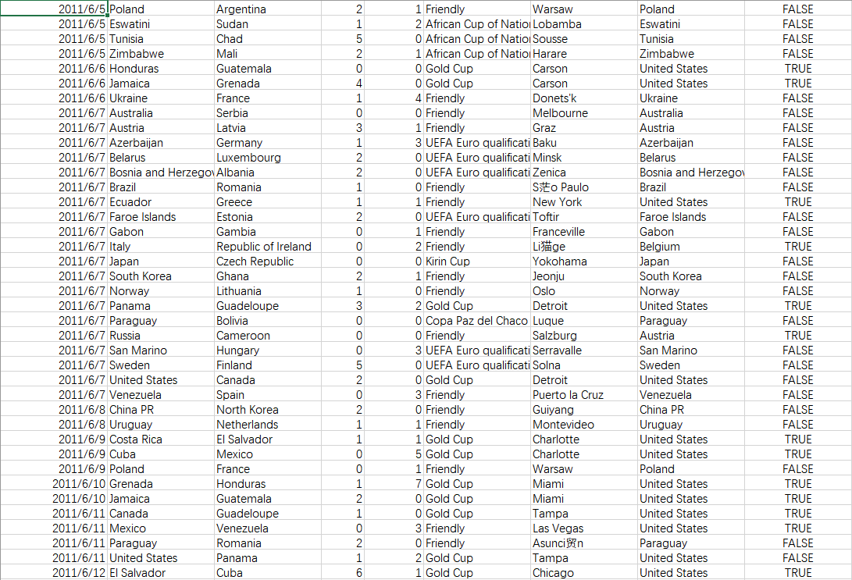
Data collection & cleaning

Slide 11
Data collection & cleaning
Data to collecting
FIFA rank
UEFA Countries rank
UEFA Clubs rank

Slide 12
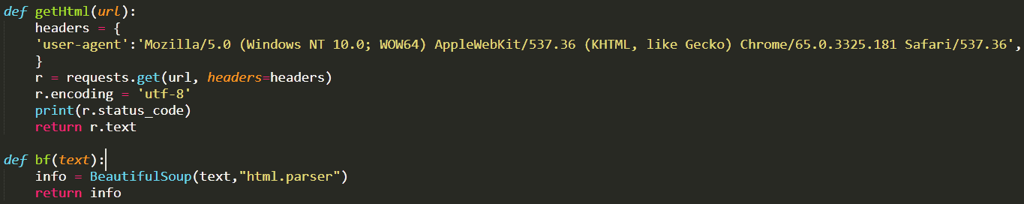

Data collection & cleaning
We wrote the code in the form of custom function

Slide 13
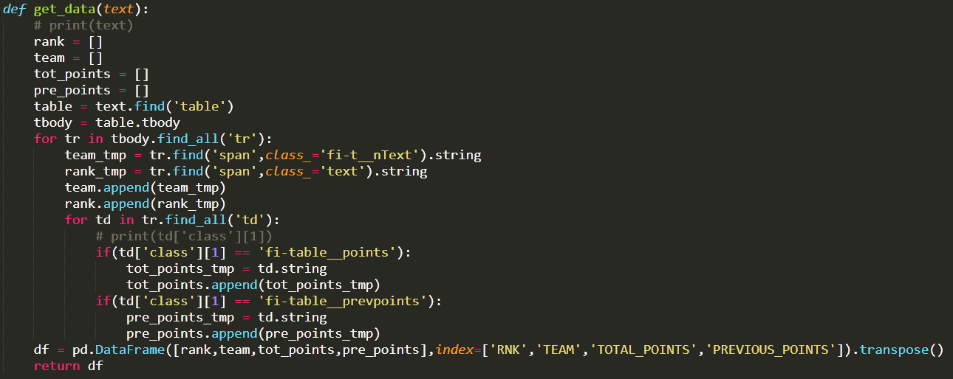
Data collection & cleaning
For FIFA rank

Slide 14
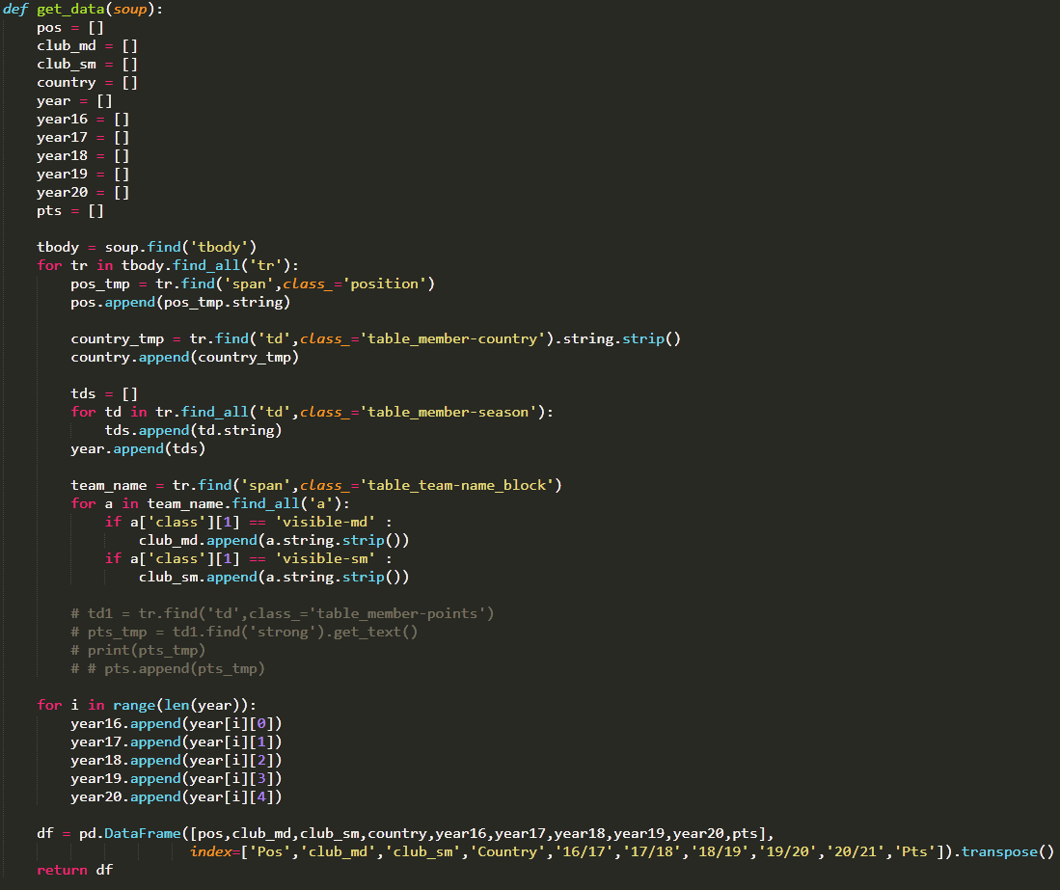
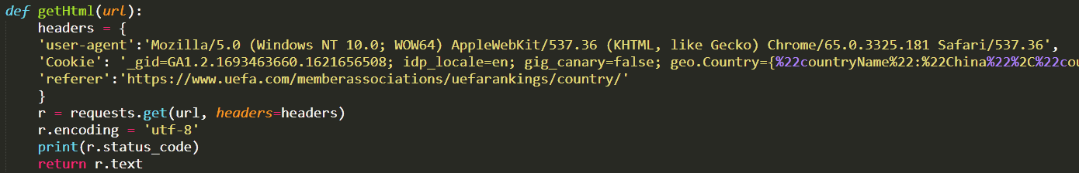
Data collection & cleaning
For UEFA countries
and club rank

Slide 15
03
Database

Slide 16
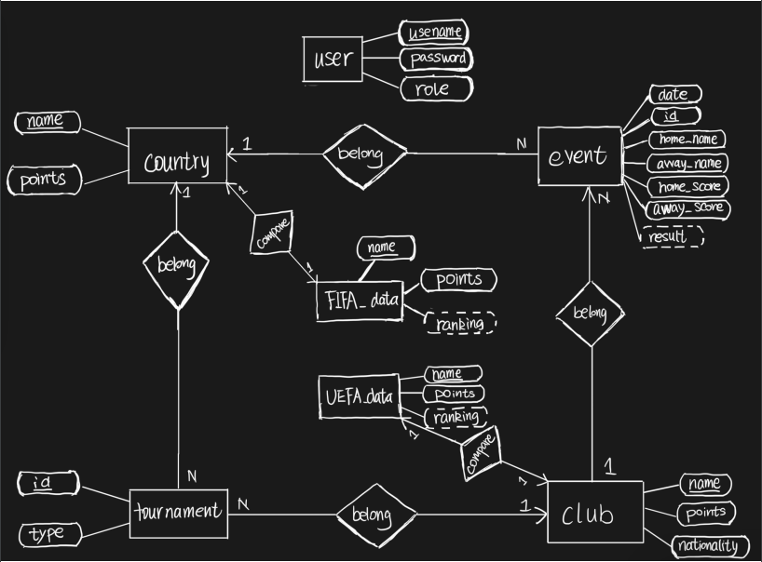
Database
The following ER diagram

Slide 17

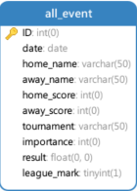
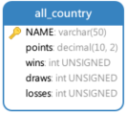
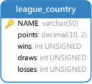
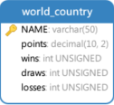
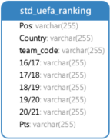
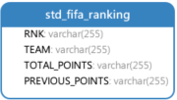
Database->Table
all_event
all_country
league_country
world_country
=
+
std_UEFA_ranking
std_FIFA_ranking

Slide 18

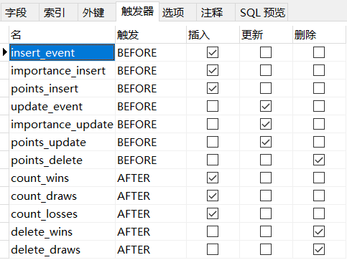
Database->Trigger
We use Triggers to sync changes, additions and deletions to the derived property.

Slide 19
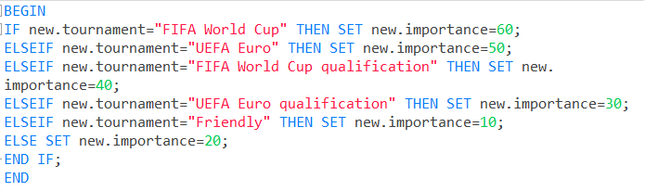
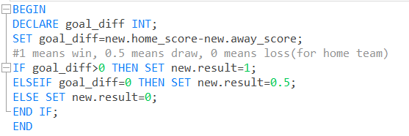
Database->Trigger
Before
Importance
Insert/Update
Before
Result
Insert/Update

Slide 20
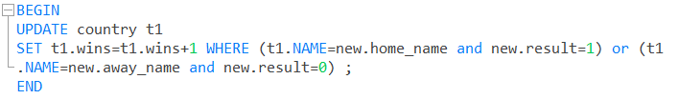
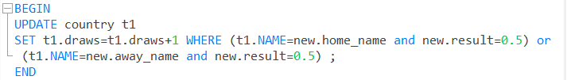
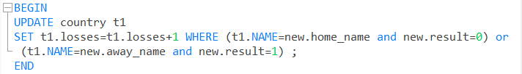
Database->Trigger
After
Wins
Insert/Delete
After
Draws
Insert/Delete
After
Losses
Insert/Delete

Slide 21
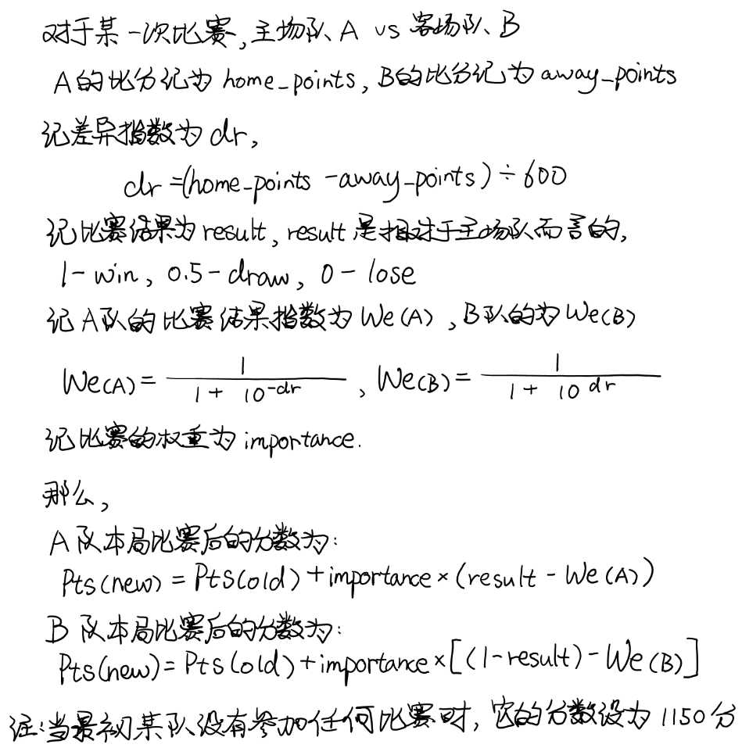

Database->Trigger(points)
The formula of points calculating:

Slide 22
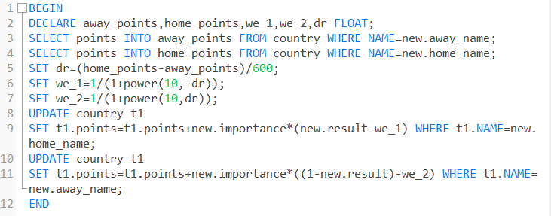
Database->Trigger(points)
Before
Points
Insert/
delete

Slide 23


Database->Constraint
At the same time, we also set the primary key constraint and foreign key constraint, which is used to realize the relationship between tables.
For example, the all_country table and the all_event table are in a 1-to-N relationship, so we use the foreign key.

Slide 24
04
Web App

Slide 25
Demonstration
Live Demo

Slide 26


Development Architecture
Front-end and back-end separation
Front-end
Back-end

Slide 27






Server Preparation
Simulate Remote Database
Virtual Machine
Host

Slide 28
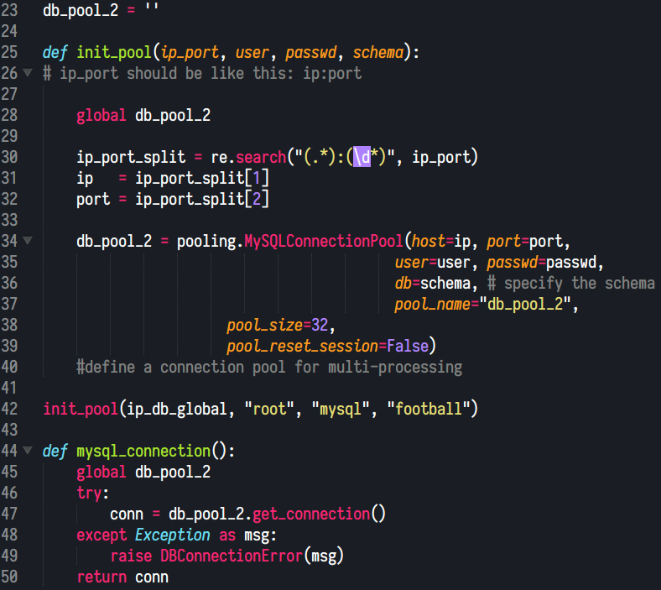

Important Code
Database Connection

Slide 29
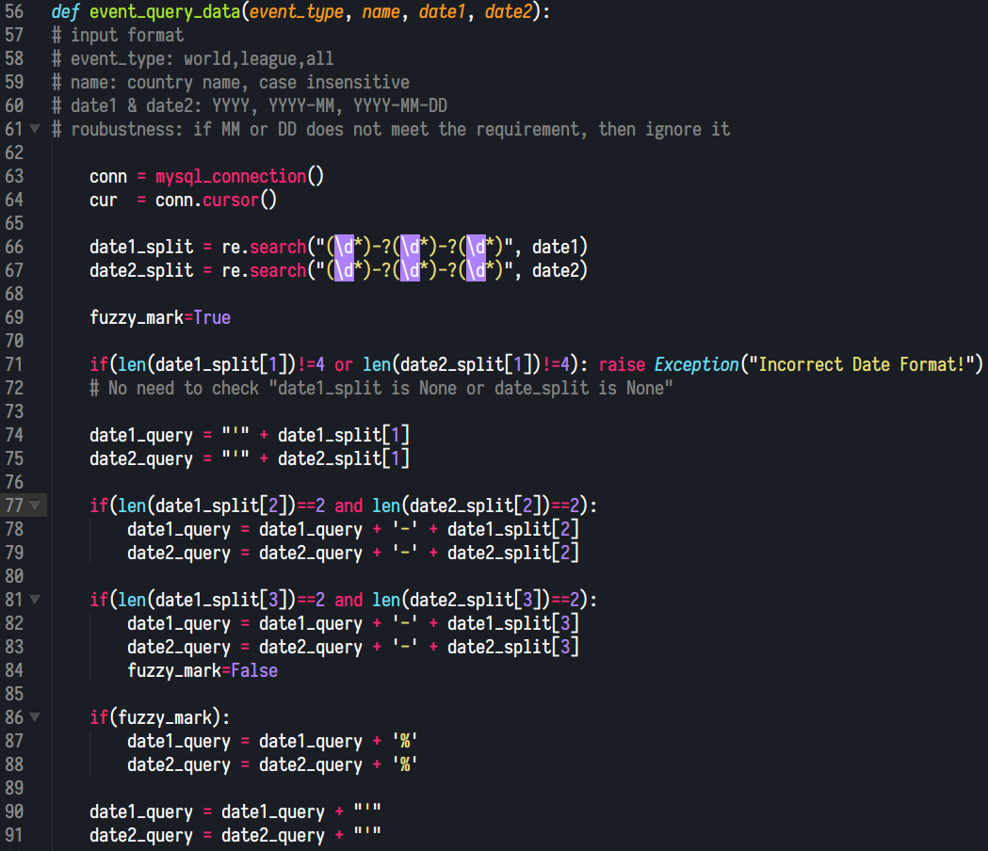
Important Code
Query for Data Visualization

Slide 30
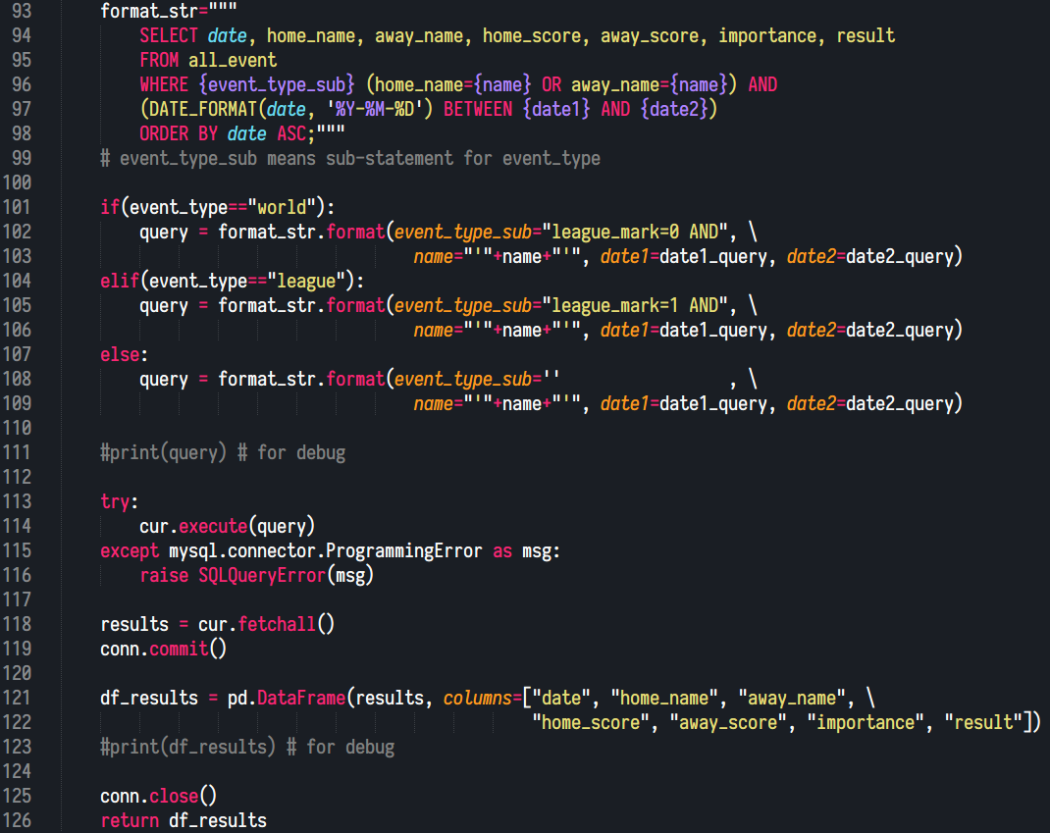
Important Code
Query for Data Visualization

Slide 31
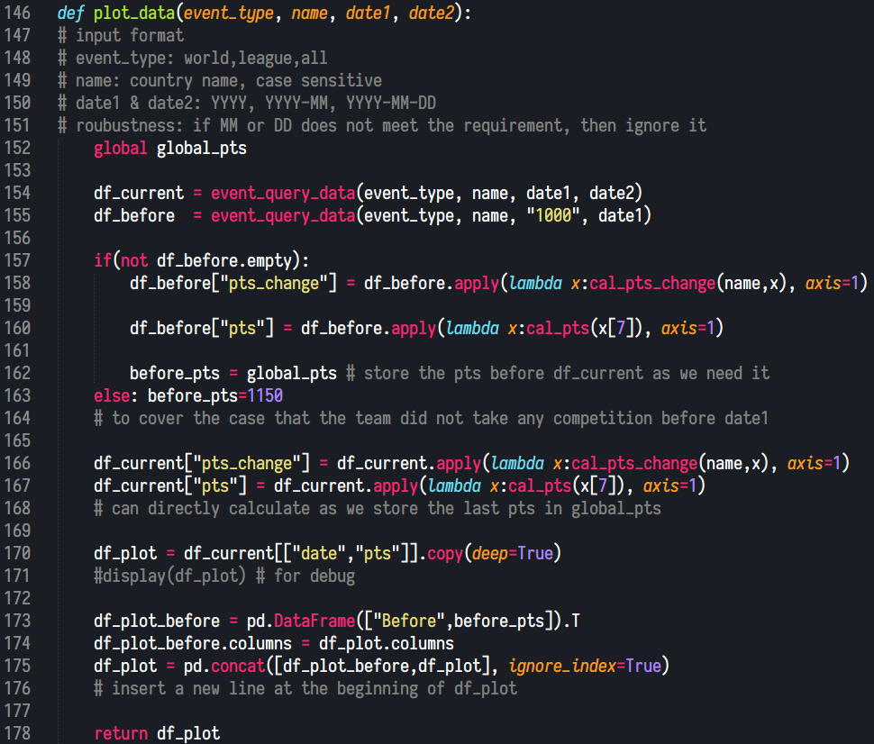
Important Code
DataFrame Construction
for Data Visualization

Slide 32
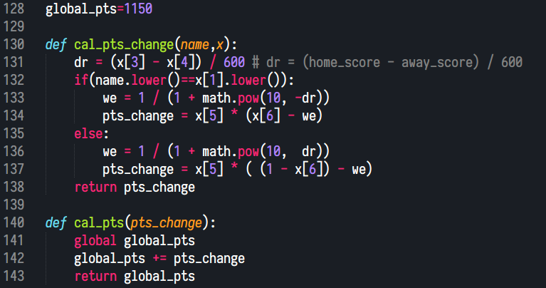
Important Code
Points Calculation

Slide 33
2
0
2
1
THANK YOU!

