Slide 1
WMitchell
Model Systems
2014.10.03
Data Slide 1 shows the cannonical KEGG route to methione. It require 7 enzymes.
We have convincing orthologs for enzymes 1-4 and 7. There may be an issue with enzymes
5 & 6. (more on this below).
Data Slide 2 shows a known alternative route to methionine. Steps 1-4, leading to
O-succinyl-L-homoserie are identical in the two routes. However, if there is
hydrogen sulfide present, then homocysteine can be formed directly from
O-succinylhomoserine by the enzyme via O-acetylhomoserine
aminocarboxypropyltranferase (AKA O-acetylhomoserin(thiol)-lyase.
We have a good ortholog for that enzyme, CAETHG 2754. So, if there is H2S present, bingo
What if there is no H2S, or insufficient?
A case can be made for a single enzyme present in C. auto performing the roles of both
cannonical enzymes 5 & 6.
Text Slide 1

Slide 2
Data Slides 3 -9 show the cannonical route and notes the IDs of the ortholog enzymes in C. auto.
As noted on slides 7 and 8, protein CAETHG 0498 (Cys/Met metabolism pyroxal-phosphate dependednt protein) may cover both steps.
Evidence?
The two E.coli enzymes are cystathione gamma synthase and cystathione beta syntase. They both use pyridoxal 5'phospate as co-factpr, for one thing. And the two E.coli enzymes are clearly related (Slide 10 shows them aligned)
If we BLAST C.auto with the E.coli cystathione gamma synthase, the best hit in C.auto is CAETHG 0498 (Cys/Met metabolism pyroxal-phosphate dependednt protein. (Slide 11)
If we BLAST C.auto with the E.coli cystathione beta synthase, the best hit in C.auto is again CAETHG 0498 (Cys/Met metabolism pyroxal-phosphate dependednt protein. (Slide 12)
Looking at the conserved domains in the BLAST alignments (slide 13) we see that the pyridoxal 5'phosphate domain is conserved in CAETHG 0498, as is the substrate binding pocket.
Text Slide 2

Slide 3
So CAETHG 0498 looks like an intermediate simiar to both beta and gamma.
Also (data slides 14 and 15) if we BLAST ref_seq with CAETHG 0498, it discovers some proteins other Clostridia species annotated as beta synthase and others annotated a gamma synthase, These other Clostriday annotaions may be wrong, but at least this shows that its hard to assign CAETHG 0498 like proteins to either beta or gamma.
Data Slides 16 and 17 will show homology models of CAETHG 0498 on crystal structures of E.coli beta and E.coli gamma. Wont have those until tomorrow, but I'm betting they look good
Text Slide 3

Slide 4
Methionine synthesis as per KEGG. 7 enzymes in E.coli. We have good orthologs for enzymes
1 – 4, and 7. The function of enzymes 5 & 6 might be handled by a single enzyme in C.auto.
6
7
5
4
3
1
2
4-Phospho-L-aspartate
L-Aspartate 4-semialdehyde
Data Slide 1

Slide 5
There is a less common pathway (wikipedia wisdom) which is complete in C.auto, but requires
H₂S
This route produces homocysteine directly from O-succinylhomoserine.. This is catalysed by O-acetylhomoserine aminocarboxypropyltransferase (formerly known as O-acetylhomoserine (thiol)-lyase, CAETHG 2754.
7
5_alt
CAETHG_2754:
O-acetylhomoserine
sulfhydrylase
NOTE: requires SH₂
4
3
1
2
4-Phospho-L-aspartate
L-Aspartate 4-semialdehyde
Data Slide 2

Slide 6
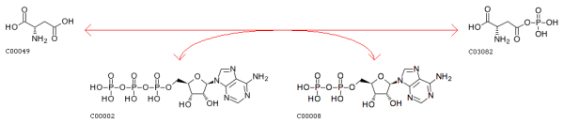
Methionine Synthesis: Step 1
5
6
7
4
3
4-Phospho-L-aspartate
1
2
EC 2.7.2.4 Enzyme: aspartokinase
In DSM10061: CAETHG_1690
L-Aspartate 4-semialehyde
L-aspartate
4-Phospho-L-aspartate
Data Slide 3

Slide 7
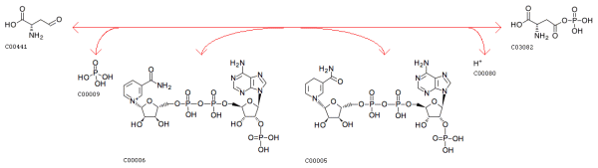
Methionine Synthesis: Step 2
5
6
7
4
3
4-Phospho-L-aspartate
1
2
L-Aspartate 4-semialehyde
E1.2.1.11 Enzyme L-Aspartate-4-semialdehyde:NADP oxidoreductase
In DSM10061: CAETHG_1353
4-Phospho-L-aspartate
L-Aspartate 4-semialdehyde
Data Slide 4

Slide 8
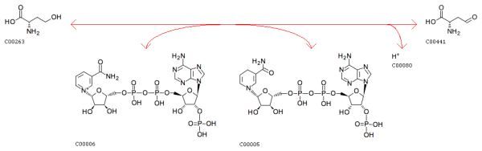
Methionine Synthesis: Step 3
EC:1.1.1.3 Enzyme homoserine dehydrogenase
In DSM10061: CAETHG_3099
homoserine
L-Aspartate 4-semialdehyde
Data Slide 5

Slide 9
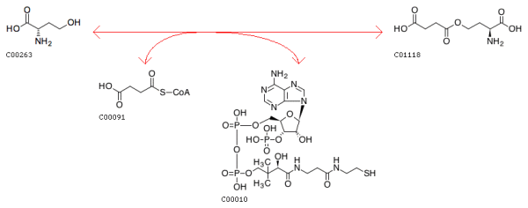
Methionine Synthesis: Step 4
EC 2.3.1.46 Enzyme Succinyl-CoA:L-homoserine O-succinyltransferase
In DSM10061: CAETHG_0492
homoserine
O-Succinyl-L-homoserine
Data Slide 6

Slide 10
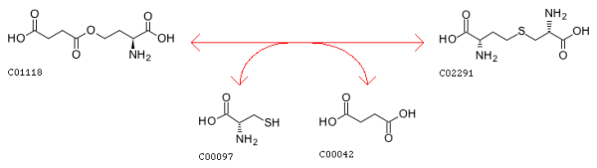
Methionine Synthesis: Step 5
5
6
7
4
3
4-Phospho-L-aspartate
1
2
L-Aspartate 4-semialehyde
EC 2.5.1.48 Enzyme cystathionine gamma-synthase
In DSM10061: CAETHG_0498 (as Cys/Met metabolism pyridoxal-phosphate-dependent protein)
O-Succinyl-L-homoserine
L-Cystathionine
Data Slide 7

Slide 11
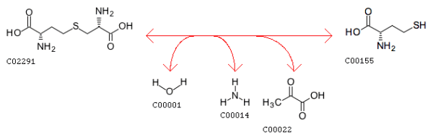
Methionine Synthesis: Step 6
5
6
7
4
3
4-Phospho-L-aspartate
1
2
L-Aspartate 4-semialehyde
EC 4.4.1.8 Enzyme cystathionine beta-synthase
In DSM10061: CAETHG_0498 (as Cys/Met metabolism pyridoxal-phosphate-dependent protein – both beta and gamma functions? See BLAST)
L-Cystathionine
L-Homocysteine
Data Slide 8

Slide 12
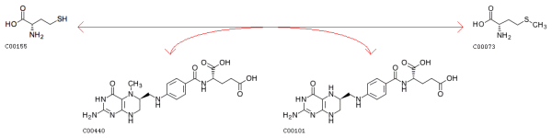
Methionine Synthesis: Step 7
5
6
7
4
3
4-Phospho-L-aspartate
1
2
L-Aspartate 4-semialehyde
EC 2.5.1.86 Enzyme 5-Methyltetrahydrofolate:L-homocysteine S-methyltransferase (methionine synthase)
In DSM10061: CAETHG_2755; CAETHG_0145
L-Homocysteine
Methioine
Data Slide 9

Slide 13
The E.coli beta and gamma enzymes are obviously related.
sp|P00935|METB_ECOLI -MTRKQATIAVRSGLNDDEQYGCVVPPIHLSSTYNFTGFNEPRAHD---------YSRRG 50
sp|P06721|METC_ECOLI MADKKLDTQLVNAGRSKKYTLGAVNSVIQRASSLVFDSVEAKKHATRNRANGELFYGRRG 60
:* * *.:* ... *.* . *: :*: * ..: : *.***
sp|P00935|METB_ECOLI NPTRDVVQRALAELEGGAGAVLTNTGMSAIHLVTTVFLKPGDLLVAPHDCYGGSYRLFDS 110
sp|P06721|METC_ECOLI TLTHFSLQQAMCELEGGAGCVLFPCGAAAVANSILAFIEQGDHVLMTNTAYEPSQDFCSK 120
. *: :*:*:.*******.** * :*: .*:: ** :: .: .* * : ..
sp|P00935|METB_ECOLI LAKRGCYRVLFVDQGDEQALRAALAEKPKLVLVESPSNPLLRVVDIAKICHLAREVG--A 168
sp|P06721|METC_ECOLI ILSKLGVTTSWFDPLIGADIVKHLQPNTKIVFLESPGSITMEVHDVPAIVAAVRSVVPDA 180
: .: . :.* : * :.*:*::***.. :.* *:. * .*.* *
sp|P00935|METB_ECOLI VSVVDNTFLSPALQNPLALGADLVLHSCTKYLNGHSDVVAGVVIAKDPDVVTELAWWANN 228
sp|P06721|METC_ECOLI IIMIDNTWAAGVLFKALDFGIDVSIQAATKYLVGHSDAMIGTAVCN-ARCWEQLRENAYL 239
: ::***: : .* :.* :* *: :::.**** ****.: *..:.: . :* *
sp|P00935|METB_ECOLI IGVTGGAFDSYLLLRGLRTLVPRMELAQRNAQAIVKYLQTQPLVKKLYHPSLPENQGHEI 288
sp|P06721|METC_ECOLI MGQMVDADTAYITSRGLRTLGVRLRQHHESSLKVAEWLAEHPQVARVNHPALPGSKGHEF 299
:* .* :*: ****** *:. :..: :.::* :* * :: **:** .:***:
sp|P00935|METB_ECOLI AARQQKGFGAMLSFELDG--DEQTLRRFLGGLSLFTLAESLGGVESLISHAATMTHAGMA 346
sp|P06721|METC_ECOLI WKRDFTGSSGLFSFVLKKKLNNEELANYLDNFSLFSMAYSWGGYESLILANQPEHIAAIR 359
*: .* ..::** *. ::: * .:*..:***::* * ** **** . *.:
sp|P00935|METB_ECOLI PEARAAAGISETLLRISTGIEDGEDLIADLENGFRAANKG 386
sp|P06721|METC_ECOLI PQG--EIDFSGTLIRLHIGLEDVDDLIADLDAGFARIV-- 395
*:. .:* **:*: *:** :******: **
metB = gamma
metC = beta
Data Slide 10

Slide 14
The E.coli gamma enzyme finds Clostridium Cys/Met metabolism
pyridoxal-phosphate-dependent protein as best hit
Cys/Met metabolism pyridoxal-phosphate-dependent protein [Clostridium autoethanogenum DSM 10061]
Sequence ID: ref|YP_008697983.1|Length: 380Number of Matches: 1
See 1 more title(s)
Related Information
Gene-associated gene details
Identical Proteins-Proteins identical to the subject
<pre> <@aln_gene_info@> </pre>
Range 1: 5 to 373GenPeptGraphics
Next Match
Previous Match
Alignment statistics for match #1
Score Expect Method Identities Positives Gaps
328 bits(840) 9e-110 Compositional matrix adjust. 157/371(42%) 240/371(64%) 2/371(0%)
Query 7 TIAVRSGLNDDEQYGCVVPPIHLSSTYNFTGFNEPRAHDYSRRGNPTRDVVQRALAELEG 66
++ + G++ D+ G V PI+ +STY +G E + ++YSR GNPTR+ +++ +AELE
Sbjct 5 SLLIHGGVDGDKTTGAVSVPIYQTSTYKQSGLGENKGYEYSRTGNPTREALEKLIAELEE 64
Query 67 GAGAVLTNTGMSAIHLVTTVFLKPGDLLVAPHDCYGGSYRLFDSLAKRGCYRVLFVDQGD 126
G + +GM+AI V T+F K GD ++ + YGG+YR+ D + K +D D
Sbjct 65 GKNGLAFASGMAAITAVLTLF-KSGDKIIISDNVYGGTYRVLDKVFKNFDLNYELIDTSD 123
Query 127 EQALRAALAEKPKLVLVESPSNPLLRVVDIAKICHLAREVGAVSVVDNTFLSPALQNPLA 186
+ + +++ ++ K + +ESP+NPL+ + DI KI +A++ +++VDNTF++P LQ P+
Sbjct 124 LEKVESSITKEVKAIYIESPTNPLMDITDIKKISEIAKKNNLLTIVDNTFMTPYLQKPIE 183
Query 187 LGADLVLHSCTKYLNGHSDVVAGVVIAKDPDVVTELAWWANNIGVTGGAFDSYLLLRGLR 246
LGAD+VLHS TKYL GHSD+VAG+V+ D + L + N+ G G FDS+LL+RG++
Sbjct 184 LGADIVLHSATKYLGGHSDLVAGLVVVNDEKLAERLYFIQNSTGGVLGPFDSWLLIRGIK 243
Query 247 TLVPRMELAQRNAQAIVKYLQTQPLVKKLYHPSLPENQGHEIAARQQKGFGAMLSFELDG 306
TL RM+ NA I ++L P V+K+Y+P L ++GHEI +Q +G+GA++SF L
Sbjct 244 TLSVRMDRHLENAAYIAQFLNESPFVEKVYYPGLESHKGHEIQKKQARGYGAIISFVLKK 303
Query 307 DEQTLRRFLGGLSLFTLAESLGGVESLISHAATMTHAGMAPEARAAAGISETLLRISTGI 366
D +++F L L T ESLGGVESL+ H ATMTHA + E R GI + L R+S GI
Sbjct 304 DID-IKKFFKNLKLITFGESLGGVESLMCHPATMTHAAIPYEIRQKVGIVDNLARLSVGI 362
Query 367 EDGEDLIADLE 377
E+ EDL+ DL+
Sbjct 363 ENKEDLVKDLK 373
Data Slide 11

Slide 15
The E.coli beta enzyme finds Clostridium Cys/Met metabolism
pyridoxal-phosphate-dependent protein as best hit
Cys/Met metabolism pyridoxal-phosphate-dependent protein [Clostridium autoethanogenum DSM 10061]
Sequence ID: ref|YP_008697983.1|Length: 380Number of Matches: 1
See 1 more title(s)
Related Information
Gene-associated gene details
Identical Proteins-Proteins identical to the subject
<pre> <@aln_gene_info@> </pre>
Range 1: 3 to 372GenPeptGraphics
Next Match
Previous Match
Alignment statistics for match #1
Score Expect Method Identities Positives Gaps
159 bits(401) 8e-45 Compositional matrix adjust. 108/388(28%) 189/388(48%) 24/388(6%)
Query 6 LDTQLVNAGRSKKYTLGAVNSVIQRASSLVFDSVEAKKHATRNRANGELFYGRRGTLTHF 65
+++ L++ G T GAV+ I + S+ K + G Y R G T
Sbjct 3 IESLLIHGGVDGDKTTGAVSVPIYQTSTY--------KQSGLGENKG-YEYSRTGNPTRE 53
Query 66 SLQQAMCELEGGAGCVLFPCGAAAVANSILAFIEQGDHVLMTNTAYEPSQDFCSKILSKL 125
+L++ + ELE G + F G AA+ ++L + GD +++++ Y + K+
Sbjct 54 ALEKLIAELEEGKNGLAFASGMAAIT-AVLTLFKSGDKIIISDNVYGGTYRVLDKVFKNF 112
Query 126 GVTTSWFDPLIGADIVKHLQPNTKIVFLESPGSITMEVHDVPAIVAAVRSVVPDAIIMID 185
+ D + + K +++ESP + M++ D+ I + + + ++D
Sbjct 113 DLNYELIDTSDLEKVESSITKEVKAIYIESPTNPLMDITDIKKISEIAKK--NNLLTIVD 170
Query 186 NTWAAGVLFKALDFGIDVSIQAATKYLVGHSDAMIGTAVCNARCWEQLRENAYLM----G 241
NT+ L K ++ G D+ + +ATKYL GHSD + G V N E+L E Y + G
Sbjct 171 NTFMTPYLQKPIELGADIVLHSATKYLGGHSDLVAGLVVVND---EKLAERLYFIQNSTG 227
Query 242 QMVDADTAYITSRGLRTLGVRLRQHHESSLKVAEWLAEHPQVARVNHPALPGSKGHEFWK 301
++ +++ RG++TL VR+ +H E++ +A++L E P V +V +P L KGHE K
Sbjct 228 GVLGPFDSWLLIRGIKTLSVRMDRHLENAAYIAQFLNESPFVEKVYYPGLESHKGHEIQK 287
Query 302 RDFTGSSGLFSFVLKKKLNNEELANYLDNFSLFSMAYSWGGYESLILANQPEHIAAI--R 359
+ G + SFVLKK + ++ + N L + S GG ESL+ AAI
Sbjct 288 KQARGYGAIISFVLKKDI---DIKKFFKNLKLITFGESLGGVESLMCHPATMTHAAIPYE 344
Query 360 PQGEIDFSGTLIRLHIGLEDVDDLIADL 387
+ ++ L RL +G+E+ +DL+ DL
Sbjct 345 IRQKVGIVDNLARLSVGIENKEDLVKDL 372
Data Slide 1`2

Slide 16
Pyroxal 5’ phosphate and substrate binding pockets present in both pairwise blasts.
gamma
beta
Data Slide 13

Slide 17
MULTISPECIES: cystathionine beta-lyase [Clostridium]
Sequence ID: ref|WP_013239086.1|Length: 380Number of Matches: 1
See 4 more title(s)
Related Information
Gene-associated gene details
Identical Proteins-Proteins identical to the subject
<pre> <@aln_gene_info@> </pre>
Range 1: 1 to 380GenPeptGraphics
Next Match
Previous Match
Alignment statistics for match #1
Score Expect Method Identities Positives Gaps
770 bits(1989) 0.0 Compositional matrix adjust. 380/380(100%) 380/380(100%) 0/380(0%)
Query 1 MNIESLLIHGGVDGDKTTGAVSVPIYQTSTYKQSGLGENKGYEYSRTGNPTREALEKLIA 60
MNIESLLIHGGVDGDKTTGAVSVPIYQTSTYKQSGLGENKGYEYSRTGNPTREALEKLIA
Sbjct 1 MNIESLLIHGGVDGDKTTGAVSVPIYQTSTYKQSGLGENKGYEYSRTGNPTREALEKLIA 60
Query 61 ELEEGKNGLAFASGMAAITAVLTLFKSGDKIIISDNVYGGTYRVLDKVFKNFDLNYELID 120
ELEEGKNGLAFASGMAAITAVLTLFKSGDKIIISDNVYGGTYRVLDKVFKNFDLNYELID
Sbjct 61 ELEEGKNGLAFASGMAAITAVLTLFKSGDKIIISDNVYGGTYRVLDKVFKNFDLNYELID 120
Query 121 TSDLEKVESSITKEVKAIYIESPTNPLMDITDIKKISEIAKKNNLLTIVDNTFMTPYLQK 180
TSDLEKVESSITKEVKAIYIESPTNPLMDITDIKKISEIAKKNNLLTIVDNTFMTPYLQK
Sbjct 121 TSDLEKVESSITKEVKAIYIESPTNPLMDITDIKKISEIAKKNNLLTIVDNTFMTPYLQK 180
Query 181 PIELGADIVLHSATKYLGGHSDLVAGLVVVNDEKLAERLYFIQNSTGGVLGPFDSWLLIR 240
PIELGADIVLHSATKYLGGHSDLVAGLVVVNDEKLAERLYFIQNSTGGVLGPFDSWLLIR
Sbjct 181 PIELGADIVLHSATKYLGGHSDLVAGLVVVNDEKLAERLYFIQNSTGGVLGPFDSWLLIR 240
Query 241 GIKTLSVRMDRHLENAAYIAQFLNESPFVEKVYYPGLESHKGHEIQKKQARGYGAIISFV 300
GIKTLSVRMDRHLENAAYIAQFLNESPFVEKVYYPGLESHKGHEIQKKQARGYGAIISFV
Sbjct 241 GIKTLSVRMDRHLENAAYIAQFLNESPFVEKVYYPGLESHKGHEIQKKQARGYGAIISFV 300
Query 301 LKKDIDIKKFFKNLKLITFGESLGGVESLMCHPATMTHAAIPYEIRQKVGIVDNLARLSV 360
LKKDIDIKKFFKNLKLITFGESLGGVESLMCHPATMTHAAIPYEIRQKVGIVDNLARLSV
Sbjct 301 LKKDIDIKKFFKNLKLITFGESLGGVESLMCHPATMTHAAIPYEIRQKVGIVDNLARLSV 360
Query 361 GIENKEDLVKDLKKSMELSK 380
GIENKEDLVKDLKKSMELSK
Sbjct 361 GIENKEDLVKDLKKSMELSK 380
Cystathione-beta-synthase
CAETHG_0498: Cys/Met metabolism
pyridoxal-phosphate-dependent protein
Finds Clostridia proteins annotated as both
beta and gamma
Data Slide 3
Data Slide 14

Slide 18
Cystathione gamma-synthase
cystathionine gamma-synthase [Clostridium botulinum]
Sequence ID: ref|WP_025774425.1|Length: 380Number of Matches: 1
Related Information
<pre> <@aln_gene_info@> </pre>
Range 1: 1 to 380GenPeptGraphics
Next Match
Previous Match
Alignment statistics for match #1
Score Expect Method Identities Positives Gaps
595 bits(1533) 0.0 Compositional matrix adjust. 283/380(74%) 333/380(87%) 0/380(0%)
Query 1 MNIESLLIHGGVDGDKTTGAVSVPIYQTSTYKQSGLGENKGYEYSRTGNPTREALEKLIA 60
M IESLLIHGG+DGDK TGAV+VPIYQTSTYKQ GEN GYEYSRTGNPTREALEKL+A
Sbjct 1 MKIESLLIHGGIDGDKHTGAVNVPIYQTSTYKQFKFGENTGYEYSRTGNPTREALEKLVA 60
Query 61 ELEEGKNGLAFASGMAAITAVLTLFKSGDKIIISDNVYGGTYRVLDKVFKNFDLNYELID 120
+LE+G G AFASG+AAITAVL+LFKSGD+I+IS+NVYGGT+RVLDKVF +FD+ Y ++D
Sbjct 61 DLEKGYKGFAFASGLAAITAVLSLFKSGDEIVISNNVYGGTFRVLDKVFNHFDIKYSIVD 120
Query 121 TSDLEKVESSITKEVKAIYIESPTNPLMDITDIKKISEIAKKNNLLTIVDNTFMTPYLQK 180
TS+L++V++SI + VKAIYIE+PTNPLMDITDI++IS+IAK+N++ TIVDNTFMTPYLQK
Sbjct 121 TSNLDEVKNSINENVKAIYIETPTNPLMDITDIEEISKIAKENDIYTIVDNTFMTPYLQK 180
Query 181 PIELGADIVLHSATKYLGGHSDLVAGLVVVNDEKLAERLYFIQNSTGGVLGPFDSWLLIR 240
PI LGADIV+HSATKYLGGHSD+VAG+ VVN E LAERL+FIQNSTGGVL PFDS+LLIR
Sbjct 181 PISLGADIVIHSATKYLGGHSDVVAGIAVVNSEDLAERLHFIQNSTGGVLAPFDSFLLIR 240
Query 241 GIKTLSVRMDRHLENAAYIAQFLNESPFVEKVYYPGLESHKGHEIQKKQARGYGAIISFV 300
GIKTL++RMDRH NA IA+FL E V KVYYPG +H GH+IQ KQA GYG +ISFV
Sbjct 241 GIKTLAIRMDRHNSNAKLIAEFLRERDEVVKVYYPGFHTHPGHKIQSKQANGYGGMISFV 300
Query 301 LKKDIDIKKFFKNLKLITFGESLGGVESLMCHPATMTHAAIPYEIRQKVGIVDNLARLSV 360
LK D KKFF+ LK++TFGESLGGVESL CHPA+MTH AIPYE+RQKVGIVDNL RLSV
Sbjct 301 LKDGYDYKKFFEGLKMVTFGESLGGVESLACHPASMTHGAIPYELRQKVGIVDNLIRLSV 360
Query 361 GIENKEDLVKDLKKSMELSK 380
GIEN +DL++DLK + + S+
Sbjct 361 GIENADDLIEDLKNAFKESR 380
CAETHG_0498: Cys/Met metabolism
pyridoxal-phosphate-dependent protein
Finds Clostridia proteins annotated as both
beta and gamma
Data Slide 15

Slide 19
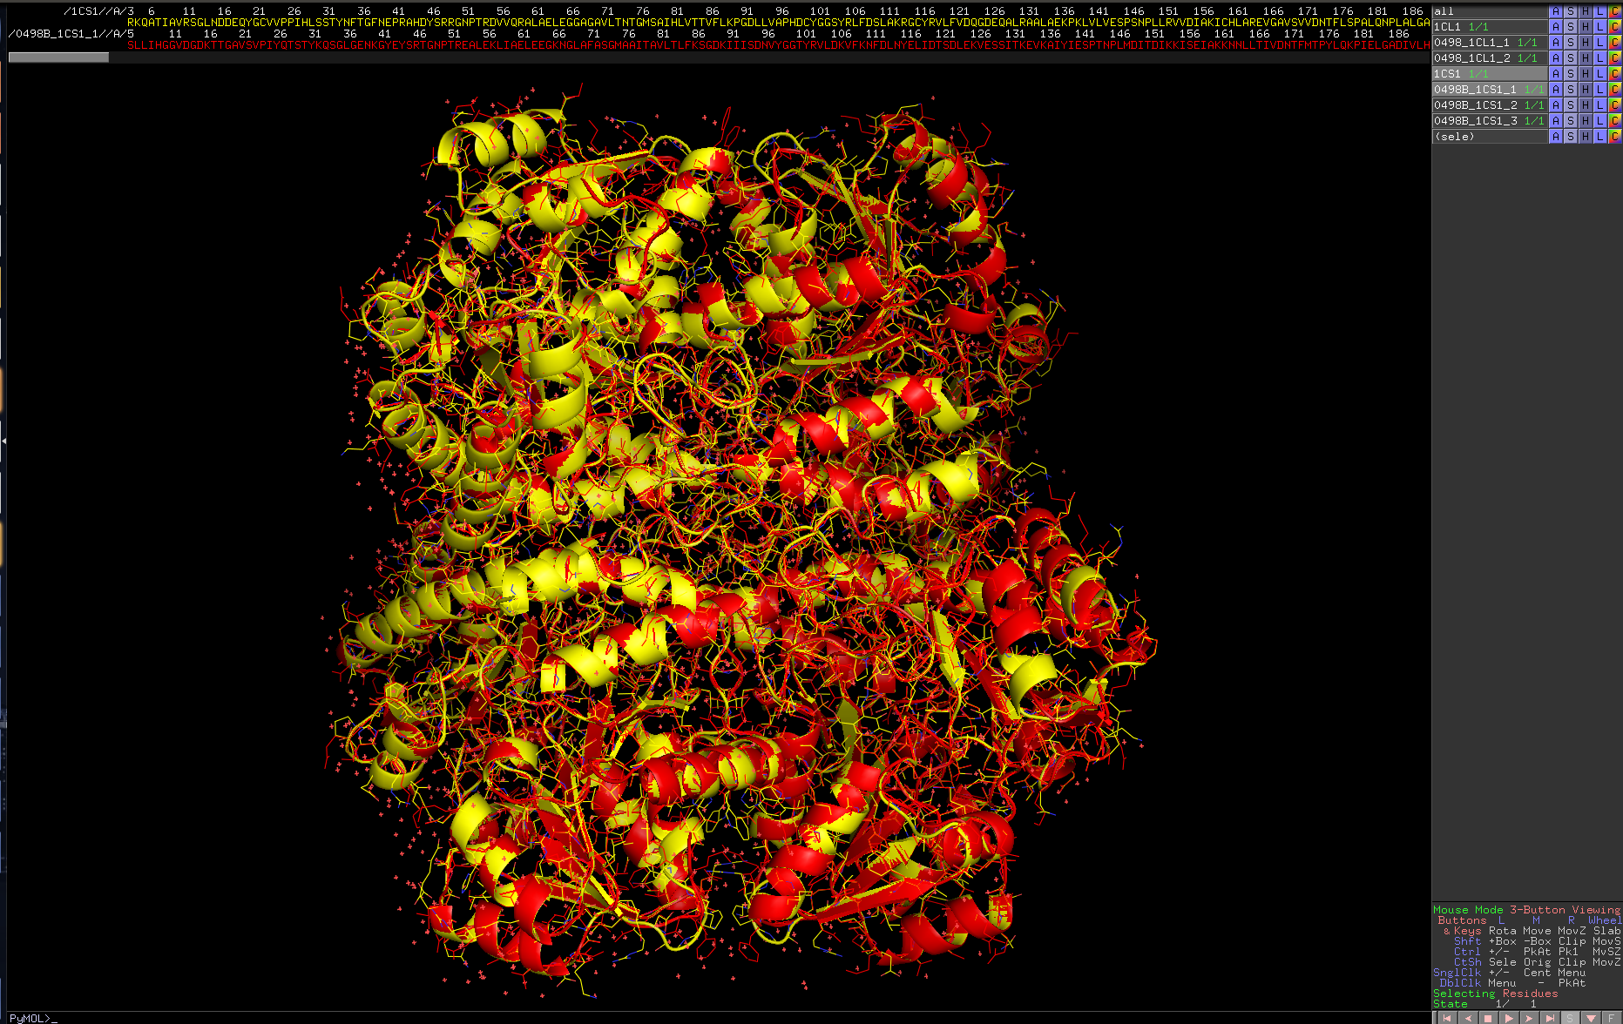
Homology model 1
Cys/Met metabolism
pyridoxal-phosphate-dependent protein on E.coli Cystathione gamma
Very Good 3-D homology
Data Slide 16

Slide 20
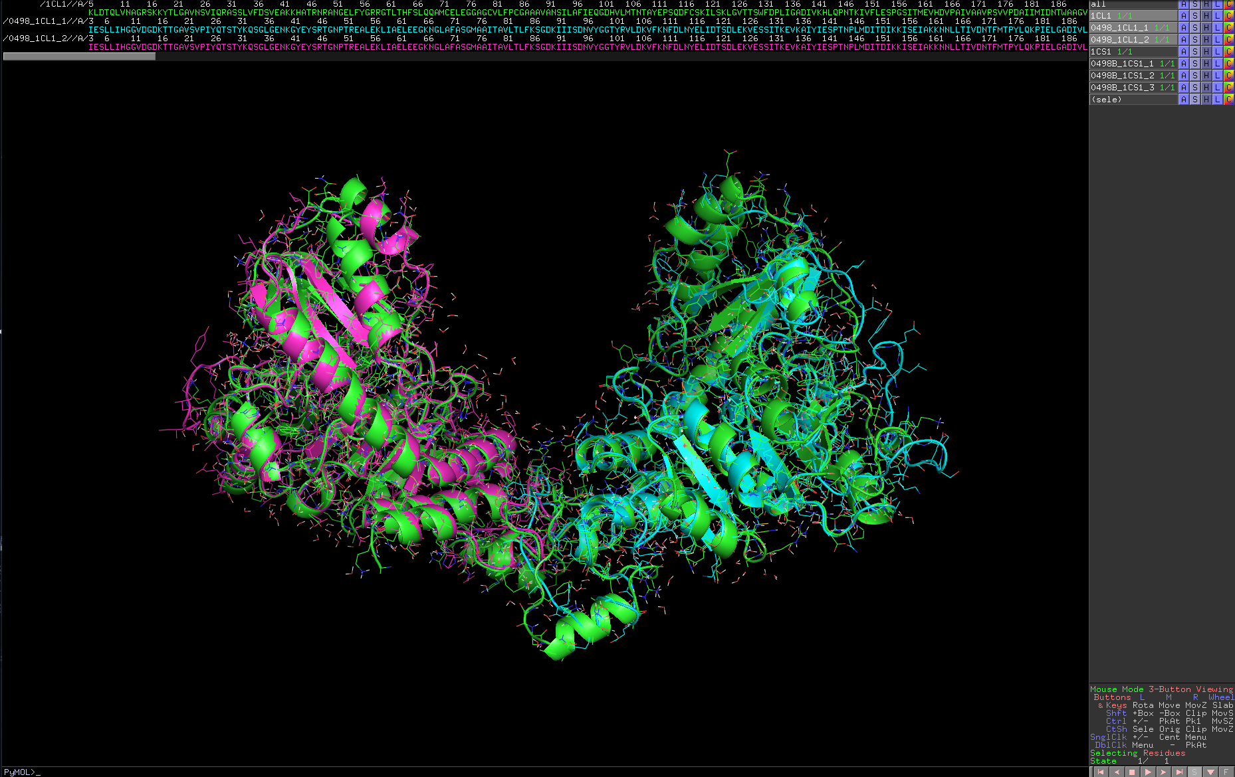
Homology model 2
Cys/Met metabolism
pyridoxal-phosphate-dependent protein on E. coli Cystathione beta
Pretty good 3D homology
Data Slide 17

Slide 21
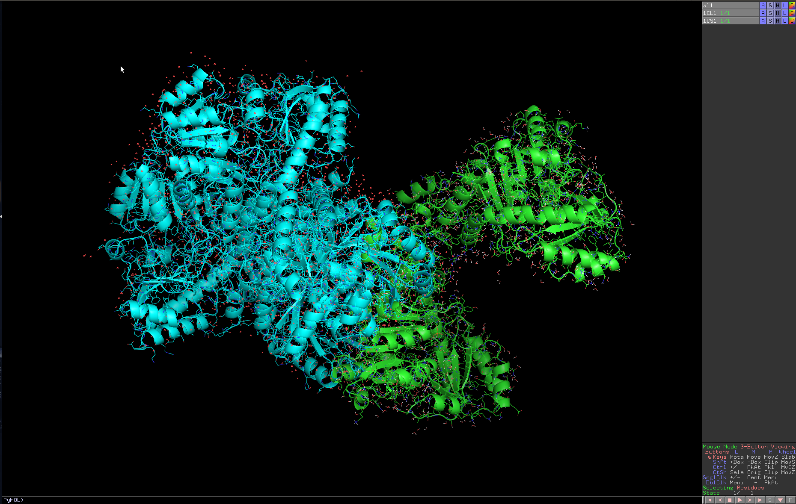
Crystal structures of E.coli Cystathione gamma and beta, superimposed –
They dimmerize quite differently.
Data Slide 18

