Slide 1
MetaVelvet – A soft touch for many little genomes
Stuart Bradley
Toshiaki, N., Hachiya, T., Tanaka, H., Sakakibara, Y. (2012). MetaVelvet: an extension of Velvet assembler to de novo metagenome assembly from short sequence reads. Nucleic Acids Research, 40 (20), 155 – 167.

Slide 2
Three Problems with Metagenomic Assembly
Short length of sequence reads produced by NGS.
Polymorphism between closely related members of the community.
Number of strains is unknown.
Relative abundance of strains is unknown.
Highly abundant species are either seen as:
Errors – and removed.
Repeats.

Slide 3
A Refresher Course in de Brujin Graphs
Given two reads:
TGGT GTCA
Pick a k-mer length (3) and produce all 3-mers from the reads, then split them into k-1-mers that overlap:
TGGT GTCA
TGG -> TG, GG GTC -> GT, TC
GGT -> GG, GT TCA -> TC, CA
Create a graph structure of the 2-mers, with each pair joined by an edge.
TG
GG
GT
TC
CA

Slide 4
How Velvet Does it Differently
Simplification – Two nodes with only two edges become one:
Tip removal – Chains of nodes with hang off the end of the graph are removed.
Bubble removal – Two almost identical sets of nodes are merged (or one is removed).
TG
GC
TG
GC
GT
TG
GTG
GG
GA
GG
GA

Slide 5
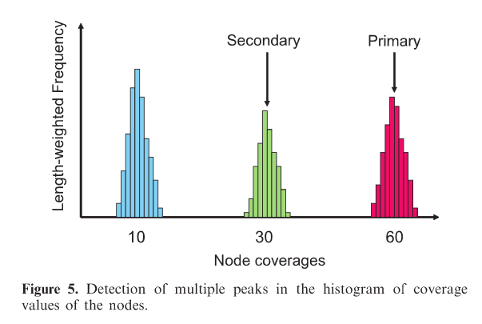
The MetaVelvet Method – Coverage Peaks
Once the primary de Brujin graph has been constructed by the standard Velvet algorithm, it must be decomposed into species graphs.
This is done by looking for peaks in the k-mer coverage of the sequences. Different k-mer concentrations suggest distinct species.

Slide 6
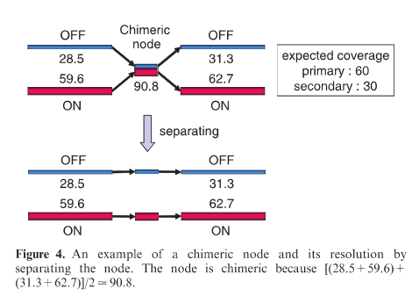
The MetaVelvet Method – Chimera Nodes
Nodes that have one incoming edge and one outgoing edge for two different coverages are termed Chimeric nodes.
They differ from repeats by having two pairs of incoming-outgoing coverage.

Slide 7
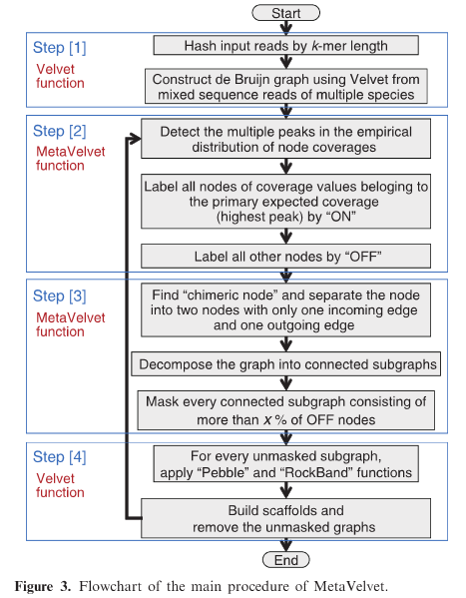
The MetaVelvet Method – Final Steps
Velvet functions are applied to the primary nodes, and this (first species) assembly is then removed from the graph.
The whole process is repeated until there are no more nodes left in the parent graph.

Slide 8
Performance Comparison - General
Method | Num. scaffolds | Cover Rate | N50 | Gene Prediction | CPU | RAM
MetaVelvet
Velvet
SOAPdenovo
Meta-IDBA | Num. Contigs
Reads were generated using the DNAA package[1], with 80bp read length and a log-normal distribution of species abundance.
[1](http://sourceforge.net/projects/dnaa)
Notes:
SOAPdenovo used its metagenomics option.
As taxa decrease, the similarity between species increases, and decomposition becomes harder.
Gene prediction is better due to 3x scaffold length when compared with Velvet.

Slide 9
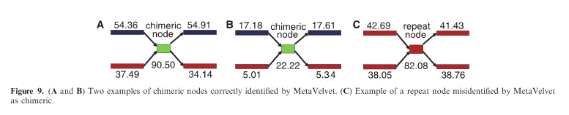
Performance Comparison – Chimeric Algorithm
To test the optimality of the MetaVelvet algorithm, the genus-level dataset was analyzed. This showed that 750/770 chimeric sites identified were correct.
The main stated reason for misidentification was statistical variance in k-mer coverage.

Slide 10
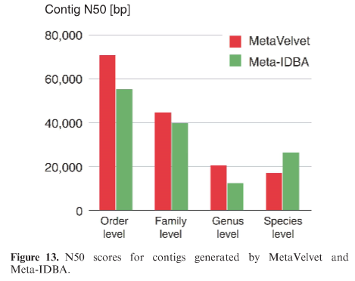
Performance Comparison – Species Level
At the species taxa level, MetaVelvet underperforms when compared to Meta-IDBA.
This is because Meta-IDBA was designed to deal with species polymorphisms, something that MetaVelvet was not.

Slide 11
Conclusion
MetaVelvet – in general – is a fairly good de novo metagenome assembler.
However, 2.5% chimeric mis-identification could possibly be reduced by a more complex method of identification. Which would result in a more robust system.
Topological structure partioning could also be integrated into the program, so it could better compete with Meta-IDBA at the species level.

Slide 12
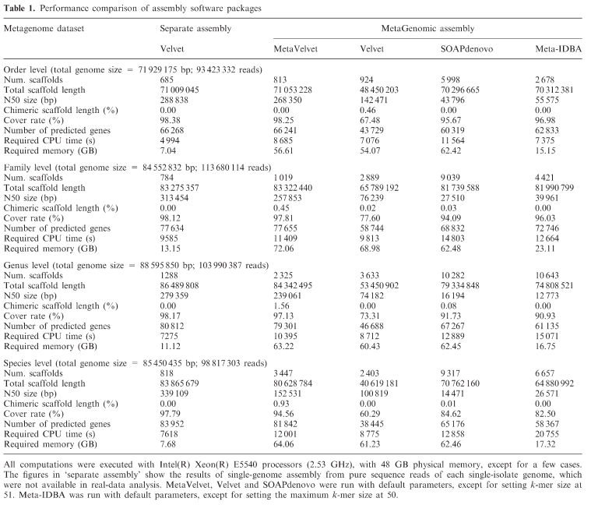
Appendix 1 – Performance Comparison

Slide 13
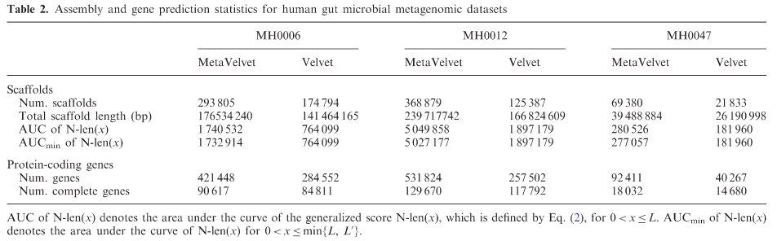
Appendix 2 – Gene Prediction

