Slide 1

Title
Efficient Credit Card Fraud Detection Using a MobileNetV3-GRU-MLP Ensemble for Imbalanced Transactions
By Henry Veilhelm Lutterodt
ID: 22259585
Supervisor: Dr. Edward Danso Ansong

Slide 2


Introduction
What is credit card fraud, and why is it a growing concern?
  projected to reach $40 billion by 2027 (Nilson Report, 2022)
Why is detecting credit card fraud so challenging?
  class imbalance (European Credit Card Fraud Dataset as an example, where only 0.172% of 284,807 transactions are fraudulent) and computational constraints.
How can we improve fraud detection in real-world settings?

Slide 3

Aim and Objectives
The aim of this study is to design an efficient and accurate credit card fraud detection using machine learning by mitigating class imbalance and optimizing computational performance.
1
Address Class Imbalance
2
Reduce Computational Complexity
To apply Synthetic Minority Over-sampling Technique (SMOTE) to balance the dataset. Compare SMOTE with baseline models to evaluate its impact on precision, recall, and F1-score.
To implement a lightweight machine learning model and compare its efficiency against complex models. Optimize feature selection to reduce dimensionality and improve model speed.
3
Evaluate Real-Time Feasibility
To benchmark the proposed model’s latency and scalability on large transaction datasets. Ensure the solution is viable for deployment in real-world financial systems by testing its performance under simulated real-time conditions.

Slide 4

SMOTE for Class Imbalance
One of the primary challenges in credit card fraud detection is the significant class imbalance, where legitimate transactions far outnumber fraudulent ones. Addressing this imbalance is crucial for building effective models. By using SMOTE, this study aims to create a balanced dataset that allows the machine learning model to learn more effectively from the minority class.
How does SMOTE help address class imbalance?

Slide 5



Lightweight Models for Efficiency
To address the computational complexity of fraud detection, lightweight models offer a promising solution. These models can provide a balance between accuracy and speed, making them suitable for real-time deployment in financial systems. Examples include Logistic Regression, Decision Trees, and pruned Neural Networks.
Faster Processing
Reduced training and inference times.
Lower Overhead
Less computational resources required.

Slide 6
Related Studies and Inspiration
Several studies have inspired our hybrid approach, each with its own strengths and limitations. These studies have informed our choices in model selection, feature engineering, and performance optimization.
Vardhani et al. (2024)
Nalayini et al. (2023)
Sisodia et al. (2024)
a. Strength: Unprecedented 100% accuracy on benchmark dataset
CNN-based Fraud Detection.
SMOTE-ENN Application.
a. Strength: Demonstrated CNNs' superior pattern recognition vs traditional ML methods (99.9% accuracy)
a. Strength: Achieved excellent performance (99.6% F1-score) through sophisticated feature engineering
b. Limitation: Prohibitively resource-intensive for practical deployment
b. Limitation: Complex ensemble methods created high computational overhead
b. Limitation: Required heavy computational resources unsuitable for real-time systems

Slide 7

Lightweight Models for Efficiency
To address the computational complexity of fraud detection, lightweight models offer a promising solution. These models can provide a balance between accuracy and speed, making them suitable for real-time deployment in financial systems. Examples include Logistic Regression, Decision Trees, and pruned Neural Networks.
Faster Processing
Reduced training and inference times.
Lower Overhead
Less computational resources required.

Slide 8


Proposed Solution: MobileNetV3-GRU-MLP Ensemble
Combines lightweight design with robust fraud detection
Addresses imbalance and efficiency for real-time edge use
Components:
  MobileNetV3: Extracts key transaction features efficiently
  GRU: Captures time-based fraud patterns
  MLP: Combines outputs for accurate predictions
Enhanced by SMOTE-ENN for balanced class representation

Slide 9

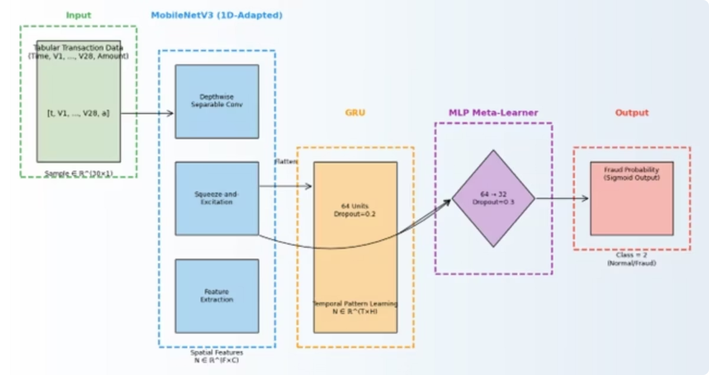
Proposed Architecture Diagram
The diagram illustrates the flow of data and the interaction between the components of our MobileNetV3-GRU-MLP ensemble, integrated with the SMOTE-ENN preprocessing step.
This architecture ensures that transactions are efficiently processed, features are comprehensively extracted, temporal patterns are recognized, and class imbalance is effectively managed for optimal fraud detection performance.

Slide 10
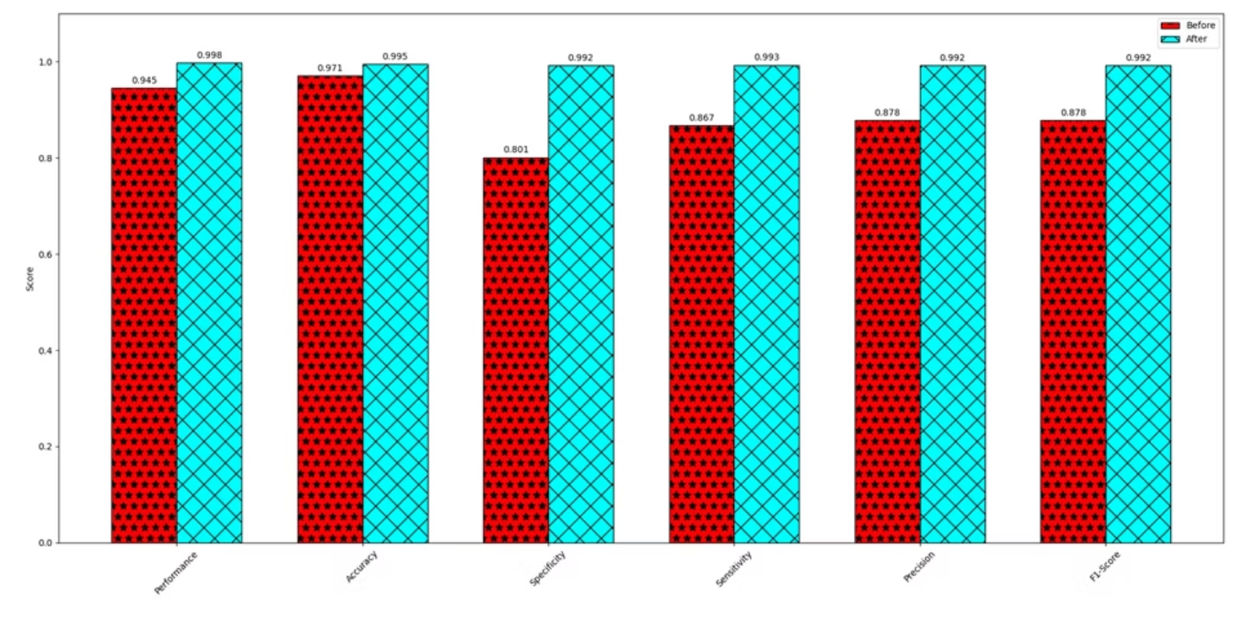
Performance of Our Model: Before and After SMOTE-ENN
The table below highlights the significant impact of integrating SMOTE-ENN into our fraud detection pipeline. The metrics clearly demonstrate the enhanced ability of our model to accurately identify fraudulent transactions once the class imbalance is addressed.
Before
0.945
0.971
0.801
0.867
0.998
After
0.878
0.995
0.992
0.993
0.992
The substantial improvements in sensitivity, precision, and F1-score post-SMOTE-ENN highlight the critical role of balanced data in achieving high-performing and reliable fraud detection systems.
While overall accuracy might slightly decrease, the critical metrics for fraud detection (Sensitivity, Precision, F1-Score) show remarkable improvement, indicating better detection of true positives.

Slide 11
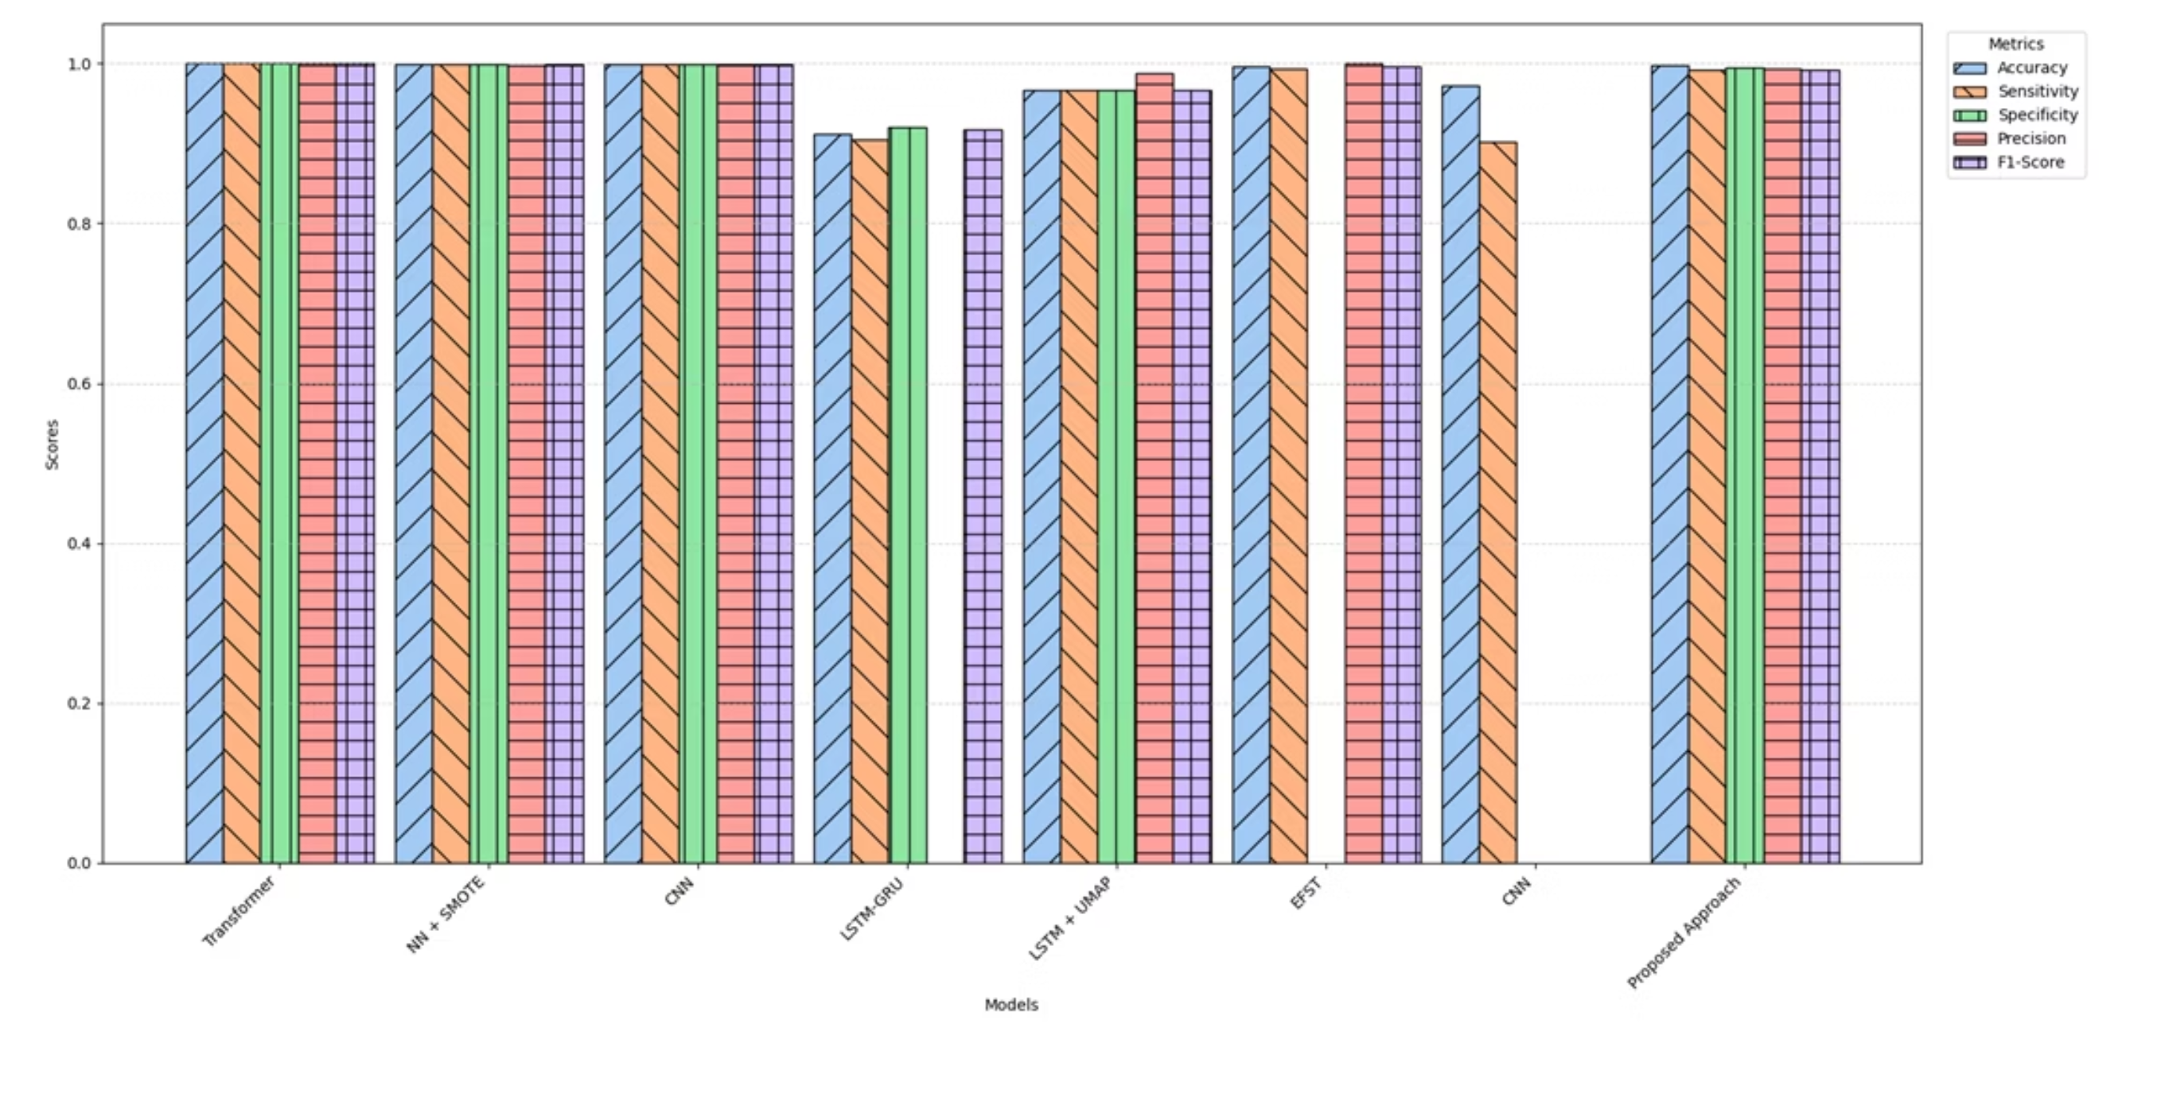
Comparison with Related Works of Credit Card Fraud Detection Models

Slide 12

Thank you

