Slide 1
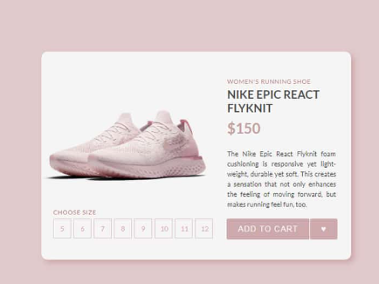

Slide 2
https://www.svgrepo.com/collection/company-logo/

Slide 3
How can I make a company card with its financials to look like the example screenshot?

