Slide 1

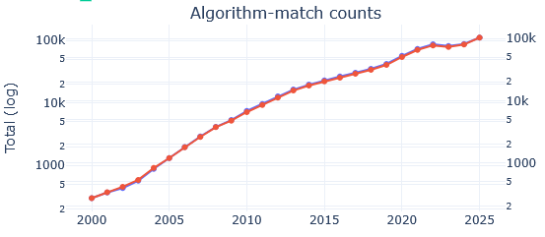
Results
For each article, we run all regex in DEFAULT_PATTERNS["algorithm"] on the article body text.
If at least one of those regex matches anywhere in the text, then that article is counted as having an algorithm match.
The yearly metric is the number of such articles in that year.
Notes:
https://medium.com/towards-data-science/what-are-stable-diffusion-models-and-why-are-they-a-step-forward-for-image-generation-aa1182801d46
The plan was to present denoising today, so what is actually denoising?!
Couple of words with examples
How big is our training set?
How much we are training?

Slide 2
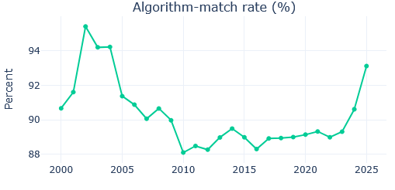
Results
the percent of articles in that year where at least one regex in DEFAULT_PATTERNS["algorithm"] matched the article body text.
Notes:
https://medium.com/towards-data-science/what-are-stable-diffusion-models-and-why-are-they-a-step-forward-for-image-generation-aa1182801d46
The plan was to present denoising today, so what is actually denoising?!
Couple of words with examples
How big is our training set?
How much we are training?

Slide 3
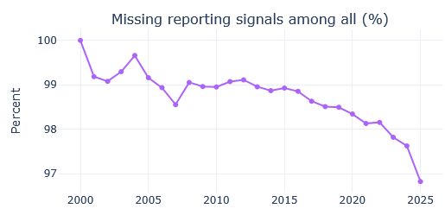
Results
This is an article-level flag that becomes 1 when the article is missing at least one of the four “reporting signal” categories.
Notes:
https://medium.com/towards-data-science/what-are-stable-diffusion-models-and-why-are-they-a-step-forward-for-image-generation-aa1182801d46
The plan was to present denoising today, so what is actually denoising?!
Couple of words with examples
How big is our training set?
How much we are training?

Slide 4
Results
missing_params: no explicit parameter value/config mentioned (k, eps, resolution, n_clusters, linkage, etc.).
missing_justification: no explicit reasoning/selection rationale for the parameter/cluster choice (elbow, silhouette analysis, “we chose… based on…”, etc.).
missing_evaluation: no explicit validation/quality check of clustering (silhouette/DBI/CH, ARI/NMI, stability, BIC/AIC, modularity, etc.).
missing_tuning: no explicit search/optimization process over parameters (grid/random search, Bayesian opt, CV, “tuned/optimized using…”, etc.).
Notes:
https://medium.com/towards-data-science/what-are-stable-diffusion-models-and-why-are-they-a-step-forward-for-image-generation-aa1182801d46
The plan was to present denoising today, so what is actually denoising?!
Couple of words with examples
How big is our training set?
How much we are training?

Slide 5
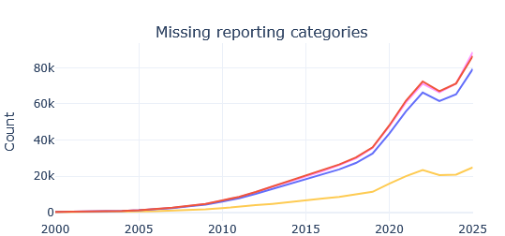
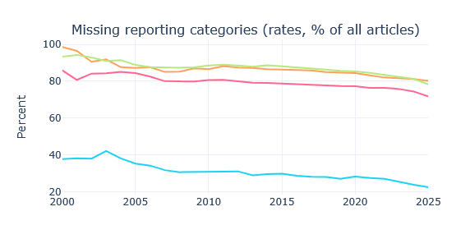
Results
Notes:
https://medium.com/towards-data-science/what-are-stable-diffusion-models-and-why-are-they-a-step-forward-for-image-generation-aa1182801d46
The plan was to present denoising today, so what is actually denoising?!
Couple of words with examples
How big is our training set?
How much we are training?

Slide 6

Results
Within a given year, how the total missingness flags are split across the four categories.
Concretely, for a year y:
missing_tuning_share (%) = “Of all missing-flags counted in that year (across the 4 categories), what fraction are tuning?”
Notes:
https://medium.com/towards-data-science/what-are-stable-diffusion-models-and-why-are-they-a-step-forward-for-image-generation-aa1182801d46
The plan was to present denoising today, so what is actually denoising?!
Couple of words with examples
How big is our training set?
How much we are training?

Slide 7
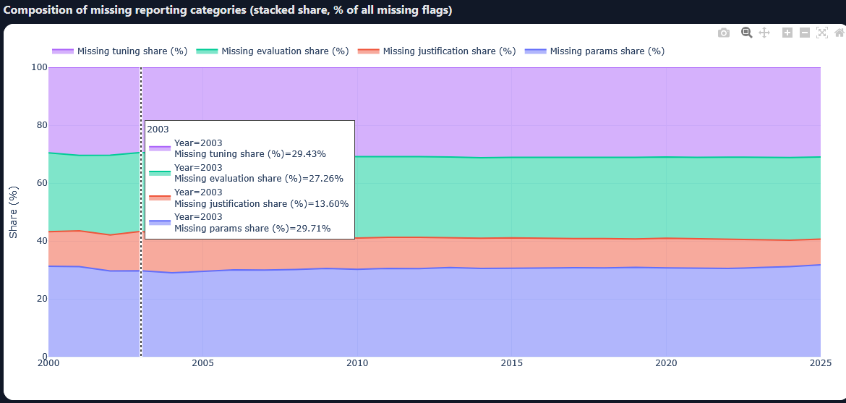
Results
Notes:
https://medium.com/towards-data-science/what-are-stable-diffusion-models-and-why-are-they-a-step-forward-for-image-generation-aa1182801d46
The plan was to present denoising today, so what is actually denoising?!
Couple of words with examples
How big is our training set?
How much we are training?

Slide 8
Is there an effect of the algorithm used?
When algorithm X is mentioned, do papers report params/justification/evaluation/tuning differently than the overall baseline?
Computes the algorithm-specific missing rates for each missing flag.
Computes the overall baseline missing rates (across all relevant articles; typically “all articles with any algorithm match”, sometimes “all articles overall” depending on how the script was written).
Reports effect sizes like deltas vs overall, and often statistical tests.
Notes:
https://medium.com/towards-data-science/what-are-stable-diffusion-models-and-why-are-they-a-step-forward-for-image-generation-aa1182801d46
The plan was to present denoising today, so what is actually denoising?!
Couple of words with examples
How big is our training set?
How much we are training?

