Slide 1
Implementation
There are two main classes of programming language implementations
  Compilers
  Interpreters

Slide 2
Compilers vs. Interpreters
Compilers vs Interpreters: What is the difference?
  Compilers translate high-level languages (Java, C, C++) into low-level languages (Java Byte Code, assembly language).
  Interpreters execute high-level languages directly ( early versions of Lisp and Basic).
Note: Virtual machines can be considered interpreters for
low-level languages; they directly execute a low-level language
without first translating it.

Slide 3
Compilers vs. Interpreters
Why choose compilation over interpretation?
  Compilers can generate very efficient code and, consequently, the compiled programs run faster than interpreted programs.

Slide 4
Compilers vs. Interpreters
Why choose interpretation over compilation?
  Responsive programming system – no compile/link step
  Architecture independent – no code generation
  Partial evaluation of a program
    REPL – ‘read, evaluate, print, loop’
    E.g. Python’s ‘>>>’ interface.

Slide 5
The Anatomy of a Compiler
Source Program
Syntax Analysis
Recognize the structure of a source program,
generate parse tree
Recognition
Phases
Semantic Analysis
Recognize/validate the meaning of a source program
Parse
Trees
(AST)
Optimization
Reorganize the parse tree/AST to make computations
more efficient
Code
Generation
Phases
Code Generation
Translate parse tree/AST into low-level language
Translated Program
Observations:
Language definitions have two parts: syntax and semantics
Compilers have two phases which deal with each of these
language definition components: syntax analysis, semantic
analysis.

Slide 6
Compilation Example
Assembly Language
consider: 3*2+5
load <address>,reg
load <value>,reg
store reg,<address>
add reg,reg,reg
sub reg,reg,reg
mul reg,reg,reg
Assembly Code:
load 3,r1
load 2,r2
mul r1,r2,r1
load 5,r2
add r1,r2,r1
Our machine has hree registers: r1, r2, r3
Note: last argument to instructions is the target!

Slide 7
Interpreter Implementation
A detailed look at an interpreter for a simple calculator language written in Rust.
Here is the grammar for our language:
<expression>* ::= <mulexp> + <expression>
| <mulexp> - <expression>
| <mulexp>
<mulexp> ::= <rootexp> * <mulexp>
| <rootexp> / <mulexp>
| <rootexp>
<rootexp> ::= number | - <rootexp> | ( <expression> )

Slide 8
Interpreter Implementation
Our implementation is based on something called syntax directed interpretation – here interpretation of expressions happens as soon as they are recognized by the interpreter
Other schemes exist where the interpreter first builds an intermediate representation of the program (similar to what we saw with the compiler) and then interprets this intermediate representation.
Our interpreter architecture consists of 2 parts:
  Lexer
  Parser

Slide 9
Interpreter Implementation
Symbol
Stream
Token
Stream
Lexical
Analyzer
Parser
Program
Text
Values
Lexical Analysis:
Convert symbol
stream into a token
stream.
Syntax Analysis/Interpretation:
Make sure the sequence
of tokens in the token stream
conforms to the rules of the
structure of the programming
language and interpret the structures
as soon as they are recognized.

Slide 10
Interpreter Implementation
Instead of using tools for the lexical analysis and the parser such as ‘lex’ and ‘yacc’ we will hand code these.
Hand coding at least at this stage has the advantage in that we see exactly what’s going on.

Slide 11
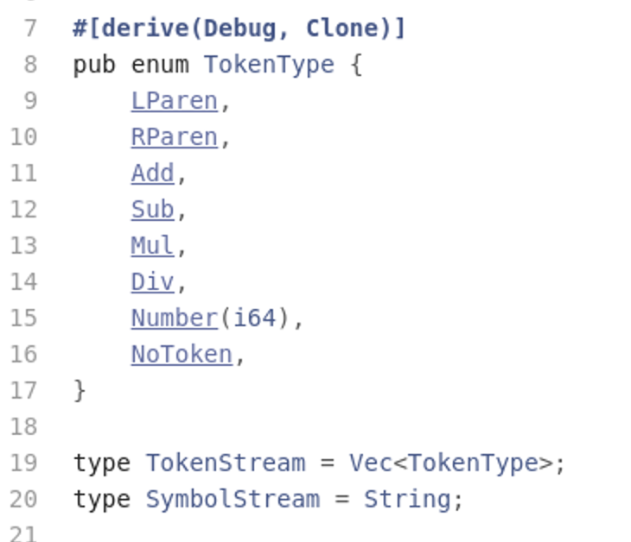
The Lexer
We need to define what kind of tokens we want to encode
Define that symbol and token stream types

Slide 12
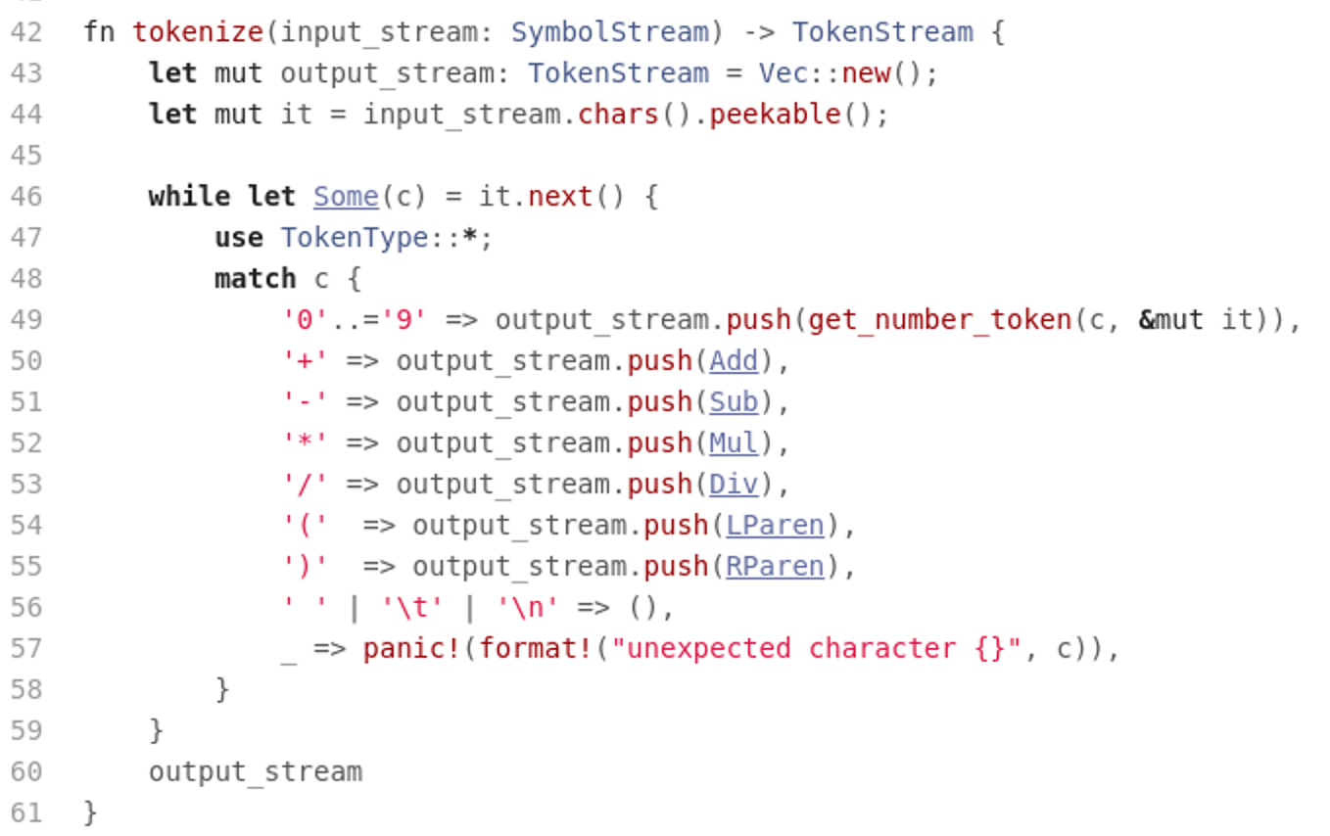
The Lexer
Tokenize the input stream:

Slide 13
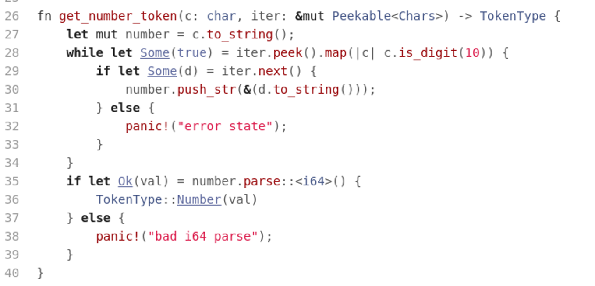
The Lexer
Tokenize the input stream:

Slide 14
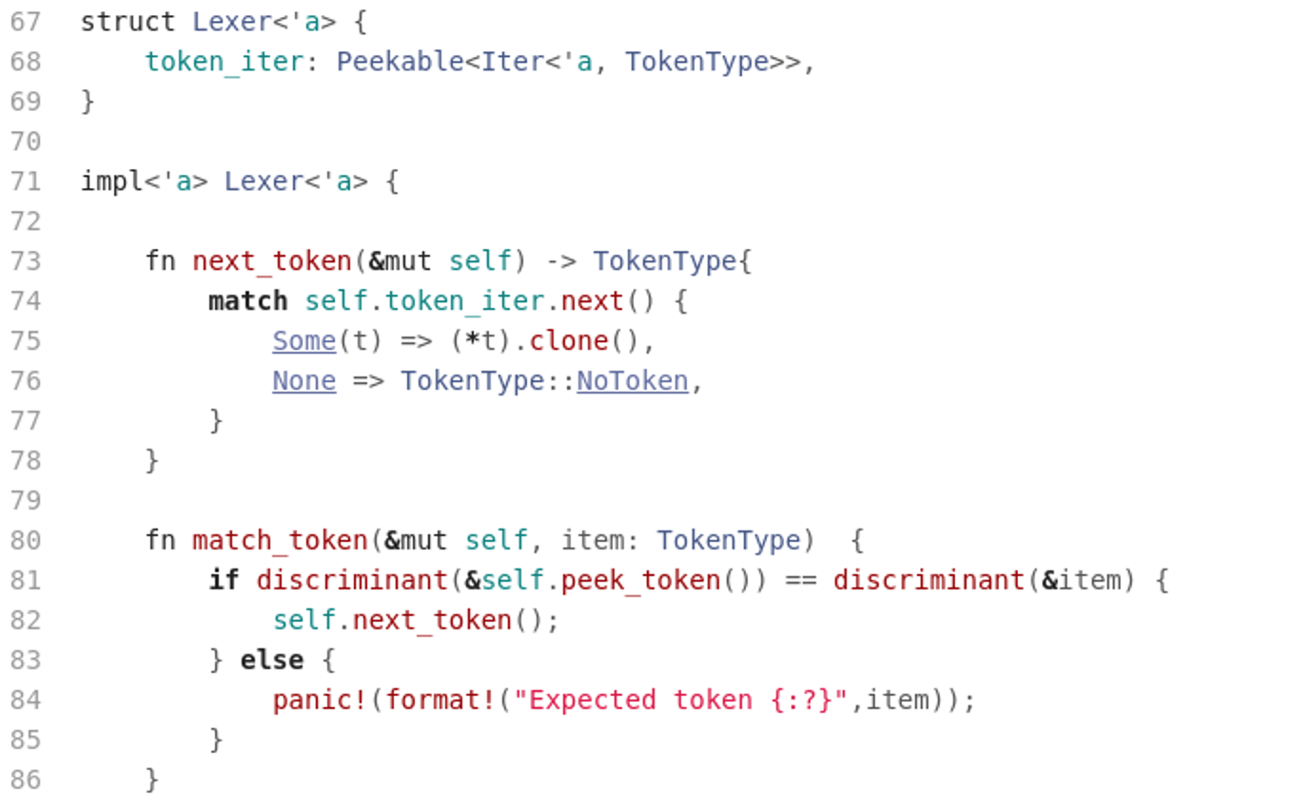
The Lexer
The Lexer interface:
…

Slide 15
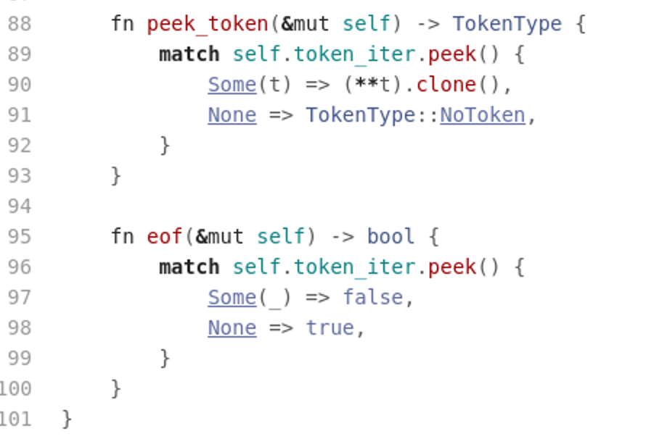
The Lexer
The Lexer interface:

Slide 16
The Parser
Here we use a parsing scheme called a “recursive descent parser”
In this scheme we have one function for each non-terminal in the grammar.
These function implement all the rules for the respective non-terminals.
This gives rise to mutually recursive functions since most grammars are highly recursive.

Slide 17
The Parser
In order to make this scheme work we need to rewrite our grammar slightly.
Our grammar:
<expression>* ::= <mulexp> + <expression>
| <mulexp> - <expression>
| <mulexp>
<mulexp> ::= <rootexp> * <mulexp>
| <rootexp> / <mulexp>
| <rootexp>
<rootexp> ::= number | - <rootexp> | ( <expression> )

Slide 18
The Parser
Becomes:
<expression>* ::= <mulexp> { ('+' <mulexp>) | ('-' <mulexp>) }
<mulexp> ::= <rootexp> { ('*' <rootexp>) | ('/' <rootexp>) }
<rootexp> ::= number | '-' <rootexp> | '(' <expression> ')'
Notes: expressions written as {something} mean that something can appear
zero or more times in the input. Also, we have put operator tokens in quotes
in order to distinguish them from operators in the grammar language itself, i.e.
parentheses.
Observation: we have replaced recursion in the grammar with the {…} operators.
You should convince yourself that we are still parsing the same language.

Slide 19
The Parser
Building the parser is now straight forward:
  For each of the non-terminals we write a function that implements the rule(s)
  The functions interface to the lexer to ask for tokens from the token stream as needed.
  The functions also perform the interpretations of the operators as they are being recognized.

Slide 20
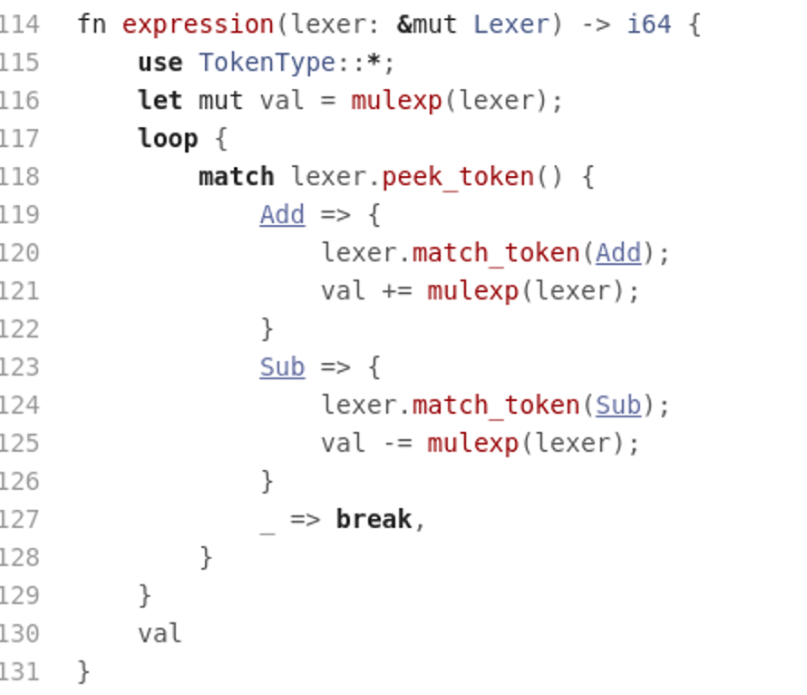
The Parser
<expression>* ::= <mulexp> { ('+' <mulexp>) | ('-' <mulexp>) }

Slide 21
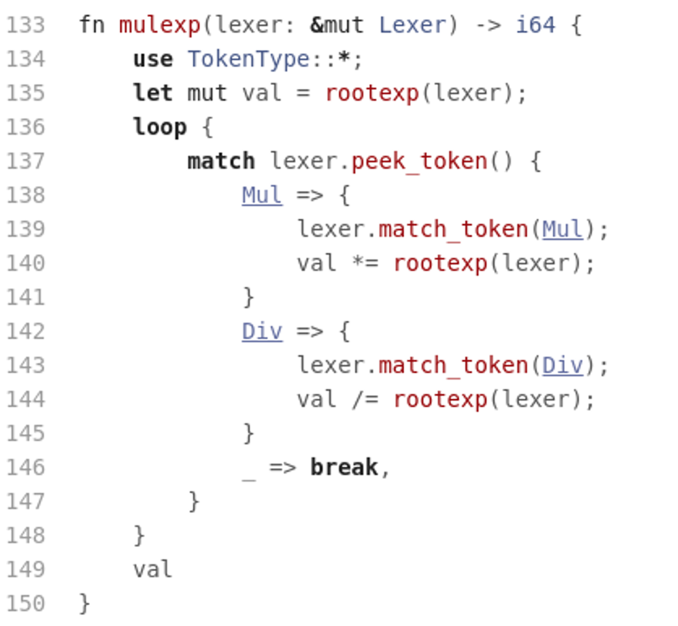
The Parser
<mulexp> ::= <rootexp> { ('*' <rootexp>) | ('/' <rootexp>) }

Slide 22
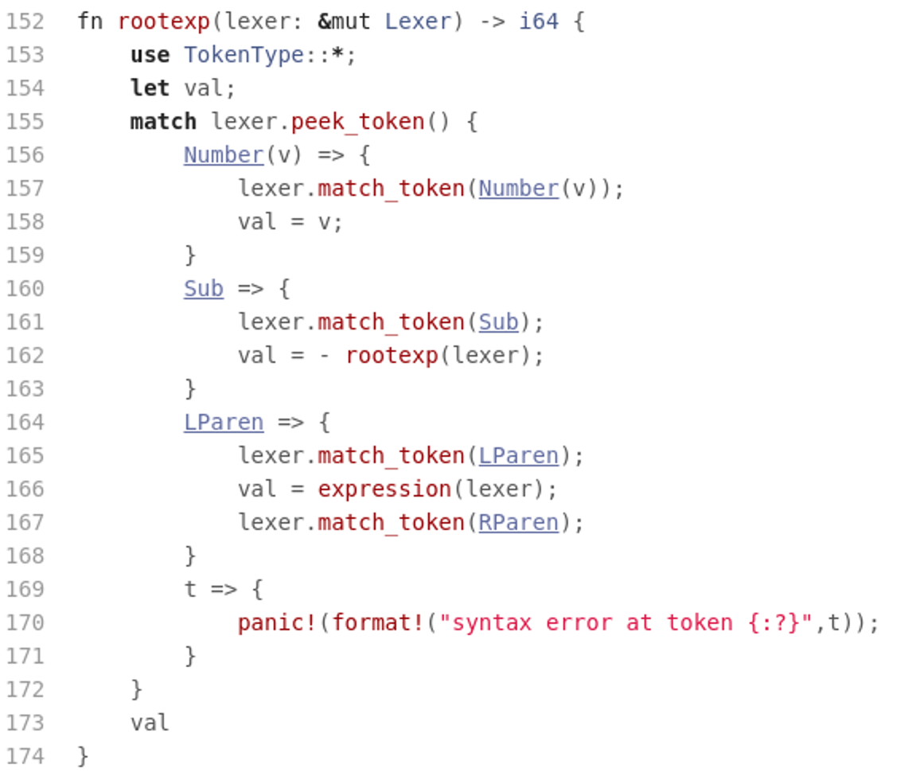
The Parser
<rootexp> ::= number | '-' <rootexp> | '(' <expression> ')'

Slide 23
The Interpreter
Putting it all together:
  Read the input stream from stdin
  Tokenize the input stream
  Instantiate the lexer with an iterator on the token stream
  Call parser functions – start with start symbol.
  Print out the computed value

Slide 24
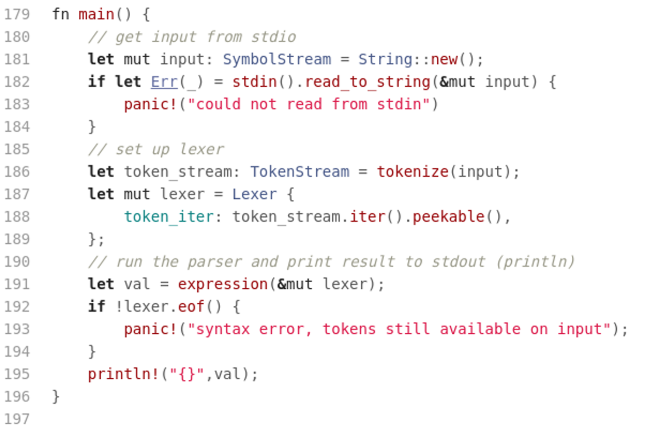
The Interpreter

Slide 25
Interpreter Code
The code for the interpreter is available on repl.it:
  https://repl.it/@lutzhamel/Calc

Slide 26
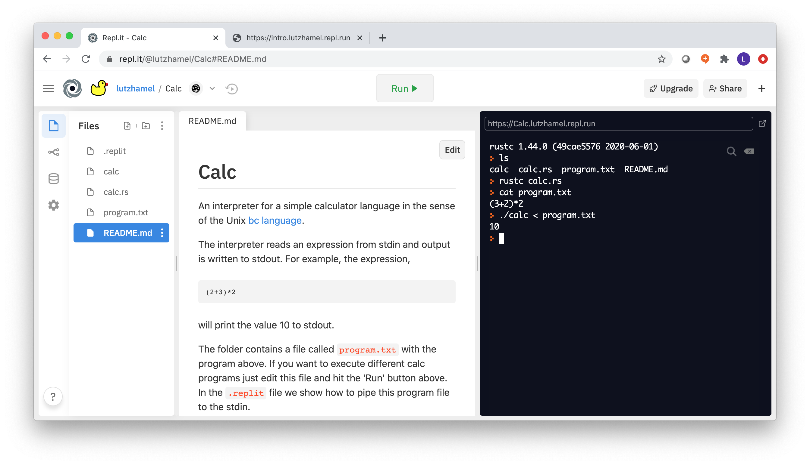
The Interpreter
Running the interpreter on a Unix-like
system (repl.it shell):

Slide 27
Assignment: Translator
Problem: Build a simple translator from arithmetic expressions to a stack machine.
The translator accepts the same language as our calc language:
  <expression>* ::= <mulexp> + <expression>
  | <mulexp> - <expression>
  | <mulexp>
  <mulexp> ::= <rootexp> * <mulexp>
  | <rootexp> / <mulexp>
  | <rootexp>
  <rootexp> ::= number | - <rootexp> | ( <expression> )
The translator generates the following stack machine language:
<comlist>* ::= <command> <comlist> | <empty>
<command> ::= <arithmetic> | <stack>
<arithmetic> ::= add | sub | mul | div
<stack> ::= push number | pop | print

Slide 28
Assignment: Translator
Given the expression (1+2)*3 your translator should produce:
push 1
push 2
add
push 3
mul
print
Note: it is assumed that the arithmetic commands pop the values off the stack that they use and push the result back onto the stack.
Base your translator implementation on the calculator code given here: https://repl.it/@lutzhamel/Calc
You can test drive you generated code with the stack machine given here: https://repl.it/@lutzhamel/Machine
See Assignment #6 in BS

