Slide 1
Memory Locations for Variables
Modern programming languages have many different classes of
Variables, e.g.
  Global variables
  Parameters
  (function) local variables (also called automatic or activation-specific)
  (object-oriented) member variables
  Etc.
It is the job of the language system to keep track of the values of these
variables during the runtime of a program.
The language system accomplishes this by binding a variable to a
memory location and then uses that memory location to store the
value of the variable.

Slide 2
Memory Locations for Variables
In imperative programs this is a fairly transparent process - the assignment
operator mimics what happens at the hardware level - namely, the updating
of memory cells.
In functional languages this is often not so obvious, since there is no global
State, but still, variables are bound to memory locations.

Slide 3
Activation Records
In order to track variables for functions, compilers use a data structure
called activation record - collects all the variables belonging to one function
into this structure.
Example: FORTRAN
  FUNCTION AVG (M,N)
  SUM = M + N
  AVG = SUM/2.0
  RETURN
  END
(Main)
Code:
…
AVG(4,2)
…
AVG
…
Activation Record
RETURN
M
N
SUM
<return addr>
Global
Data:
Activation Records are often called Frames

Slide 4
Activation Records
Note: Non-recursive languages such as FORTRAN keep a single activation
record per function in the program.
Recursive languages (ML, Java, C, C++, etc) keep a stack of activation
records; one per function call.

Slide 5
The Runtime Stack
Code:
(Main)
…
(function code)
…
Activation Record
Activation Record
RETURN
<local vars>
<return addr>
<next record>
<local vars>
<return addr>
<next record>
Global
Data:
<Stack pointer>
Runtime Stack

Slide 6
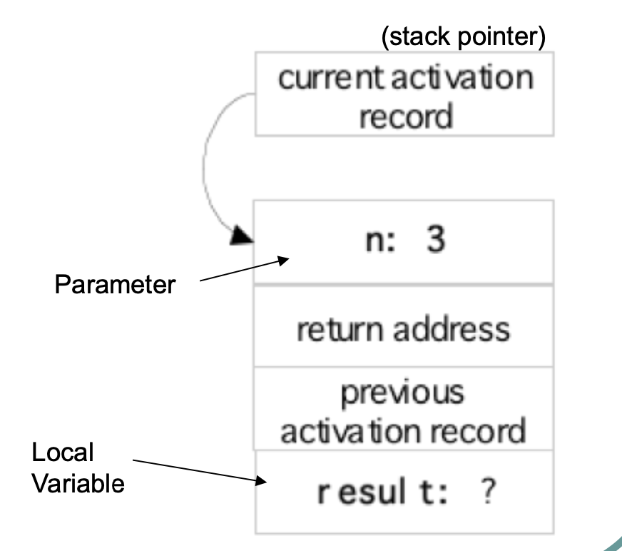
Java Example
We are evaluating fact(3). This shows the contents of memory just before the recursive call that creates a second activation.
int fact(int n) {
int result;
if (n<2) result = 1;
else result = n * fact(n-1);
return result;
}

Slide 7
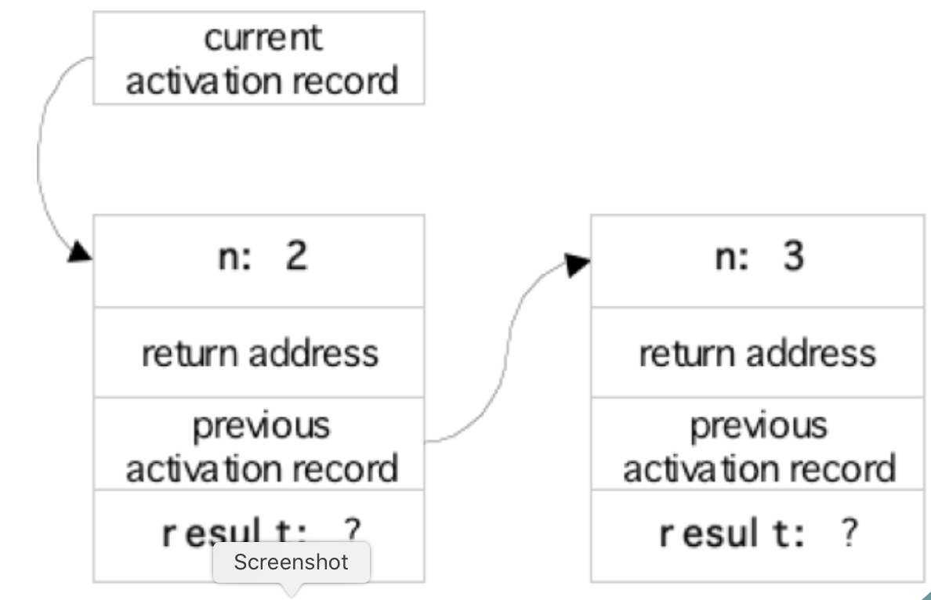
Java Example
This shows the contents of memory just before the third activation.
int fact(int n) {
int result;
if (n<2) result = 1;
else result = n * fact(n-1);
return result;
}

Slide 8
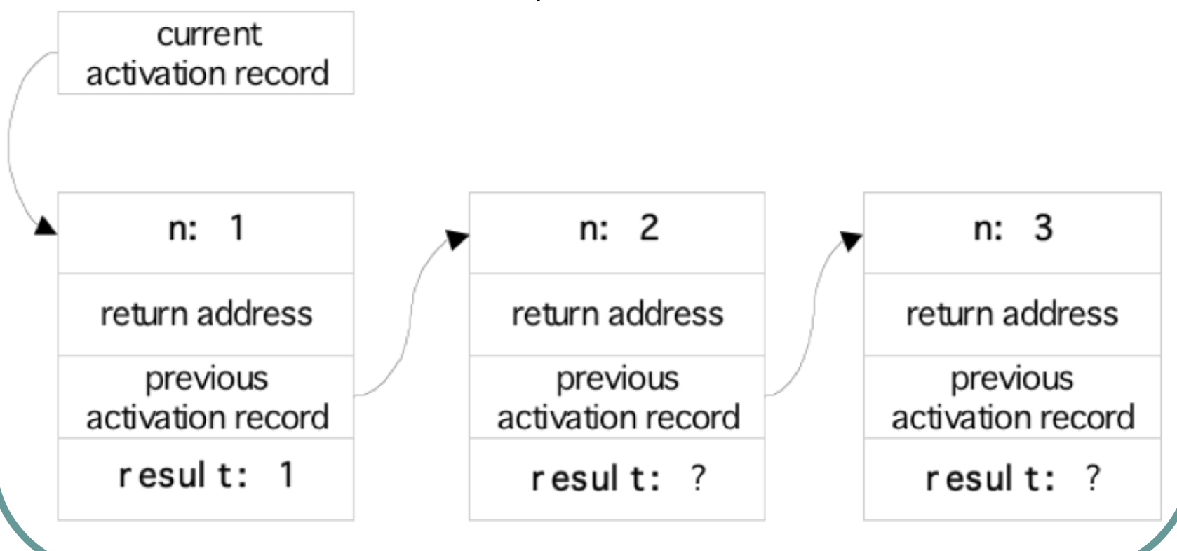
Java Example
This shows the contents of memory just before the third activation returns.
int fact(int n) {
int result;
if (n<2) result = 1;
else result = n * fact(n-1);
return result;
}

Slide 9
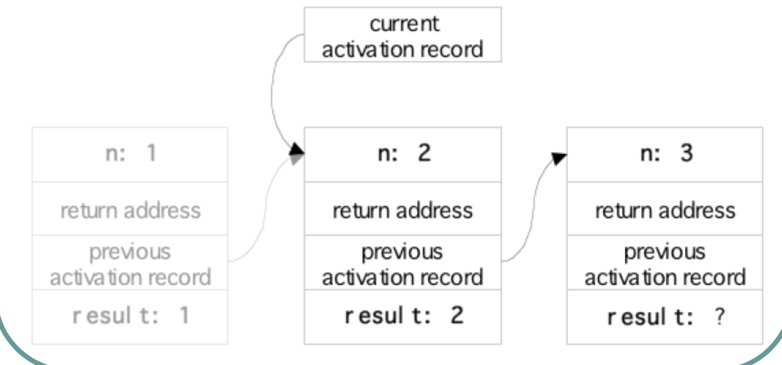
Java Example
int fact(int n) {
int result;
if (n<2) result = 1;
else result = n * fact(n-1);
return result;
}
The second activation is about to return.

Slide 10
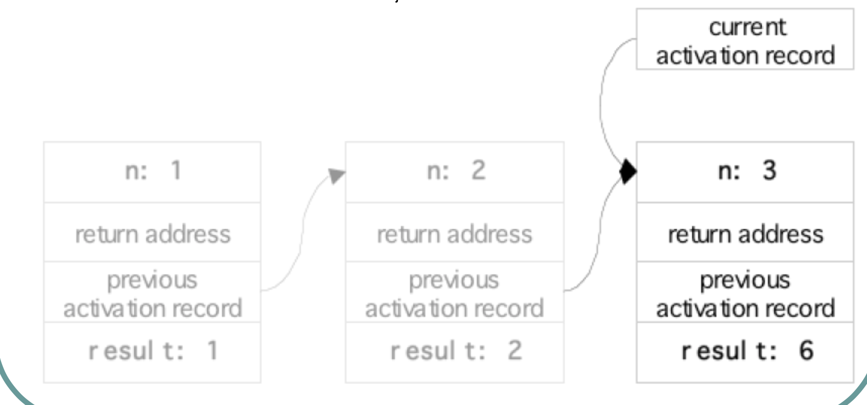
Java Example
The first activation is about to return with the result fact(3) = 6.
int fact(int n) {
int result;
if (n<2) result = 1;
else result = n * fact(n-1);
return result;
}

Slide 11
C Example - Debugger
We use the fact.c program
To use the debugger compile the program with the –g flag
Then start the debugger: gdb <image name>
Set break point at fact function
Run – frame, bt, up, down are all debugger commands that allow to see the stack and the frames.
The program is available in the REPL
  https://replit.com/@lutzhamel/fact#main.sh

