Slide 1
Types
A Type is a Set of Values
Consider the statement:
let mut n : i32;
Here we declare n to be a variable of type i32; what we mean, n can take on any
value from the set of all 32 bit integer values.

Slide 2
Types
Def: A type is a set of values.
Def: A primitive type is a type a programmer can use but not define.
Def: A constructed type is a user defined type.
Example: Java, primitive type
float q;
q is of type float, only
a value that is a member
of the set of all floating point
values can be assigned to q.
type float ⇒ set of all
possible floating point values

Slide 3
Types
Example: Java, constructed type
class Rectangle { int xdim; int ydim; };
Rectangle r = new Rectangle();
Now the variable c only accepts values that are members of type Rectangle;
☞ object instantiations of class Rectangle.

Slide 4
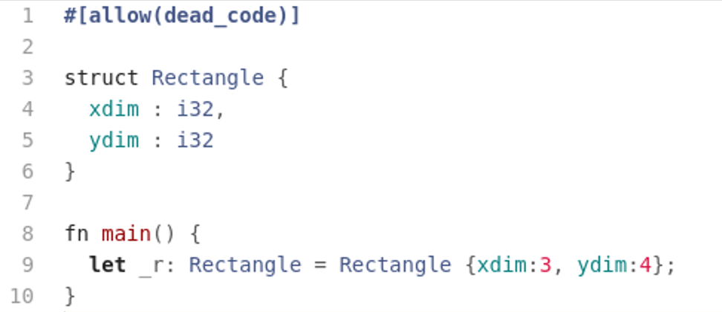
Types
Example: Rust, constructed type
an element of
type Rectangle.

Slide 5
Types
Example: C, constructed type
int a[3];
the variable a will accept values
which are arrays of 3 integers.
e.g.: int a[3] = {1,2,3};
int a[3] = {7,24,9}
Example: Rust, constructed type
let a : [i64;3] = ...;
the variable a will accept values
which are arrays of 3 i64 integers.

Slide 6
Subtypes
Def: a subtype is a subset of the elements of a type.
Example: Java
Short is a subtype of int: short ⊂ int
Observations:
converting a value of a subtype to a values of the super-type is
called widening type conversion. (safe)
converting a value of a supertype to a value of a subtype is
called narrowing type conversion. (not safe)
Example: Java
float ⊂ double
Subtypes give rise to type hierarchies and
type hierarchies allow for automatic type
coercion – widening conversions!

Slide 7
Subtypes & Type Hierarchies
Here the arrow means “subtype of”, e.g., int is a subtype of float.
In type hierarchies it is always safe to move from subtype to supertype – widening conversion (coercion)
  E.g. short -> int ✓
Never the other way around
  E.g. int -> short ✗
double
float
int
short
char

Slide 8
Subtypes
Rust does NOT have subtypes
  Therefore, it does NOT support automatic type coercion
  It is an error in Rust to do:
  let x : i64 = 3;
  let i : f64 = x;
  You would have to explicitly cast the integer variable as a floating point:
  let x : i64 = 3;
  let i : f64 = x as f64;

Slide 9
Function Types
Rust and Haskell (as we will see) treat functions as just another data type
that can be manipulated in a very elegant way.
Functions can be passed as values; just as values that belong to other data types
Functions belong to function types
Example: in Rust consider the function type
x: fn(f64) → f64
This type represents the set of all functions from f64 to f64.
Looking at the Rust standard library std::f64 we can find some examples
from this set of functions
floor: fn(f64) → f64
ceil: fn(f64) → f64
round: fn(f64) → f64

Slide 10
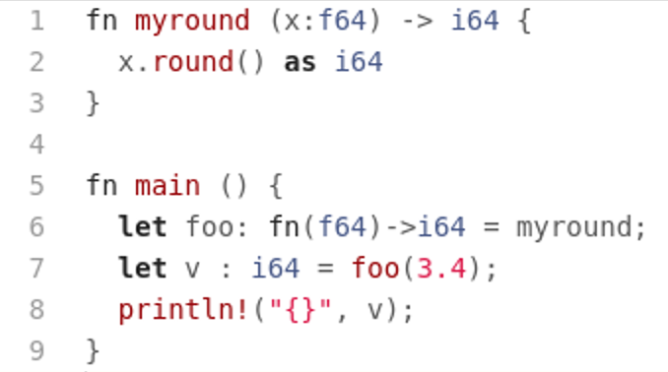
Function Types
Example: Functions as values
☞ A function is just an element of a particular function set.

Slide 11
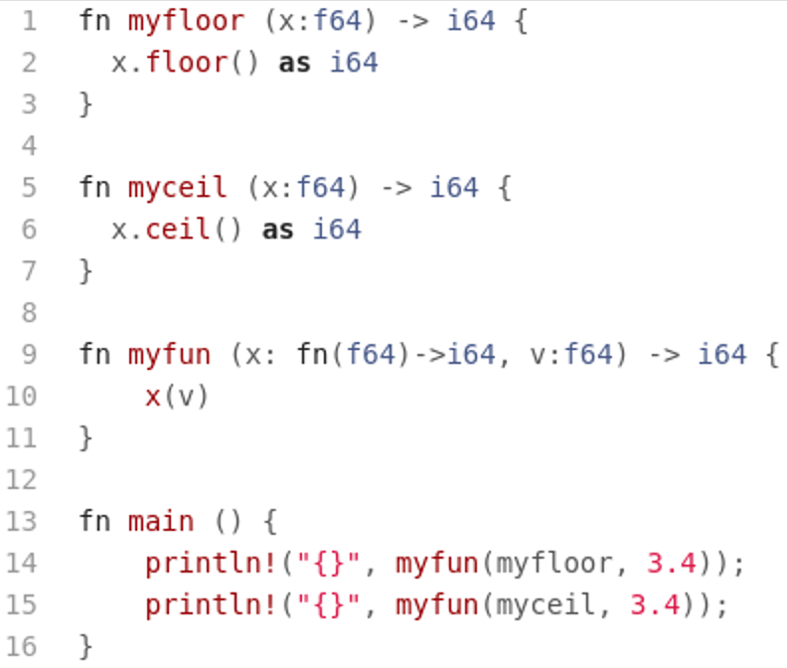
Function Types
Example: Functions as function arguments
☞ A function is just an element of a particular function set.

Slide 12
Why do we use types?
Types allow the computer/language system to assist the developer write better programs. Type mismatches in a program usually indicate some sort of programming error.
  Static type checking – check the types of all statements and expressions at compile time.
  Dynamic type checking – check the types at runtime.

Slide 13
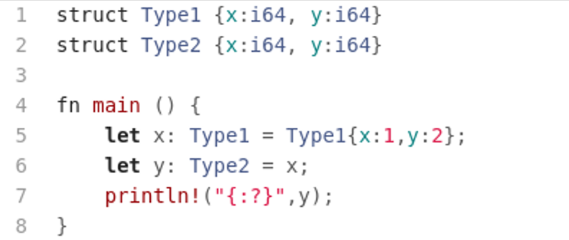
Type Equivalence
I. Name (nominal) Equivalence – two objects are of the same type if and only
if they share the same type name.
Example: Rust
Error; even though the types look
the same, their names are different,
therefore, Rust will not compile.
Rust uses name equivalence

Slide 14
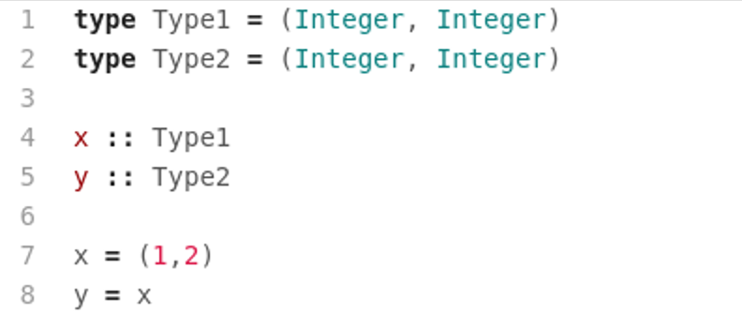
Type Equivalence
II. Structural Equivalence – two objects are of the same type if and only if
they share the same type structure.
Example: Haskell
Even though the type names are different, Haskell correctly recognizes this statement.
☞ Haskell uses structural equivalence.

Slide 15
Type Inference
Type inference refers to the automatic detection of the data type of an expression in a programming language.
To see how this might work let’s work through an example.

Slide 16
Type Inference
Assume we have the following statements in a programming language like Rust:
We want to make sure that all the assignments are legal.
We will use the type notation ‘3.{i64}’ indicating that this syntactic unit has the type i64.
let x : i64 = 3;
let y : i64 = 2 * x;

Slide 17
Type Inference
We start at the primitives on the right side of the assignments starting with the first statement and then stepping through all the remaining statements

Slide 18
Type Inference
✓
let x : i64 = 3;
let y : i64 = 2.{i64} * x;
let x : i64 = 3.{i64};
let y : i64 = 2 * x;
✓
let x : i64 = 3;
let y : i64 = 2.{i64} * x.{i64};
✓
let x : i64 = 3.{i64};
let y : i64 = 2 * x;
✓
let x : i64 = 3;
let y : i64 = 2 *.{fn(i64,i64)->i64} x;
✓
let x : i64 = 3;
let y : i64 = 2 *.{fn(i64,i64)->i64} x;
✓
✓
let x : i64 = 3;
let y : i64 = 2 * x;
✓

Slide 19
Type Inference
Let’s try a program with a bug in it:
let x : i64 = 3;
let y : f64 = 2 * x;

Slide 20
Type Inference
✓
let x : i64 = 3;
let y : f64 = 2.{i64} * x;
let x : i64 = 3.{i64};
let y : f64 = 2 * x;
✓
let x : i64 = 3;
let y : f64 = 2.{i64} * x.{i64};
✓
let x : i64 = 3.{i64};
let y : f64 = 2 * x;
✓
let x : i64 = 3;
let y : f64 = 2 *.{fn(i64,i64)->i64} x;
✓
let x : i64 = 3;
let y : f64 = 2 *.{fn(i64,i64)->i64} x;
✘
✓
let x : i64 = 3;
let y : f64 = 2 * x;
✘

Slide 21
Types & Objects
In any OO language class definitions create new types
Objects are the values in those types
In OO languages that support inheritance, inheritance creates a subtype-supertype relationship in the class hierarchy

Slide 22
Types & Objects
Example: Java
class Cup { ... };
class CoffeeCup extends Cup { ... };
class TeaCup extends Cup { ... };
Cup
Which ones of the following statements are safe and
which ones are not?
Cup x = new Cup();
Cup y = new CoffeeCup();
TeaCup z = new Cup();
TeaCup t = new TeaCup();
Cup c = t;
CoffeeCup
TeaCup
Notation:
A → B means A is subtype of B
Note: Type coercion in type hierarchies gives
rise to polymorphic programming in OO - objects
can appear in different type contexts.

Slide 23
Exercises
Describe the type associated with the set of values {-1,-2,-3,-4,…}, call this type Q.
Describe the type associate with the set of values {-2,-4,-6,-8,…}, call this type P.
Is there a subtype-supertype relationship between this types? If so, what is it?
Let x be a variable of type Q and y be a variable of type P, then is the assignment
x := y
a safe assignment? Why? Why not?
Describe the type associated with set Q → P.

Slide 24
Take Away
Types are sets of values, typically with a common representation and common set of operations.
Types in programming languages allows compilers and interpreters to check for consistency in your programs.
Inconsistencies usually show up a type mismatches.
Type equivalence between constructed types can be established in one of two ways, name equivalence or structural equivalence.
Class hierarchies in OO languages give rise to subtype-supertype relationships due to inheritance.

Slide 25
Assignments
Assignment #2 – See BrightSpace

