Slide 1
Welcome - CSC 301
CSC 301- Foundations of Programming Languages
Instructor: Dr. Lutz Hamel
Email: lutzhamel@uri.edu
Office Hours: WF 11-noon, remotely
TA: Siyi Li
(for more details see course website)

Slide 2
Why Study Programming Languages?
Amazing variety
  ~2300 different programming languages discussed on online forums*.
“Strange” controversies
  Should a programming language have a ‘goto’ statement?
  Should an OO language support inheritance?
  Terminology: argument vs. actual parameter.
Many connections
  Programming languages touch upon virtually all areas of computer science: from the mathematical theory of formal languages and automata to the implementation of operating systems.
Intriguing evolution
  Programming languages change!
    New ideas and experiences trigger new languages.
    New languages trigger new ideas, etc.
*Source: Webber, Modern Programming Languages: A Practical Introduction.

Slide 3
Programming Language Classes
There are many different programming language classes, but three classes or paradigms stand out:
  Imperative Languages
  Functional Languages
  Logic/Rule Based Languages

Slide 4
What Happened to OOP?
Object-orientation is really a property of the type system of a language.
OO features have traditionally been added to imperative languages (C++, Java, Python)
Object-oriented features have also been added to:
  Functional programming languages like Lisp (CLOS)
  Logic languages like Prolog (Logtalk)
Here we look at object-orientation in terms of another imperative language - Rust

Slide 5
Meet Our Languages
Rust – Imperative with OOP features
Haskell – Functional
Prolog – Logic

Slide 6
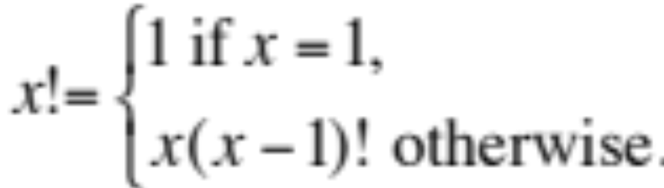
Example Computation
Recursive definition of the factorial operator
for all x > 0.

Slide 7
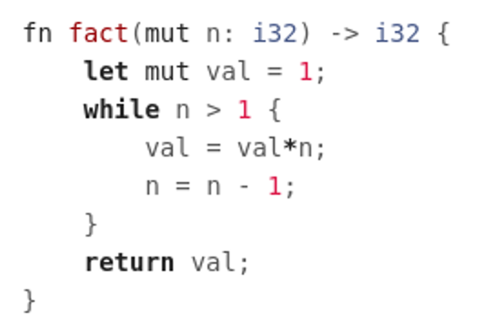
Imperative Languages
Hallmarks: assignment and iteration
Examples: C, FORTRAN, Rust
Example Program: factorial program in Rust

Slide 8
Imperative Languages
Observations:
  The program text determines the order of execution of the statements.
  We have the notion of a ‘current value’ of a variable – accessible state of variable.
This is not always true in other languages.

Slide 9
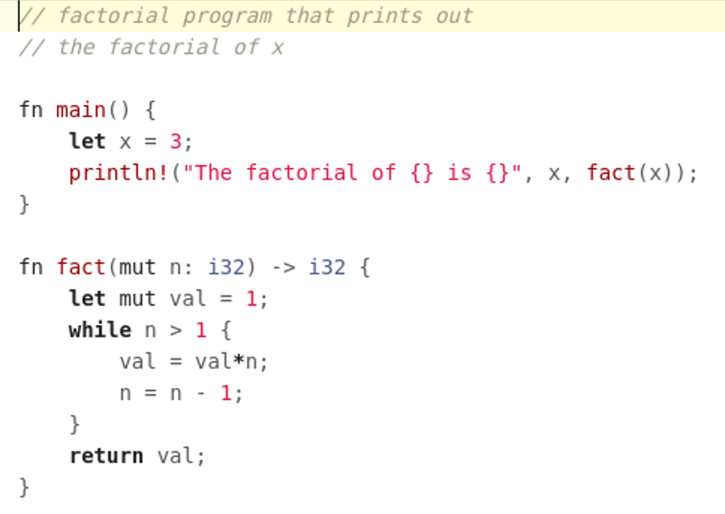
Rust

Slide 10
Functional Languages
Hallmarks: recursion and single valued variables.
Examples: ML, Lisp, Haskell
Example Program: factorial program in Haskell
fact 1 = 1
fact n = n * fact (n-1)
recursion

Slide 11
Functional Languages
Observations:
  There are no explicit assignments.
  The name stems from the fact that programs consist of recursive definitions of functions.

Slide 12
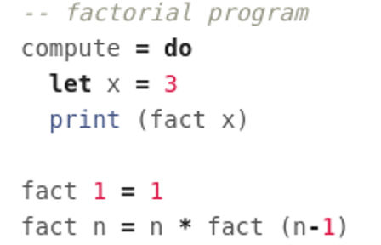
Haskell

Slide 13
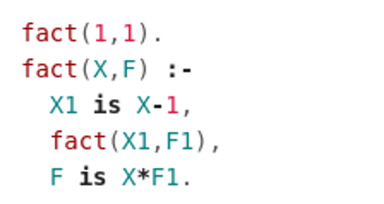
Logic Programming Languages
Hallmarks: programs consist of rules that specify the problem solution.
Examples: Prolog, Maude, Isabelle
Example Program: factorial program written in Prolog
fact(in,out)
‘and’
rules
unification

Slide 14
Logic Programming Languages
Observations:
  Rules do not appear in the order of execution in the program text.
  No specific order of execution is given – rules ‘fire’ when necessary.

Slide 15
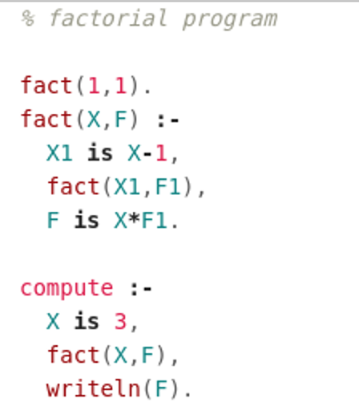
Prolog

Slide 16
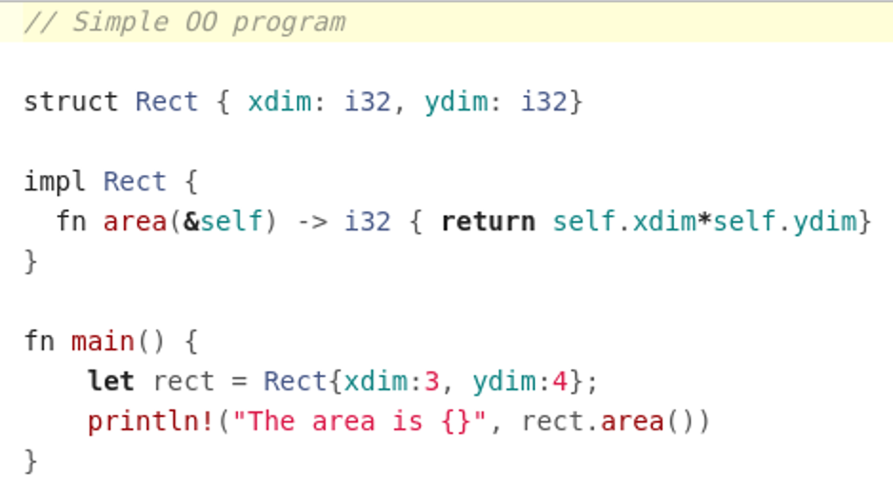
Object-Oriented Languages
Hallmarks: bundle data with the allowed operations  Objects
Rust takes an interesting approach here – structures with functions.

Slide 17
Programming Language Classes
General Observations:
  Programming languages guide programmers towards a particular programming style:
    Imperative → iteration/assignment
    Functional → mathematical functions
    OO → objects
    Logic → rules
  Programming itself guides the developer towards new language ideas:
    Recursion was introduced by John McCarthy in the 1950’s with the programming language Lisp to solve problems in AI.
    Classes and objects were developed by Nygaard and Dahl in the 1960’s and 70’s for the language Simula in order to solve problem in simulations.

Slide 18
Take Away
There exist many programming languages today (> 2000)
In order to understand the similarities and differences ⇒ sort into classes
  Imperative
    assignment and iteration
  Functional
    Recursion, single valued variables
  Logic/rule based
    programs consist of rules
Object-oriented
  bundle data with the allowed operations

Slide 19
Reading & Assignments
Reading: Intro from “A Gentle Introduction to Rust” from here on known as GIR
  https://stevedonovan.github.io/rust-gentle-intro/readme.html
Assignment #0: Download & Read Syllabus – upload a copy of it into BS

