Slide 1
Tuples & Lists
Tuples have almost the same syntax as Rust.
> joe = (32,185,”married”,”pilot”)
> :type joe
joe :: (Num a, Num b) => (a, b, [Char], [Char])
> (age, height, _, _) = joe
> age
=> 32
> :type age
age :: Num a => a
Type
Pattern Matching

Slide 2
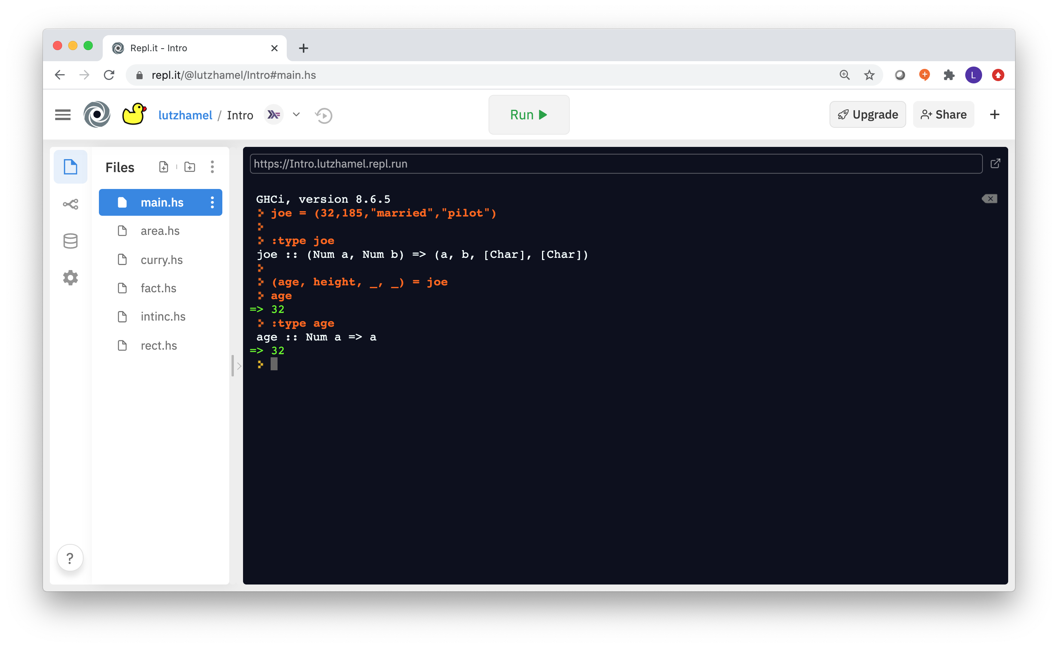
Tuples & Lists
Haskell supports tuples, almost the same syntax as Rust.

Slide 3
Tuples & Lists
Nested tuples – say we want to specify a circle with a center and a radius…
> circle = ((2.5,3.6),5.0)
> circle
=> ((2.5,3.6),5.0)
> :type circle
circle :: (Fractional a, Fractional b1, Fractional b2) => ((a, b1), b2)
=> ((2.5,3.6),5.0)
> center, radius) = circle
center
=> (2.5,3.6)
> radius=> 5.0

Slide 4
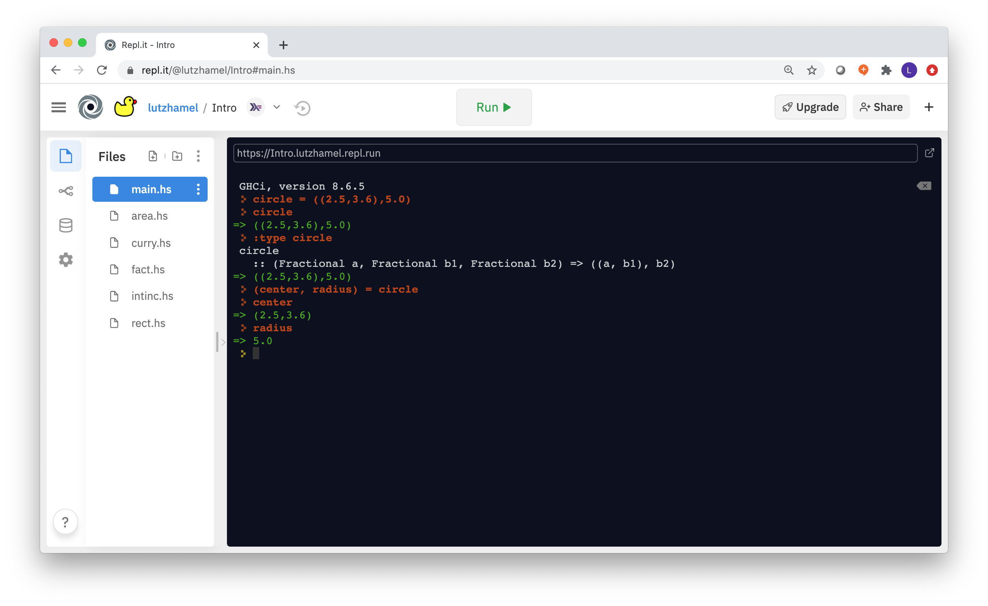
Tuples & Lists

Slide 5
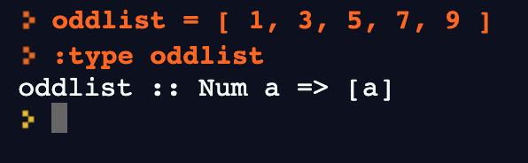
Tuples & Lists
In a list all elements are of the same type
different from tuples!
nested = [(1,2),(3,4)]
nested = [[1,2],[3,4]]
nested = [[1,2],[3,4,5]]
nested = [(1,2),(3,4,5)]
what is the type of these constructions?

Slide 6
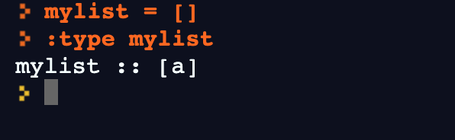
Tuples & Lists
There exists a special list → the empty list: [ ]
Polymorphic type!

Slide 7
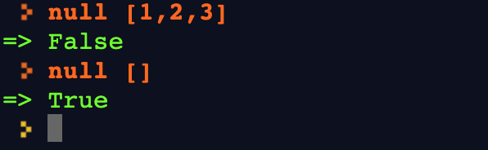
List Operators
null – tests whether a list is empty
  null :: [a] -> Bool

Slide 8
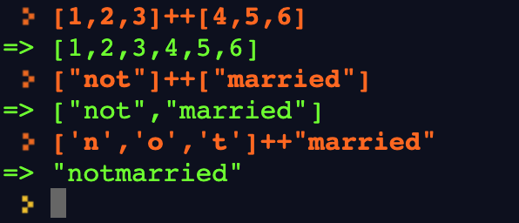
List Operators
++ - concatenates two lists
  (++) :: [a] -> [a] -> [a]
Recall, any infix operator can be viewed as a function by putting
parentheses around it.
But…

Slide 9
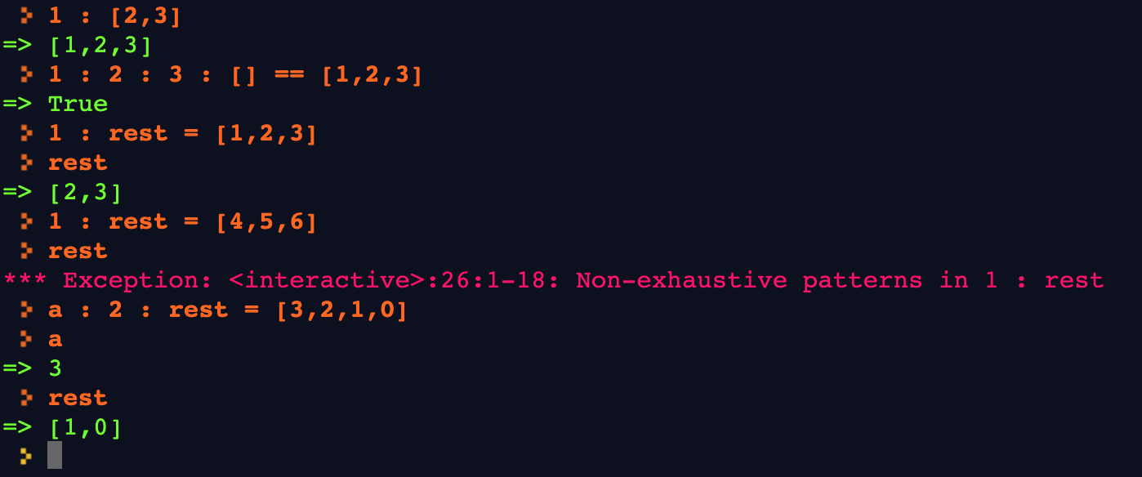
List Operators
: - (cons operator) glue elements together to form a list
the last elements has to always be a list
  (:) :: a -> [a] -> [a]

Slide 10
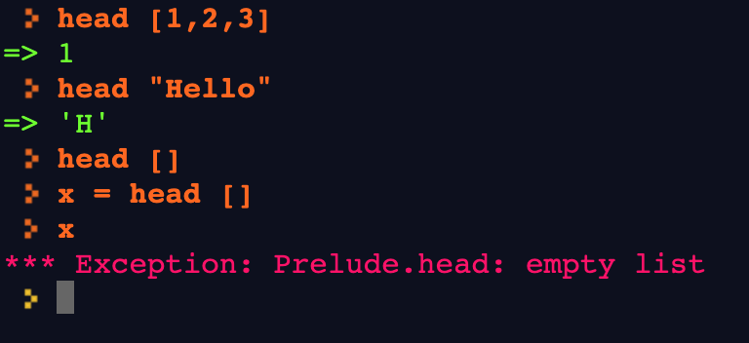
List Operators
head – return the first element of a list
  head :: [a] -> a

Slide 11
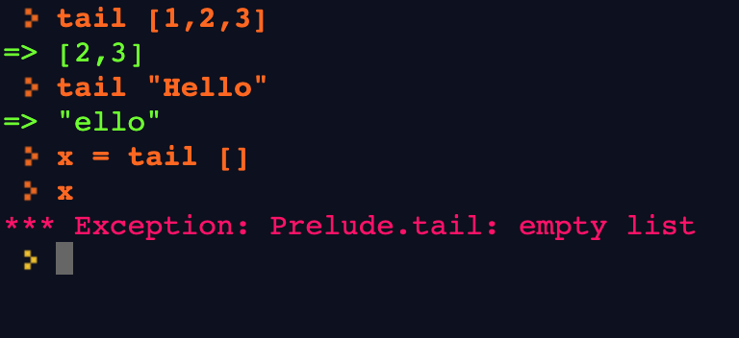
List Operators
tail – return the list without its first element
  tail :: [a] -> [a]

Slide 12
List Operators
(a) x = ["hello"] ++ ["there"]
(b) x = ["hello" ++ "there"]
(c) joe = (32, 185, "married", "pilot")
jack = (29, 160, "not married", "cook")
people = [joe, jack]
(d) l = [[1,2,3],["one", "two", "three"]]
(e) x = [1,2,3]
h = head(x)
t = tail(x)
l = h : t
l?
(f) y = 1::2::3

