Slide 1
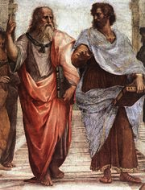
Logic as a Programming Language
Logic can be considered the oldest programming language
Aristotle invented propositional logic over 2000 years ago in order to prove properties of formal arguments
Propositions - simple statements that are either true or false; e.g. Betty wears a white dress. Today is Sunday.
Propositional Logic ≡ propositions + rules of inference
Most famous inference rule: modus ponens
HW:
Read Section 1 online tutorial
available on the CSC301
Prolog page. (first tutorial)
Let A and B be propositions, then
A implies B
A is true
--------------------
∴ B is true
(1) Inference is the act or process of drawing a conclusion based solely on what one already knows.
(2) Rule of inference is a scheme for constructing valid inferences.

Slide 2
Propositional Logic
Example:
If Betty wears a white dress then today is Sunday.
Betty wears a white dress.
------------------------------------------------------------------------
∴ Today is Sunday.
A fundamental problem with propositional logic is that it is not powerful
enough to encode general knowledge - we would like to say things like:
All objects that are considered human are mortal.
Due to the fact that this sentence is not simple it can not be considered
a proposition. But these kind of sentences are key in describing
general knowledge.

Slide 3
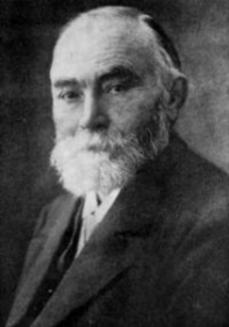
Quantification
In 1879 Gottlob Frege introduced the predicate calculus (‘Begriffsschrifft’)
Today predicate calculus is more commonly known as First Order Logic.
This logic solves the problems of propositional logic by introducing three new structures: predicates, universal quantification, and existential quantification.
Friedrich Ludwig Gottlob Frege
Philosopher and Logician

Slide 4
First-Order Logic
Quantified Variables
  Universally quantified variables
  ∀X – for All objects X
  Existentially quantified variables
  ∃Y – there Exists an object Y

Slide 5
First-Order Logic
Predicates
  Predicates are functions that map their arguments into true/false
  The signature of a predicate p(X) is
    p: Objects → { true, false }
  Example: human(X)
    human: Objects → { true, false }
    human(tree) = false
    human(paul) = true
  Example: mother(X,Y)
    mother: Objects × Objects → { true, false }
    mother(betty,paul) = true
    Mother(giraffe,peter) = false

Slide 6
First-Order Logic
We can combine predicates and quantified variables to make statements on sets of objects
  ∃X[mother(X,paul)]
    there exists an object X such that X is the mother of Paul
  ∀Y[human(Y)]
    for all objects Y such that Y is human

Slide 7
First-Order Logic
Logical Connectives: and, or, not
  ∃F∀C[parent(F,C) and male(F)]
    There exists an object F for all object C such that F is a parent of C and F is male.
  ∀X[day(X) and (wet(X) or dry(X))]
    For all objects X such that X is a day and X is either wet or dry.

Slide 8
First-Order Logic
If-then rules: A → B
  ∀X∀Y[parent(X,Y) and female(X) → mother(X,Y)]
    For all objects X and for all objects Y such that if X is a parent of Y and X is female then X is a mother.
  ∀Q[human(Q) → mortal(Q)]
    For all objects Q such that if Q is human then Q is mortal.

Slide 9
Horn Clause Logic
In horn clause logic the form of the WFF’s is restricted:
P₁ ∧ P₂ ∧ … ∧ P_{n-1} ∧ P_{n} → P₀
Where P₀ , P₁ , P₂, … P_{n-1}, P_{n} are predicates.
Single predicate in consequent
Conjunctions only!

Slide 10
Proving things is computation!
Use resolution to reason with horn clause expressions - resolution mimics
the modus ponens using horn clause expressions.
Advantage: this can be done mechanically (Alan Robinson, 1965)
“Deduction is Computation”
J. Alan Robinson: A Machine-Oriented Logic Based on the Resolution Principle. J. ACM 12(1): 23-41 (1965)

Slide 11
Basic Prolog Programs
Facts - a fact constitutes a declaration of a truth; in Prolog it has to
to be a positive assertion.
Prolog Programs - a Prolog program is a collection of facts (…and rules,
as we will see later).
Example: a simple program
man(phil).
man(john).
woman(betty).
Facts, Prolog will treat these as true and enters
them into its knowledgebase.
We execute Prolog programs by posing queries on its knowledgebase:
?- man(phil).
true - because Prolog can use its knowledgebase to prove true.
?- woman(phil).
false - this fact is not in the knowledgebase.
Prompt
Prolog ≡ Programming in Logic

Slide 12
Prolog - Queries & Goals
A query is a way to extract information from a logic program.
Given a query, Prolog attempts to show that the query is a logical
consequence of the program; of the collection of facts.
In other words, a query is a goal that Prolog is attempting to satisfy (prove true).
When queries contain variables they are existentially quantified, consider
?- parent(X,liz).
The interpretation of this query is: prove that there is at least one object X
that can be considered a parent of liz, or formally, prove that
∃x[parent(x,liz)]
holds.
NOTE: Prolog will return all objects for which a query evaluates to true.

Slide 13
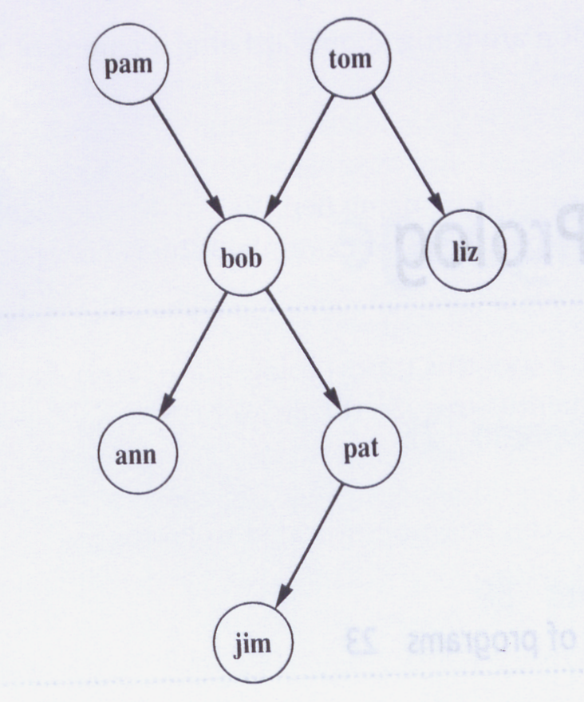
A Prolog Program
% a simple prolog program
woman(pam).
woman(liz).
woman(ann).
woman(pat).
man(tom).
man(bob).
man(jim).
parent(pam,bob).
parent(tom,bob).
parent(tom,liz).
parent(bob,ann).
parent(bob,pat).
parent(pat,jim).
Parent
Relation
Example Queries:
?- man(pam).
?- woman(X). ∃X[woman(X)]?
?- parent(tom,Z).
?- father(Y).
A Family Tree
Demo of ‘trace’ that demonstrates the search in Prolog

Slide 14
Compound Queries
A compound query is the conjunction of individual simple queries.
Stated in terms of goals: a compound goal is the conjunction of individual
subgoals each of which needs to be satisfied in order for the compound goal
to be satisfied. Consider:
?- parent(X,Y) , parent(Y,ann).
or formally,
∃X,Y[parent(X,Y) ∧ parent(Y,ann)]
When Prolog tries to satisfy this compound goal, it will make sure that the
two Y variables always have the same values.
Prolog uses unification and backtracking in order to find all the solutions
which satisfy the compound goal.

Slide 15
Unification & Backtracking
Unification is a special kind of pattern matching that instantiates variables with terms/objects.
Backtracking allows Prolog to search for all unifications, called substitutions, that make a query true.

