Slide 1
Functional Programming
Here we explore aspects of functional programming in Asteroid
Functional programming is defined by two things:
  Programs exclusively consist of (recursive) definition of functions – no for-loops allowed!
  Functions are first-class citizens of the language

Slide 2
Functions as First-Class Citizens
Functions as first-class citizens means that we can pass functions around in a program as values, not much different than an integer or real value!
When functional languages first appeared in the late 1970’s and the 1980’s this was a radical concept
Today almost all modern languages support this, e.g.
  Python, JavaScript, Rust, Go

Slide 3
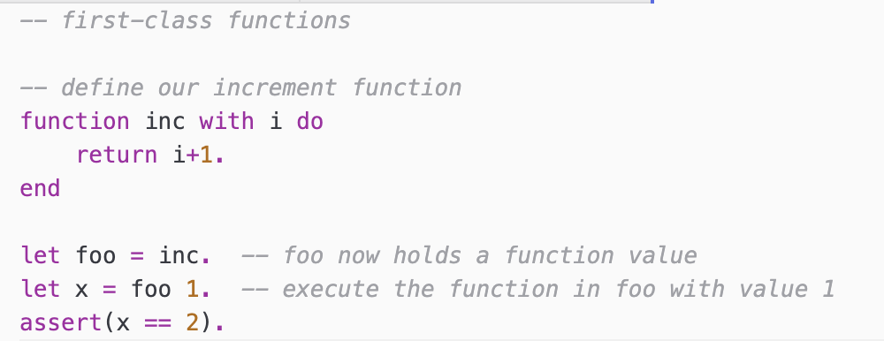
Functions as First-Class Citizens

Slide 4
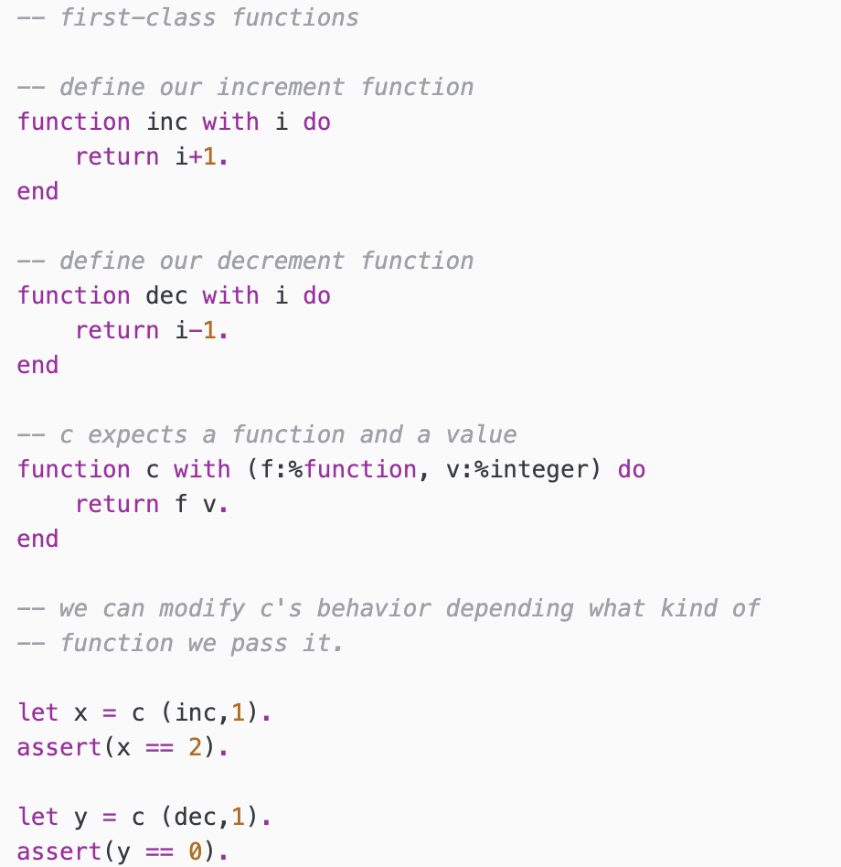
Functions as First-Class Citizens

Slide 5
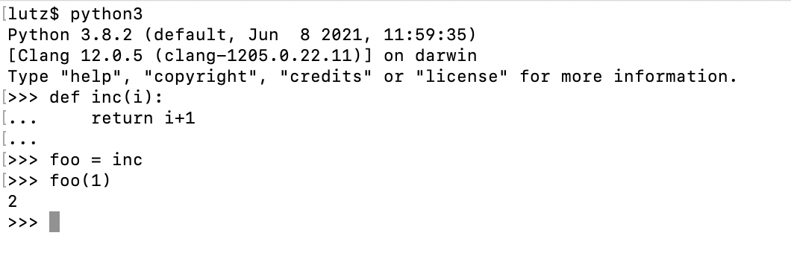
Python
Python supports functions as first-class citizens

Slide 6
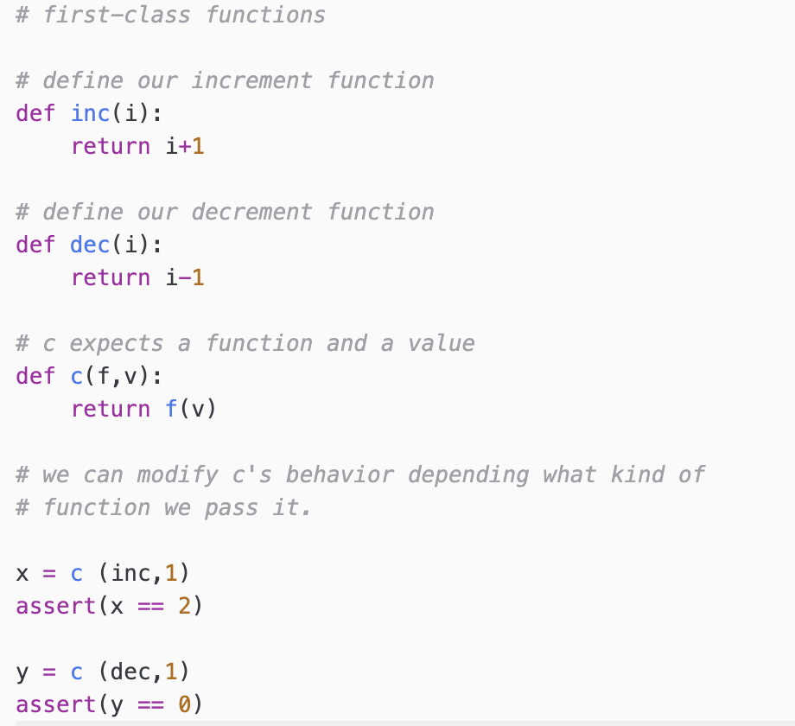
Python

Slide 7
Pattern Matching
In computer science, pattern matching is the act of
checking a given sequence of tokens or a structure for
the presence of the constituents of some pattern.
Pattern matching in programming languages is another invention of functional programming languages.
Easy access to sub-parts of a data structure.

Slide 8
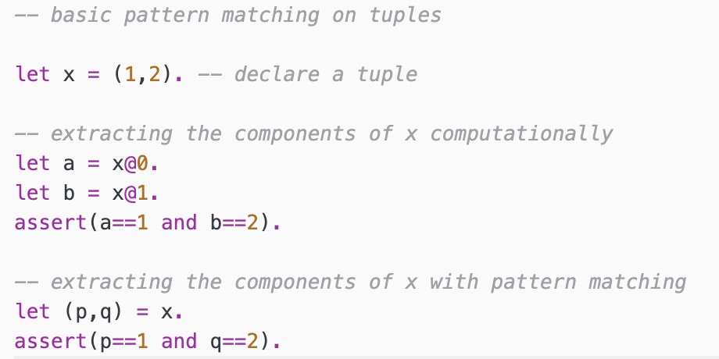
Tuples & Lists
In Asteroid we can use pattern matching to extract the components of a tuple.
Pattern!

Slide 9
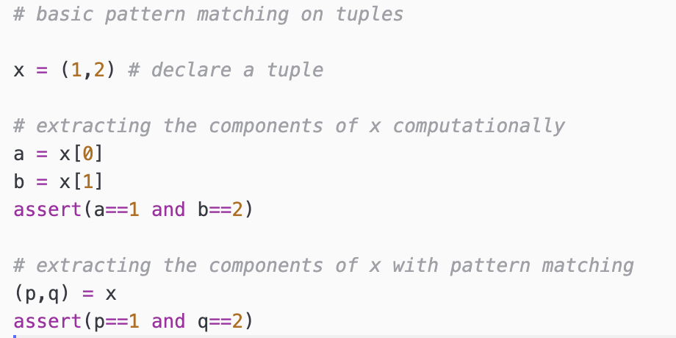
Tuples & Lists
As an example of another programming language Python also supports pattern matching.

Slide 10
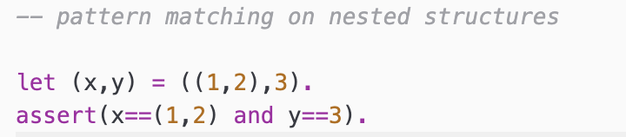
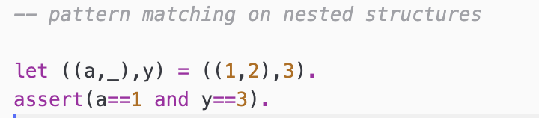
Tuples & Lists
This also works with nested tuples.

Slide 11
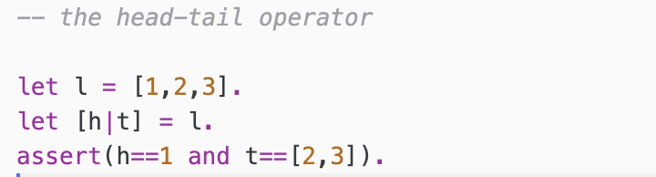
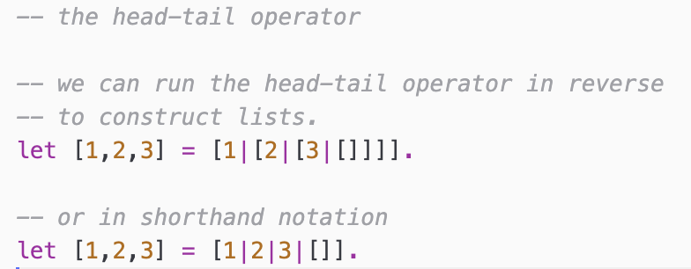
Tuples & Lists
The head-tail pattern [ _ | _ ] is particularly useful to destructure lists – especially when we consider recursive algorithms.
h = 1
first element
of list
t = [2,3]
rest of list
without first
element

Slide 12
Tuples & Lists
In the functional programming language ML the head-tail operator is expressed with _::_
val h::t = [1,2,3];
h = 1
first element
of list
t = [2,3]
rest of list
without first
element

Slide 13
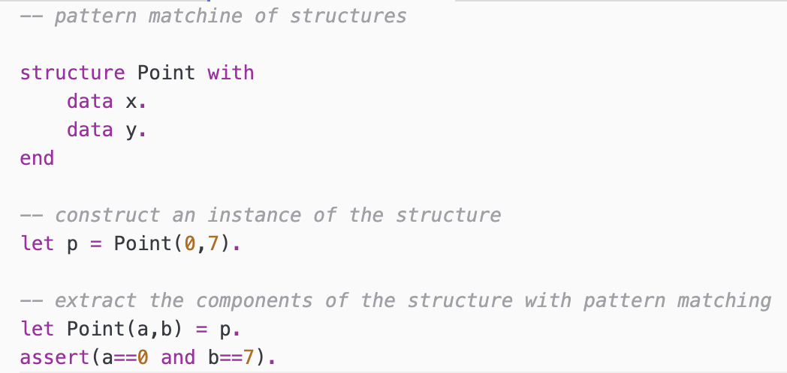
Structures
We can also pattern match on instances of structures – a convenient way to extract the components.
Pattern!

Slide 14
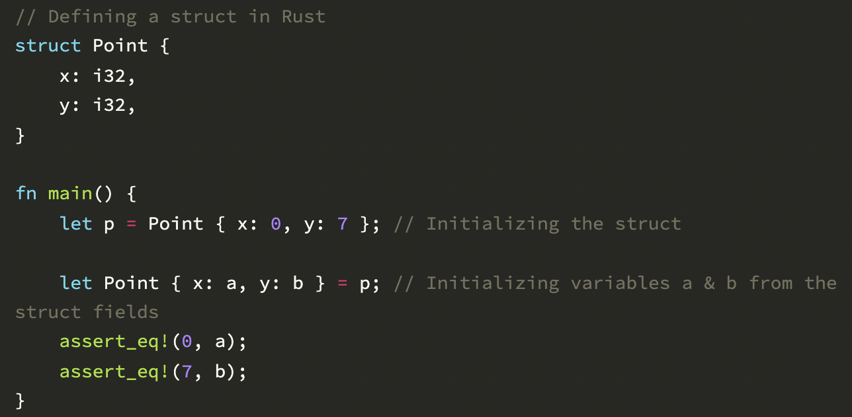
Structures
Structure pattern matching in Rust
Source: https://oribenshir.github.io/afternoon_rusting/blog/enum-and-pattern-matching-part-1

Slide 15
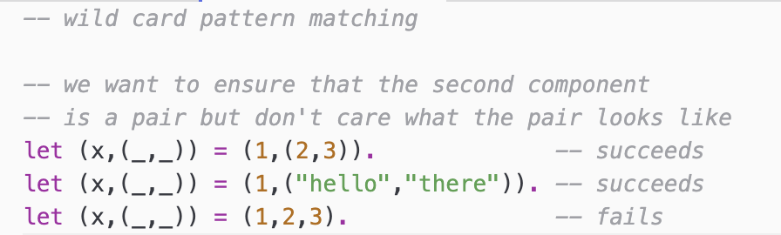
Special Patterns
Wild card patterns will match anything but do not retain what they matched.

Slide 16
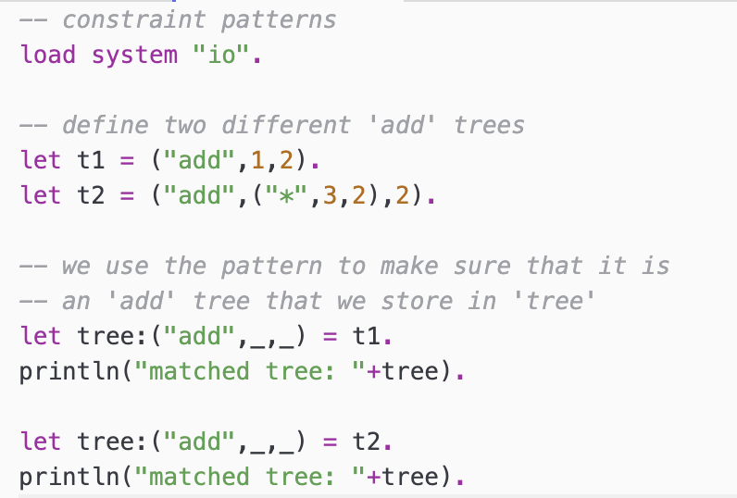
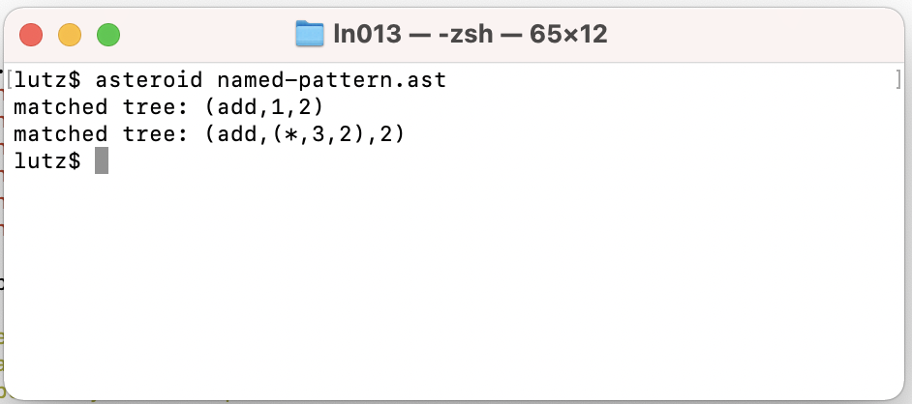
Special Patterns
Constraint Patterns allow us to use patterns in order to limit what is stored in a variable.

Slide 17
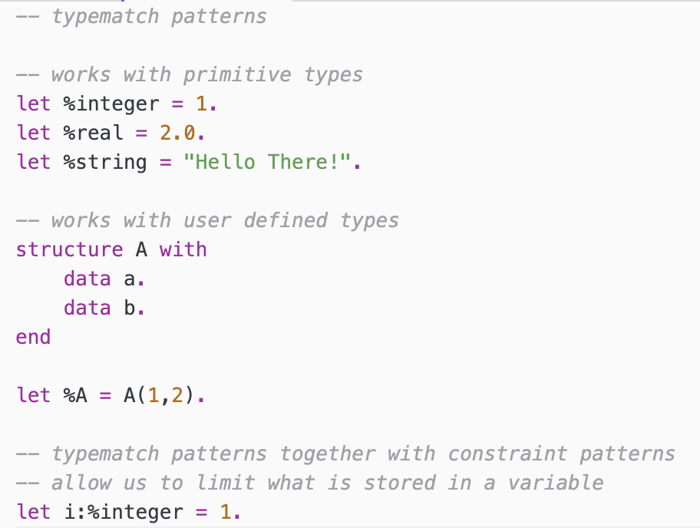
Special Patterns
Typematch patterns allow us to match on all values of a particular type.

Slide 18
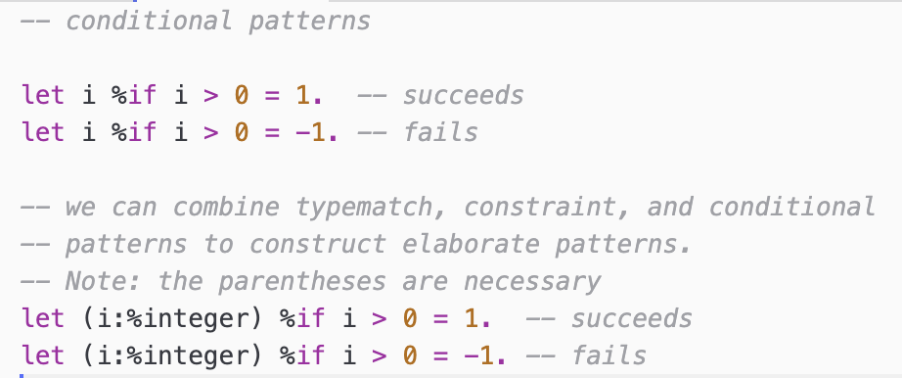
Special Patterns
Conditional patterns allow us to test values during a pattern match.

Slide 19
Multi-Dispatch
Multi-dispatch is a declarative way to look at function definitions using pattern matching on function arguments.
Essentially, we are declaring one function body for each input pattern.

Slide 20
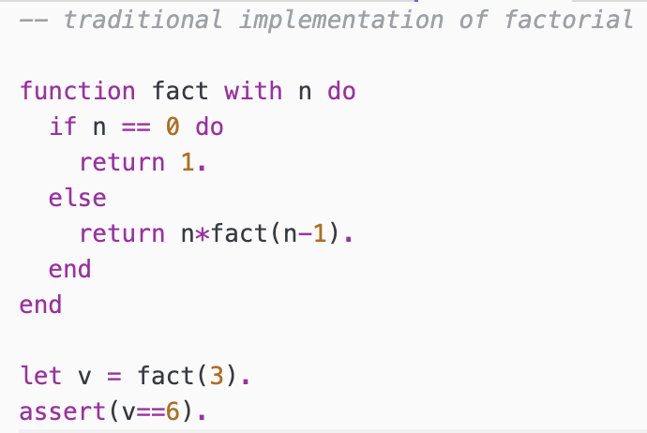
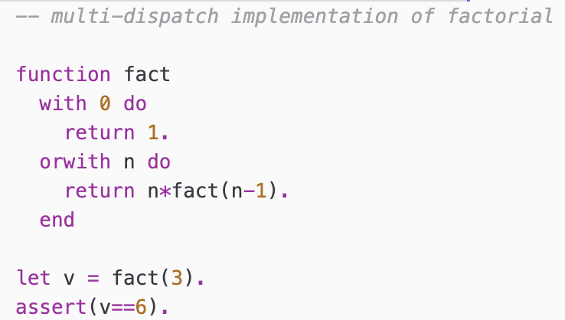
Multi-Dispatch
Computational Approach
Multi-Dispatch Approach

Slide 21
Multi-Dispatch
We have something similar in ML
fun fact n =
if n=0 then 1 else n*fact(n-1);
fun fact 0 = 1
| fact n = n*fact(n-1);

Slide 22
Recursion
This is particularly interesting with more complicated input structures like lists.
In functional programming iteration is not available therefore we need to use recursion
  Base case
  Recursive case

Slide 23
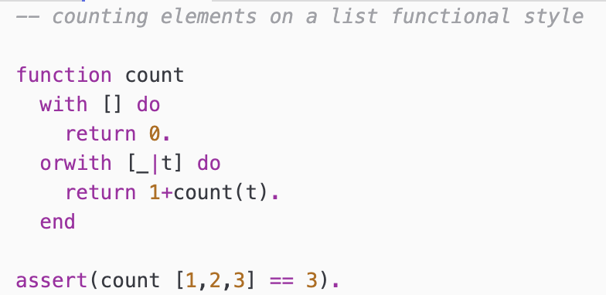
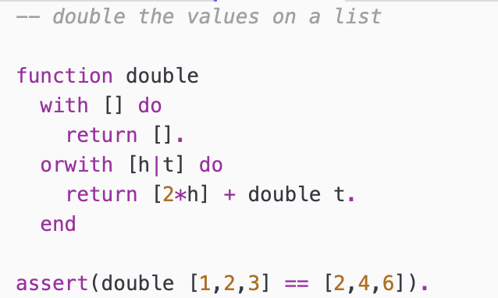
Recursion
Observation: The first ‘with’ clause is always the
base case of the recursion.

Slide 24
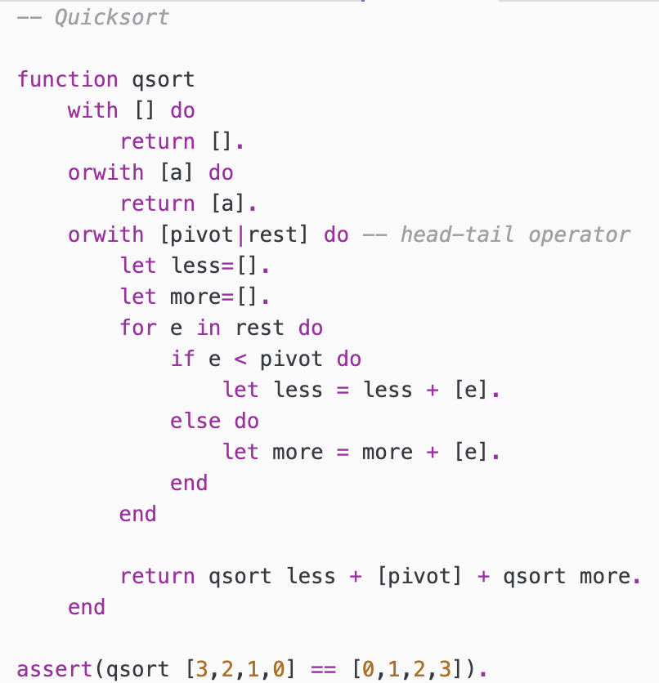
Multi-Dispatch
Recursion with multiple
base cases.

