Slide 1
Formal Semantics
The structure of a language defines its syntax, but what defines
semantics or meaning?
⇒ Behavior!
The most straight forward way to define semantics is to provide a
simple interpreter for the programming language that highlights the
behavior of the language,
⇒ Operational Semantics

Slide 2
Reading
Sections 23.1 & 23.2 in MPL

Slide 3
Operational Semantics
Let’s develop an operational semantics for a simple programming
language called ONE;
ONE: <exp>* ::= <exp> + <mulexp> | <mulexp>
<mulexp> ::= <mulexp> * <rootexp> | <rootexp>
<rootexp> ::= (<exp>) | <constant>
<constant> ::= all valid integer constants
Note: The grammar is unambiguous, both precedence and associativity
rules of “standard” arithmetic are observed.
Do the following sentences belong to L(ONE)? Why? Why not?
s = 1 + 2 * 3
s = (1 + 2) * 3
s = a + 3

Slide 4
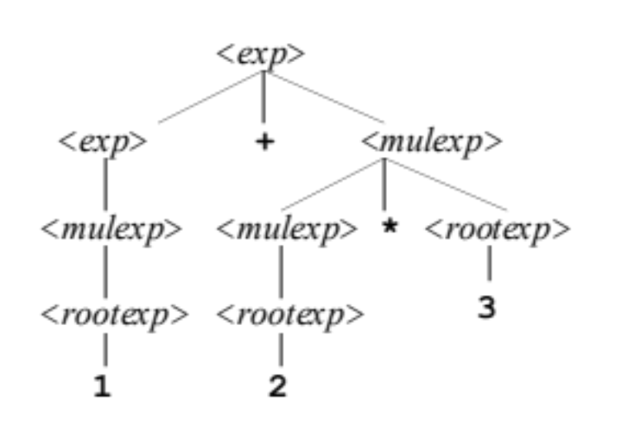
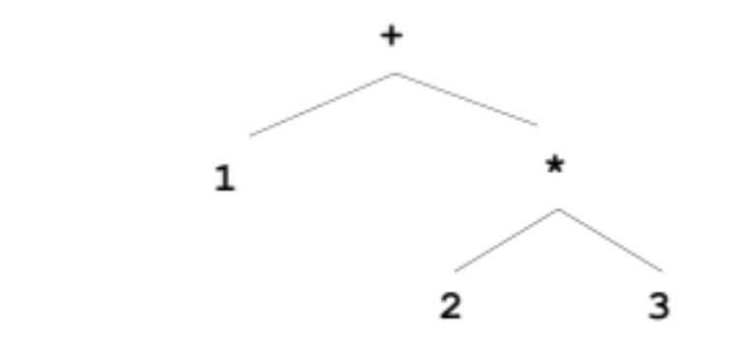
Abstract Syntax Trees
We want to define an operational semantics, i.e., an abstract interpreter
for the language, but parse trees are not very convenient, too many
non-terminal symbols ⇒ Abstract Syntax Tree (AST)
⇒
Transformation Rules:
<N>
<N>
op
⇒
T
⇒
Note: This rule also applies to
unary operators and operators
with arity > 2.
T
A
op
B
A
B

Slide 5
Observations
Observation: The abstract syntax tree is a simplified form of the parse
tree: same order as the parse tree, but no non-terminals.

Slide 6
ASTs & Parentheses
What happens to parentheses in the AST representation of a program?
They are not needed!
ASTs naturally represent associativity and precedence relations.
Consider: (1 + 2) * 3
Parentheses do not contribute to computations, therefore the following tree transformations can be applied:
<N>
( )
⇒
⇒
T
(
T
)
T

Slide 7
Prolog ASTs
We can represent ASTs in Prolog:
+
⇒
plus(A,B)
A
B
*
⇒
times(A,B)
⇓
A
B
plus(const(1),times(const(2),const(3)))
(constant)
⇒
const(c)
c

Slide 8
ONE: Prolog Interpreter
A simple interpreter that computes a semantic value for syntactic
constructs, the computation of this semantic value can be interpreted
as the behavior: myeval / 2, AST input and semantic value as output.
myeval(plus(X,Y),Value) :-
myeval(X,XValue),
myeval(Y,YValue),
Value is XValue + YValue.
myeval(times(X,Y),Value) :-
myeval(X,XValue),
myeval(Y,YValue),
Value is XValue * YValue.
myeval(const(X),Value) :- Value = X.
?- myeval(const(1),X).
X = 1
Yes
?- myeval(plus(const(1),const(2)),X).
X = 3
Yes
?- myeval(plus(const(1),times(const(2),const(3))),X).
X = 7
Yes

Slide 9
Semantics of Expressions
With our semantics (interpreter) in place we can now compute the semantic value of any expression program, e.g.
1+2*3
plus(const(1),times(const(2),const(3)))
?- myeval(plus(const(1),times(const(2),const(3))),X).
X = 7

Slide 10
Exercises
Extend the grammar for language ONE with the subtraction operator
Extend the operational semantics appropriately, e.g.,
  6 – 3 should give the value 3
  Assume that the abstract syntax of this operator is sub(x,y).
Compute the semantic value for the following expressions:
  sub(3,1)
  sub(4,2)

Slide 11
Exercises
Extend the grammar for language ONE with the ‘!’ factorial operator
Extend the operational semantics appropriately, e.g.,
  3! should give the value 6
  Assume that the abstract syntax of this operator is fact(x).
Compute the semantic value for the following expressions:
  fact(3)
  fact(4)

