Slide 1
Generics
Functions, structs, and enums can be turned into ‘generics’
By that we mean that generic functions, structs, or enums are parameterized over some type variables.
We often call this parametric polymorphism – more on that later.

Slide 2
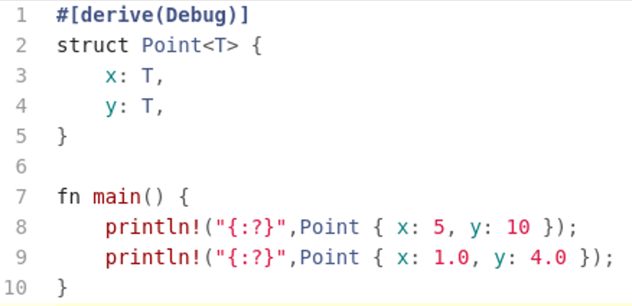
Generic Structs
Generic structs look like ordinary structs with the exception that they introduce a type variable.
In our example the type variable is ‘T’ which allows the type Point to be specified in different coordinate systems.
  Eg integer coordinates and floating point coordinates.
Here Rust’s type system insures that both ‘x’ and ‘y’ are instantiated with the same type ‘T’ (whatever that might be)

Slide 3
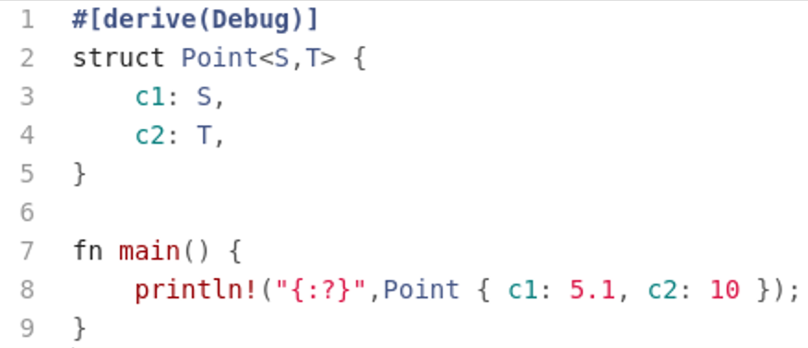
Generic Structs
We can get rid of that constraint by introducing two type variables.

Slide 4
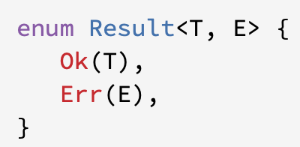
Generic Enums
Generic enums look almost identical to generic structs in that the variants of the enum can be parameterized of different data types
Perhaps the most common generic enum is ‘Result’ which is a type that the standard Rust library uses to return status from a function call

Slide 5
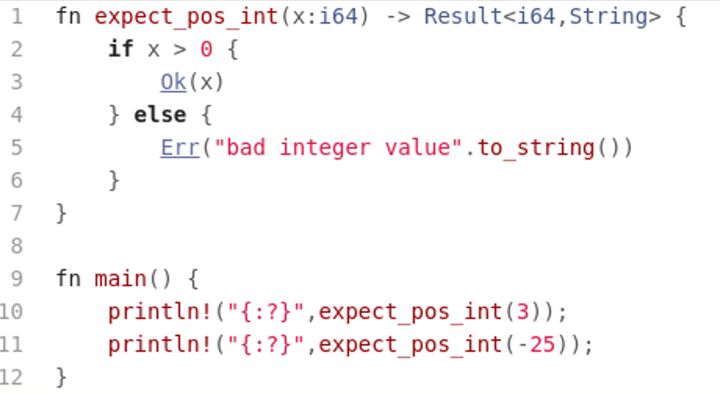
Generic Enums

Slide 6
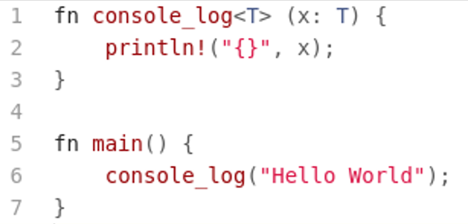
Generic Functions
As we said at the beginning, functions can also be parameterized over types using type variables.
However, things are a bit more complicated because given a generic type we want to be able to compute things…but we don’t know virtually anything about a generic type.
Consider the following program, ‘console_log’ is a generic function parameterized using ‘T’, yet..

Slide 7
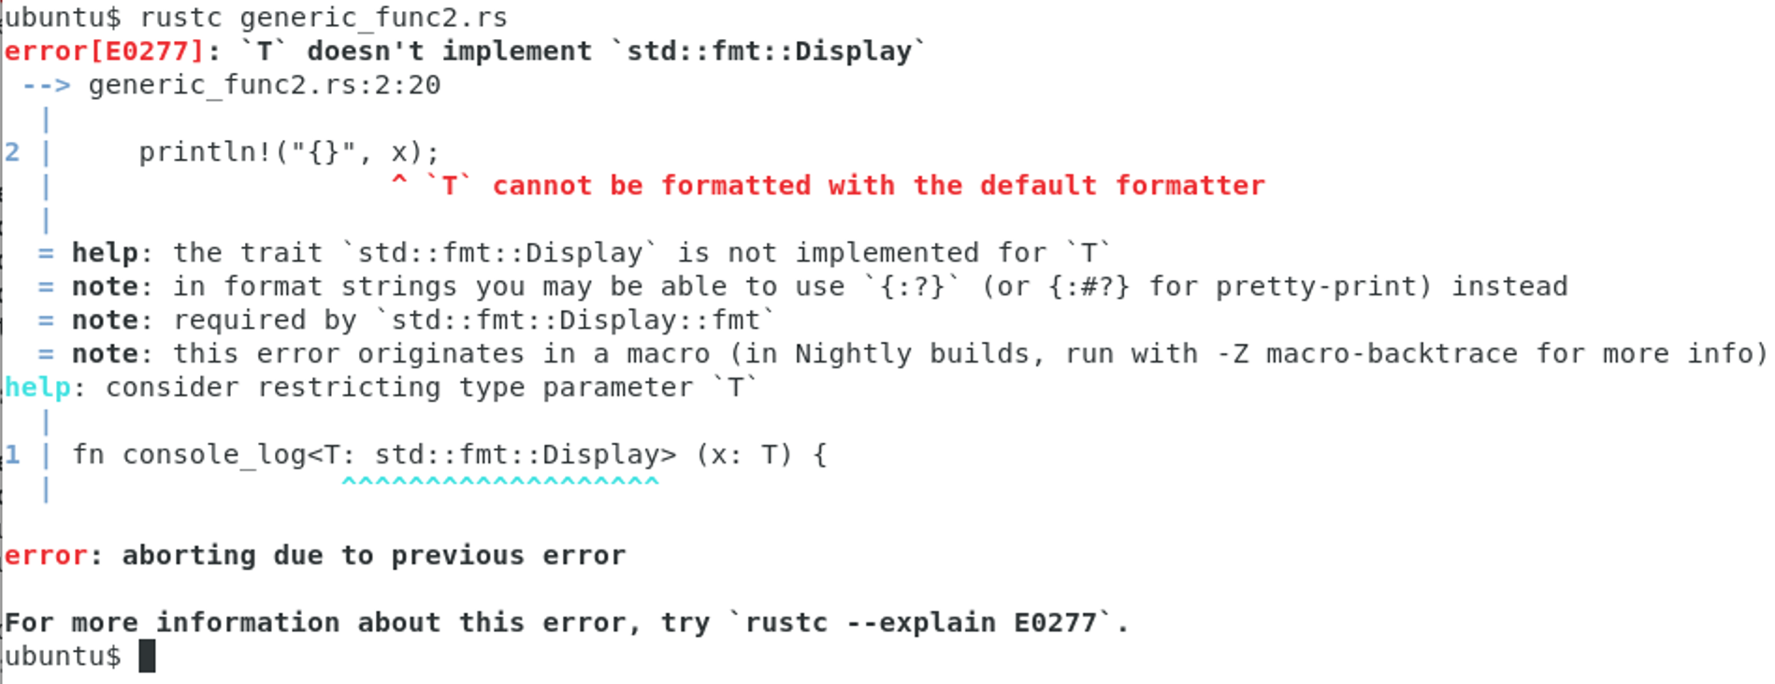
Generic Functions
Rust does not know how to print generic type ‘T’….

Slide 8
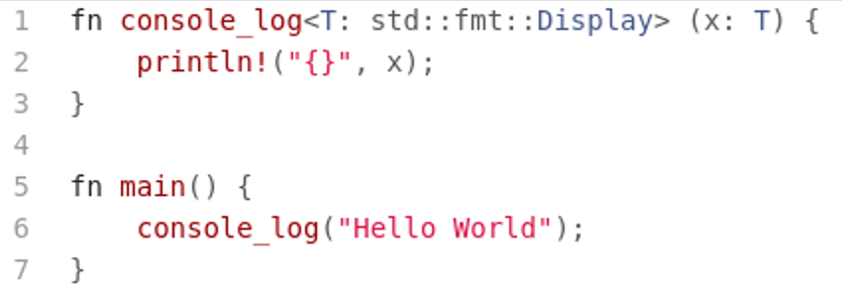
Generic Functions
The solution: tell the compiler that we expect type ‘T’ to have certain Traits!
Introduce Trait Bounds.

Slide 9
Generic Functions
Being able to bound the types to a generic is sometimes called:
  Bounded Parametric Polymorphism

Slide 10
Rust Values and Moving
Rust keeps track how memory is used
In particular, it keeps track how values move around your program
It flags situations where you might be using a ‘stale’ value after you copied the value somewhere else.
Consider…

Slide 11
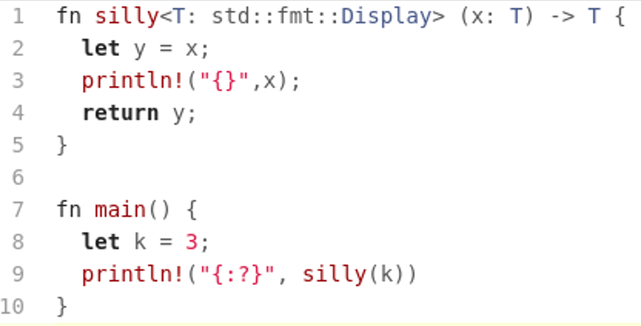
Rust Values and Moving
This program will generate an error because you are trying to use ‘x’ after you copied the value out of ’x’.

Slide 12
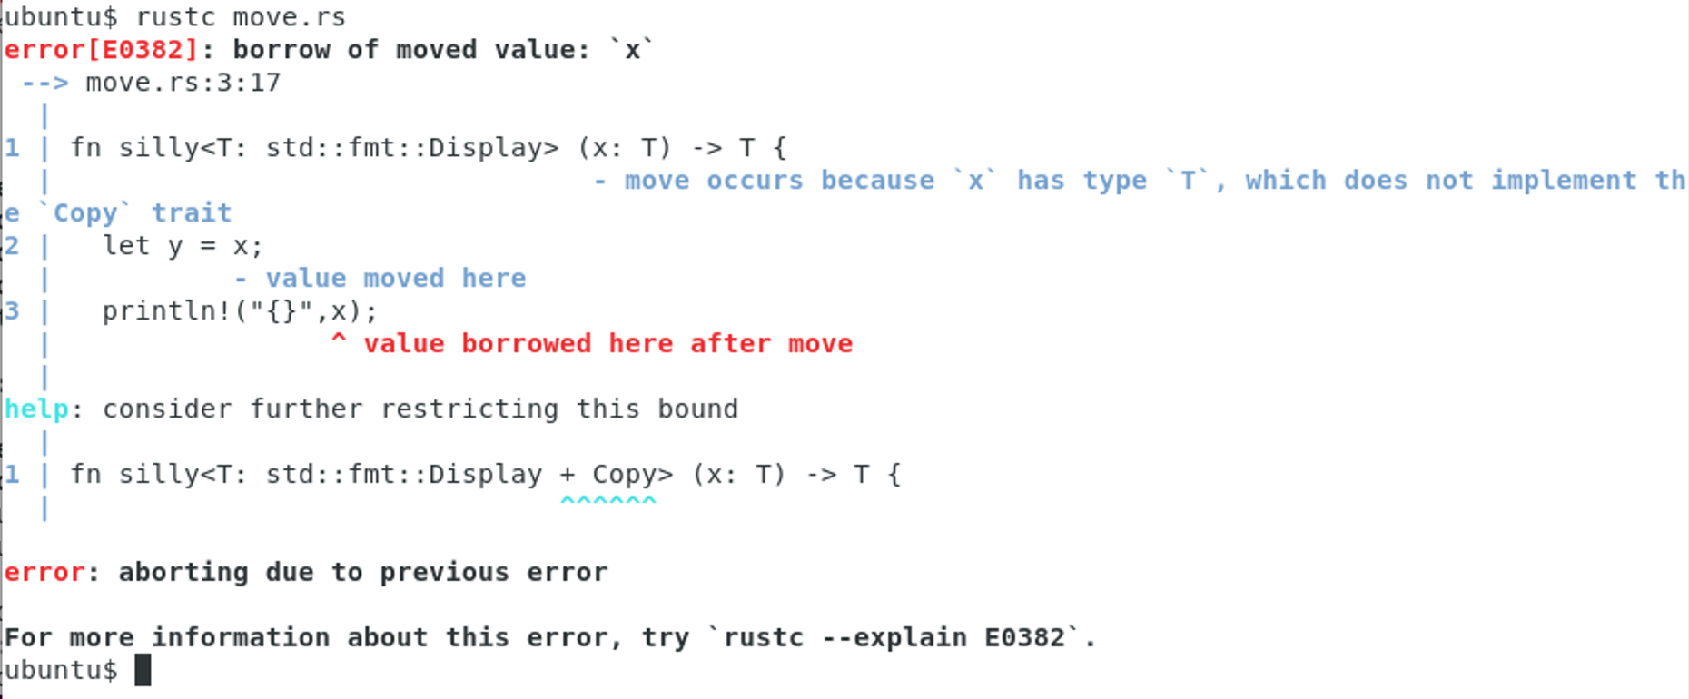
Rust Values and Moving

