Slide 1
Rust’s std Library
This is a very large library and you are encouraged to take a peek at it
  https://doc.rust-lang.org/std
Here we only look at two things:
  Strings
  Basic I/O

Slide 2
Strings
Rust has TWO string types
  str – string constants/string literals – these are strings allocated in static memory
  String – strings allocated on the heap
Being a system programming language Rust is very concerned with memory usage.
  Think of an embedded system with limited RAM
  you don’t want to fill up RAM with string constants
  therefore Rust allows the developer this additional level of control of how strings are being used
  Static strings can be stored in ROM rather than RAM

Slide 3
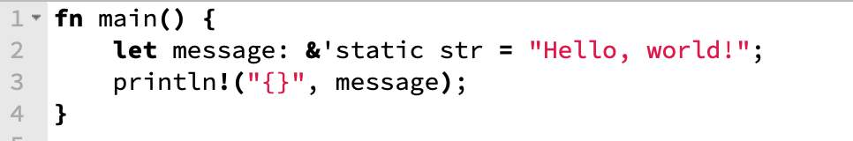
Strings
Here is an example snippet using the ‘str’ type
String constants live in static memory therefore you can only get references to them
You should only use ‘str’ if you are really concerned about memory usage – not the case in our 64-bit memory laptops.
The library info on this type can be found here:
  https://doc.rust-lang.org/std/primitive.str.html

Slide 4
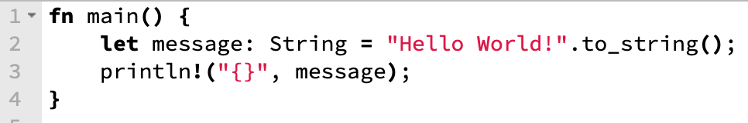
Strings
Enter the other string type: String
  https://doc.rust-lang.org/std/string/
This string type behaves much like the strings we are used to from other languages
  No references needed
The only catch is that you will have to explicitly convert string literals into this String type.

Slide 5
I/O
We have seen one I/O related operation – the println macro
Here we take a look at
  Reading and writing to/from stdin and stdout, respectively
  Reading and writing files

Slide 6
I/O
The key to Rust I/O is that we have file handles and traits that these file handles implement.
Setting up I/O operations is mostly driven by importing the correct file handles and the appropriate traits.

Slide 7
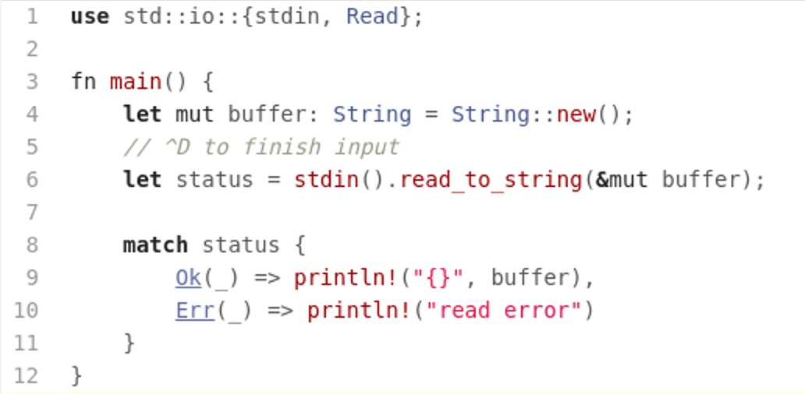
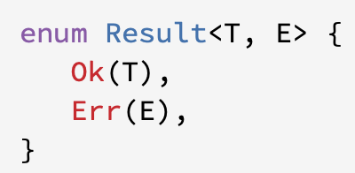
Stdin
Here we are importing the file handle stdin and the trait Read
We then call read_to_string on the file handle which is a function the trait Read implements
All I/O functions return the type Result which is an enum with variants Ok and Err.

Slide 8
io::Result
Turns out that I/O functions use an abbreviated version of Result, one which as the second type argument instantiated to io::Error
You have to be aware of this when trying to return the status of an I/O operation from your own functions.

Slide 9
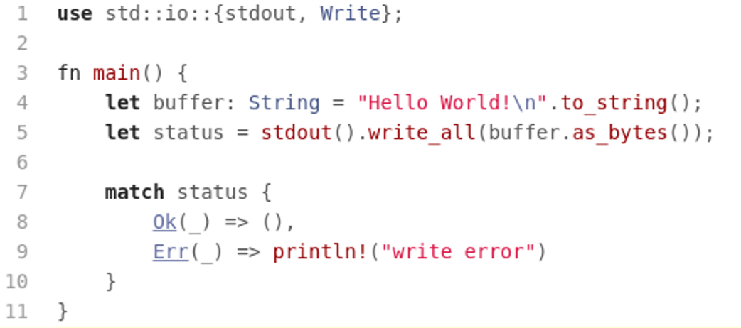
Stdout
Writing to stdout works analogously to reading from stdin
Just be aware that the write_all functions expects bytes rather than a string.

Slide 10
Reading from a File
Reading from a file follows the same patterns as reading from stdin
The only difference is that we have to open the file first

Slide 11
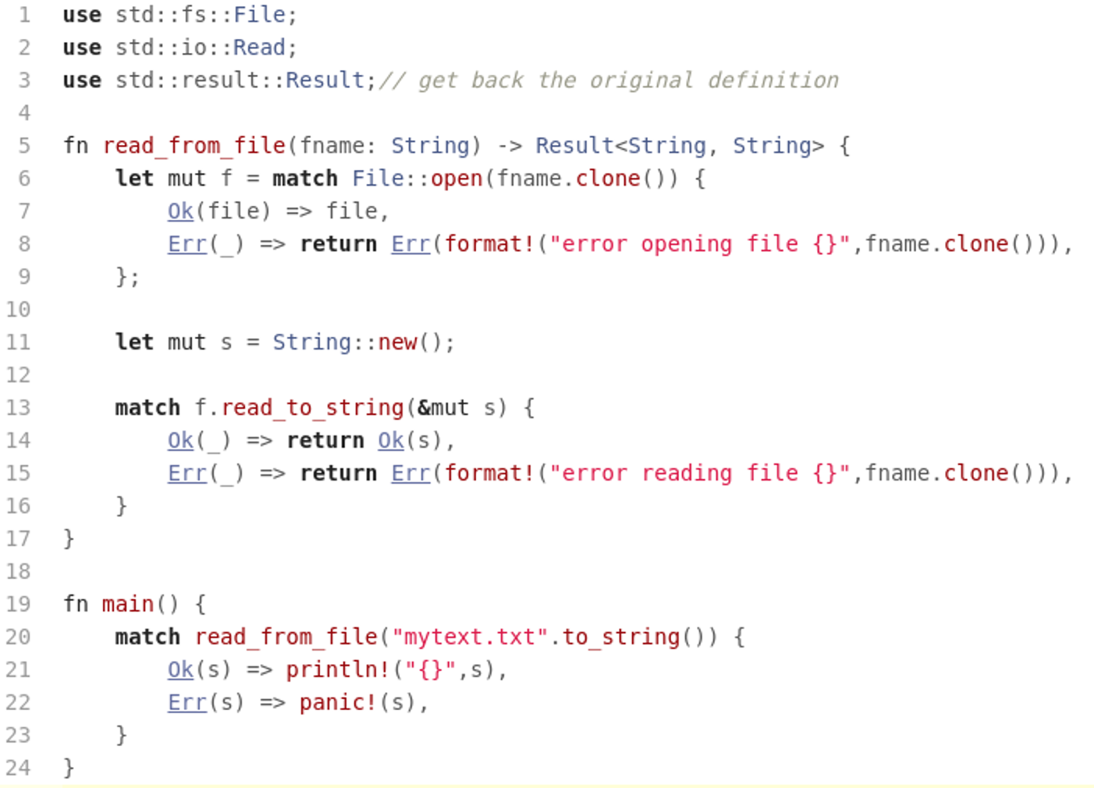
Reading from a File

Slide 12
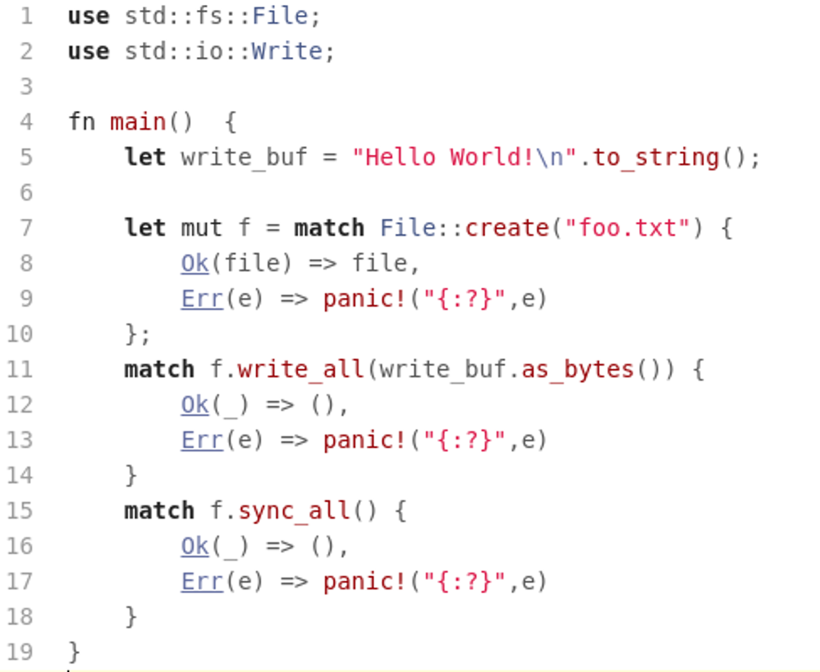
Writing to a File

