Slide 1
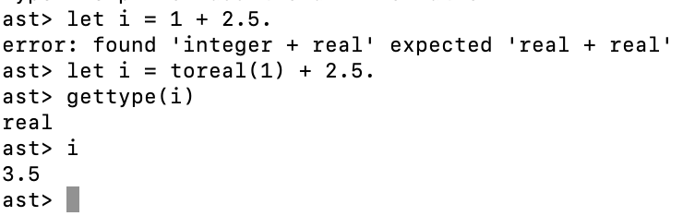
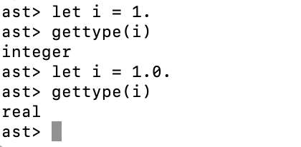
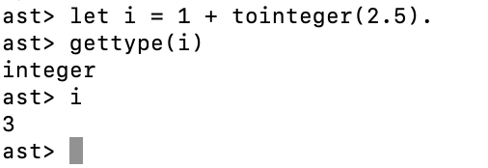
Types in Asteroid
Asteroid is dynamically type checked
  Infers types of variables at runtime
  No type hierarchy, explicit type conversions!
  Be careful, incorrect type conversions can lead to information loss!

Slide 2
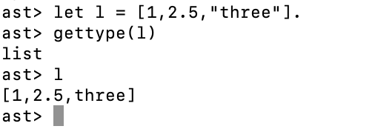
Types in Asteroid
Lists:
  Lists in Asteroid are polymorphic in the sense that they do not enforce any kind of type restrictions on their elements.
  This is similar to Python and very different from languages like C++ where this kind of polymorphism can only be achieved via class inheritance.
  The following is legal in Asteroid,

Slide 3

Types in Asteroid
Tuples:
  One way to think about tuples is as “fixed length lists” that are immutable, i.e.
    Once you have decided on the number of components of a tuple you cannot change it.
    Tuples with different number of components are incompatible.
    You cannot change the contents of a tuple.

Slide 4
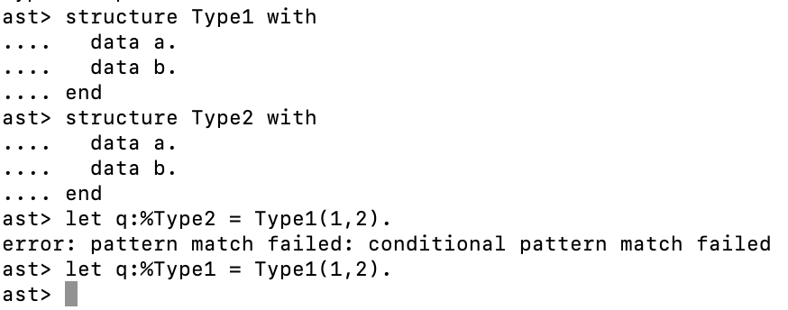
Types in Asteroid
Structures
  Asteroid uses name equivalence when computing the compatibility of two constructed types

