Slide 1
Higher-Order Programming
Definition: In higher-order programming, one can pass functions as arguments to other functions and functions can be the return value of other functions.
This, just like patterns matching, is a concept that was developed for functional programming languages.
Actually, the idea of functions accepting functions as parameters and/or returning functions is even older than that…
  it dates back to the 1930’s when Alan Turing and Alfonso Church explored what computation actually is. Turing did this with Turing machines and Church did this with lambda-calculus – a computational model which had functions as its primitive notion rather than a state machine as in the Turing machines.
  The lambda calculus can be considered a precursor to our modern notion of functional programming languages.

Slide 2
Higher-Order Programming
We can use higher-order programming to customize the behavior of functions
Consider a function that computes multiples
  We can customize the behavior of this function by passing in functions with specific behavior

Slide 3
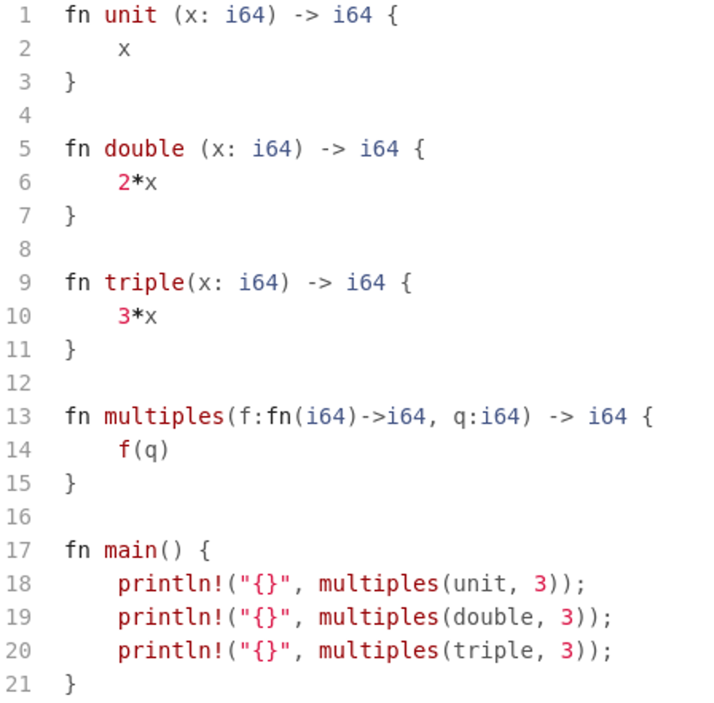
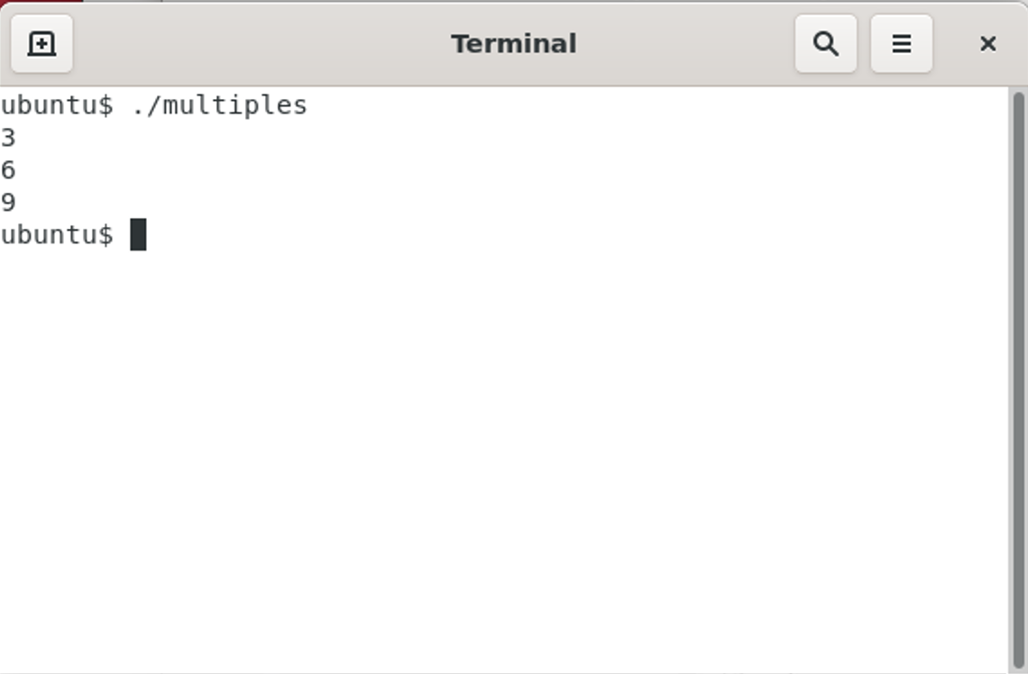
Higher-Order Programming

Slide 4
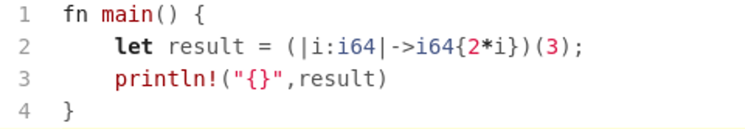
Higher-Order Programming
One consequence of higher-order programming is you will wind up with the definition of a lot of small functions
Rather than defining a full fledge function for these simple computation use closures (also called lambda functions)
In Rust closures are themselves functions that can be used to compute values:

Slide 5
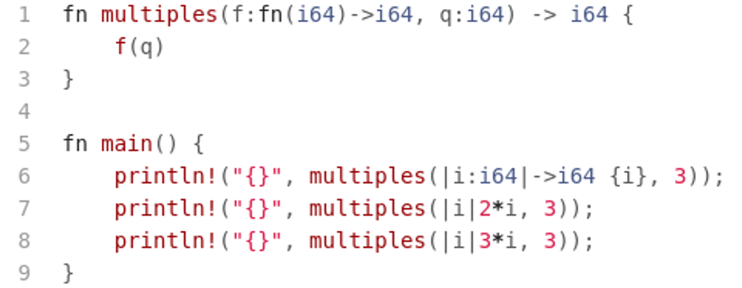
Higher-Order Programming
Abbreviated form of a closure

Slide 6
Higher-Order Programming
As the paradigm definition suggests we can also return functions from functions
This again allows us to write general code that can be specialized using higher-order functions
Consider a function that returns a specific computation based on some input parameters.

Slide 7
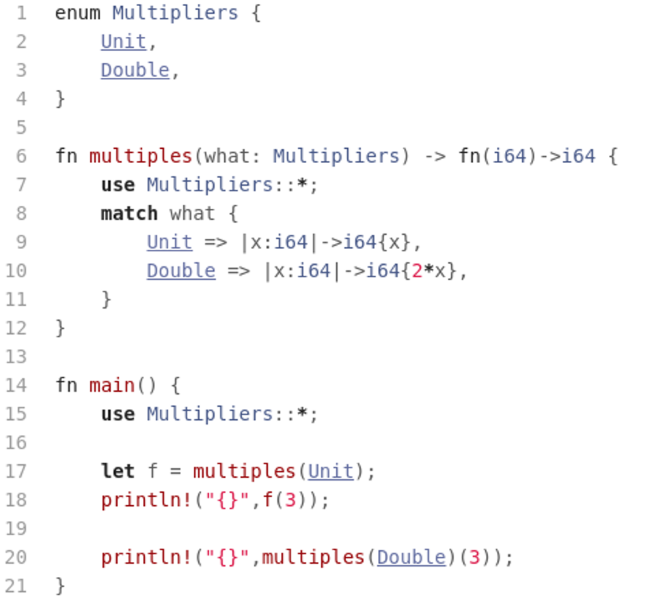
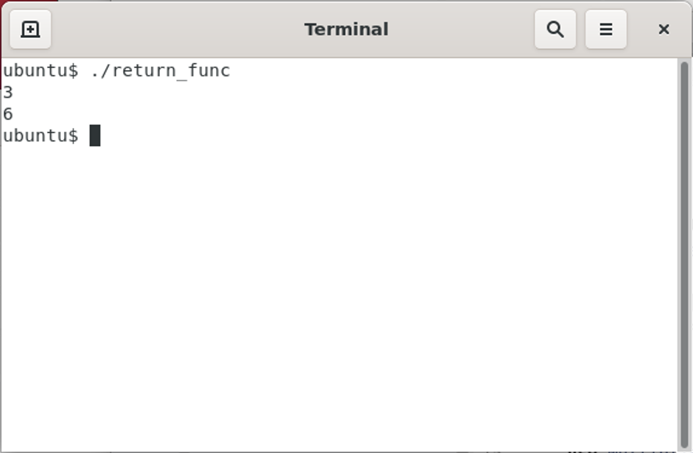
Higher-Order Programming

Slide 8
Higher-Order Programming
In the functional programming language context higher-order programming also gives us access to partially evaluated functions
Unfortunately this is not available in Rust but we will see this when we discuss Haskell
Partially evaluated functions are a powerful tool when customizing code from a given library
An interesting application of higher-order programming are iterators

Slide 9
Iterators
Definition: An iterator is an object that enables a programmer to traverse a container, particularly lists.

Slide 10
Iterators
Typically we classify iterators into two classes:
  Internal iterators: Internal iterators are higher order functions implementing the traversal across a container, applying the given function to every element in turn.
  External iterators: An external iterator may be thought of as a type of pointer that has two primary operations: referencing one particular element in a collection (called element access) and modifying itself so it points to the next element (called element traversal).

Slide 11
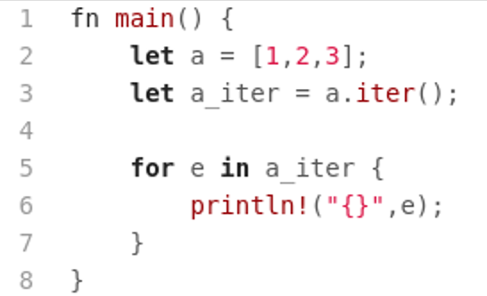
Iterators
Here is a basic Rust external iterator:
  Element access
  Forward to next element

Slide 12
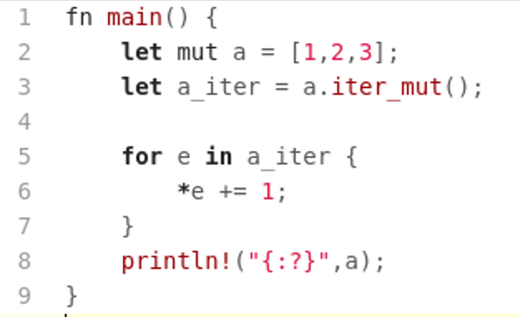
Iterators
We can also use iterators to modify the container

Slide 13
Iterators
In Rust internal iterators sit on top of external iterators
  This is not true for many other languages
  We will see true internal iterators in Haskell

Slide 14
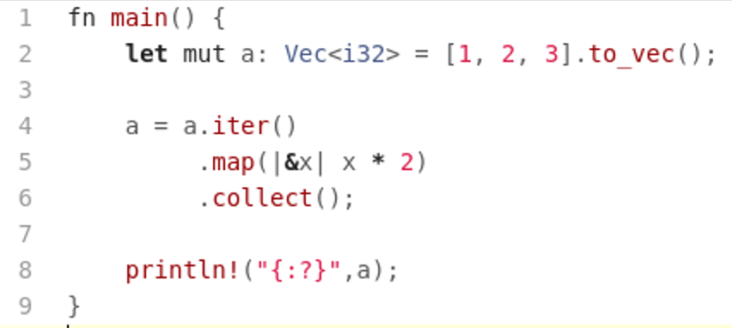
Iterators
A basic internal iterator program
Notice, no explicit iteration needed
Note: we needed to switch from arrays to vectors because ‘collect’ only supports vectors.

Slide 15
Assignments
Assignment #3

