Slide 1
Polymorphism
A closer look at types....
polymorphism ≡ comes from Greek meaning ‘many forms’
In programming:
Def: A function or operator is polymorphic if it has at
least two possible types.
Read MPL Chap 8

Slide 2
Polymorphism
Different types of polymorphisms
Polymorphism
Duck Typing
“the duck test”*
Asteroid & Python
Parametric
Types with type variables
Rust: vec<T>
Ad hoc (overloading)
Asteroid & Python: operator overloading,
e.g. 1+2, “Hello” + ”There”
Subtyping
Python: Class inheritance
*If it looks like a duck, swims like a duck, and quacks like a duck, then it probably is a duck. --Wikipedia

Slide 3
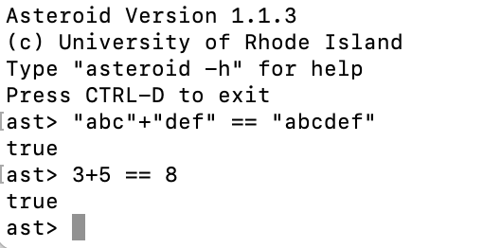
Ad Hoc Polymorphism (overloading)
Def: An overloaded function name or operator is one that has at least two
definitions, all of different types.
Example: In Asteroid the ‘+’ operator is overloaded. It can function as
a string concatenation operator or as an addition operator depending
on the type context – polymorphism!

Slide 4
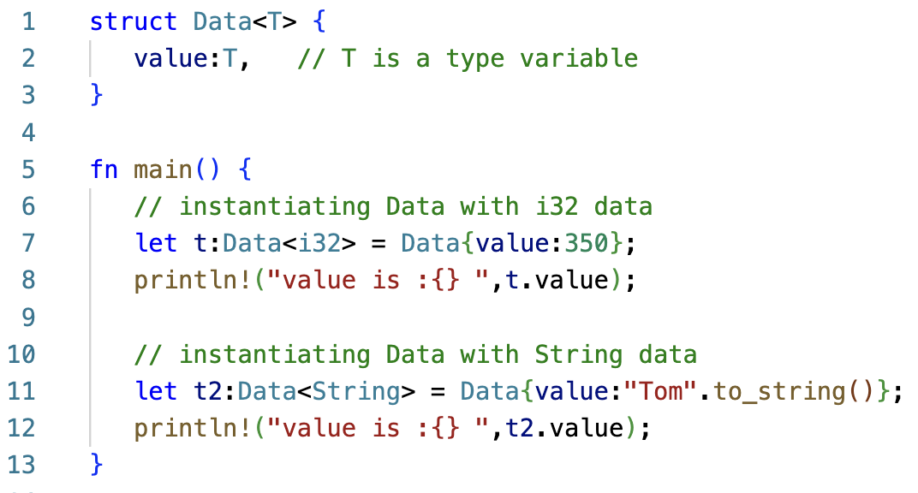
Parametric Polymorphism
Def: A function/structure exhibits parametric polymorphism if it has a type
that contains one or more type variables.
Example: Rust
Source: https://www.tutorialspoint.com/rust/rust_generic_types.htm

Slide 5
Subtype Polymorphism
Def: A function or operator exhibits subtype polymorphism if one or more
of its types have subtypes.

Slide 6
Subtype Polymorphism
Example: Java
class Cup { ... };
class CoffeeCup extends Cup { ... };
class TeaCup extends Cup { ... };
Subtype
TeaCup
TeaCup t = new TeaCup();
Cup c = t;
Cup
CoffeeCup
type coercion: TeaCup → Cup
safe!
void fill (Cup c) {...}
TeaCup t = new TeaCup();
CoffeeCup k = new CoffeeCup();
fill(t);
fill(k);
SuperType
subtype polymorphism

Slide 7
Duck Typing
Duck typing in computer programming is an application of the duck test—"If it walks like a duck and it quacks like a duck, then it must be a duck"—to determine if an object can be used for a particular purpose.
  With normal typing, suitability is determined by an object's type.
  In duck typing, an object's suitability is determined by the presence of certain methods and properties, rather than the type of the object itself. No common base type!
https://en.wikipedia.org/wiki/Duck_typing

Slide 8
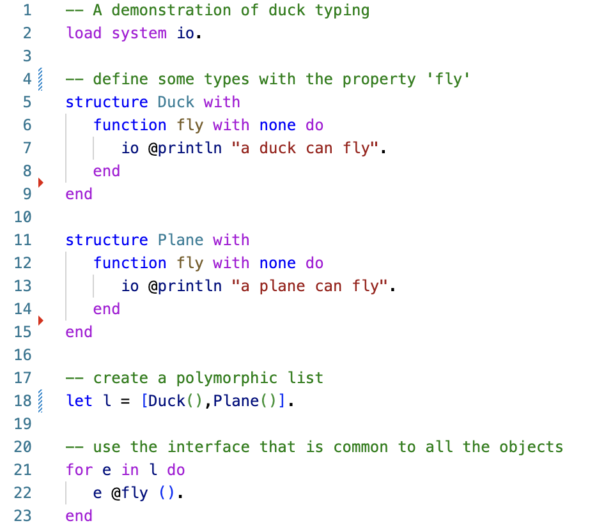
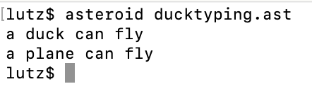
Duck Typing
Example: a polymorphic list with Duck Typing.
Polymorphic list

Slide 9
Duck Typing
Duck typing is not possible in statically typed languages like Rust, C++, and Java
Instead, in this languages one has to rely on subtype polymorphism in order to construct a polymorphic list.

Slide 10
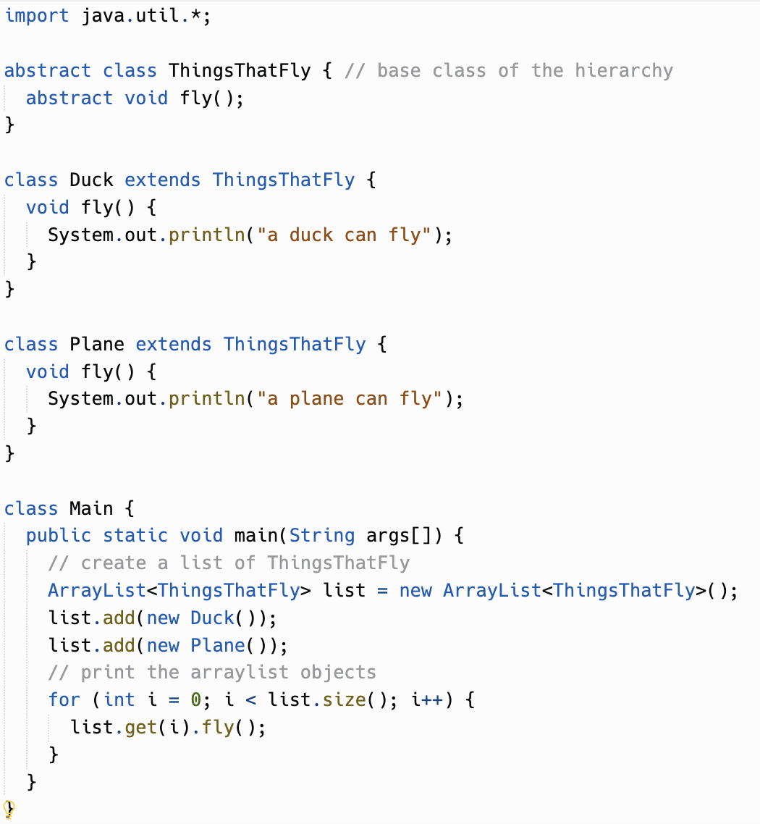
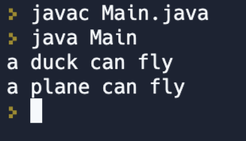
Duck Typing
Subtype
Duck
Plane
ThingsThatFly
SuperType

