Slide 1

Imperative Asteroid with Objects
The “Hello World” program…
Load system module
Sentence terminator

Slide 2
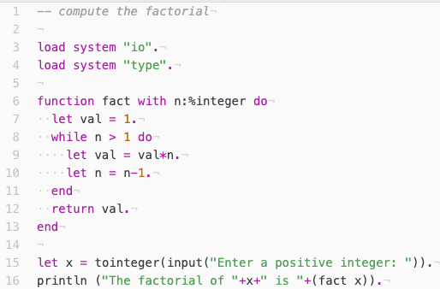
Iteration
‘while’, ‘for’, ‘loop’ constructs are all supported
Constraint pattern
Iteration
Assignment
Type conversion

Slide 3
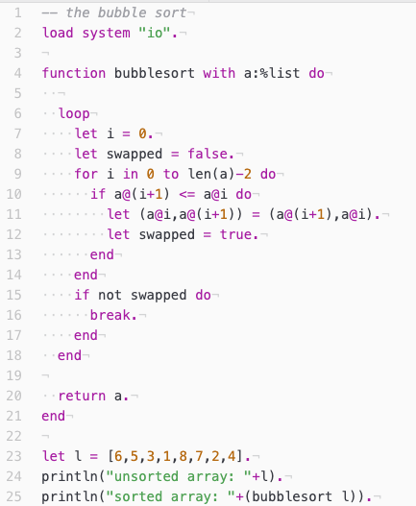
Data Structures
Built-in lists
  [1,2,3]
Built-in tuples
  (x,y)
Element access
  a@i

Slide 4
Structures & Objects
Asteroid is object-based
Bundle operations with data
No inheritance
  Construct new objects from other objects via object composition (and traits in the case of Rust)
New languages with a full object-oriented type system are waning
  Of the three “big” new languages (Rust, Go, Swift) only Swift supports OO, the others are object-based.

Slide 5
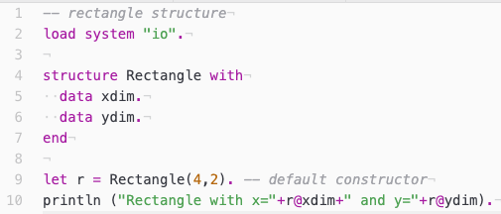
Structures
Structures consist of ‘data’ fields and are associated with a ‘default constructor
Member access is via the ‘@’ operator

Slide 6
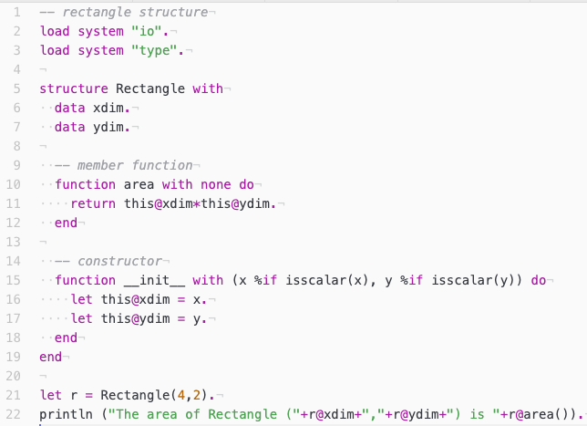
Structures
Member functions
Object identity is given with the ‘this’ keyword
Member functions are called on objects with the ‘@’ operator
  E.g., r@area()

Slide 7
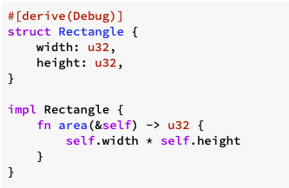
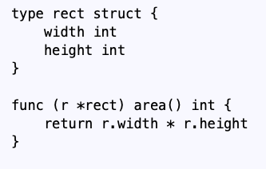
Structures: Rust & Go
Rust
Go

Slide 8
Types in Asteroid
Asteroid has a set of primitive data types:
  integer
  real
  string
  boolean
Asteroid arranges these data types in a type hierarchy in order to facilitate automatic type promotion:
  boolean < integer < real < string

Slide 9
Types in Asteroid
Asteroid has two more built-in data types:
  list
  tuple
These are structured data types in that they can contain entities of other data types.
Lists and tuples themselves are also embedded in type hierarchies, although very simple ones:
  list < string
  tuple < string
That is, any list or tuple can be viewed as a string. This is very convenient for printing lists and tuples.

Slide 10
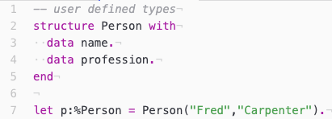
Types in Asteroid
Using the ‘structure’ keyword Asteroid also supports user defined types.
  The name of the structure becomes a new type available in the program.

Slide 11
Types in Asteroid
Finally, Asteroid supports one more type, namely the none type.
  The none type has a constant named conveniently ’none’.
  The empty pair of parentheses () can often be used as a convenient short-hand for the constant none.
  The none data type does not belong to any type hierarchy.

Slide 12
Running Asteroid
Install the interpreter on your machine
  See https://github.com/lutzhamel/asteroid
Run Asteroid in the cloud
  https://replit.com/@lutzhamel/asteroid

Slide 13
Assignments
Explore the links in the github readme
Do Assignment #1 – see BrightSpace

