Slide 1
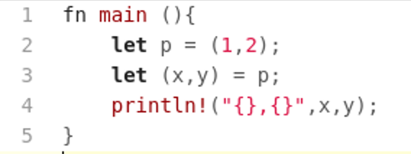
Pattern Matching
In computer science, pattern matching is the act of checking a given sequence of tokens or a given tree structure for the presence of the constituents of some pattern.
A pattern looks like the input sequence or the input tree with the exception that it may contain variables.
A simple program in Rust that does pattern matching:
Build a tuple
pattern
Destructure the tuple
using pattern matching.
Note: the pattern looks just like the structure except that it has variables
in it which will get instantiated with values from the structure.

Slide 2
Pattern Matching
Pattern matching was developed in the 1970’s for functional programming languages.
In functional programming languages virtually all data structures have structure that can be pattern matched – abstract data types.
Pattern matching is a way to compute on those data structures.
Virtually all modern programming languages support one form or another of pattern matching
  E.g. Python, Rust, Swift, Scala, Haskell as well as Prolog (being the oldest language on this list)
Code using pattern matching tends to be much more succinct and readable.

Slide 3
Rust Pattern Matching
In Rust, similar to functional programming languages, all data structures have structure that can be explicitly matched using pattern matching.
This includes enums, struct, and primitive data types

Slide 4
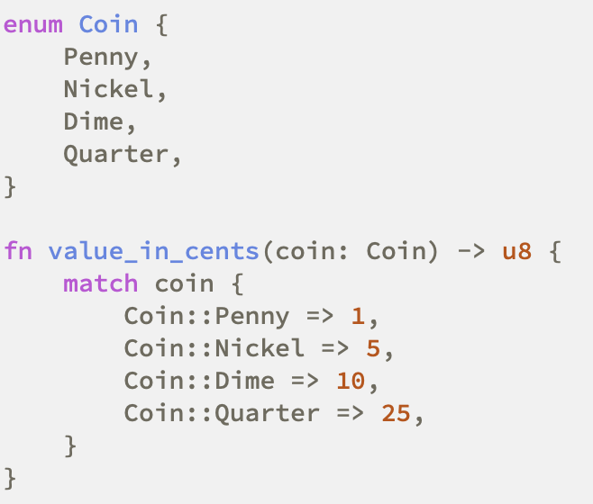
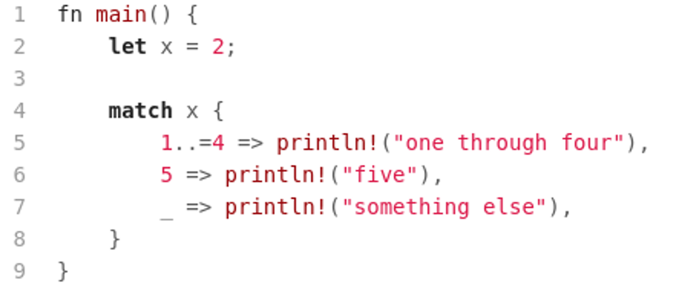
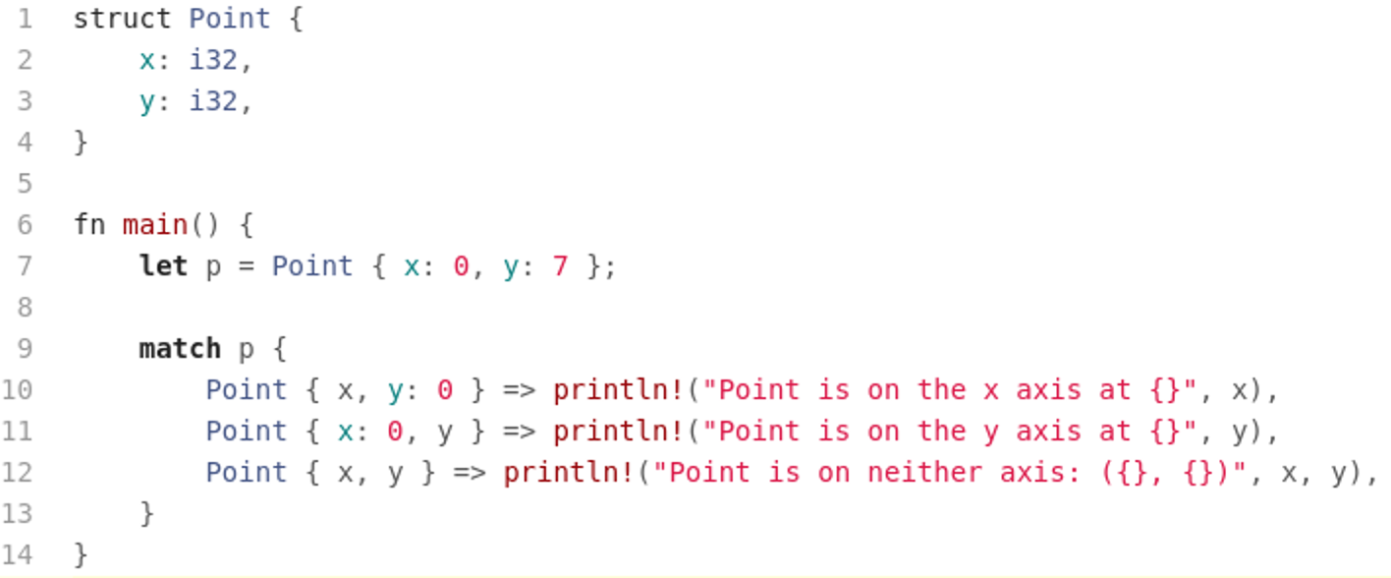
Rust Pattern Matching
Here we use ‘match’
to pattern match the value
in parameter coin.
Generate 1 through 4
sequence.

Slide 5
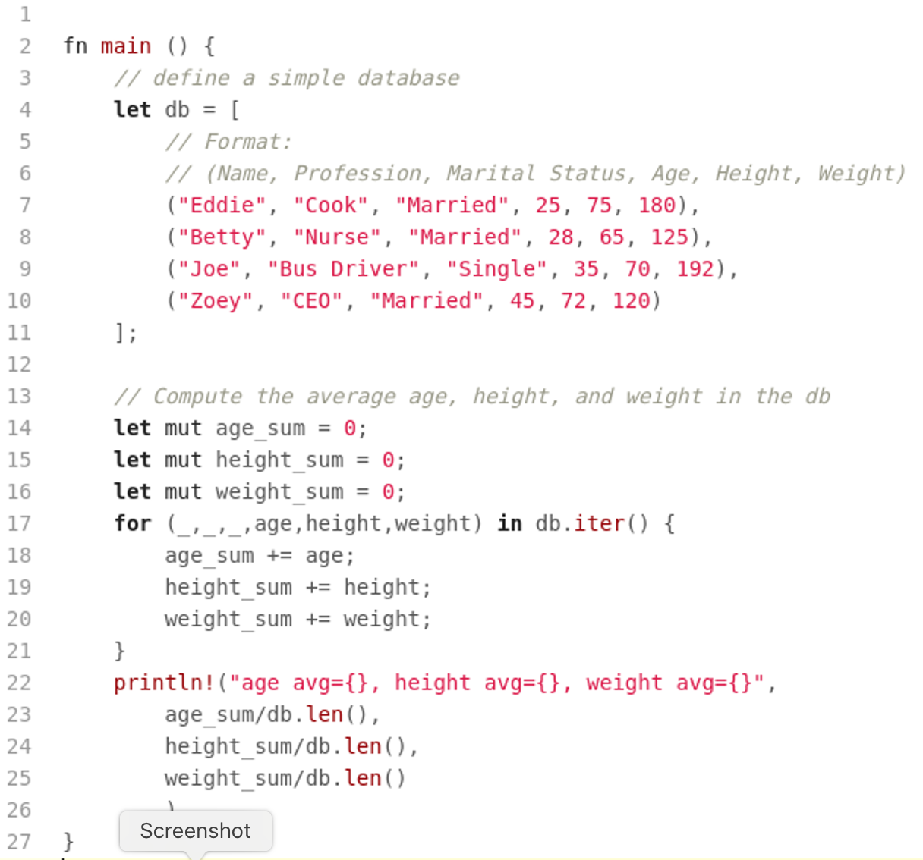
Rust Pattern Matching

Slide 6
Rust Pattern Matching
Rust allows pattern matching in many different places
We have seen pattern matching in the ‘let’, ‘for’ and ‘match’ statements
Beyond that we can pattern match in virtually all control structures and in functions.

Slide 7
Tree Traversal with Pattern Matching
The idea is to construct a tree structure in Rust representing some computation
and then walk this tree and generate an infix representation of the tree.
Here we take advantage of Rust’s smart pointers – the Box type – in order to create a tree structure.

Slide 8
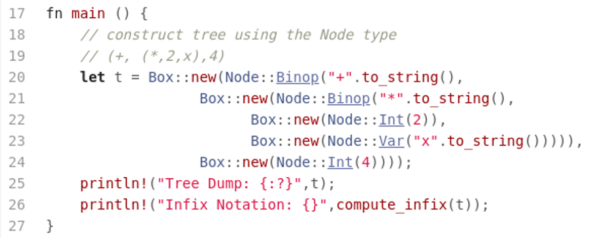
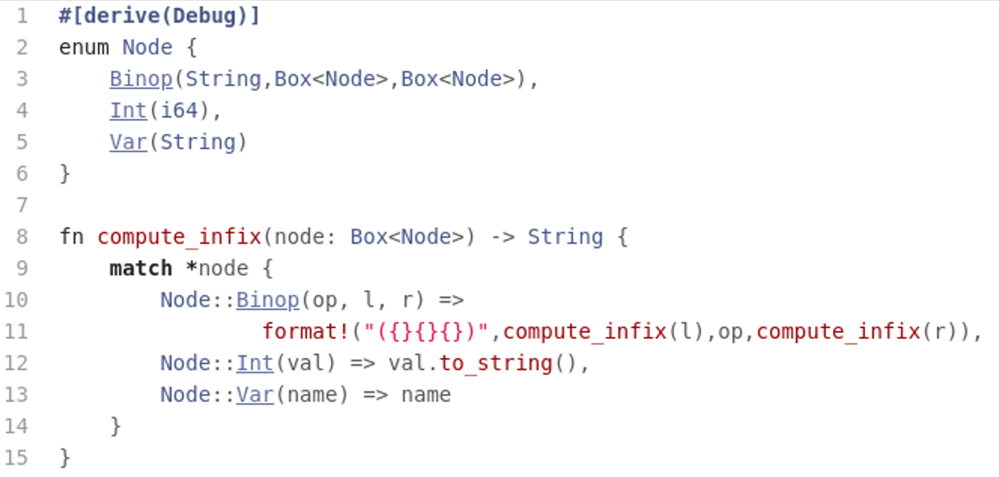
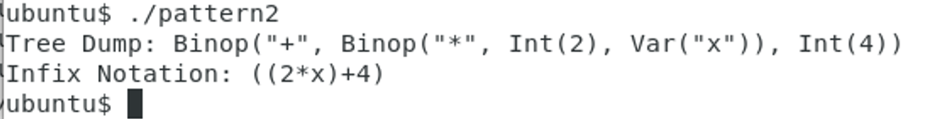
Tree Traversal with Pattern Matching

Slide 9
Assignments
Read: doc.rust-lang.org/book/ch18-00-patterns.html
Assignment #3

