Slide 1
Abstract Syntax Trees
Our Exp1bytecode language was so straightforward that the best IR was an abstract representation of the instructions
In more complex languages, especially higher level languages it usually not possible to design such a simple IR
Instead we use Abstract Syntax Trees (ASTs)
Chap 5

Slide 2
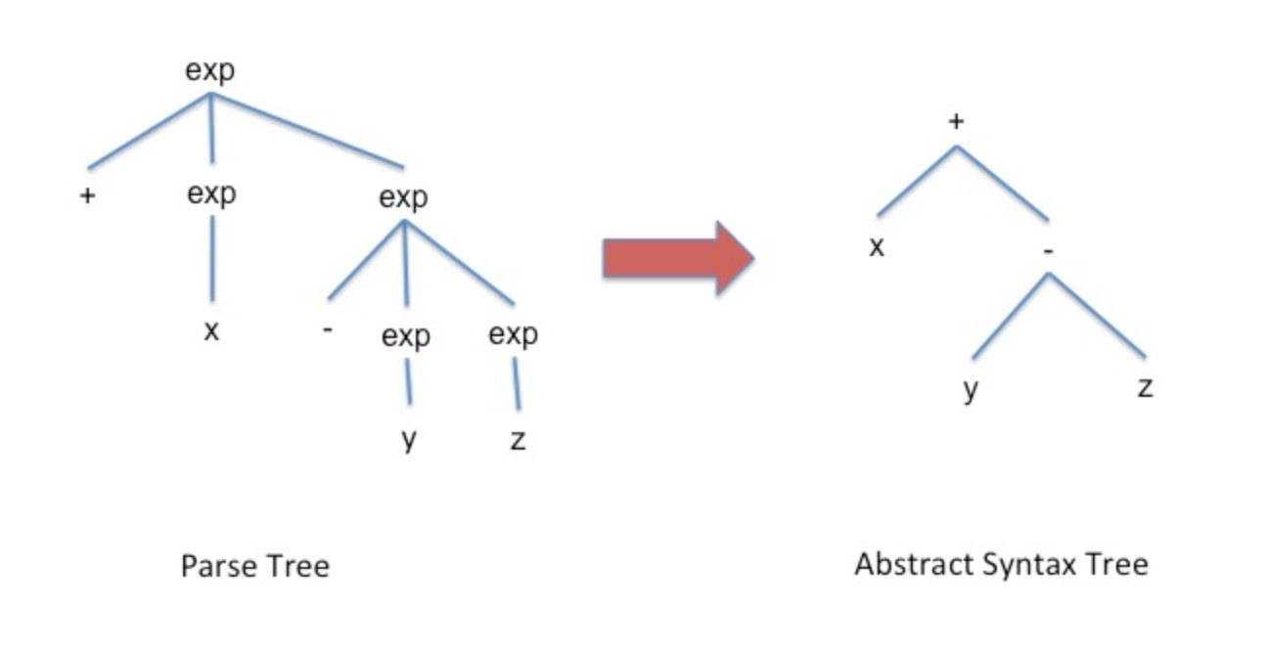
Abstract Syntax Trees
One way to think about ASTs is as parse trees with all the derivation information deleted

Slide 3
Abstract Syntax Trees
Because every valid program has a parse tree, it is always possible to construct an AST for every valid input program.
In this way ASTs are the IR of choice because it doesn’t matter how complex the input language, there will always be an AST representation.
Besides being derived from the parse tree, AST design typically follows three rules of thumb:
Dense: no unnecessary nodes
Convenient: easy to understand, easy to process
Meaningful: emphasize the operators, operands, and the relationship between them; emphasize the computations

Slide 4
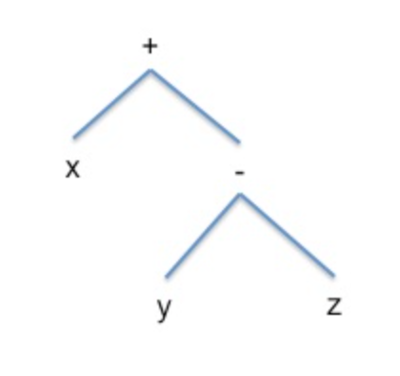
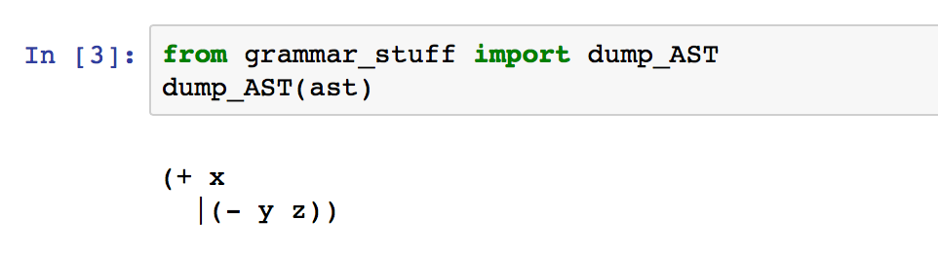
Tuple Representation of ASTs
A convenient way to represent AST nodes is with the following structure,
(TYPE [, child1, child2,...])
A tree node is a tuple where the first component represents the type or name of the node followed by zero or more components each representing a child of the current node.
Consider the abstract syntax tree for + x - y x,

Slide 5
The Cuppa1 Language
Our next language is a simple high-level language that supports structured programming with ‘if’ and ‘while’ statements.
However, it has no scoping and no explicit variable declarations.

Slide 6
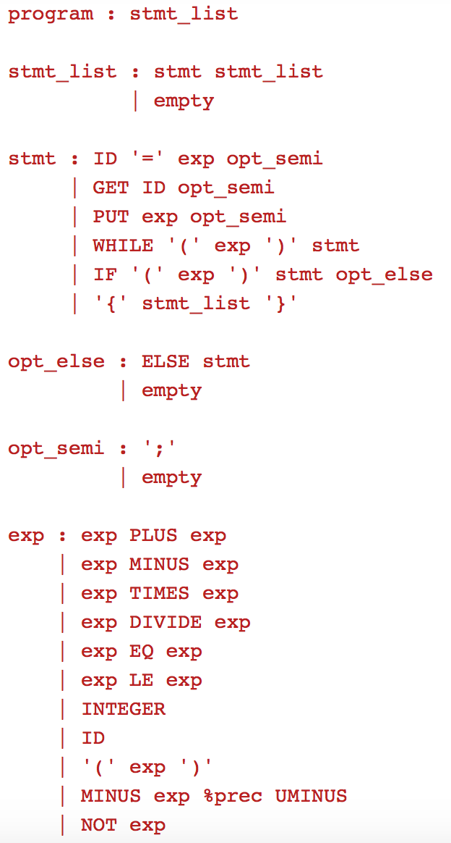
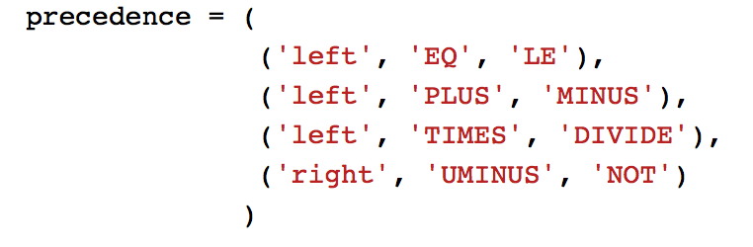
The Cuppa1 Language
// list of integers
get x;
while (1 <= x)
{
put x;
x = x - 1;
}
Infix Expressions!
Precedence & Associativity Table:

Slide 7
The Cuppa1 Language
cuppa1_gram.py
# grammar for Cuppa1
from ply import yacc
from cuppa1_lex import tokens, lexer
# set precedence and associativity
# NOTE: all arithmetic operator need to have tokens
# so that we can put them into the precedence table
precedence = (
('left', 'EQ', 'LE'),
('left', 'PLUS', 'MINUS'),
('left', 'TIMES', 'DIVIDE'),
('right', 'UMINUS', 'NOT')
)
def p_grammar(_):
'''
program : stmt_list
stmt_list : stmt stmt_list
| empty
stmt : ID '=' exp opt_semi
| GET ID opt_semi
| PUT exp opt_semi
| WHILE '(' exp ')' stmt
| IF '(' exp ')' stmt opt_else
| '{' stmt_list '}'
opt_else : ELSE stmt
| empty
opt_semi : ';'
| empty
…
The Parser Specification
…
exp : exp PLUS exp
| exp MINUS exp
| exp TIMES exp
| exp DIVIDE exp
| exp EQ exp
| exp LE exp
| INTEGER
| ID
| '(' exp ')'
| MINUS exp %prec UMINUS
| NOT exp
'''
pass
def p_empty(p):
'empty :'
pass
def p_error(t):
print("Syntax error at '%s'" % t.value)
### build the parser
parser = yacc.yacc()

Slide 8
The Cuppa1 Language
cuppa1_lex.py
# Lexer for Cuppa1
from ply import lex
reserved = {
'get' : 'GET',
'put' : 'PUT',
'if' : 'IF',
'else' : 'ELSE',
'while' : 'WHILE',
'not' : 'NOT'
}
literals = [';','=','(',')','{','}']
tokens = [
'PLUS','MINUS','TIMES','DIVIDE',
'EQ','LE',
'INTEGER','ID',
] + list(reserved.values())
t_PLUS = r’\+'
t_MINUS = r'-'
t_TIMES = r’\*'
t_DIVIDE = r'/'
t_EQ = r'=='
t_LE = r'<='
t_ignore = ' \t'
…
The Lexer Specification
…
def t_ID(t):
r'[a-zA-Z_][a-zA-Z_0-9]*'
t.type = reserved.get(t.value,'ID') # Check for reserved words
return t
def t_INTEGER(t):
r'[0-9]+'
return t
def t_COMMENT(t):
r'//.*'
pass
def t_NEWLINE(t):
r’\n'
pass
def t_error(t):
print("Illegal character %s" % t.value[0])
t.lexer.skip(1)
# build the lexer
lexer = lex.lex(debug=0)

Slide 9
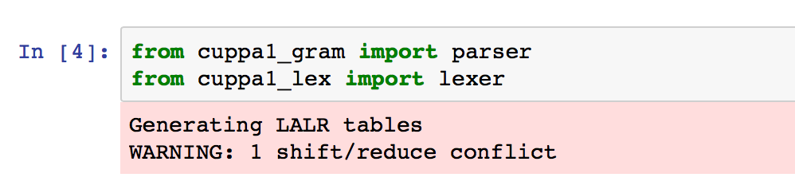
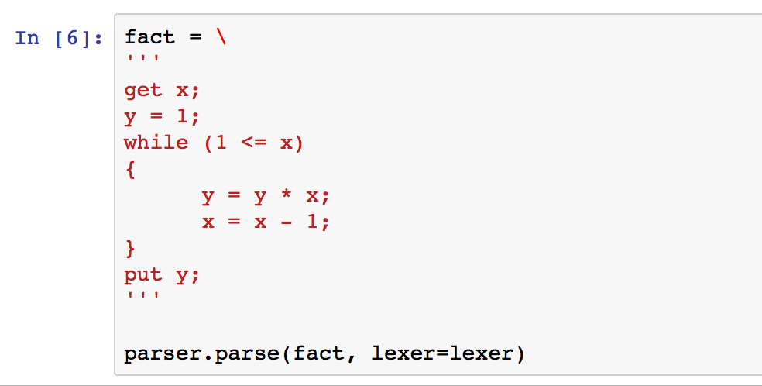
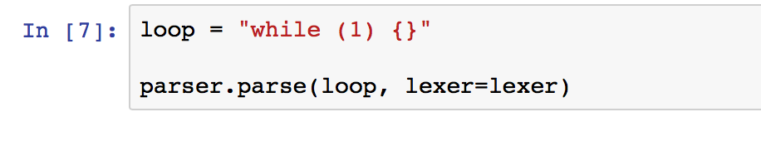
Testing our Parser
Notice the shift/reduce conflict! The error is due to the if-then-else statement with the optional else.
The default action for shift/reduce conflicts
is to always shift.
That is exactly right for us!

Slide 10
The Cuppa1 Frontend
A frontend is a parser that
Constructs an AST
Fills out some rudimentary information in a symbol table
cuppa1_state.y
class State:
def __init__(self):
self.initialize()
def initialize(self):
# symbol table to hold variable-value associations
self.symbol_table = {}
# when done parsing this variable will hold our AST
self.AST = None
state = State()
We use the State to maintain the program AST and a symbol table.

Slide 11
AST: Statements
cuppa1_frontend_gram.py
def p_stmt(p):
'''
stmt : ID '=' exp opt_semi
| GET ID opt_semi
| PUT exp opt_semi
| WHILE '(' exp ')' stmt
| IF '(' exp ')' stmt opt_else
| '{' stmt_list '}'
'''
if p[2] == '=':
p[0] = ('assign', p[1], p[3])
state.symbol_table[p[1]] = None
elif p[1] == 'get':
p[0] = ('get', p[2])
state.symbol_table[p[2]] = None
elif p[1] == 'put':
p[0] = ('put', p[2])
elif p[1] == 'while':
p[0] = ('while', p[3], p[5])
elif p[1] == 'if':
p[0] = ('if', p[3], p[5], p[6])
elif p[1] == '{':
p[0] = ('block', p[2])
else:
raise ValueError("unexpected symbol {}".format(p[1]))
def p_opt_else(p):
'''
opt_else : ELSE stmt
| empty
'''
if p[1] == 'else':
p[0] = p[2]
else:
p[0] = p[1]
def p_empty(p):
'empty :'
p[0] = ('nil',)
Consider:
stmt : ID '=' exp opt_semi
Gives rise to the following actions:
p[0] = ('assign', p[1], p[3])
state.symbol_table[p[1]] = None
Consider the rule: IF '(' exp ')' stmt opt_else What does the tuple tree look like for the various shapes of the ‘if’ statement?

Slide 12
AST: Statement Lists & Programs
cuppa1_frontend_gram.py
def p_prog(p):
'''
program : stmt_list
'''
state.AST = p[1]
Save the construct AST in the state!
def p_stmt_list(p):
'''
stmt_list : stmt stmt_list
| empty
'''
if (len(p) == 3):
p[0] = ('seq', p[1], p[2])
elif (len(p) == 2):
p[0] = p[1]
Statement lists are ‘nil’ terminated
‘seq’ terms.
def p_empty(p):
'''
empty :
'''
p[0] = ('nil',)

Slide 13
AST: Expressions
cuppa1_frontend_gram.py
#########################################################################
def p_integer_exp(p):
'''
exp : INTEGER
'''
p[0] = ('integer', int(p[1]))
#########################################################################
def p_id_exp(p):
'''
exp : ID
'''
p[0] = ('id', p[1])
#########################################################################
def p_paren_exp(p):
'''
exp : '(' exp ')'
'''
p[0] = ('paren', p[2])
#########################################################################
def p_uminus_exp(p):
'''
exp : MINUS exp %prec UMINUS
'''
p[0] = ('uminus', p[2])
#########################################################################
def p_not_exp(p):
'''
exp : NOT exp
'''
p[0] = ('not', p[2])
#########################################################################
def p_binop_exp(p):
'''
exp : exp PLUS exp
| exp MINUS exp
| exp TIMES exp
| exp DIVIDE exp
| exp EQ exp
| exp LE exp
'''
p[0] = (p[2], p[1], p[3])
This should look familiar,
same structure as for the expressions in exp1bytecode
language.

Slide 14
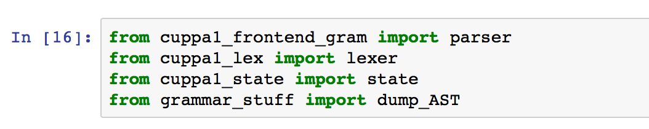
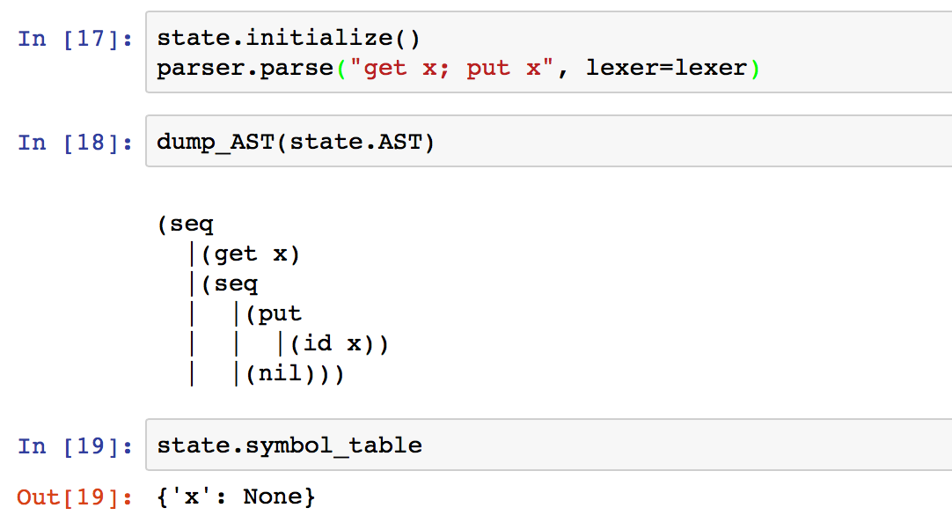
Running the Frontend

Slide 15
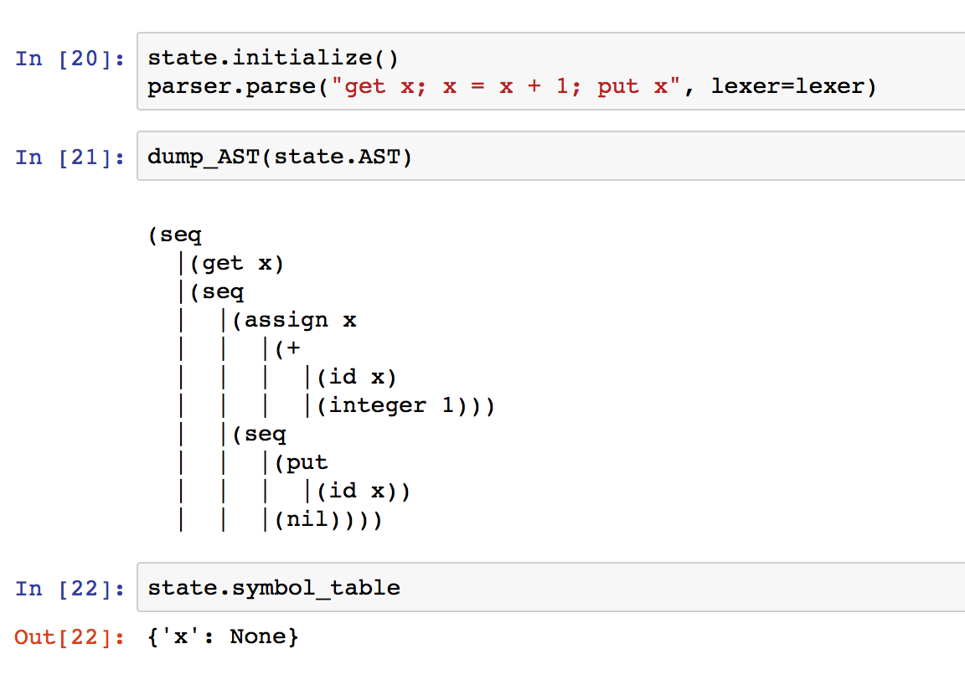
Running the Frontend

Slide 16
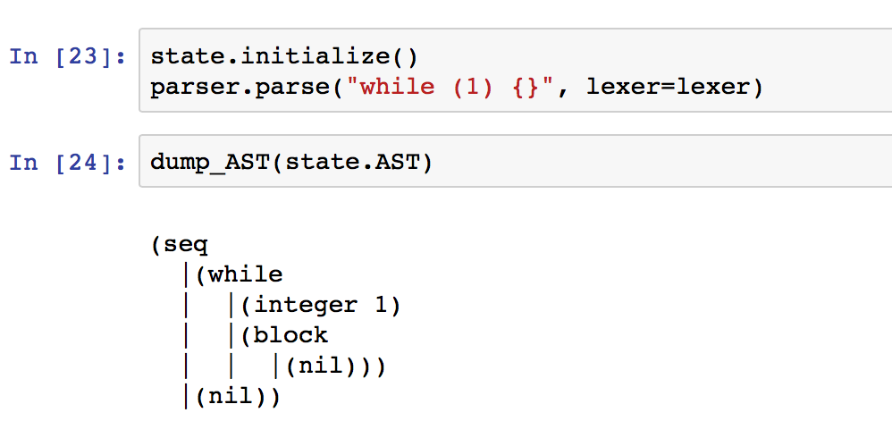
Running the Frontend

Slide 17
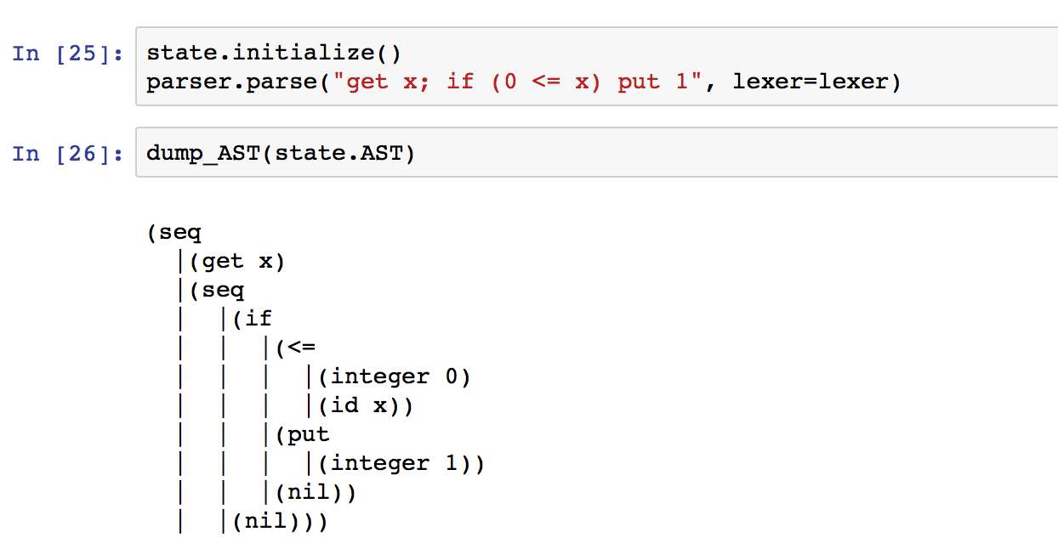
Running the Frontend

Slide 18
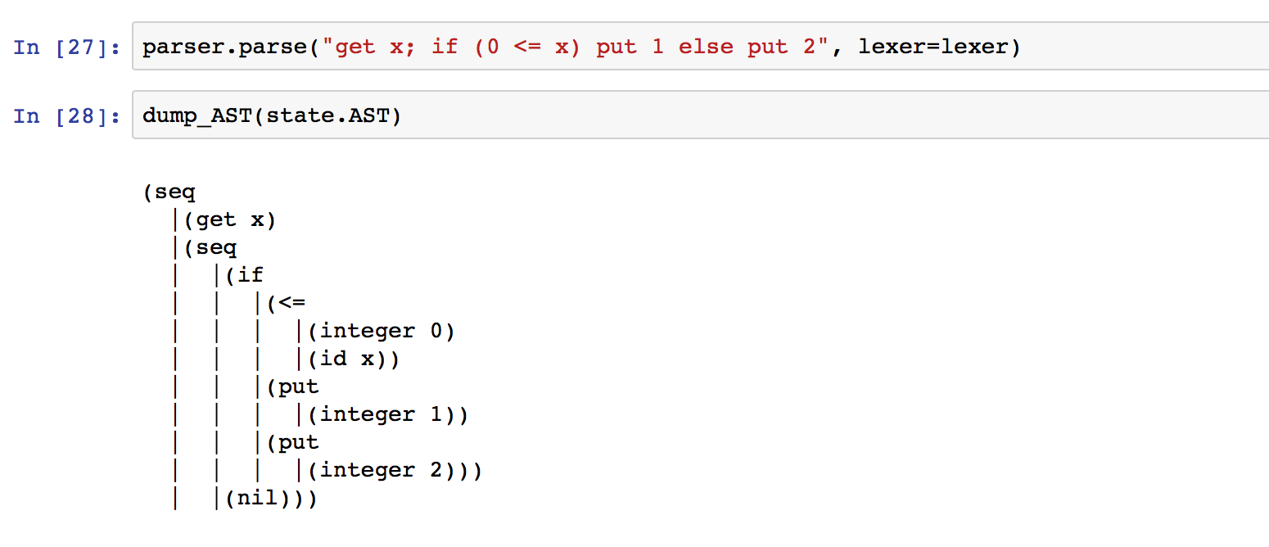
Running the Frontend

Slide 19
Processing ASTs: Tree Walking
The recursive structure of trees gives rise to an elegant way of processing trees: tree walking.
A tree walker typically starts at the root node and traverses the tree in a depth first manner.

Slide 20
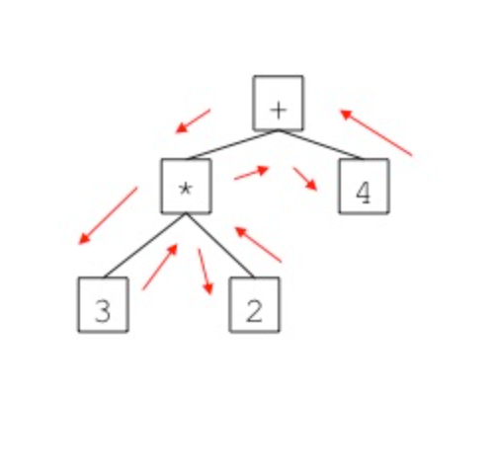
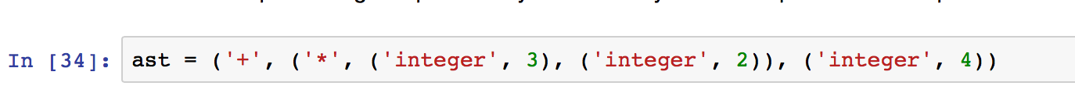
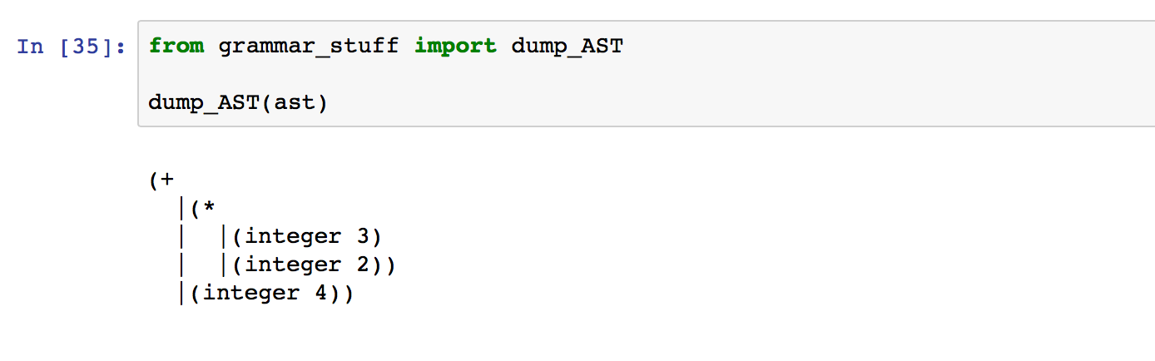
Processing ASTs: Tree Walking
Consider the following:

Slide 21
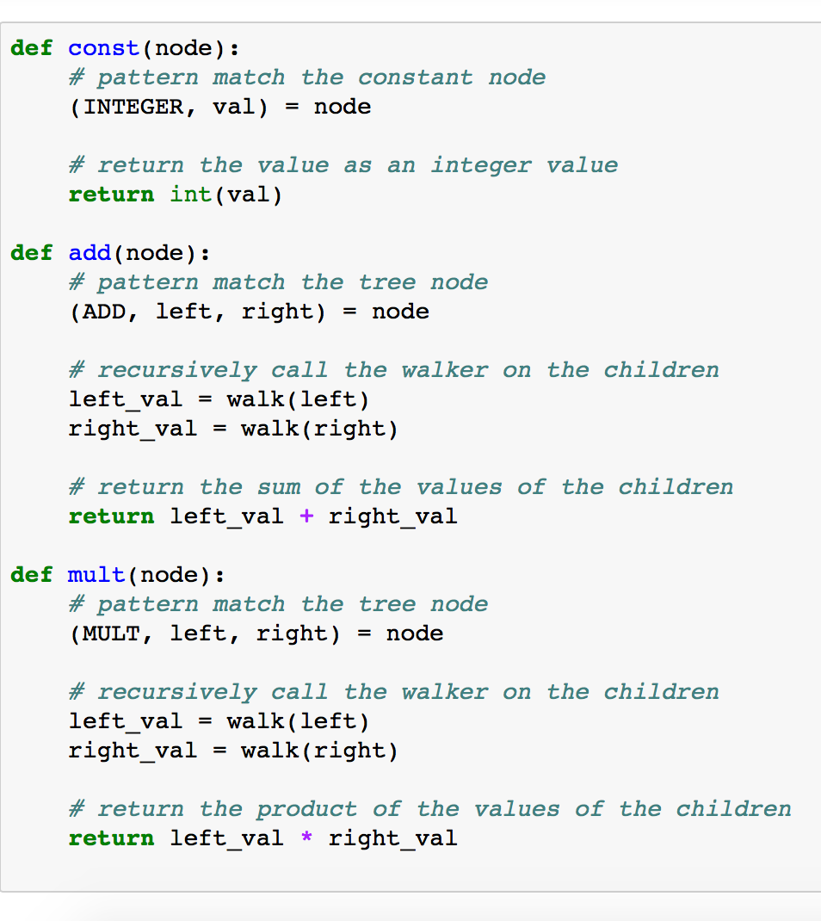
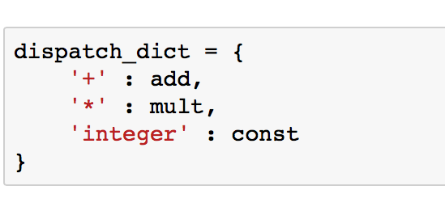
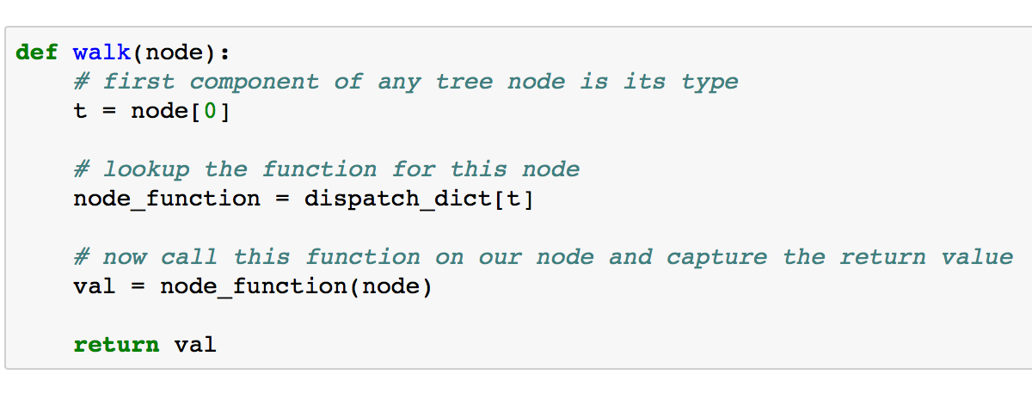
Processing ASTs: Tree Walking
A simple tree walker for our expression tree

Slide 22
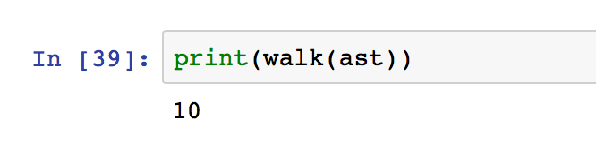
Processing ASTs: Tree Walking
A simple tree walker for our expression tree
We just interpreted the expression tree!!!

Slide 23
Processing ASTs: Tree Walking
A simple tree walker for our expression tree
Notice that this scheme mimics what we did in the syntax directed interpretation schema,
But now we interpret an expression tree rather than the implicit tree constructed by the parser.

Slide 24
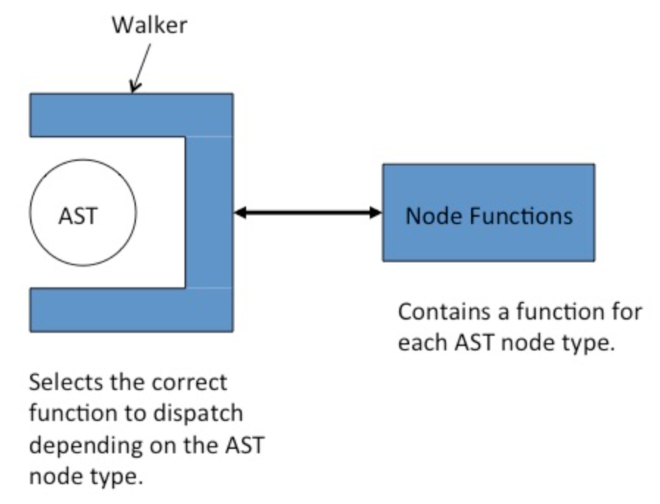
Tree Walkers are Plug'n Play
Tree walkers exist completely separately from the AST.
Tree walkers plug into the AST and process it using their node functions.

Slide 25
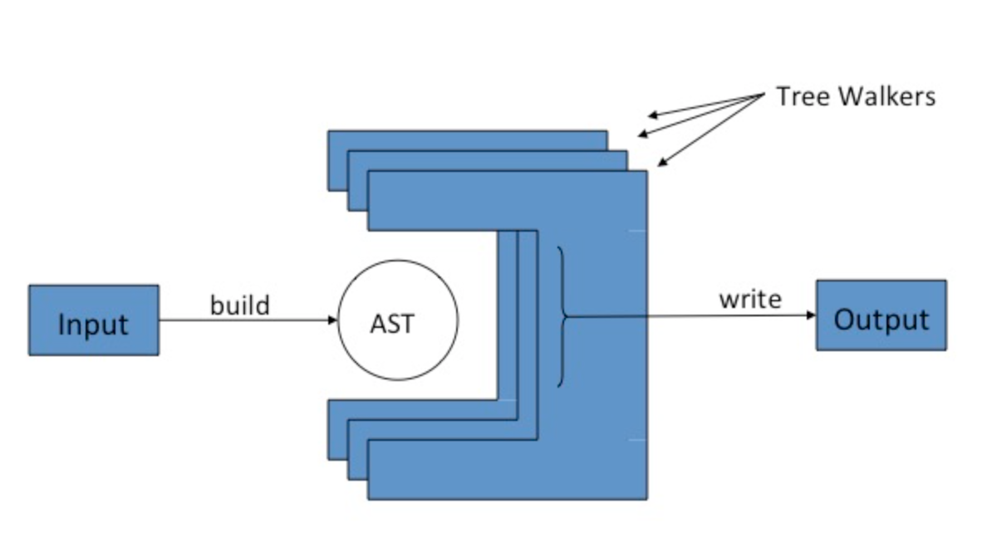
Tree Walkers are Plug'n Play
There is nothing to prevent us from plugging in multiple walkers during the processing of an AST, each performing a distinct phase of the processing.

Slide 26
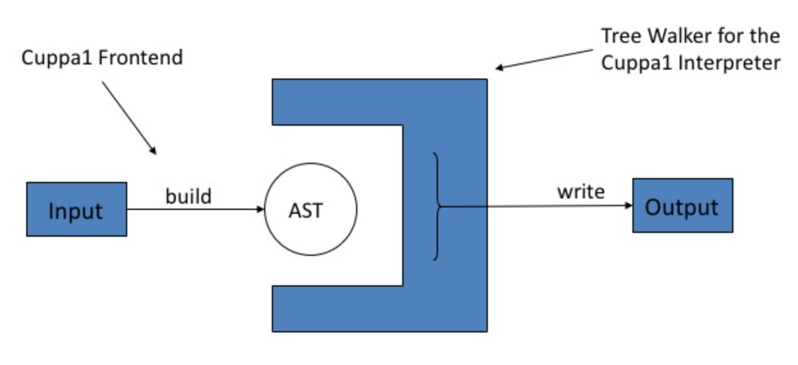
An Interpreter for Cuppa1

Slide 27
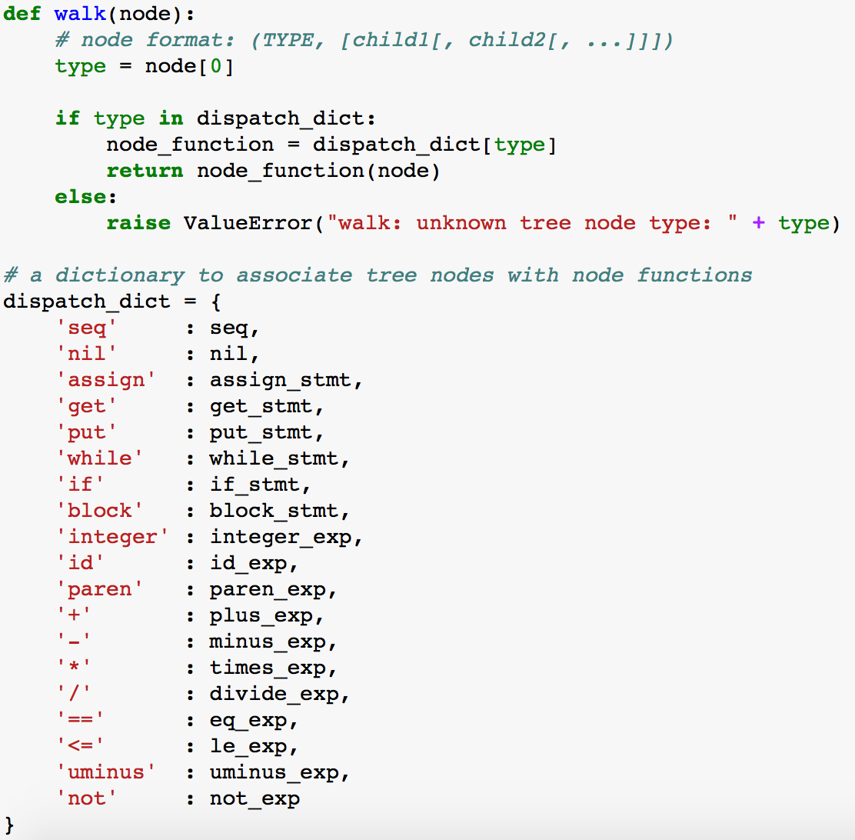
An Interpreter for Cuppa1
cuppa1_interp_walk.py

Slide 28
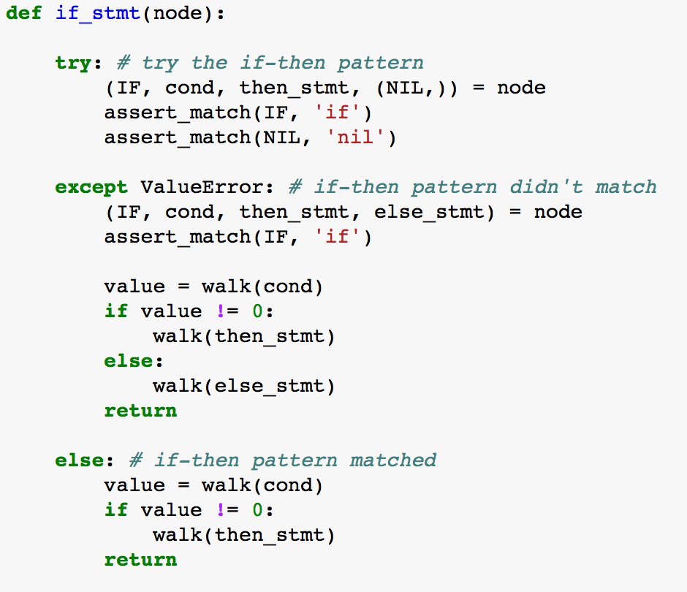
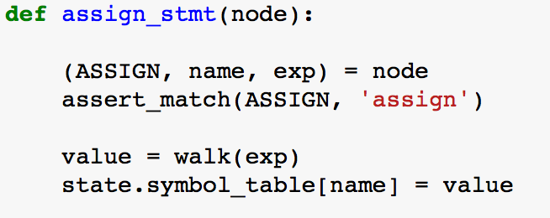
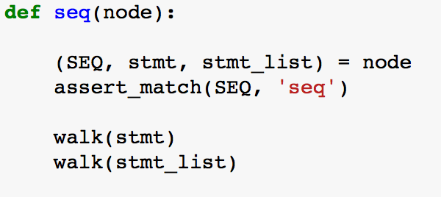
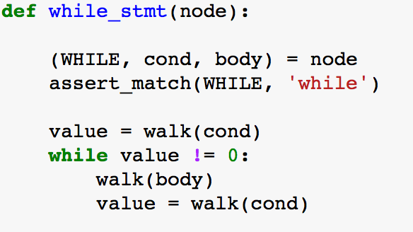
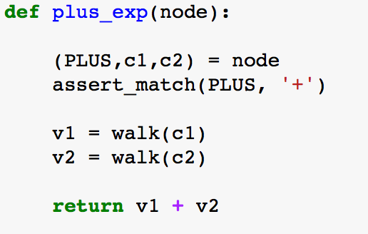
An Interpreter for Cuppa1
cuppa1_interp_walk.py

Slide 29
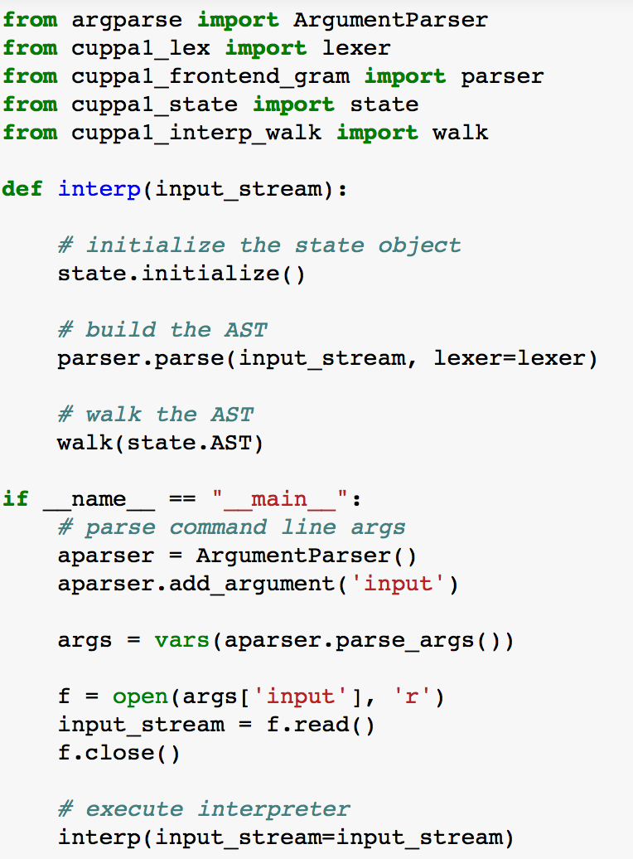
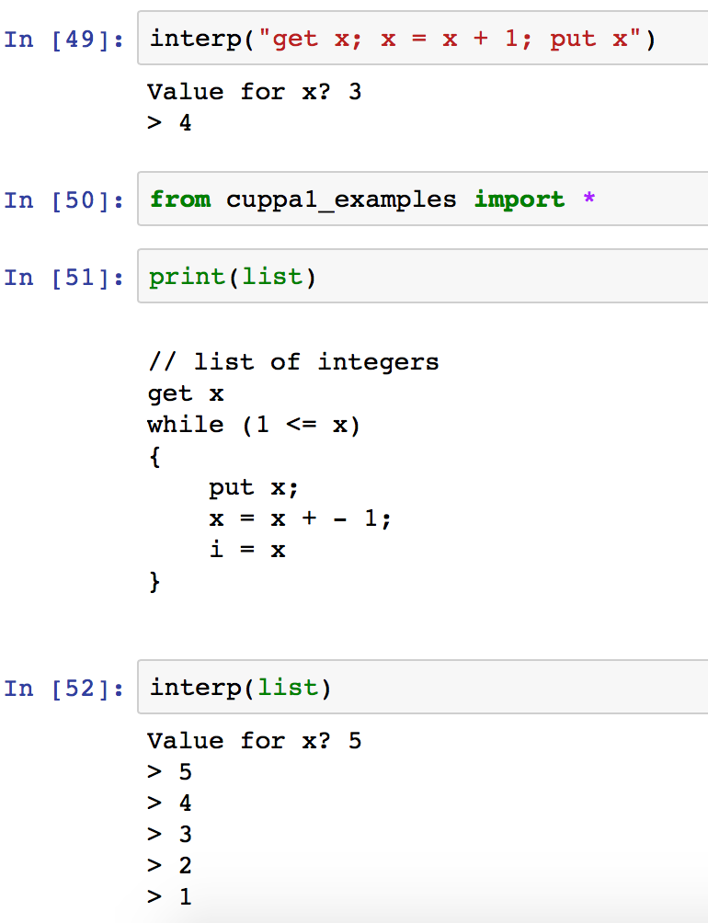
An Interpreter for Cuppa1
cuppa1_interp.py

Slide 30
A Pretty Printer with a Twist
Our pretty printer will do the following things:
It will read the Cuppa1 programs and construct an AST
It will compute whether a particular variable is used in the program
It will output a pretty printed version of the input script but will flag assignment/get statements to variables which are not used in the program
➔This cannot be accomplished in a syntax directed manner – therefore we need the AST

Slide 31
PrettyPrinting the Language
// list of integers
get x;
i = x;
while (1 <= x) {
put x;
x = x - 1;
}
get x
i = x // -- var i unused --
while ( 1 <= x )
{
put x
x = x - 1
}
 We need an IR because usage will always occur after definition – cannot be handled by a syntax directed pretty printer.

Slide 32
The Pretty Printer is a Translator!
The Pretty Printer with a Twist fits neatly into our translator class
Read input file and construct AST/Collect info
Generate output code, flagging unused assignments
IR
IR
Syntax
Analysis
Semantic
Analysis
Code
Generation
Target Language
Program Text
Variable definition/usage analysis

Slide 33
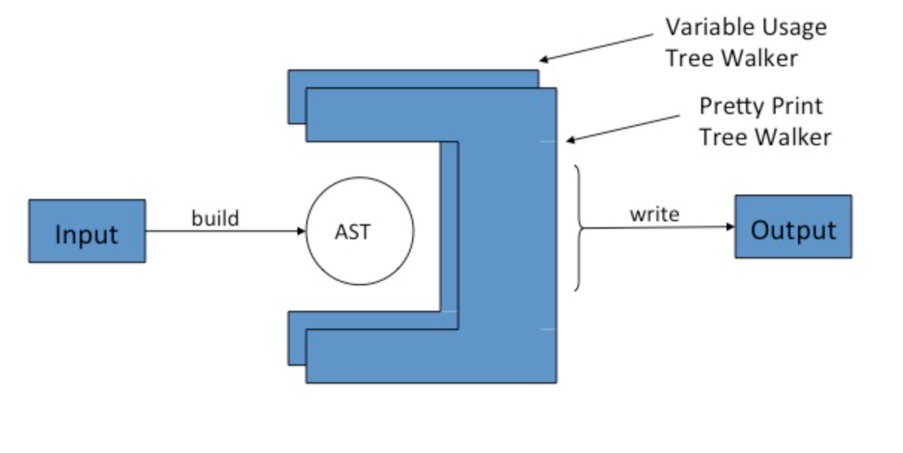
Pretty Printer Architecture
Frontend + 2 Tree Walkers

Slide 34
PP1: Variable Usage
The first pass of the pretty printer walks the AST and looks for variables in expressions
only those count as usage points.
A peek at the tree walker for the first pass, cuppa1_pp1_walk.py shows that it literally just walks the tree doing nothing until it finds a variable in an expression.
If it finds a variable in an expression then the node function for id_exp marks the variable in the symbol table as used,

Slide 35
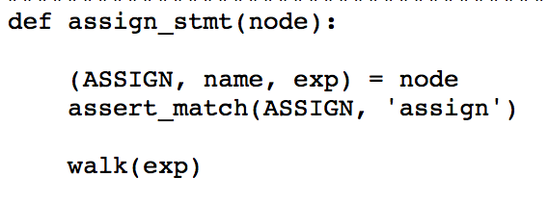
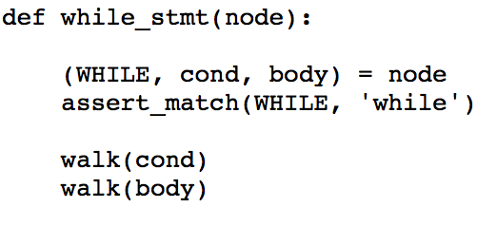
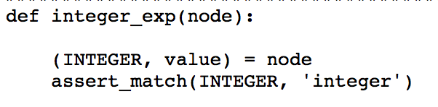
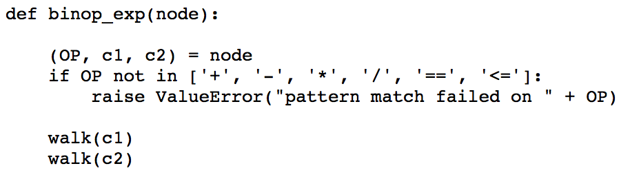
PP1: Variable Usage
Just Walking the Tree!

Slide 36
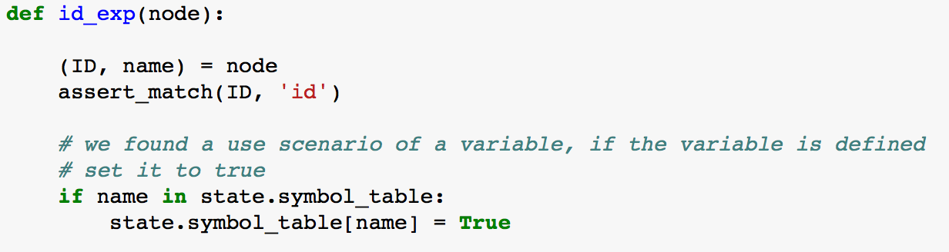
PP1: Variable Usage
But…

Slide 37
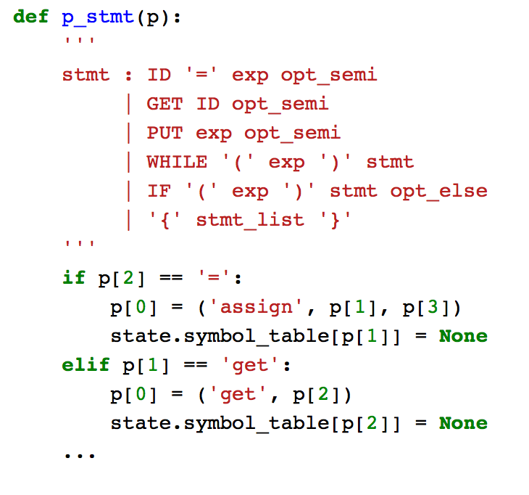
PP1: Variable Usage
Recall that when the frontend finds a definition of a variable as an
assignment statement or a
get statement
it enters the variable into the symbol table and initializes it with None.

Slide 38
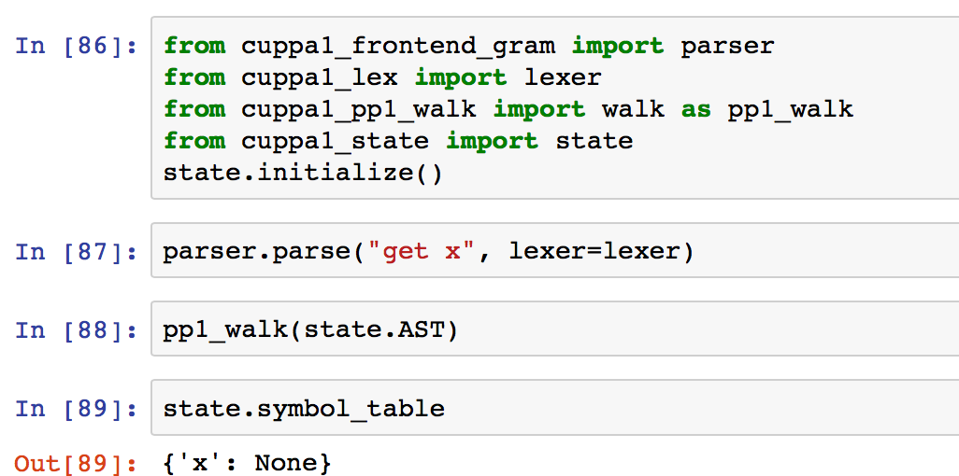
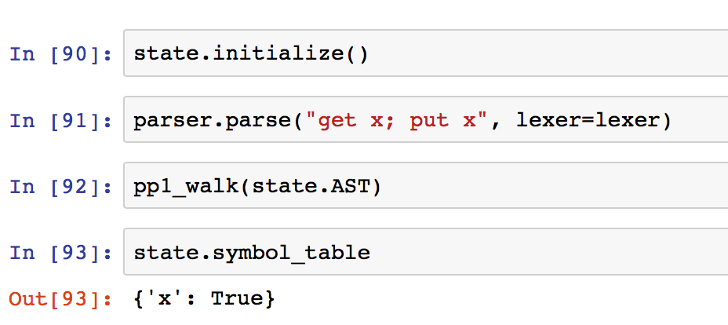
PP1: Variable Usage
Testing the tree walker

Slide 39
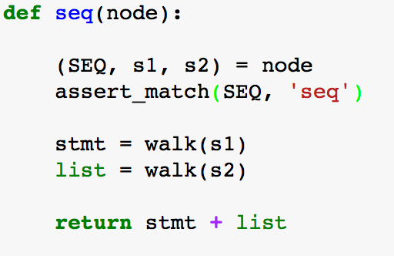
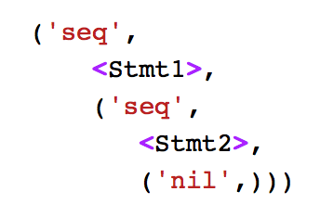
PP2: Pretty Print Tree Walker
The tree walker for the second pass walks the AST and compiles a formatted string that represents the pretty printed program.
Recall that programs are nil terminated Seq lists of statements:
Concatenate the string
for stmt with the string from the rest of the Seq list.

Slide 40
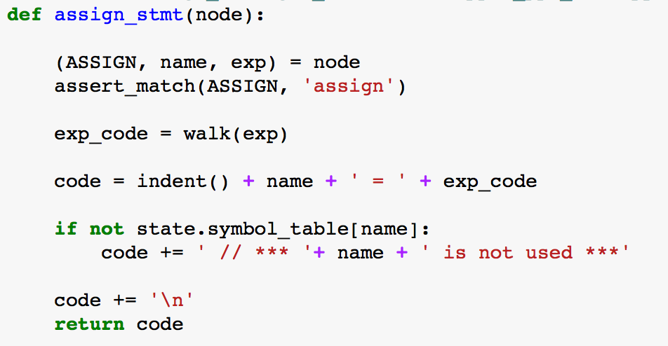
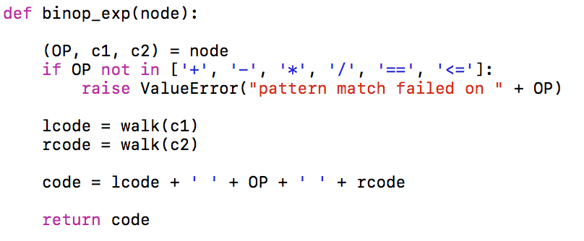
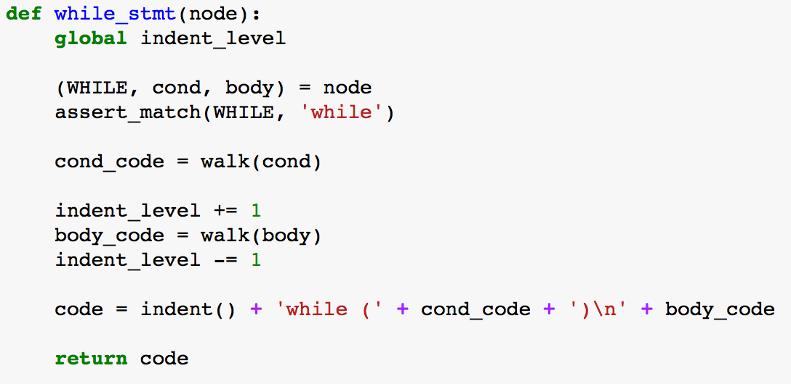
PP2: Pretty Print Tree Walker
Indent() and indent_level keep track of the code indentation for formatting purposes.

Slide 41
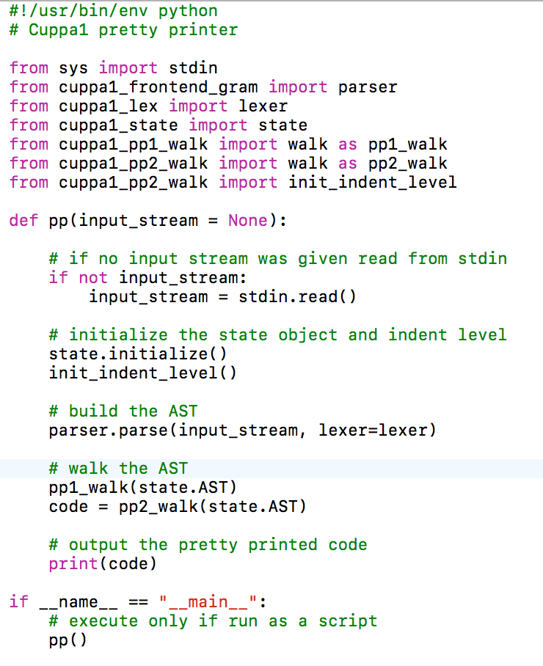
Top Level Function of PP
Top level function

Slide 42
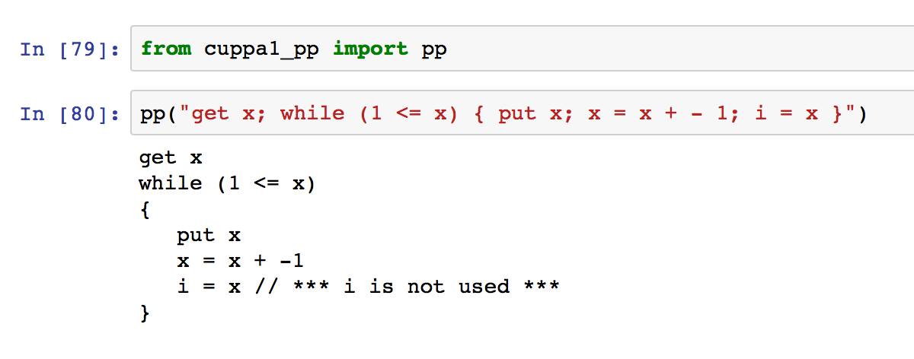
The Cuppa1 PP
Testing the pretty printer

Slide 43
Assignment
Assignment #5 – see webpage.

