Slide 1
Structured Data Types
Chap 12
The data types we have considered so far all had a single value:
Int
Float
String (we view strings as immutable)
Structured data types are typically made up of/contain multiple values
Arrays
Class structures
Enums
Here we will take a look at arrays.

Slide 2
Arrays
Arrays are data structures that look like lists where every element in the list is of the same data type.
A convenient way to view arrays is that of a structure that can hold multiple values:
int[3] v - v is a (array) variable that holds integer arrays of size three.

Slide 3
Arrays
Initializers
int[3] a = { 3,-2,10 };
Arrays can be viewed as array values
int[3] a = { 3,-2,10 };
int[3] b = a; ← copy values from a to b
The size of the array and the type of the elements matters
int[3] a = { 3,-2,10};
float[3] b = a; 
or
int[4] b = a; 

Slide 4
Interpreting Arrays
Symbol Table
Global Scope
int[3] a = { 3,-2,10 };
int[3] b = a;
b[1] = 0;
Current Scope Pointer

Slide 5
Interpreting Arrays
Symbol Table
Global Scope
int[3] a = { 3,-2,10 };
int[3] b = a;
b[1] = 0;
a → Array int 3 {3,-2,10}
Current Scope Pointer

Slide 6
Interpreting Arrays
Symbol Table
Global Scope
int[3] a = { 3,-2,10 };
int[3] b = a;
b[1] = 0;
a → Array int 3 {3,-2,10}
Current Scope Pointer
b → Array int 3 {3,-2,10}

Slide 7
Interpreting Arrays
Symbol Table
Global Scope
int[3] a = { 3,-2,10 };
int[3] b = a;
b[1] = 0;
a → Array int 3 {3,-2,10}
Current Scope Pointer
b → Array int 3 {3,0,10}

Slide 8
Computing with Arrays
Just as in the case of scalar variables, array variables can appear in two types of contexts:
Expressions: here we read the contents of the array location indexed, e.g., x = a[2].
Assignment statements: here we access the index array location and update its contents, e.g., a[2] = x

Slide 9
Computing with Arrays
Here is a program that computes a sequence of numbers into an array:
int[3] a;
int i = 0;
while (i =< 2) {
a[i] = i;
i = i + 1
}
put “the array is: “, a;

Slide 10
Interpreting Arrays
Symbol Table
Global Scope
int[3] a;
int i = 0;
while (i =< 2) {
a[i] = i;
i = i + 1
}
put “the array is: “,a;
Current Scope Pointer
Local Scope

Slide 11
Interpreting Arrays
Symbol Table
Global Scope
int[3] a;
int i = 0;
while (i =< 2) {
a[i] = i;
i = i + 1
}
put “the array is: “,a;
a → Array int 3 {0,0,0}
Current Scope Pointer
Local Scope

Slide 12
Interpreting Arrays
Symbol Table
Global Scope
int[3] a;
int i = 0;
while (i =< 2) {
a[i] = i;
i = i + 1
}
put “the array is: “,a;
a → Array int 3 {0,0,0}
Current Scope Pointer
i → int 0
Local Scope

Slide 13
Interpreting Arrays
Symbol Table
Global Scope
int[3] a;
int i = 0;
while (i =< 2) {
a[i] = i;
i = i + 1
}
put “the array is: “,a;
a → Array int 3 {0,0,0}
Current Scope Pointer
i → int 0
Local Scope

Slide 14
Interpreting Arrays
Symbol Table
Global Scope
int[3] a;
int i = 0;
while (i =< 2) {
a[i] = i;
i = i + 1
}
put “the array is: “,a;
a → Array int 3 {0,0,0}
Current Scope Pointer
i → int 0
Local Scope

Slide 15
Interpreting Arrays
Symbol Table
Global Scope
int[3] a;
int i = 0;
while (i =< 2) {
a[i] = i;
i = i + 1
}
put “the array is: “,a;
a → Array int 3 {0,0,0}
Current Scope Pointer
i → int 1
Local Scope

Slide 16
Interpreting Arrays
Symbol Table
Global Scope
int[3] a;
int i = 0;
while (i =< 2) {
a[i] = i;
i = i + 1
}
put “the array is: “,a;
a → Array int 3 {0,0,0}
Current Scope Pointer
i → int 1
Local Scope

Slide 17
Interpreting Arrays
Symbol Table
Global Scope
int[3] a;
int i = 0;
while (i =< 2) {
a[i] = i;
i = i + 1
}
put “the array is: “,a;
a → Array int 3 {0,1,0}
Current Scope Pointer
i → int 1
Local Scope

Slide 18
Interpreting Arrays
Symbol Table
Global Scope
int[3] a;
int i = 0;
while (i =< 2) {
a[i] = i;
i = i + 1
}
put “the array is: “,a;
a → Array int 3 {0,1,0}
Current Scope Pointer
i → int 2
Local Scope

Slide 19
Interpreting Arrays
Symbol Table
Global Scope
int[3] a;
int i = 0;
while (i =< 2) {
a[i] = i;
i = i + 1
}
put “the array is: “,a;
a → Array int 3 {0,1,0}
Current Scope Pointer
i → int 2
Local Scope

Slide 20
Interpreting Arrays
Symbol Table
Global Scope
int[3] a;
int i = 0;
while (i =< 2) {
a[i] = i;
i = i + 1
}
put “the array is: “,a;
a → Array int 3 {0,1,2}
Current Scope Pointer
i → int 2
Local Scope

Slide 21
Interpreting Arrays
Symbol Table
Global Scope
int[3] a;
int i = 0;
while (i =< 2) {
a[i] = i;
i = i + 1
}
put “the array is: “,a;
a → Array int 3 {0,1,2}
Current Scope Pointer
i → int 3
Local Scope

Slide 22
Interpreting Arrays
Symbol Table
Global Scope
int[3] a;
int i = 0;
while (i =< 2) {
a[i] = i;
i = i + 1
}
put “the array is: “,a;
a → Array int 3 {0,1,2}
Current Scope Pointer
i → int 3
Local Scope

Slide 23
Interpreting Arrays
the array is: {0,1,2}
Symbol Table
Global Scope
int[3] a;
int i = 0;
while (i =< 2) {
a[i] = i;
i = i + 1
}
put “the array is: “,a;
a → Array int 3 {0,1,2}
Current Scope Pointer
i → int 3
Local Scope

Slide 24
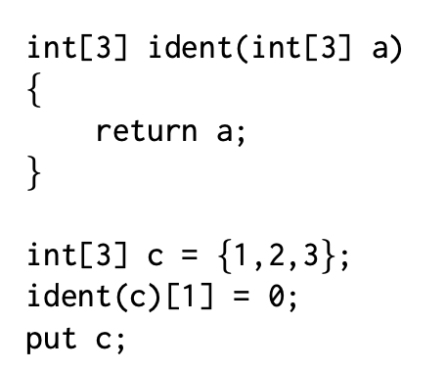
Functions and Arrays
We pass arrays by-reference to functions
The types of the formal and actual parameters have to correspond exactly – no type coercion possible.
We also return arrays from a function by reference.
We are modifying c!

Slide 25
Interpreting Arrays
Symbol Table
Global Scope
float[3] init(float[3] a) {
int i = 0;
while (i =< 2) {
a[i] = -1.0;
i = i+1;
}
}
float[3] q;
init(q);
Current Scope Pointer
Function Scope

Slide 26
Interpreting Arrays
Symbol Table
Global Scope
float[3] init(float[3] a) {
int i = 0;
while (i =< 2) {
a[i] = -1.0;
i = i+1;
}
}
float[3] q;
init(q);
init → Function float[3] (float[3] a) {
int i = 0;
while (i =< 2) {
a[i] = -1.0;
i = i+1;
}
}
Current Scope Pointer
Function Scope

Slide 27
Interpreting Arrays
Symbol Table
Global Scope
float[3] init(float[3] a) {
int i = 0;
while (i =< 2) {
a[i] = -1.0;
i = i+1;
}
}
float[3] q;
init(q);
init → Function float[3] (float[3] a) {
int i = 0;
while (i =< 2) {
a[i] = -1.0;
i = i+1;
}
}
Current Scope Pointer
q → Array float 3 {0.0,0.0,0.0}
Function Scope

Slide 28
Interpreting Arrays
Symbol Table
Global Scope
float[3] init(float[3] a) {
int i = 0;
while (i =< 2) {
a[i] = -1.0;
i = i+1;
}
}
float[3] q;
init(q);
init → Function float[3] (float[3] a) {
int i = 0;
while (i =< 2) {
a[i] = -1.0;
i = i+1;
}
}
Current Scope Pointer
q → Array float 3 {0.0,0.0,0.0}
Function Scope
Function float[3] (float[3] a) {
int i = 0;
while (i =< 2) {
a[i] = -1.0;
i = i+1;
}
}

Slide 29
Interpreting Arrays
Symbol Table
Global Scope
float[3] init(float[3] a) {
int i = 0;
while (i =< 2) {
a[i] = -1.0;
i = i+1;
}
}
float[3] q;
init(q);
init → Function float[3] (float[3] a) {
int i = 0;
while (i =< 2) {
a[i] = -1.0;
i = i+1;
}
}
Current Scope Pointer
q → Array float 3 {0.0,0.0,0.0}
Function Scope
a → @q
Function float[3] (float[3] a) {
int i = 0;
while (i =< 2) {
a[i] = -1.0;
i = i+1;
}
}

Slide 30
Interpreting Arrays
Symbol Table
Global Scope
float[3] init(float[3] a) {
int i = 0;
while (i =< 2) {
a[i] = -1.0;
i = i+1;
}
}
float[3] q;
init(q);
init → Function float[3] (float[3] a) {
int i = 0;
while (i =< 2) {
a[i] = -1.0;
i = i+1;
}
}
Current Scope Pointer
q → Array float 3 {0.0,0.0,0.0}
Function Scope
a → @q
i → int 0
Function float[3] (float[3] a) {
int i = 0;
while (i =< 2) {
a[i] = -1.0;
i = i+1;
}
}

Slide 31
Interpreting Arrays
Symbol Table
Global Scope
float[3] init(float[3] a) {
int i = 0;
while (i =< 2) {
a[i] = -1.0;
i = i+1;
}
}
float[3] q;
init(q);
init → Function float[3] (float[3] a) {
int i = 0;
while (i =< 2) {
a[i] = -1.0;
i = i+1;
}
}
Current Scope Pointer
q → Array float 3 {-1.0,-1.0,-1.0 }
Function Scope
a → @q
i → int 3
Function float[3] (float[3] a) {
int i = 0;
while (i =< 2) {
a[i] = -1.0;
i = i+1;
}
}

Slide 32
Interpreting Arrays
Symbol Table
Global Scope
float[3] init(float[3] a) {
int i = 0;
while (i =< 2) {
a[i] = -1.0;
i = i+1;
}
}
float[3] q;
init(q);
init → Function float[3] (float[3] a) {
int i = 0;
while (i =< 2) {
a[i] = -1.0;
i = i+1;
}
}
Current Scope Pointer
q → Array float 3 {-1.0,-1.0,-1.0}
Function Scope
a → Array float 3 {-1.0,-1.0,-1.0}
i → int 3

Slide 33
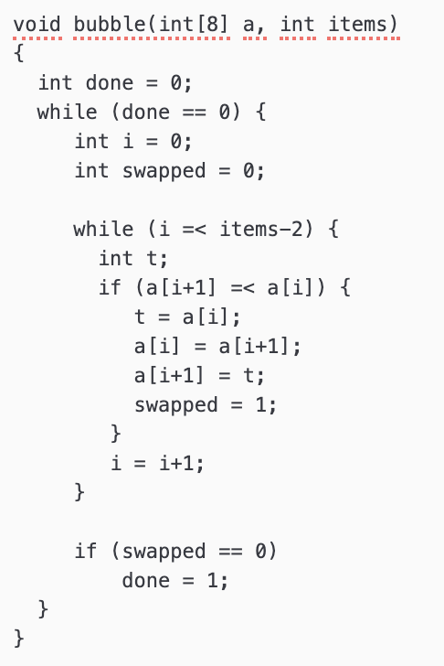
Computing with Arrays
The Bubble Sort

Slide 34
Functions and Arrays
Quicksort
int[100] qsort(int[100] a, int count) {
int[100] less;
int[100] more;
int lesscount = 0;
int morecount = 0;
if (count =< 1)
return a;
int i = 1;
int pivot = a[0];
while (i =< count-1) {
if (a[i] =< pivot) {
less[lesscount] = a[i];
lesscount = lesscount+1;
}
else {
more[morecount] = a[i];
morecount = morecount+1;
}
}
less[lesscount] = pivot;
lesscount = lesscount+1;
less = qsort(less,lesscount);
more = qsort(more,morecount);
return append(less,lesscount,more,morecount);
}

Slide 35
Functions and Arrays
Append
int[100] append(int[100] a, int acount, int[100] b, bcount) {
int[100] result;
int rcount = 0;
int i = 0;
while (i =< acount-1) {
result[rcount] = a[i];
rcount = rcount+1;
}
i = 0;
while (i =< bcount-1) {
result[rcount] = b[i];
rcount = rcount+1;
}
return result;
}

