Slide 1
An Optimizing Compiler
The big difference between interpreters and compilers is that compilers have the ability to think about how to translate a source program into target code in the most effective way.
Usually that means trying to translate the program in such a way that it executes as fast as possible on the target machine.
This usually implies either one or both of the following tasks:
Rewrite the AST so that it represents a more efficient program – Tree Rewriting
Reorganize the generated instructions so that they represent the most efficient target program possible
This is referred to as Optimization.
There are many optimization techniques available to compilers in addition to the two mentioned above:
Register allocation, loop optimization, common subexpression elimination, dead code elimination, etc
Chap 6

Slide 2
An Optimizing Compiler
In our optimizing compiler we study:
Tree rewriting in the context of constant folding, and
Target code optimization in the context of peephole optimization.

Slide 3
Tree Rewriting
So far our applications only have looked at the AST as an immutable data structure
Bytecode interpreter used it to execute instructions
The Cuppa1 interpreter used it as an abstract representation of the original program
PrettyPrinter used it to regenerate programs
But there are many cases where we actually want to transform the AST
Consider constant folding

Slide 4
Constant Folding
Constant folding is an optimization that tries to find arithmetic operations in the source program that can be performed at compile time rather than runtime.

Slide 5
Constant Folding
In constant folding we look at the operations in arithmetic expressions and if the operands are constants then we perform the operation and replace the AST with a result node.
x = 10 + 5
x = 15
=
=
x
+
x
15
10
5

Slide 6
Constant Folding
One way to view constant folding is as a AST rewriting.
Here the AST for the expression 10 + 5 is replaced by an AST node for the constant 15.
In order to accomplish this we need to walk the AST for a Cuppa1 program and look for patterns that allow us to rewrite the tree.
This is very similar to code generation tree walker where we walked the tree and looked for AST patterns that we could translate into Exp1bytecode.
The big difference being that in the constant folder we will be returning the rewritten tree from the tree walker rather than bytecode as in the code generator.

Slide 7
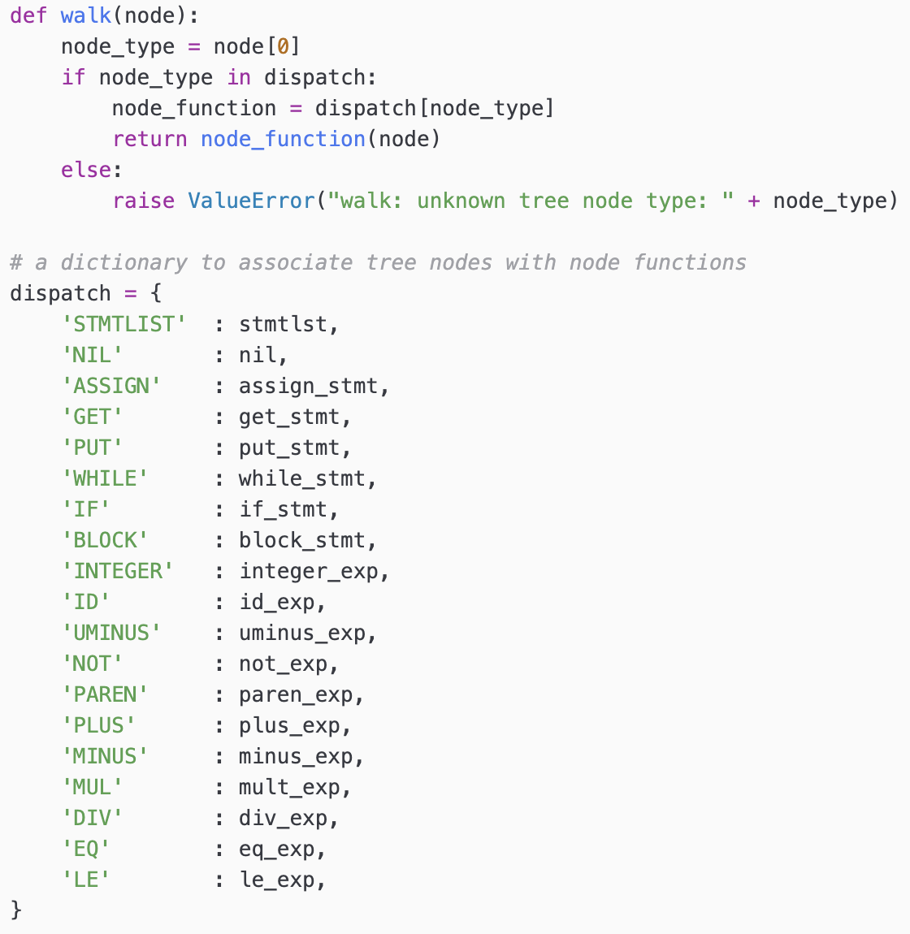
Constant Folding Walker
cuppa1_fold.py

Slide 8
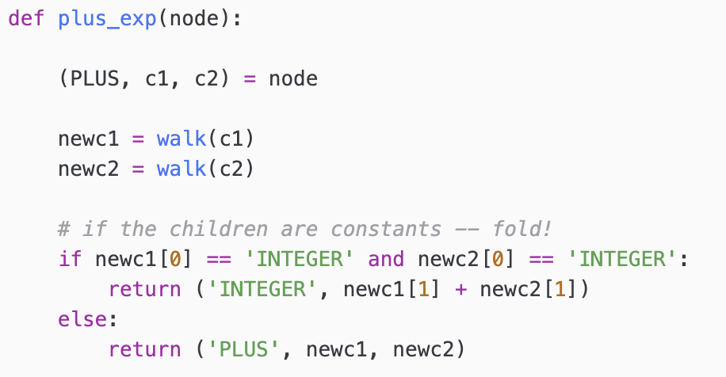
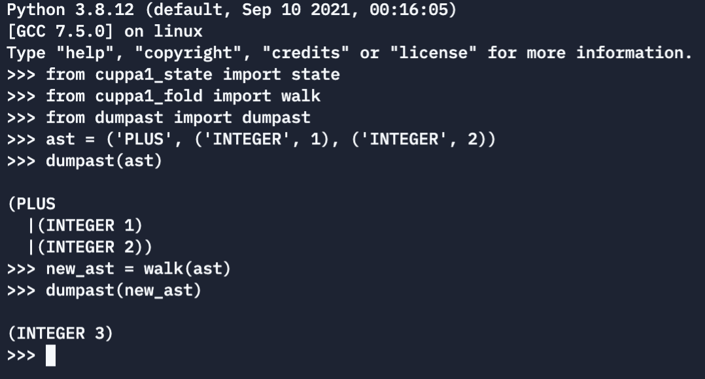
Constant Folding Walker
cuppa1_fold.py

Slide 9
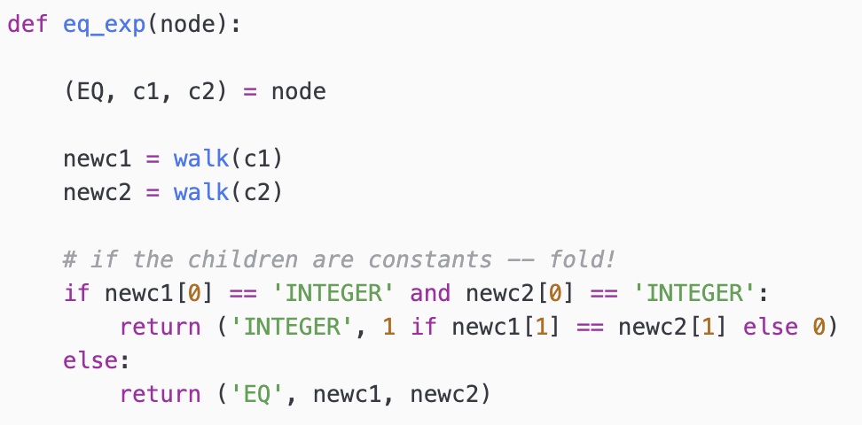
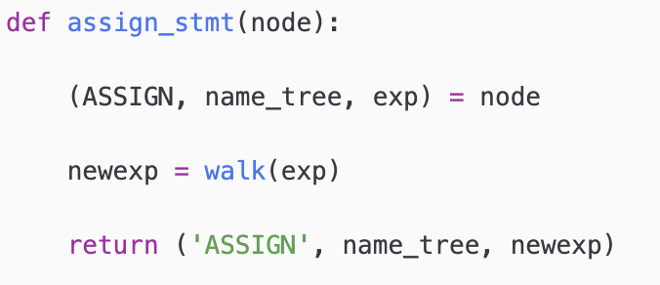
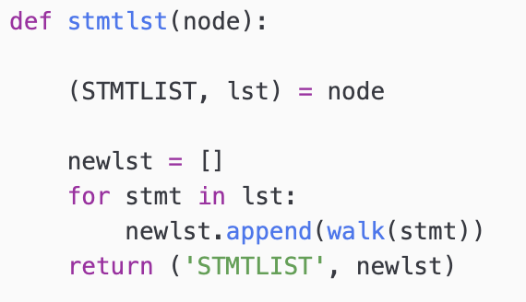
Constant Folding Walker
cuppa1_fold.py

Slide 10
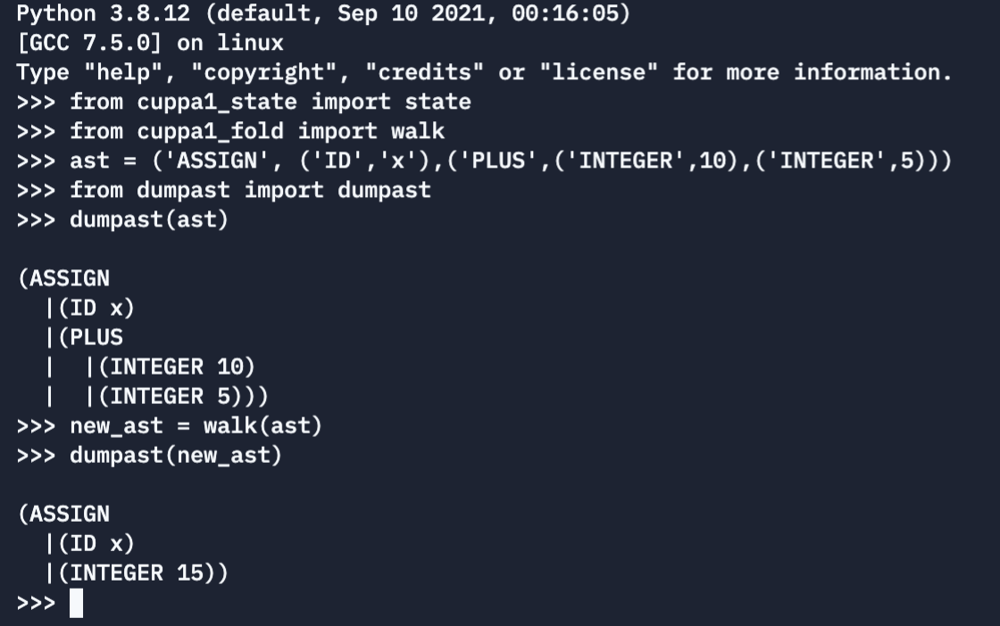
Constant Folding
Let's try our walker on our assignment statement example to see if it does what we claim it does,

Slide 11
Compiler Architecture
We insert our constant folding tree rewriting phase into our Cuppa1 compiler as a tree walker.
Constant Folding Walker
CodeGen
Walker
Frontend
Input
build
write
Output
AST

Slide 12
Peephole Code Optimization
A peephole optimizer improves the generated code by reorganizing the generated instructions.
If you recall the code generator for our Cuppa1 compiler translates Cuppa1 AST patterns into Exp1bytecode patterns and simply composes the generated bytecode patterns into a list of instructions.
That can lead to very silly looking code.

Slide 13
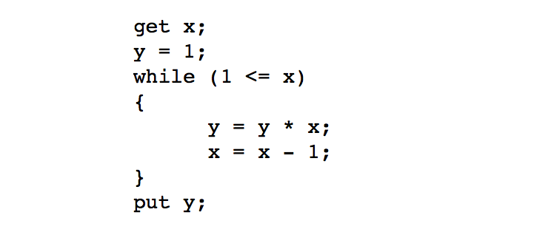
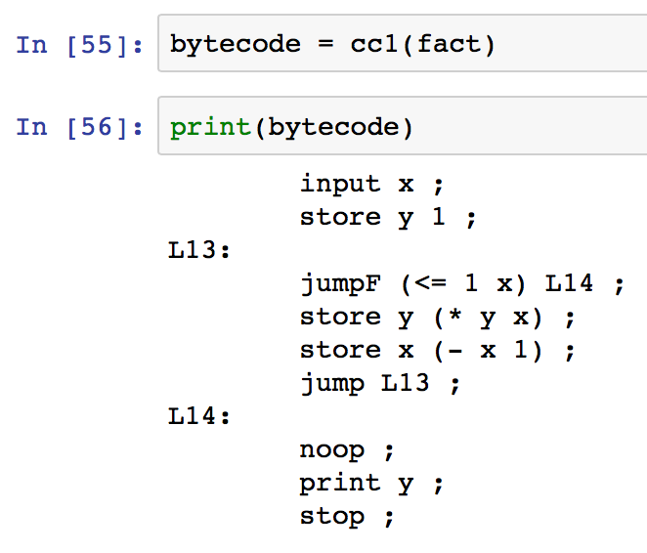
Peephole Code Optimization
Consider:
Really Silly!

Slide 14
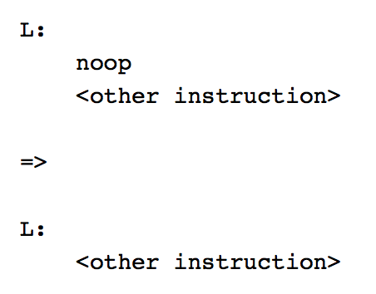
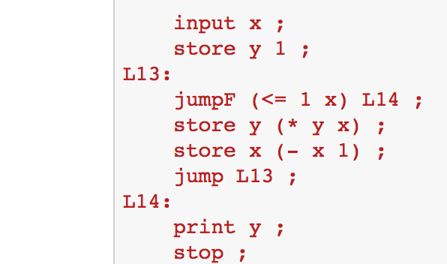
Peephole Code Optimization
There is a rule for that:

Slide 15
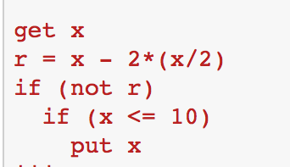
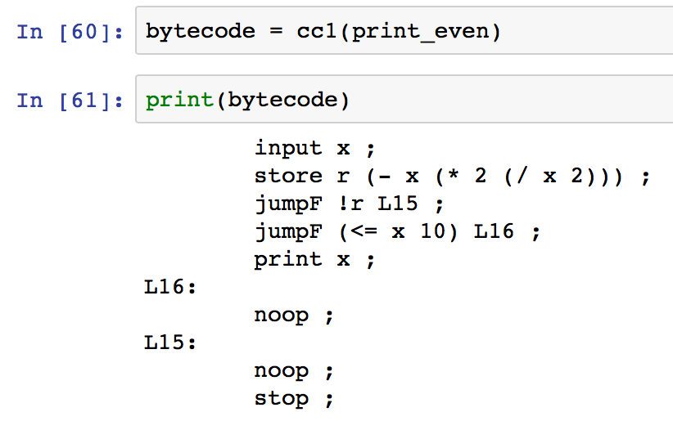
Peephole Code Optimization
Consider:
Even Sillier!

Slide 16
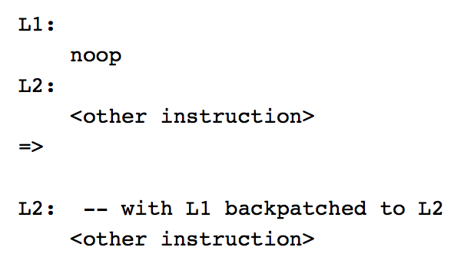
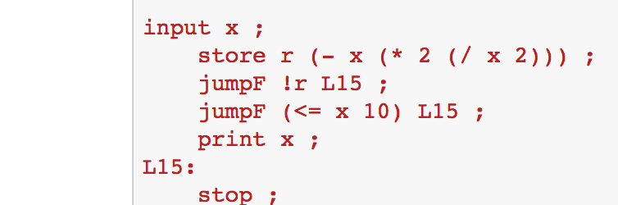
Peephole Code Optimization
There is a rule for that:

Slide 17
Peephole Code Optimization
One way to think of a peephole optimizer is as a window (the peephole) which we slide across the generated instructions repeatedly and apply rewrite rules like the ones we developed above to the code within the window.
The peephole optimizer terminates once no longer any code is being rewritten.
The repeated nature of the process is necessary because applying one rewrite rule to the instruction list can expose opportunities to apply other rewrite rules.
So we need to keep sliding the window across the instructions until no further rewrites are possible.

Slide 18
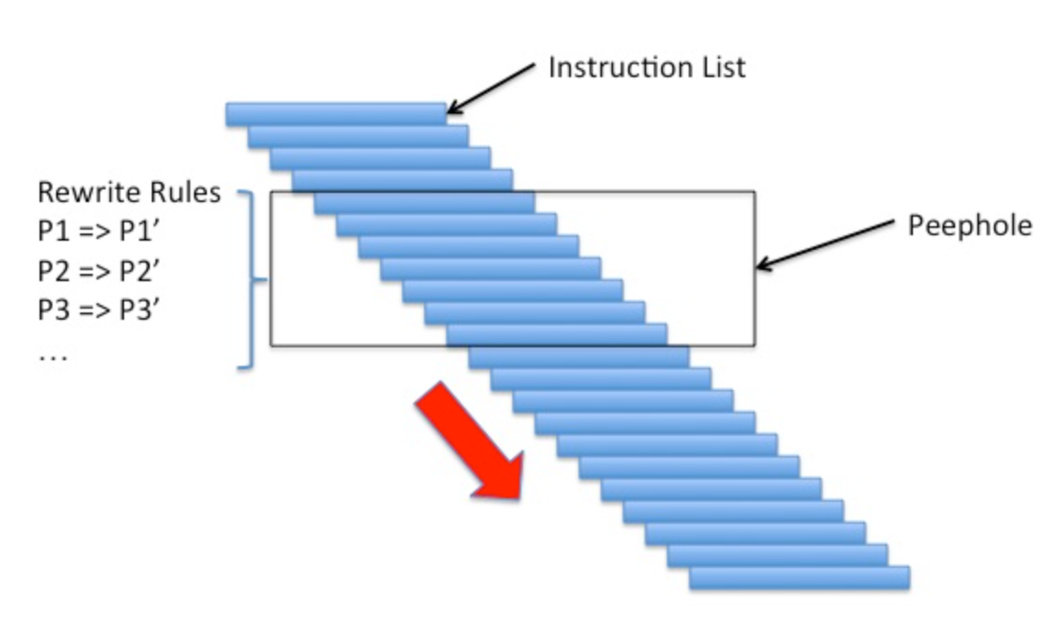
Peephole Code Optimization

Slide 19
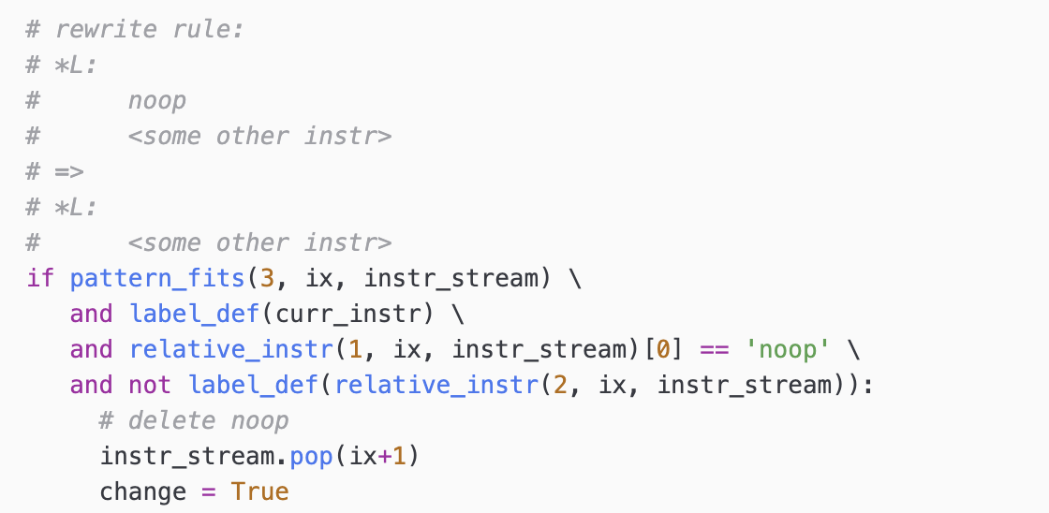
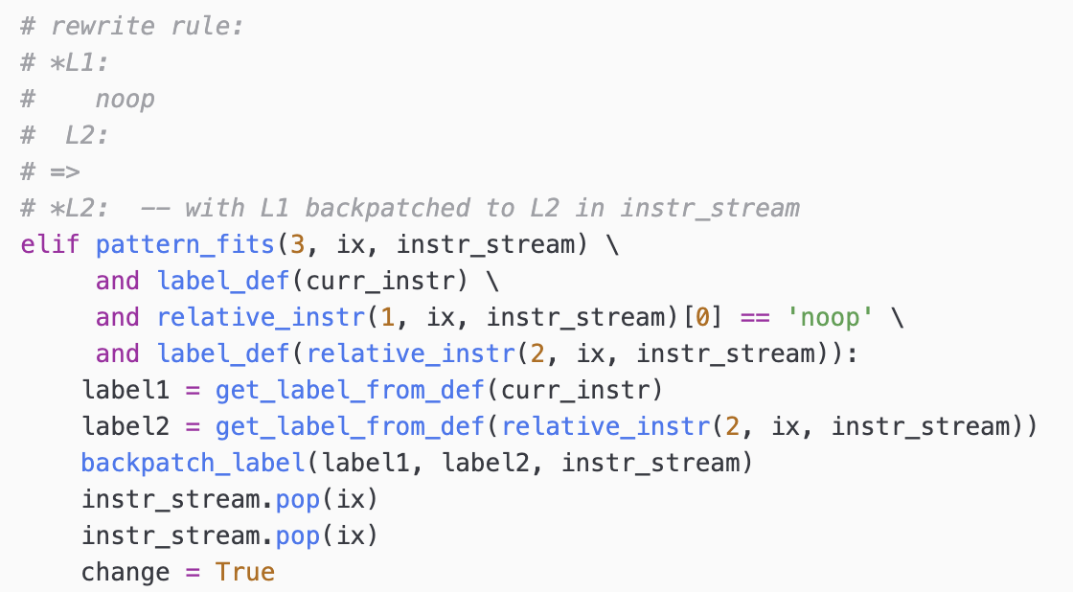
Peephole Code Optimization
Rewrite Rules:
cuppa1_output.py

Slide 20
Peephole Code Optimization
#########################################################################
# apply peephole optimization. The instruction tuple format is:
# (instr_name_str, [param_str1, param_str2, ...])
def peephole_opt(instr_stream):
ix = 0
change = False
while(True):
curr_instr = instr_stream[ix]
### compute some useful predicates on the current instruction
is_first_instr = ix == 0
is_last_instr = ix+1 == len(instr_stream)
has_label = True if not is_first_instr and label_def(instr_stream[ix-1]) else False
<** rewrite rules here **>
### advance ix
if is_last_instr and not change:
break
elif is_last_instr:
ix = 0
change = False
else:
ix += 1
cuppa1_output.py

Slide 21
Optimizing Compiler Architecture
We insert our peephole optimizer between the code generator and the output phase
Constant Folding Walker
CodeGen
Walker
Frontend
Input
build
AST
Peephole
Opt
Output

Slide 22
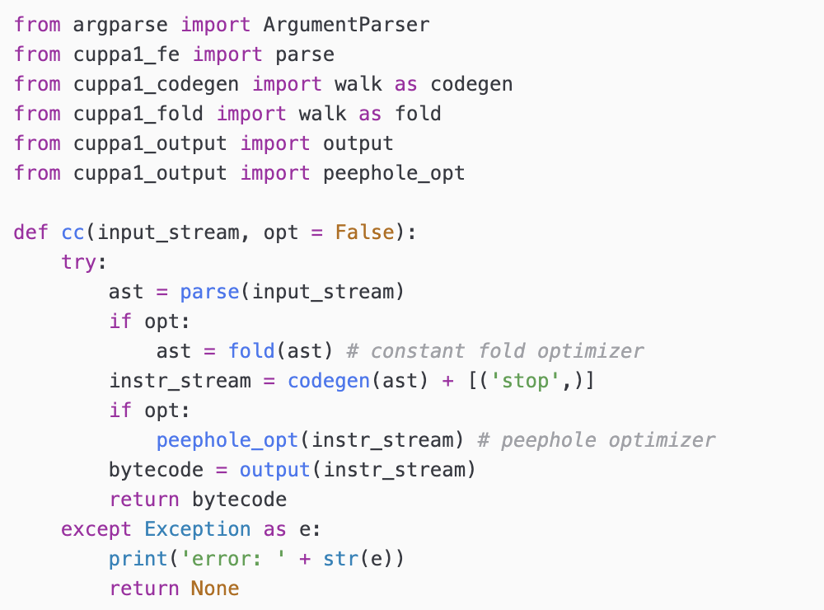
Optimizing Compiler
Top-level Driver Function
cuppa1_cc.py

Slide 23
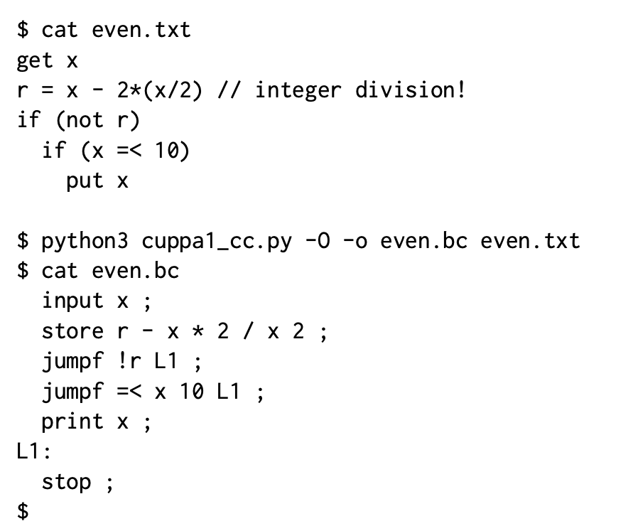
Testing the Compiler

