Slide 1
Scope & Symbol Table
Most modern programming languages have some notion of scope.
Scope defines the “lifetime” of a program symbol.
If a symbol is no longer accessible then we say that it is “out of scope.”
The simplest scope is the “block scope.”
With scope we need a notion of variable declaration which allows us to assert in which scope the variable is visible or accessible.
Read Chap 7

Slide 2
Cuppa2
We extend our Cuppa1 language with variable declarations of the form declare x = 10;
Declares the variable x in the current scope and initializes it to the value 10
If the current scope is the global (outermost) scope then we call x a “global” variable.

Slide 3
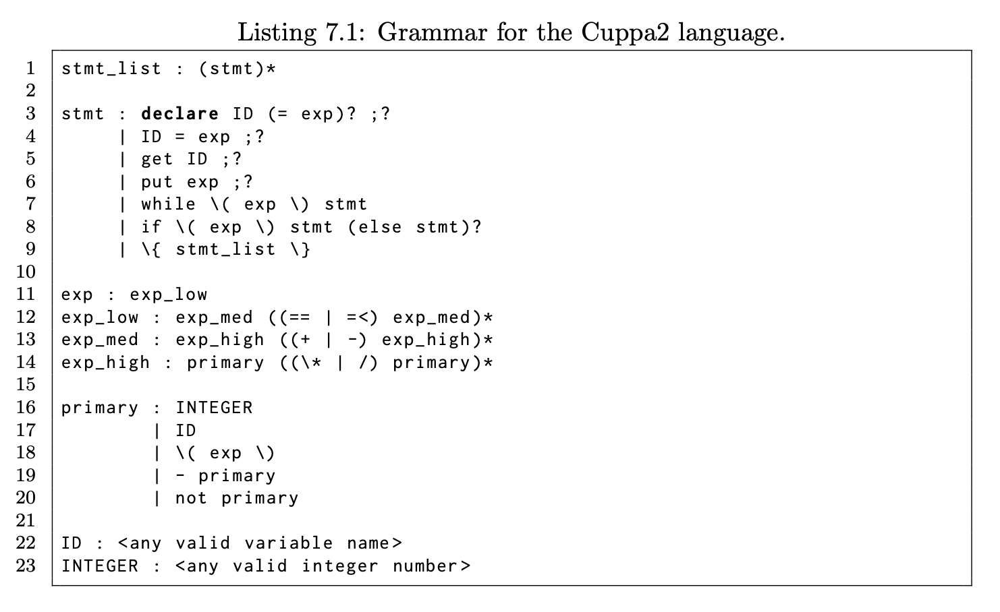
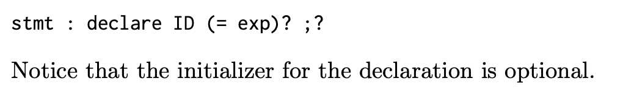
Cuppa2 Grammar

Slide 4
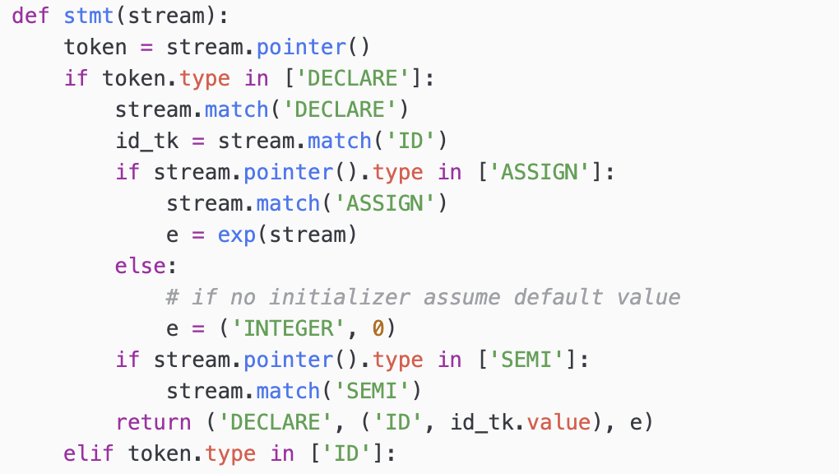
Cuppa2 Frontend
cuppa2_fe.py
…
The relevant piece of code in the frontend.

Slide 5
Cuppa2
We can now write properly scoped programs
Consider:
declare x = 1;
{
declare x = 2;
put x;
}
{
declare x = 3;
put x;
}
put x;

Slide 6
Variable Shadowing
An issue with scoped declarations is that inner declarations can “overshadow” outer declarations
Consider:
declare x = 2;
{
declare x = 3;
{
declare y = x + 2;
put y;
}
}
What is the output of the program once it is run?

Slide 7
Variable update
A variable update can be outside of our current scope.
Consider
declare x = 2;
{
declare y = 3;
x = y + x;
put x;
}
put x;

Slide 8
Symbol Tables
To deal with programs like that we need something more sophisticated for variable lookup than a dictionary.
a dictionary stack
This stack needs to be able to support the following functionality
Declare a variable (insertion)
Lookup a variable
Update a variable value

Slide 9
Semantic Rules for Variable Declarations
Here are the rules which we informally used in the previous examples:
The ‘declare’ statement inserts a variable declaration into the current scope
a variable lookup returns a variable value from the current scope or the surrounding scopes
Every variable needs to be declared before use
No variable can be declared more than once in the current scope.

Slide 10
Symbol Tables
Design:
we have a class SymTab that:
Holds a stack of scopes
scoped_symtab
Defines the interface to the symbol table
push_scope, pop_scope, declare_sym, etc
By default, SymTab is initialized with a single scope on the stack – the global scope.

Slide 11
Symbol Tables
Symbol Table
Global Scope
declare x = 2;
{
declare y = 3;
x = y + x;
put x;
}
put x;
Current Scope Pointer
Local Scope

Slide 12
Symbol Tables
Symbol Table
Global Scope
declare x;
get x;
If (0 <= x)
{
declare i = x;
put i;
}
else
{
declare j = -1 * x;
put j;
}
put x;
Current Scope Pointer
Local Scope

Slide 13
Symbol Tables
Symbol Table
Global Scope
declare x = 2;
{
declare x = 3;
{
declare y = x + 2;
put y;
}
}
Current Scope Pointer
Local Scope
Local Scope

Slide 14
Symbol Tables
CURR_SCOPE = 0
class SymTab:
#-------
def __init__(self):
# global scope dictionary must always be present
self.scoped_symtab = [{}]
#-------
def push_scope(self):
# push a new dictionary onto the stack - stack grows to the left
self.scoped_symtab.insert(CURR_SCOPE,{})
#-------
def pop_scope(self):
# pop the left most dictionary off the stack
if len(self.scoped_symtab) == 1:
raise ValueError("cannot pop the global scope")
else:
self.scoped_symtab.pop(CURR_SCOPE)
#-------
def declare_sym(self, sym, init):
# declare the symbol in the current scope: dict @ position 0
…
#-------
def lookup_sym(self, sym):
# find the first occurence of sym in the symtab stack
# and return the associated value
…
#-------
def update_sym(self, sym, val):
# find the first occurence of sym in the symtab stack
# and update the associated value
…
cuppa2_symtab.py

Slide 15
Symbol Tables
def declare_sym(self, sym, init):
# declare the symbol in the current scope: dict @ position 0
# first we need to check whether the symbol was already declared
# at this scope
if sym in self.scoped_symtab[CURR_SCOPE]:
raise ValueError("symbol {} already declared".format(sym))
# enter the symbol in the current scope
scope_dict = self.scoped_symtab[CURR_SCOPE]
scope_dict[sym] = init
def lookup_sym(self, sym):
# find the first occurence of sym in the symtab stack
# and return the associated value
n_scopes = len(self.scoped_symtab)
for scope in range(n_scopes):
if sym in self.scoped_symtab[scope]:
val = self.scoped_symtab[scope].get(sym)
return val
# not found
raise ValueError("{} was not declared".format(sym))

Slide 16
Symbol Tables
def update_sym(self, sym, val):
# find the first occurence of sym in the symtab stack
# and update the associated value
n_scopes = len(self.scoped_symtab)
for scope in range(n_scopes):
if sym in self.scoped_symtab[scope]:
scope_dict = self.scoped_symtab[scope]
scope_dict[sym] = val
return
# not found
raise ValueError("{} was not declared".format(sym))

Slide 17
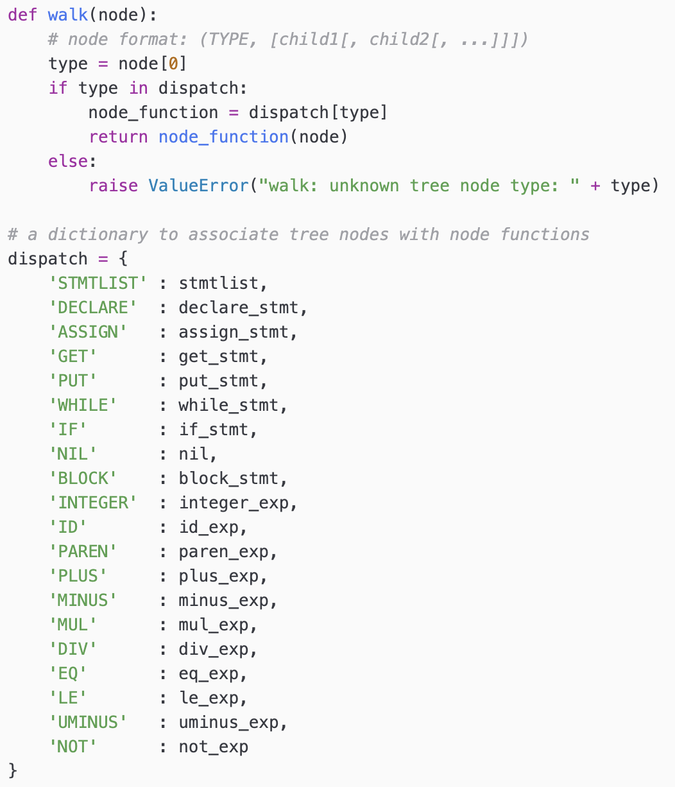
Interpret Walker
Note: Same as Cuppa1 interpreter except for the addition of the declaration statement and additional functionality in block statements and variable expressions.
cuppa2_interp_walk.py

Slide 18
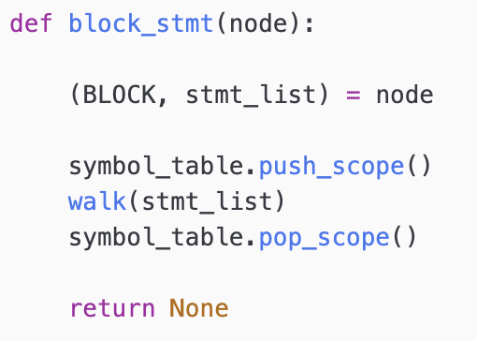
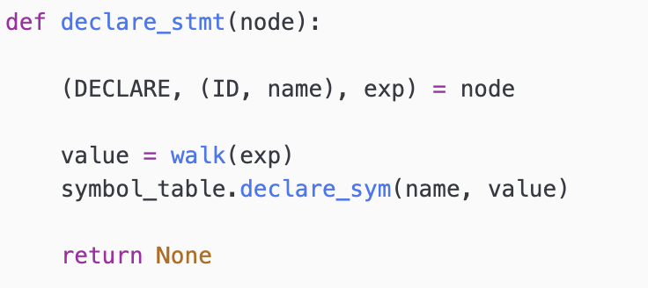
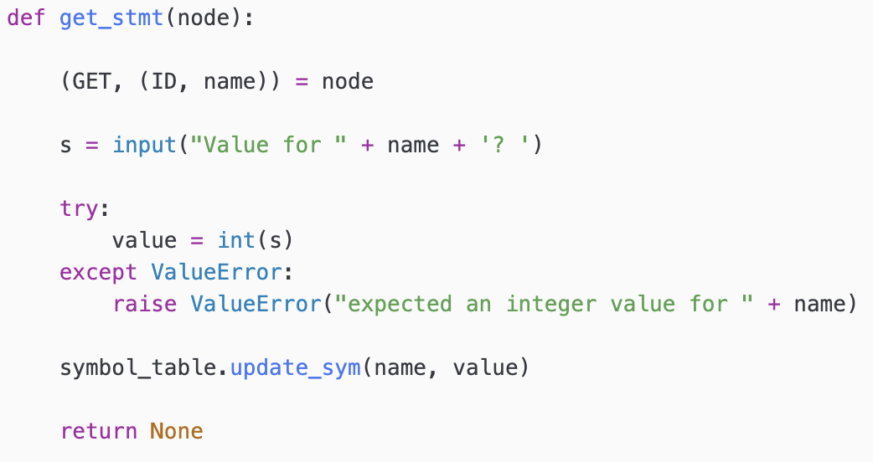
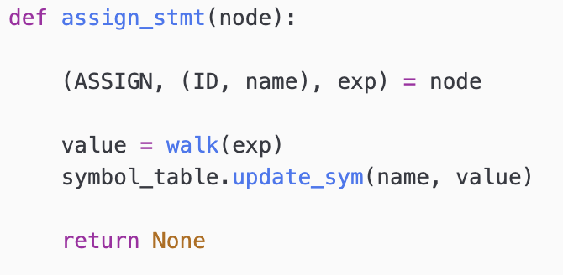
Interpret Walker
That’s it – everything else is the same as the Cuppa1 interpreter!

Slide 19
Syntactic vs Semantic Errors
Grammars allow us to construct parsers that recognize the syntactic structure of languages.
Any program that does not conform to the structure prescribed by the grammar is rejected by the parser.
We call those errors “syntactic errors.”

Slide 20
Syntactic vs Semantic Errors
Semantic errors are errors in the behavior of the program and cannot be detected by the parser.
Programs with semantic errors are usually syntactically correct
A certain class of these semantic errors can be caught by the interpreter/compiler. Consider: declare x = 10; put x + 1; declare x = 20; put x + 2;
Here we are redeclaring the variable ‘x’ which is not legal in many programming languages.
Many other semantic errors cannot be detected by the interpreter/compiler and show up as “bugs” in the program.

Slide 21
Symbol Tables
Symbol Table
Global Scope
declare x = 10; put x + 1; declare x = 20; put x + 2;
Current Scope Pointer

Slide 22
Symbol Tables
Symbol Table
Global Scope
x = x + 1;
put x;
Current Scope Pointer

