Slide 1
Multi-Symbol Words - Lexical Analysis
In our exp0 programming language we only had words of length one
However, most programming languages have words of lengths more than one
The lexical structure of a programming language specifies how symbols are combined to form words
Not to be confused with the phrase structure which tells us how words are combined to form phrases and sentences
The lexical structure of a programming language can be specified with regular expressions
whereas the phrase structure is specified with grammars.
The “parser” for the lexical structure of a programming language is called a lexical analyzer or lexer
The output of a lexer is usually given in terms of tokens.
Read Chap 2

Slide 2
Multi-Symbol Words - Lexical Analysis
This gives us the following hierarchy:
symbol
Lexical structure (regular expressions)
word
phrase
Phrase structure (grammars)
sentence

Slide 3
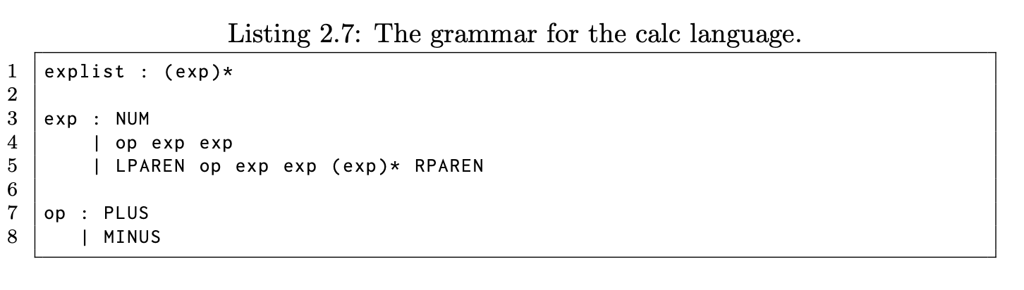
The Calc Language
EBNF notation stating that exp can appear zero or more times
Tokens
Tokens
This language allows us to write expression like,
125
+ 36 14
(+ 1 2 3)
Note that actual values and op names are now encoded as tokens in the grammar, e.g. NUM, PLUS

Slide 4
Tokens
The definition of Tokens usually has two parts:
A token type
A token value
For example, in Calc we have
a token type PLUS with a token value of ‘+’
a token type NUM with an integer token value.
That means lexers turn character/symbols streams into token streams
Token streams is what is read by parsers.

Slide 5
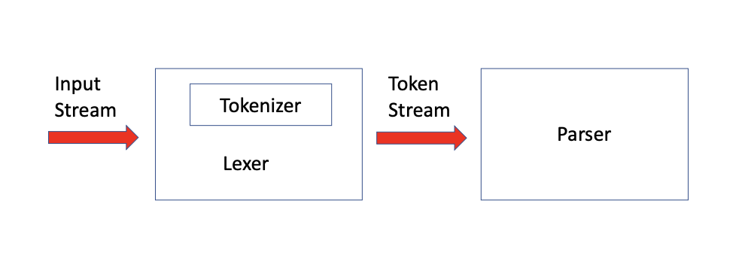
The Syntactic Analysis Phase

Slide 6
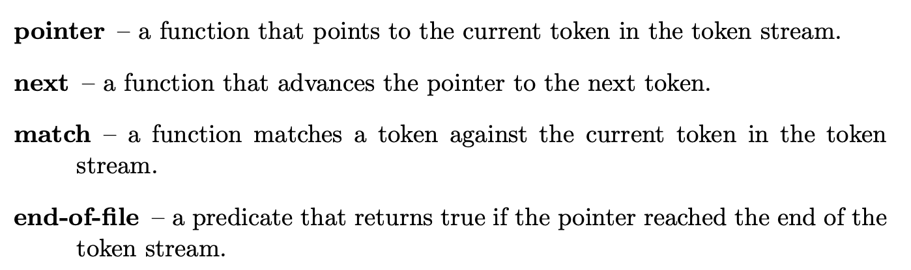
The Lexer
The lexer includes the tokenizer and implements a token stream with the following interface:
Note: same interface as our earlier InputStream class.

Slide 7
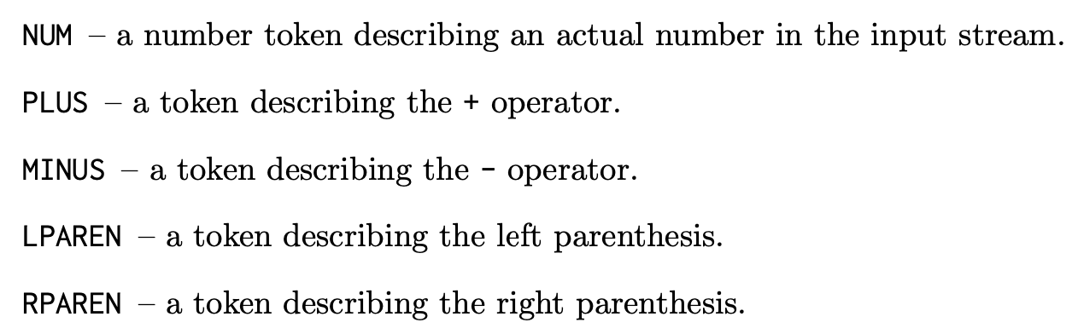
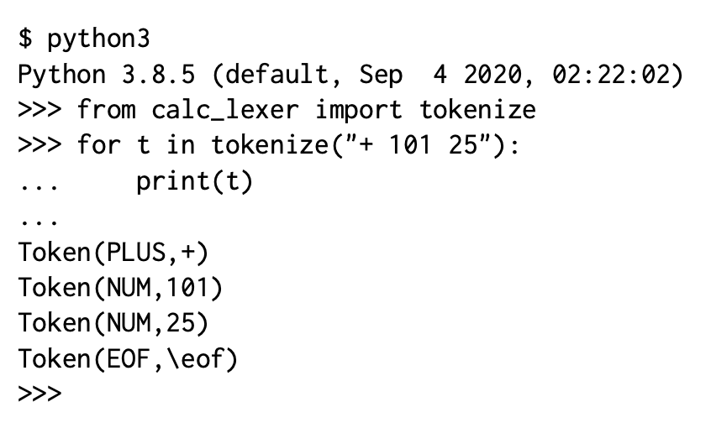
Calc Tokens

Slide 8
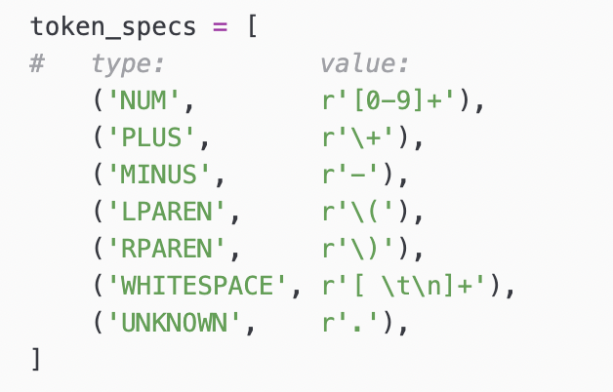
Specifying Tokens
In our calc_lexer.py file all we need to do is to define the token types and values
The rest of the code is boiler plate implementing the tokenizer and lexer
We use regular expression to specify the token values

Slide 9
Regular Expressions
Each letter A through Z and a through z is a regular expression.
Each number 0 through 9 is a regular expression.
Each printable character \(, \), -, \+, etc. is a regular expression.
If A and B are regular expressions then AB is also a regular expression and represents the concatenation of the two regular expressions.
If A is a regular expression then ( A ) is also a regular expression. Parentheses allow us to group regular expressions. Just as in grammars, the use of escaped parentheses in regular expressions is very important because the regular expression ( A ) is different from the regular expression \(A\). The former is the grouping of regular expression A and the latter is the concatenation of the three regular expressions.
If A and B are regular expressions then A | B is also a regular expression and represents the choice between regular expression A and regular expression B.
If A is a regular expression then A? is also a regular expression and specifies the regular expression A as optional.
If A is a regular expression then A* is also a regular expression and specifies that the regular expression A can appear zero or more times. We use the same operator in the EBNF notation for grammars.
If A is a regular expression then A+ is also a regular expression and specifies that the regular expression A can appear one or more times. You can think of A+ as a shorthand for AA*.

Slide 10
Regular Expression
The regular expression [A-Z] represents a single character between A and Z. Similarly for [a-z] and [0-9].
The special characters \n, \t, and \r are also regular expressions representing the newline character, the TAB character, and the carriage return character, respectively.
The dot operator . is a regular expression that represents any single printable character. Most importantly, it does not represent the newline character \n.
The ˆ operator computes the complement of a set. For example, if we have the regular expression [abc] matching either a,b or c, then the complement [ˆabc] will match any character other than a, b, or c. This is useful in conjunction with character classes. For example, the regular expression [A-Z][ˆA-Z] specifies a word structure that starts with a capital letter followed by a single character that is not a capital letter.

Slide 11
Parsing with Lexers
Good news: the techniques of building top-down parser we have looked at so far apply to parsers that use lexers!
Instead of using lookahead symbol we will now use lookahead tokens.

Slide 12
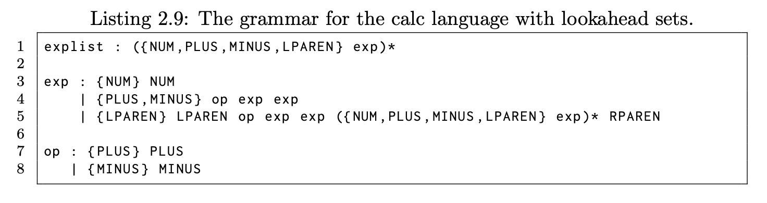
Parsing with Lexers
Consider our calc language again
We compute the lookahead sets in terms of tokens

Slide 13
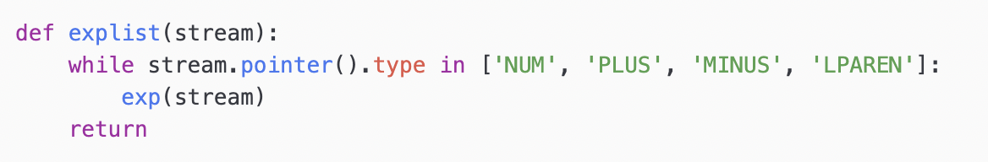
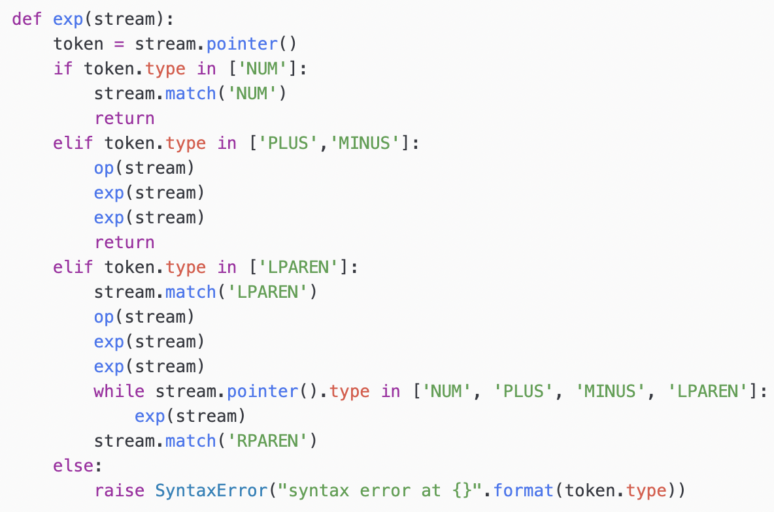
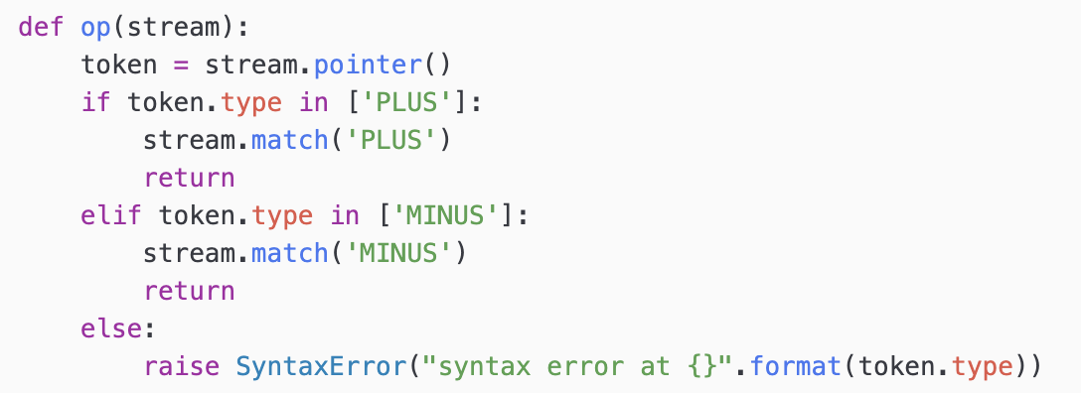
Parsing with Lexers
Now it is straightforward to build the parser

Slide 14
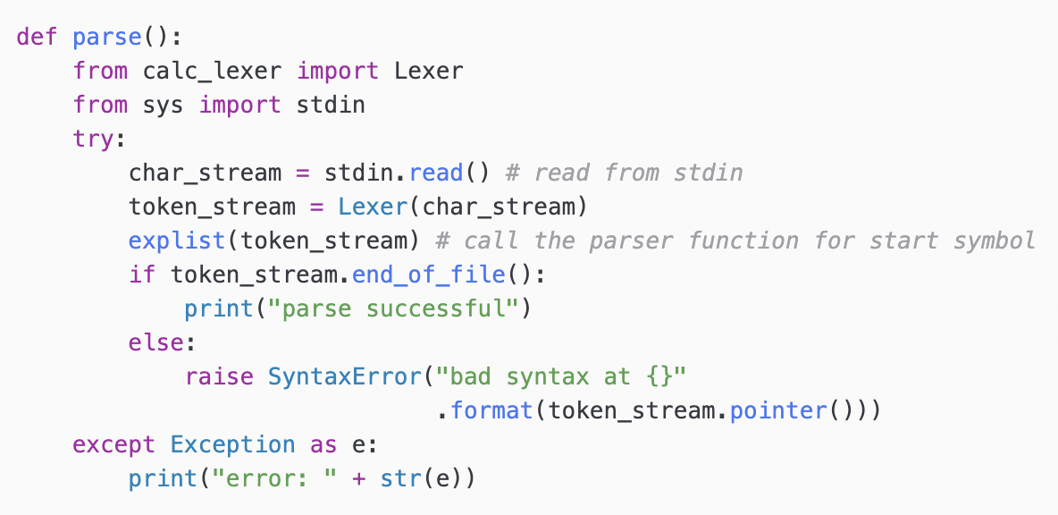
Parsing with Lexers
Top-level driver function

Slide 15
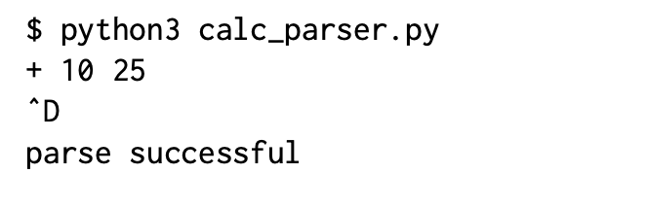
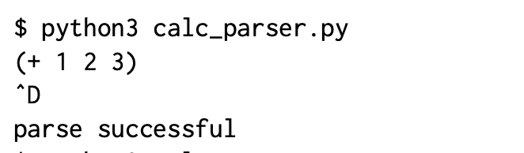
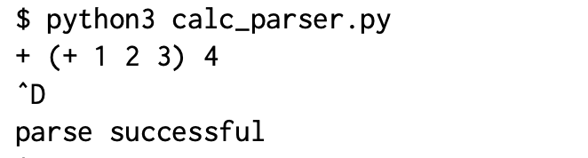
Parsing with Lexers
Running the parser

Slide 16
Class Exercise 1a
Please see BrightSpace

