Slide 1
Functions
Chap 8
Functions are parameterized pieces of code with a single entry point.
The function body is usually executed in the context of its own local scope.
When the function exists that local scope disappears
Function declaration and calling works analogously to variable declaration and usage.
Function arguments that appear in the declaration are called “formal parameters”
Function arguments that appear in the function call are called “actual parameters”.

Slide 2
Parameters
Terminology: Example: Java, C, C++
int plus (int a, int b)
{
return a + b;
}
…
int x = plus(1,2);
…
Formal Parameters
Function
Declaration
Observation: in function
declaration formal parameters
act as placeholders for the values of actual parameters.
Function Body
Actual Parameters
Function
Call

Slide 3
Two Fundamental Questions
How is the correspondence between actual and formal parameters established?
How is the value of an actual parameter transmitted to a formal parameter?

Slide 4
Correspondence
Most programming languages use positional parameters; the first actual
parameter is assigned to the first formal parameter, the second actual parameter is assigned to the second formal parameters, etc.
1
2
int x = plus(1,2);
int plus (int a, int b)
{
return a + b;
}
1
2

Slide 5
Correspondence
Some languages such as Ada provide keyword parameters.
Example: Ada
FUNCTION Divide(Dividend:Float, Divisor:Float) RETURN Float IS
BEGIN
RETURN Dividend/Divisor;
END
...
Foo = Divide(Divisor => 2.0, Dividend => 4.0);
...
2nd formal
parameter
becomes 2.0
1st formal
Parameter
Becomes 4.0

Slide 6
Parameter Value Transmission
Two of the most popular techniques
By value
By reference

Slide 7
I. By Value
For by-value parameter passing, the formal parameter is just like a local variable in the activation record of the called method, with one important difference: it is initialized using the value of the corresponding actual parameter, before the called method begins executing.
Also called ‘copy-in’
Simplest method
Widely used
The only method in Java

Slide 8
II. By Reference
For passing parameters by reference, the memory address (reference) of the actual parameter is computed before the called method executes. Inside the called method, that memory address (reference) is used as the memory address (reference) of the corresponding formal parameter. In effect, the formal parameter is an alias for the actual parameter — another name for the same memory location.
One of the earliest methods: Fortran
Most efficient for large objects
Still frequently used; C++ allows you define calls by reference

Slide 9
Functions
We extend our Cuppa2 language (our language with variable declarations and scoping) to include function declaration and calling, and call it Cuppa3:
Declaration: declare inc(x) return x+1;
Call Statement: inc(3);
Call as expression: 4 + inc(3)
We implement positional parameter correspondence and call-by-value.

Slide 10
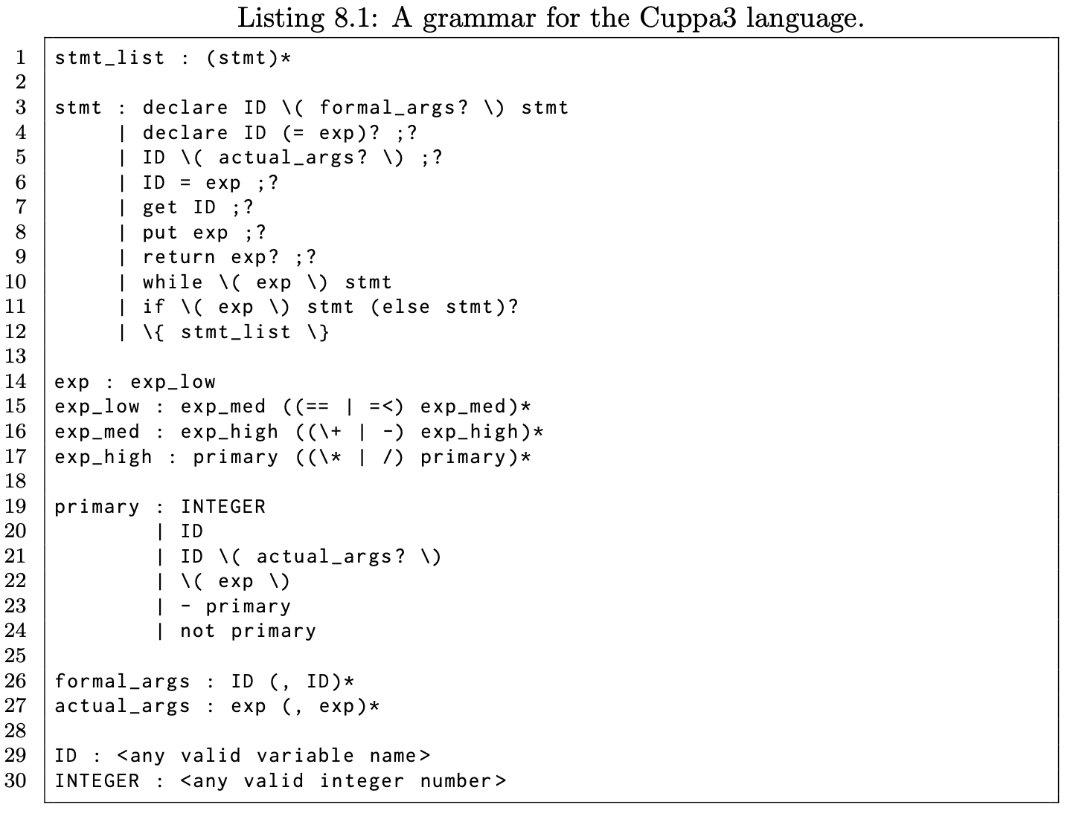
Functions

Slide 11
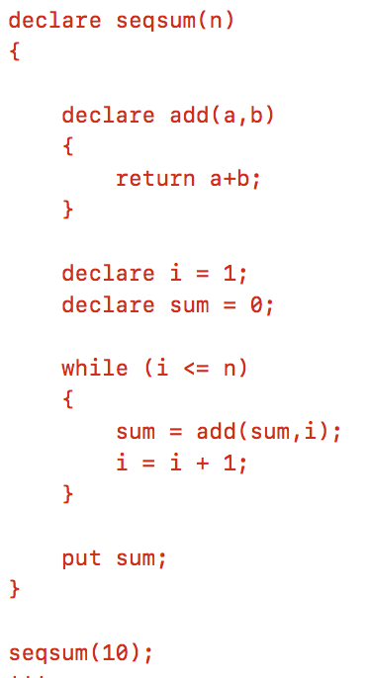
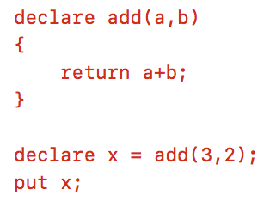
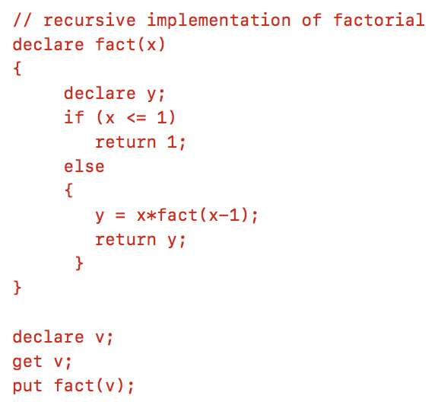
Example Programs

Slide 12
Programs with Functions
Symbol Table
Global Scope
declare inc(i) return i+1;
declare x = 10;
declare y;
y = inc(x);
put y;
Current Scope Pointer
Function Scope

Slide 13
Programs with Functions
Symbol Table
Global Scope
declare inc(i) return i+1;
declare x = 10;
declare y;
y = inc(x);
put y;
inc(i) → function…
Current Scope Pointer
Function Scope

Slide 14
Programs with Functions
Symbol Table
Global Scope
declare inc(i) return i+1;
declare x = 10;
declare y;
y = inc(x);
put y;
inc(i) → function…
Current Scope Pointer
x → 10
Function Scope

Slide 15
Programs with Functions
Symbol Table
Global Scope
declare inc(i) return i+1;
declare x = 10;
declare y;
y = inc(x);
put y;
inc(i) → function…
Current Scope Pointer
x → 10
y → 0
Function Scope

Slide 16
Programs with Functions
Symbol Table
Global Scope
declare inc(i) return i+1;
declare x = 10;
declare y;
y = inc(x);
put y;
inc(i) → function…
Current Scope Pointer
x → 10
y → 0
Function Scope
i → 10
Execute function body; as the function exits return the the computed value.

Slide 17
Programs with Functions
Symbol Table
Global Scope
declare inc(i) return i+1;
declare x = 10;
declare y;
y = inc(x);
put y;
inc(i) → function…
Current Scope Pointer
x → 10
y → 0
Function Scope
i → 10
Execute function body; as the function exits return the the computed value.

Slide 18
Programs with Functions
Symbol Table
Global Scope
declare inc(i) return i+1;
declare x = 10;
declare y;
y = inc(x);
put y;
inc(i) → function…
Current Scope Pointer
x → 10
y → 11
Function Scope
i → 10

Slide 19
Programs with Functions
Symbol Table
Global Scope
declare inc(i) return i+1;
declare x = 10;
declare y;
y = inc(x);
put y;
inc(i) → function…
Current Scope Pointer
x → 10
y → 11
Execute put statement ⇒ 11
Function Scope
i → 10

Slide 20
Programs with Functions
Symbol Table
Global Scope
declare inc(i) return i+1;
declare x = 10;
declare y;
y = inc(x);
put y;
inc(i) → function…
Current Scope Pointer
x → 10
y → 11
Function Scope
i → 10

Slide 21
Multiple Parameters
Symbol Table
Global Scope
declare add(a,b) return a+b;
put add(3,2);
Current Scope Pointer
Function Scope

Slide 22
Multiple Parameters
Symbol Table
Global Scope
declare add(a,b) return a+b;
put add(3,2);
add(a,b) → function…
Current Scope Pointer
Function Scope

Slide 23
Multiple Parameters
Symbol Table
Global Scope
declare add(a,b) return a+b;
put add(3,2);
add(a,b) → function…
Current Scope Pointer
Function Scope
a → 3
b → 2
Execute function body and return the computed value, execute put statement ⇒ 5

Slide 24
Multiple Parameters
Symbol Table
Global Scope
declare add(a,b) return a+b;
put add(3,2);
add(a,b) → function…
Current Scope Pointer
Function Scope
a → 3
b → 2
Execute function body and return the computed value, execute put statement ⇒ 5

Slide 25
Multiple Parameters
Symbol Table
Global Scope
declare add(a,b) return a+b;
put add(3,2);
add(a,b) → function…
Current Scope Pointer
Function Scope
a → 3
b → 2

Slide 26
Multiple Parameters
Symbol Table
Global Scope
declare add(a,b) return a+b;
put add(3,2);
add(a,b) → function…
Current Scope Pointer
Function Scope
a → 3
b → 2

Slide 27
Recursion
Symbol Table
Global Scope
declare fact(x) {
declare y;
if (x <= 1)
return 1;
else {
y = x*fact(x-1);
return y;
}
}
put fact(3);
Current Scope Pointer
Function Scope
Function Scope
Function Scope

Slide 28
Recursion
Symbol Table
Global Scope
declare fact(x) {
declare y;
if (x <= 1)
return 1;
else {
y = x*fact(x-1);
return y;
}
}
put fact(3);
fact(x) → function…
Current Scope Pointer
Function Scope
Function Scope
Function Scope

Slide 29
Recursion
Symbol Table
Global Scope
declare fact(x) {
declare y;
if (x <= 1)
return 1;
else {
y = x*fact(x-1);
return y;
}
}
put fact(3);
fact(x) → function…
Current Scope Pointer
Function Scope
x → 3
Function Scope
Function Scope

Slide 30
Recursion
Symbol Table
Global Scope
declare fact(x) {
declare y;
if (x <= 1)
return 1;
else {
y = x*fact(x-1);
return y;
}
}
put fact(3);
fact(x) → function…
Current Scope Pointer
Function Scope
x → 3
y → 0
Function Scope
Function Scope

Slide 31
Recursion
Symbol Table
Global Scope
declare fact(x) {
declare y;
if (x <= 1)
return 1;
else {
y = x*fact(x-1);
return y;
}
}
put fact(3);
fact(x) → function…
Current Scope Pointer
Function Scope
x → 3
y → 0
Function Scope
Function Scope

Slide 32
Recursion
Symbol Table
Global Scope
declare fact(x) {
declare y;
if (x <= 1)
return 1;
else {
y = x*fact(x-1);
return y;
}
}
put fact(3);
fact(x) → function…
Current Scope Pointer
Function Scope
x → 3
y → 0
Function Scope
x → 2
Function Scope

Slide 33
Recursion
Symbol Table
Global Scope
declare fact(x) {
declare y;
if (x <= 1)
return 1;
else {
y = x*fact(x-1);
return y;
}
}
put fact(3);
fact(x) → function…
Current Scope Pointer
Function Scope
x → 3
y → 0
Function Scope
x → 2
y → 0
Function Scope

Slide 34
Recursion
Symbol Table
Global Scope
declare fact(x) {
declare y;
if (x <= 1)
return 1;
else {
y = x*fact(x-1);
return y;
}
}
put fact(3);
fact(x) → function…
Current Scope Pointer
Function Scope
x → 3
y → 0
Function Scope
x → 2
y → 0
Function Scope

Slide 35
Recursion
Symbol Table
Global Scope
declare fact(x) {
declare y;
if (x <= 1)
return 1;
else {
y = x*fact(x-1);
return y;
}
}
put fact(3);
fact(x) → function…
Current Scope Pointer
Function Scope
x → 3
y → 0
Function Scope
x → 2
y → 0
Function Scope
x → 1

Slide 36
Recursion
Symbol Table
Global Scope
declare fact(x) {
declare y;
if (x <= 1)
return 1;
else {
y = x*fact(x-1);
return y;
}
}
put fact(3);
fact(x) → function…
Current Scope Pointer
Function Scope
x → 3
y → 0
Function Scope
x → 2
y → 0
Function Scope
x → 1
y → 0

Slide 37
Recursion
Symbol Table
Global Scope
declare fact(x) {
declare y;
if (x <= 1)
return 1;
else {
y = x*fact(x-1);
return y;
}
}
put fact(3);
fact(x) → function…
Current Scope Pointer
Function Scope
x → 3
y → 0
Function Scope
x → 2
y → 0
Function Scope
x → 1
y → 0

Slide 38
Recursion
Symbol Table
Global Scope
declare fact(x) {
declare y;
if (x <= 1)
return 1;
else {
y = x*fact(x-1);
return y;
}
}
put fact(3);
fact(x) → function…
Current Scope Pointer
Function Scope
x → 3
y → 0
Function Scope
x → 2
y → 0
Function Scope
x → 1
y → 0

Slide 39
Recursion
Symbol Table
Global Scope
declare fact(x) {
declare y;
if (x <= 1)
return 1;
else {
y = x*fact(x-1);
return y;
}
}
put fact(3);
fact(x) → function…
Current Scope Pointer
Function Scope
x → 3
y → 0
Function Scope
x → 2
y → 2*1=2
Function Scope
x → 1
y → 0

Slide 40
Recursion
Symbol Table
Global Scope
declare fact(x) {
declare y;
if (x <= 1)
return 1;
else {
y = x*fact(x-1);
return y;
}
}
put fact(3);
fact(x) → function…
Current Scope Pointer
Function Scope
x → 3
y → 0
Function Scope
x → 2
y → 2*1=2
Function Scope
x → 1
y → 0

Slide 41
Recursion
Symbol Table
Global Scope
declare fact(x) {
declare y;
if (x <= 1)
return 1;
else {
y = x*fact(x-1);
return y;
}
}
put fact(3);
fact(x) → function…
Current Scope Pointer
Function Scope
x → 3
y → 3*2=6
Function Scope
x → 2
y → 2*1=2
Function Scope
x → 1
y → 0

Slide 42
Recursion
Symbol Table
Global Scope
declare fact(x) {
declare y;
if (x <= 1)
return 1;
else {
y = x*fact(x-1);
return y;
}
}
put fact(3);
fact(x) → function…
Current Scope Pointer
Function Scope
x → 3
y → 3*2=6
Function Scope
x → 2
y → 2*1=2
Function Scope
x → 1
y → 0

Slide 43
Recursion
Symbol Table
Global Scope
declare fact(x) {
declare y;
if (x <= 1)
return 1;
else {
y = x*fact(x-1);
return y;
}
}
put fact(3);
fact(x) → function…
Current Scope Pointer
Function Scope
Execute put statement ⇒ 6
x → 3
y → 3*2=6
Function Scope
x → 2
y → 2*1=2
Function Scope
x → 1
y → 0

Slide 44
Recursion
Symbol Table
Global Scope
declare fact(x) {
declare y;
if (x <= 1)
return 1;
else {
y = x*fact(x-1);
return y;
}
}
put fact(3);
fact(x) → function…
Current Scope Pointer
Function Scope
x → 3
y → 3*2=6
Function Scope
x → 2
y → 2*1=2
Function Scope
x → 1
y → 0

Slide 45
Static vs. Dynamic Scoping
There is an interesting interaction between function scopes and global variables
Consider the following program:
declare step = 10;
declare inc(x) {
return x+step;
}
// start a local scope…
{
declare step = 2;
put inc(5);
}
What is the expected output of the program?

Slide 46
Dynamic Scoping
Symbol Table
declare step = 10;
declare inc(x) {
return x+step;
}
// start a local scope…
{
declare step = 2;
put inc(5);
}
Global Scope
Current Scope Pointer
Local Scope
 In dynamic scoping we treat the function scope like
any other local scope and push it on the scope stack. What is the expected output of the program under these assumptions?
Function Scope

Slide 47
Dynamic Scoping
Symbol Table
Global Scope
declare step = 10;
declare inc(x) {
return x+step;
}
// start a local scope…
{
declare step = 2;
put inc(5);
}
step → 10
Current Scope Pointer
Local Scope
Function Scope

Slide 48
Dynamic Scoping
Symbol Table
Global Scope
declare step = 10;
declare inc(x) {
return x+step;
}
// start a local scope…
{
declare step = 2;
put inc(5);
}
step → 10
Current Scope Pointer
Inc(x) → function…
Local Scope
Function Scope

Slide 49
Dynamic Scoping
Symbol Table
Global Scope
declare step = 10;
declare inc(x) {
return x+step;
}
// start a local scope…
{
declare step = 2;
put inc(5);
}
step → 10
Current Scope Pointer
Inc(x) → function…
Local Scope
step → 2
Function Scope

Slide 50
Dynamic Scoping
Symbol Table
Global Scope
declare step = 10;
declare inc(x) {
return x+step;
}
// start a local scope…
{
declare step = 2;
put inc(5);
}
step → 10
Current Scope Pointer
Inc(x) → function…
Local Scope
step → 2
Function Scope
x → 5

Slide 51
Dynamic Scoping
Symbol Table
Global Scope
declare step = 10;
declare inc(x) {
return x+step;
}
// start a local scope…
{
declare step = 2;
put inc(5);
}
step → 10
Current Scope Pointer
Inc(x) → function…
Local Scope
step → 2
Function Scope
x → 5

Slide 52
Dynamic Scoping
Symbol Table
Global Scope
declare step = 10;
declare inc(x) {
return x+step;
}
// start a local scope…
{
declare step = 2;
put inc(5);
}
step → 10
Current Scope Pointer
Inc(x) → function…
Local Scope
step → 2
Function Scope
x → 5
Now execute the put statement ⇒ 7

Slide 53
Dynamic Scoping
Symbol Table
Global Scope
declare step = 10;
declare inc(x) {
return x+step;
}
// start a local scope…
{
declare step = 2;
put inc(5);
}
step → 10
Current Scope Pointer
Inc(x) → function…
Local Scope
step → 2
Function Scope
x → 5

Slide 54
Dynamic Scoping
Symbol Table
Global Scope
declare step = 10;
declare inc(x) {
return x+step;
}
// start a local scope…
{
declare step = 2;
put inc(5);
}
step → 10
Current Scope Pointer
Inc(x) → function…
Local Scope
step → 2
Function Scope
x → 5

Slide 55
Static Scoping
Symbol Table
declare step = 10;
declare inc(x) {
return x+step;
}
// start a local scope…
{
declare step = 2;
put inc(5);
}
Global Scope
Current Scope Pointer
Local Scope
 In static scoping we push the function scope on scope stack but it remembers the scope it was declared in. What is the expected output of the program under these assumptions?
Function Scope

Slide 56
Static Scoping
Symbol Table
Global Scope
declare step = 10;
declare inc(x) {
return x+step;
}
// start a local scope…
{
declare step = 2;
put inc(5);
}
step → 10
Current Scope Pointer
Local Scope
Function Scope

Slide 57
Static Scoping
Symbol Table
Global Scope
declare step = 10;
declare inc(x) {
return x+step;
}
// start a local scope…
{
declare step = 2;
put inc(5);
}
step → 10
Current Scope Pointer
Inc(x) → function…
Local Scope
Function Scope

Slide 58
Static Scoping
Symbol Table
Global Scope
declare step = 10;
declare inc(x) {
return x+step;
}
// start a local scope…
{
declare step = 2;
put inc(5);
}
step → 10
Current Scope Pointer
Inc(x) → function…
Local Scope
step → 2
Function Scope

Slide 59
Static Scoping
Symbol Table
Global Scope
declare step = 10;
declare inc(x) {
return x+step;
}
// start a local scope…
{
declare step = 2;
put inc(5);
}
step → 10
Current Scope Pointer
Inc(x) → function…
Local Scope
step → 2
Function Scope
x → 5

Slide 60
Static Scoping
Symbol Table
Global Scope
declare step = 10;
declare inc(x) {
return x+step;
}
// start a local scope…
{
declare step = 2;
put inc(5);
}
step → 10
Current Scope Pointer
Inc(x) → function…
Local Scope
step → 2
Function Scope
x → 5

Slide 61
Static Scoping
Symbol Table
Global Scope
declare step = 10;
declare inc(x) {
return x+step;
}
// start a local scope…
{
declare step = 2;
put inc(5);
}
step → 10
Current Scope Pointer
Inc(x) → function…
Local Scope
step → 2
Function Scope
x → 5
Now execute the put statement ⇒ 15

Slide 62
Static Scoping
Symbol Table
Global Scope
declare step = 10;
declare inc(x) {
return x+step;
}
// start a local scope…
{
declare step = 2;
put inc(5);
}
step → 10
Current Scope Pointer
Inc(x) → function…
Local Scope
step → 2
Function Scope
x → 5

Slide 63
Static Scoping
Symbol Table
Global Scope
declare step = 10;
declare inc(x) {
return x+step;
}
// start a local scope…
{
declare step = 2;
put inc(5);
}
step → 10
Current Scope Pointer
Inc(x) → function…
Local Scope
step → 2
Function Scope
x → 5
 It is clear that what we want is static scoping.

Slide 64
Assignment
Final project proposal
Read: Chap 8

