Slide 1


IDEs not necessary!
Eclipse Verboten
AntlrWorks Verboten

Slide 2
Command Line Projects
IDEs hide tool chains – the sequence of tools that are necessary to process a source file.
Eclipse hides the Java tool chain: src file ➔ javac ➔ class file ➔ java ➔ output
AntlrWorks+Eclipse hide the grammar tool chain: g file ➔ antlr ➔ java src ➔ javac ➔ class file ➔ java ➔ output

Slide 3
Command Line Projects
The fact that IDEs hide tools chains makes it sometimes difficult to understand what’s going on under the hood
Let’s examine the Exp1Bytecode interpreter as an example of building a project without an IDE
Assume that I have a folder /Users/lutz/CSC402 Projects/EXP1BYTECODE that holds all the source files

Slide 4
Command Line Projects
The first thing I need to do is to download the command line version of Antlr
It is a jar file available from antlr.org: antlr-3.4-complete.jar
I decided to place that jar file in my toplevel project folder, CSC402 Projects, so it can be shared among all my projects

Slide 5
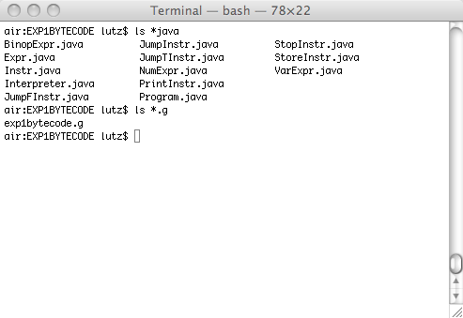
Command Line Projects
Here are the contents of my project folder:

Slide 6
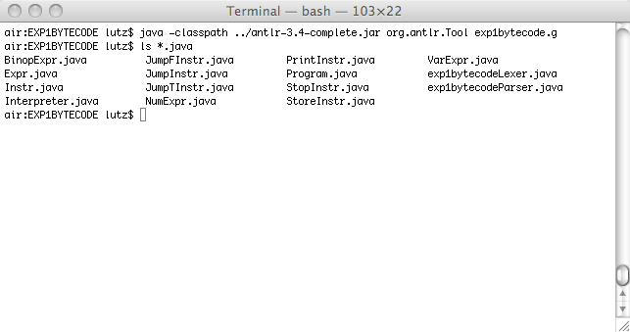
Command Line Projects
The first thing we want to do is to process the grammar file with Antlr

Slide 7
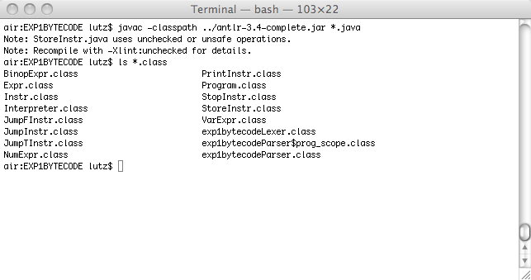
Command Line Projects
Next we want to compile all the Java source files, the ones that we have written and the ones that were generated by Antlr

Slide 8
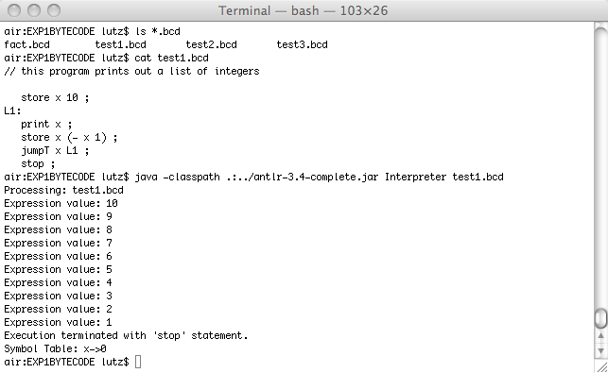
Command Line Projects
We can now run our bytecode interpreter

Slide 9
Command Line Projects
That’s all there is to it
You can use your favorite text editor for editing Java and grammar files – no IDE necessary (I work on a Mac and I happen to like TextWrangler: http://www.barebones.com/products/TextWrangler/)
For those folks working on a Mac or Linux here is command summary/tutorial: http://www.math.utah.edu/lab/unix/unix-commands.html
For those folks working under Windows: http://www.computerhope.com/msdos.htm (check out the top 10 msdos commands)

Slide 10
Command Line Projects
Note: under Windows you will have to install a full Java development kit (JDK) version 1.6 or better available here: http://www.oracle.com/technetwork/java/javase/downloads/jdk7u7-downloads-1836413.html
On the Mac the JDK usually is preinstalled

