Slide 1
Interpreter Implementation
The crucial insight to implementing functions is that function names act just like variable names - they are the key into a symbol lookup table.
During function declaration we enter the function name into the symbol table
During a function call we search for the function name in the symbol table
The second important insight is that the function body is the value that we store with the function name in the symbol table.
During a function call we lookup the function name in the symbol table and return the function body for interpretation.
The symbol table is extended to distinguish between scalar values and function values

Slide 2
Interpreting Functions
Symbol Table
Global Scope
declare inc(i) {
return i+1;
}
declare x = 10;
declare y;
y = inc(x);
put y;
Current Scope Pointer
Function Scope

Slide 3
Interpreting Functions
Symbol Table
Global Scope
declare inc(i) {
return i+1;
}
declare x = 10;
declare y;
y = inc(x);
put y;
inc → Function (i) {
return i+1;
}
Current Scope Pointer
Function Scope

Slide 4
Interpreting Functions
Symbol Table
Global Scope
declare inc(i) {
return i+1;
}
declare x = 10;
declare y;
y = inc(x);
put y;
inc → Function (i) {
return i+1;
}
Current Scope Pointer
x → 10
Function Scope

Slide 5
Interpreting Functions
Symbol Table
Global Scope
declare inc(i) {
return i+1;
}
declare x = 10;
declare y;
y = inc(x);
put y;
inc → Function (i) {
return i+1;
}
Current Scope Pointer
x → 10
y → 0
Function Scope

Slide 6
Interpreting Functions
Symbol Table
Global Scope
declare inc(i) {
return i+1;
}
declare x = 10;
declare y;
y = inc(x);
put y;
inc → Function (i) {
return i+1;
}
Current Scope Pointer
x → 10
y → 0
Function Scope
Function (i) {
return i+1;
}
i → 10
Setup the function call:
lookup function name
retrieve function body
push new function scope
init formal parameters with actual parameters

Slide 7
Interpreting Functions
Symbol Table
Global Scope
declare inc(i) {
return i+1;
}
declare x = 10;
declare y;
y = inc(x);
put y;
inc → Function (i) {
return i+1;
}
Current Scope Pointer
x → 10
y → 0
Function Scope
Function (i) {
return i+1;
}
i → 10
Execute the called function and compute return value.

Slide 8
Interpreting Functions
Symbol Table
Global Scope
declare inc(i) {
return i+1;
}
declare x = 10;
declare y;
y = inc(x);
put y;
inc → Function (i) {
return i+1;
}
Current Scope Pointer
x → 10
y → 11
Function Scope
i → 10
Exit the called function:
pop the function scope
store the return value in y

Slide 9
Interpreting Functions
Symbol Table
Global Scope
declare inc(i) {
return i+1;
}
declare x = 10;
declare y;
y = inc(x);
put y;
inc → Function (i) {
return i+1;
}
Current Scope Pointer
x → 10
y → 11
Function Scope
i → 10
Execute the put statement ⇒ 11

Slide 10
Interpreting Functions
Symbol Table
Global Scope
declare inc(i) {
return i+1;
}
declare x = 10;
declare y;
y = inc(x);
put y;
inc → Function (i) {
return i+1;
}
Current Scope Pointer
x → 10
y → 11
Function Scope
i → 10

Slide 11
Interpreting Functions
Note that we use the function value just like we would use the value of a variable, but instead of using it in some arithmetic expression we simply interpret the body of the function in order to compute a return value.

Slide 12
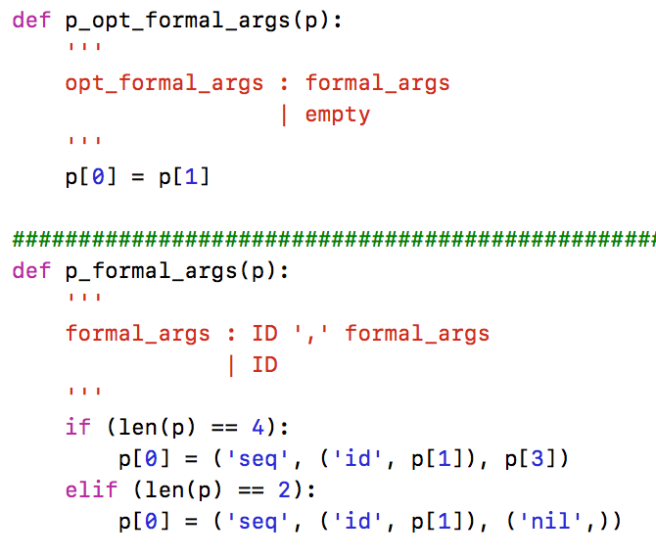
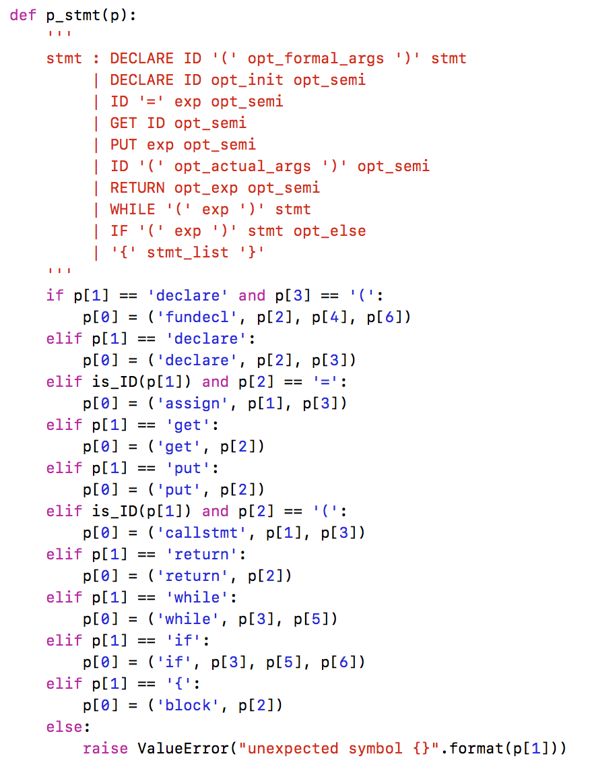
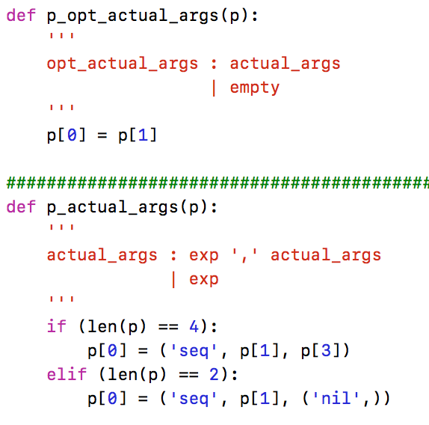
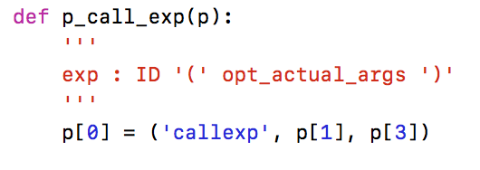
Cuppa3 Frontend

Slide 13
Symbol Table
The symbol table is extended to store two different kinds of objects:
Scalars
Functions
It is also extended so that we can manipulate scopes in order to implement static scoping

Slide 14
Symbol Table
class SymTab:
def __init__(self):
self.scoped_symtab = [{}]
def get_config(self):
# we make a shallow copy of the symbol table
return list(self.scoped_symtab)
def set_config(self, c):
self.scoped_symtab = c
def push_scope(self):
…
def pop_scope(self):
…
def declare_sym(self, sym, init):
# declare the scalar in the current scope: dict @ position 0
# first we need to check whether the symbol was already declared
# at this scope
if sym in self.scoped_symtab[CURR_SCOPE]:
raise ValueError("symbol {} already declared".format(sym))
# enter the symbol in the current scope
scope_dict = self.scoped_symtab[CURR_SCOPE]
scope_dict[sym] = ('scalar', init)
def declare_fun(self, sym, init):
# declare a function in the current scope: dict @ position 0
# first we need to check whether the symbol was already declared
# at this scope
if sym in self.scoped_symtab[CURR_SCOPE]:
raise ValueError("symbol {} already declared".format(sym))
# enter the function in the current scope
scope_dict = self.scoped_symtab[CURR_SCOPE]
scope_dict[sym] = ('function', init)
def lookup_sym(self, sym):
…
def update_sym(self, sym, val):
…
cuppa3_symtab.py

Slide 15
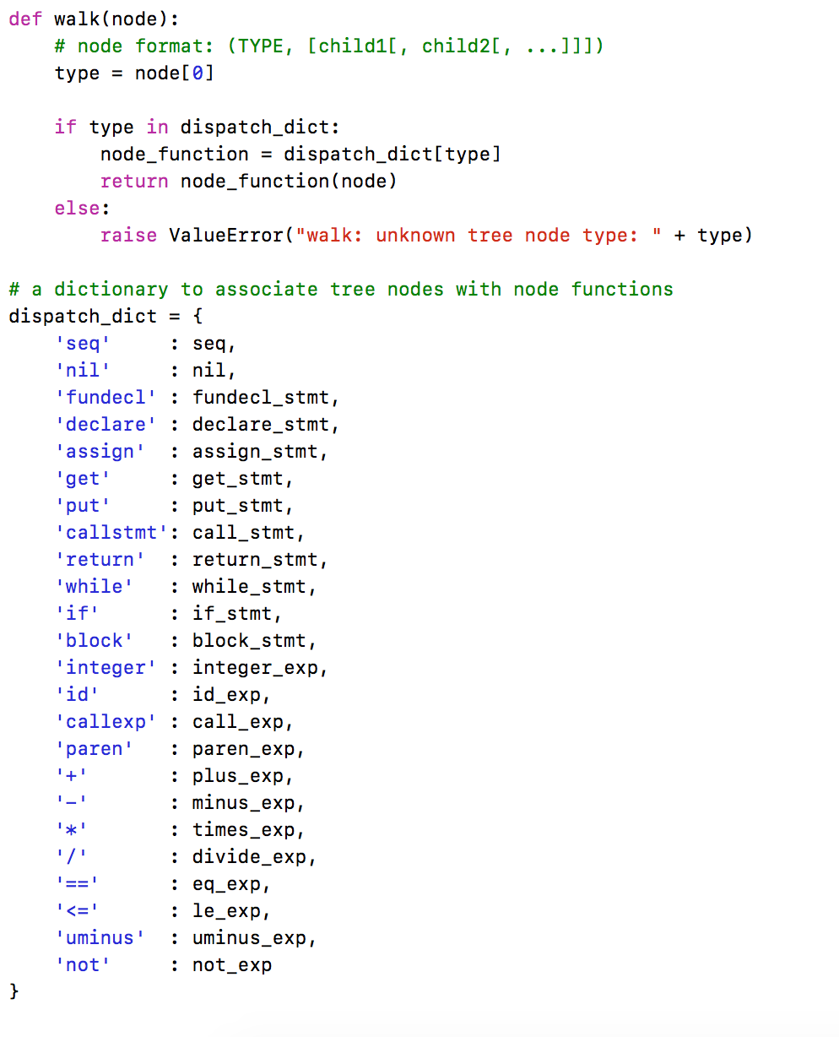
Interp Walker
Good News: the interpretation of the AST is the same as for Cuppa2 except for the nodes shown with the red arrow.
cuppa3_interp_walk.py

Slide 16
Interp Walk
The difference between call statements and call expressions:
Call statements – return value of a function is ignored
Call expressions – function has to provide a return value
Note: the return value of functions
called as statement is ignored.
Consider:
declare f () {
put(1001);
return 1001;
}
f();
declare inc(i)
{
return i+1;
}
declare x = 10;
declare y;
y = inc(x);
put y;

Slide 17
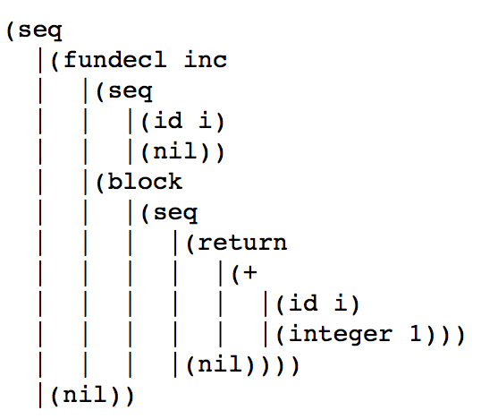
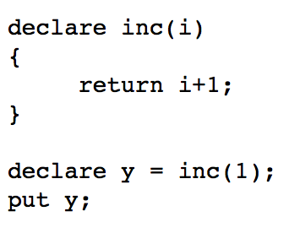
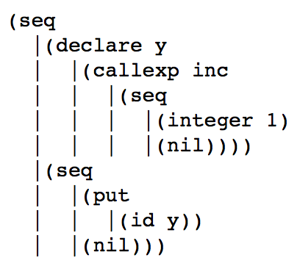
Interp Walk
How do we get function return values to the call site?
We throw them!

Slide 18
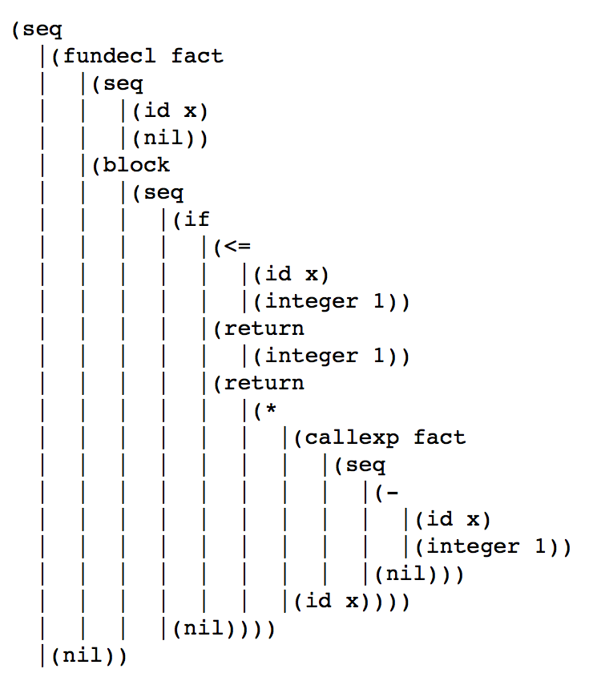
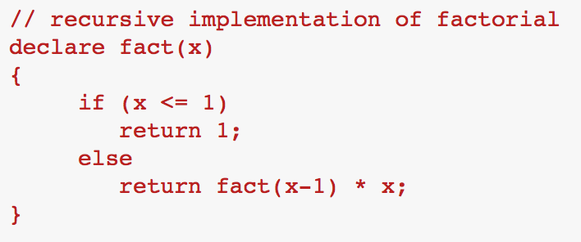
Interp Walk
Throwing the return value also solves the problem of terminating a deeply recursive computation on the AST!

Slide 19
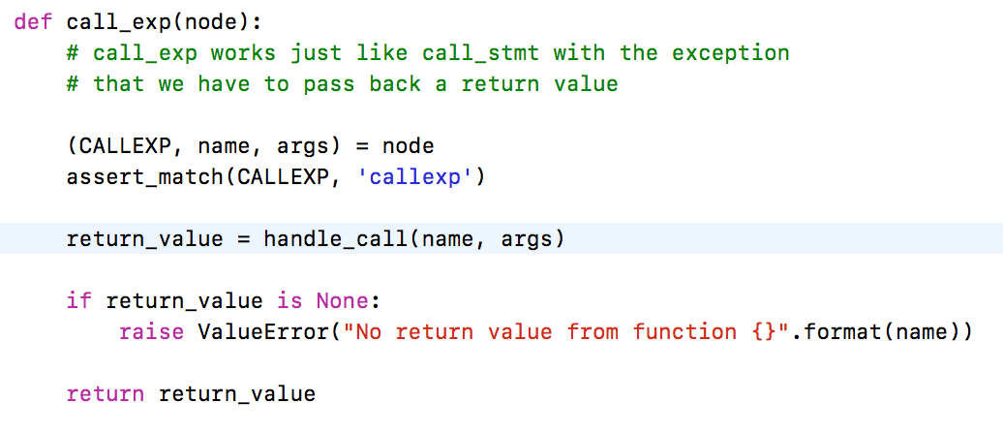
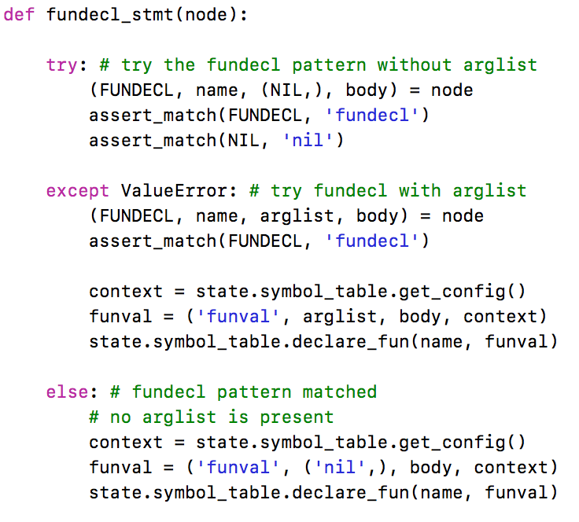
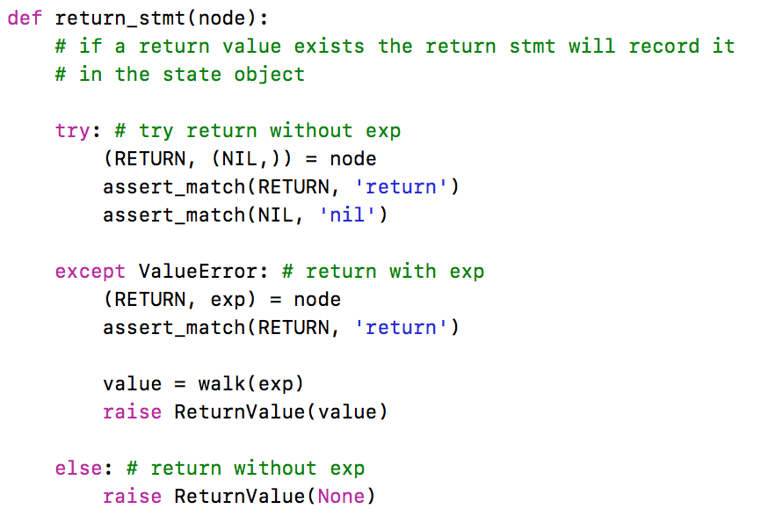
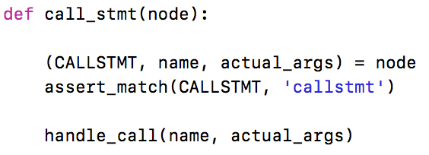
Interp Walk

Slide 20
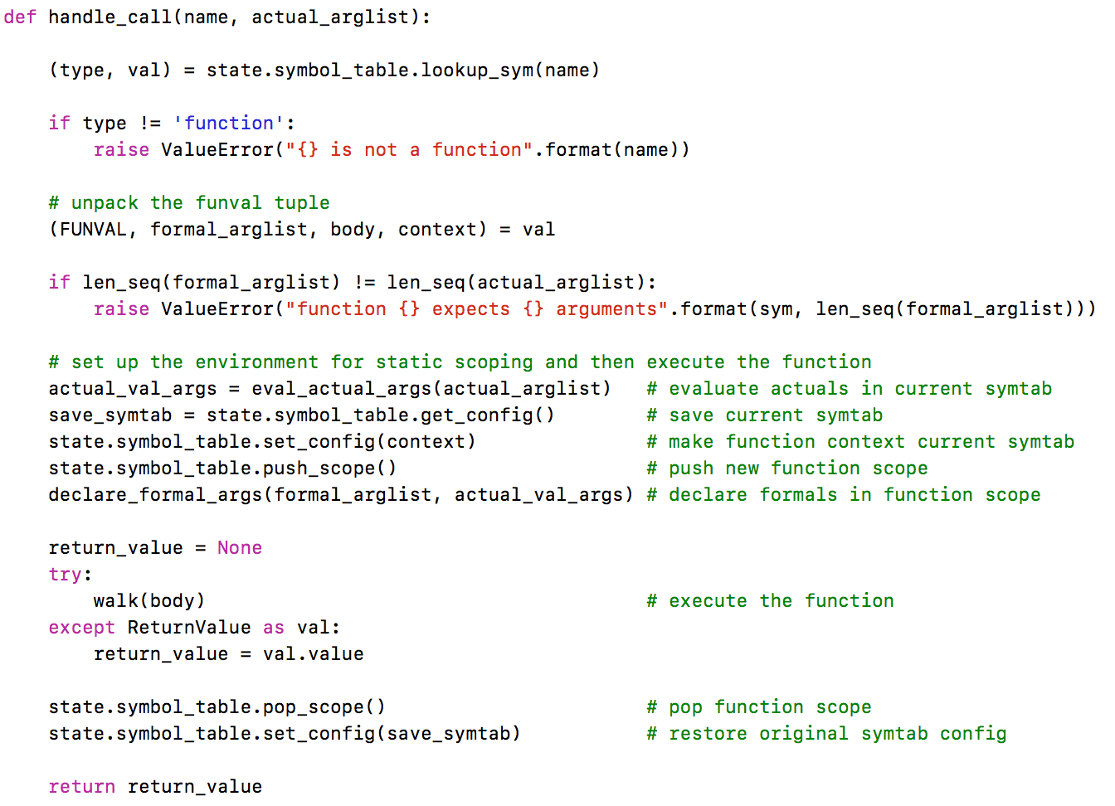
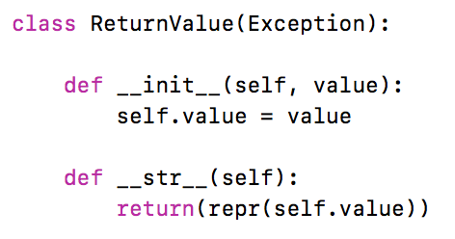
Interp Walk

Slide 21
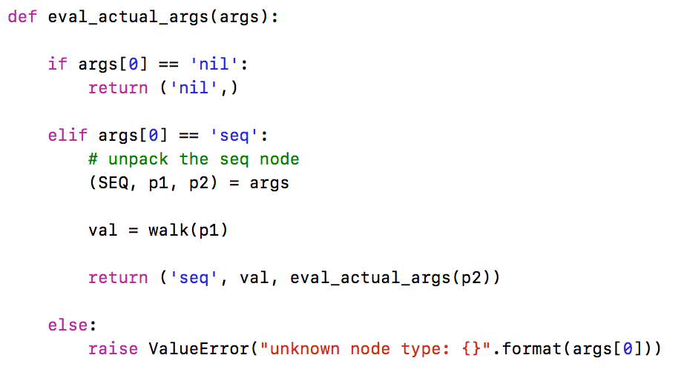
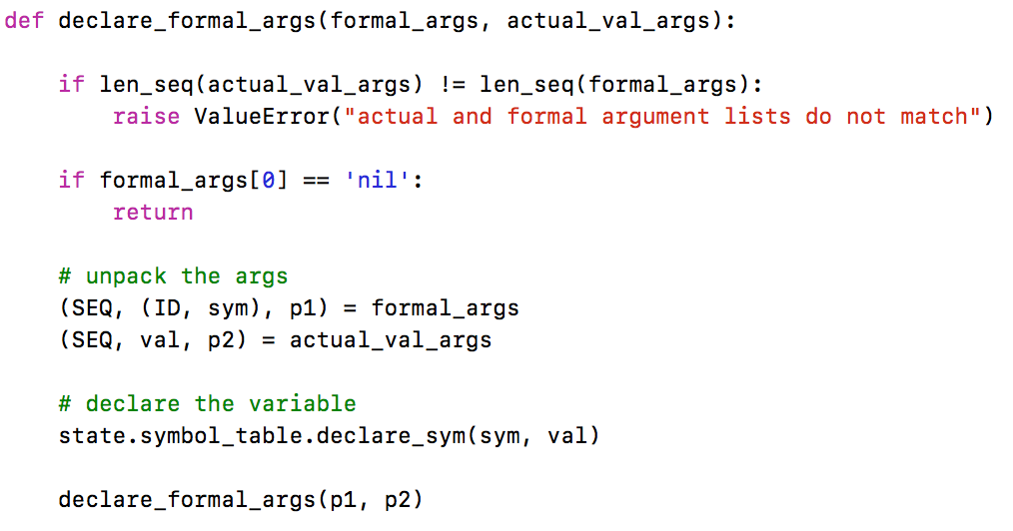
Interp Walk

Slide 22
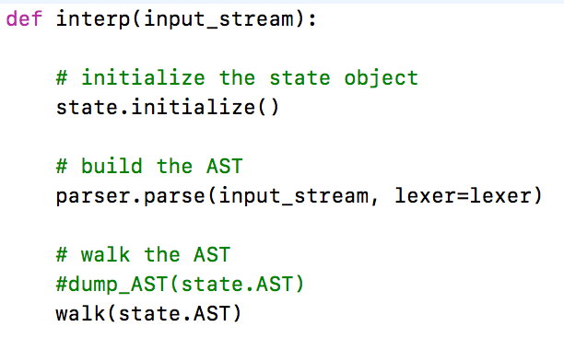
Driver Function

Slide 23
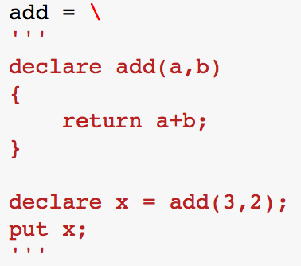
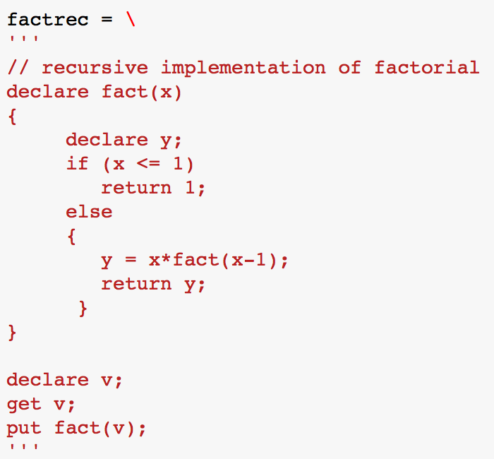
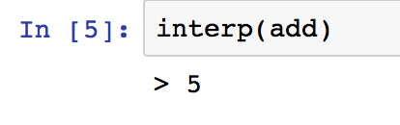
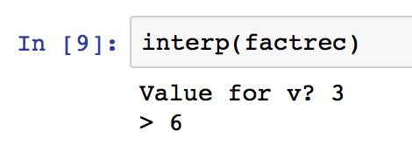
Testing the Interpreter

Slide 24
Assignment
Final project proposal

Slide 25
Assignment
Assignment #7

